Slide 1
8.6(2) OVAs
UCBU Platform Team

Slide 2
Overview
8.6(2) OVAs Overview
OVA Specifications
Deploying OVA for CUC 8.6.2 fresh install
Upgrade from CUC 8.x to CUC 8.6.2 OVAs
Troubleshooting Tips
Resources

Slide 3
8.6(2) OVAs Overview
8.6(2) OVAs provide spec based requirements to configure CUC VM on servers in existing virtualization infrastructure eliminating the need to shift to UCS
The preconfigured OVA provided by Cisco ensures that virtual hardware meets minimum requirements for CUC during install phase
CPU and Memory reservations have been introduced in the virtual machine template(OVA) to achieve the same

Slide 4
8.6(2) OVAs Overview
Server CPU needs to be an E5500, E5600, E7500 series Intel processor
Supported server vendors are Cisco, HP and IBM
One vCPU on the server shall be left un-provisioned for VMware ESXi scheduler use
VMware ESXi 4.0 and 4.1 are supported

Slide 5
OVA Specifications
Users | # vCPU | CPU Reservation(GHz) | Memory Reservation(GB) | Disk options (GB)
Up to 1000 | 1vCPU | 2.13 | 4 | 160
Up to 5000 | 2vCPU | 5.06 | 6 | 200
Up to 10,000 | 4vCPU | 10.12 | 6 | 2 x 146, 2 x 300, 2 x 500
Up to 20,000 | 7vCPU | 17.71 | 8 | 2 x 300, 2 x 500
Above table lists the specifications for different Virtual Platform Overlays of Unity Connection 8.6.2
All the above virtual platform overlays are bundled as a single OVA which when deployed in vSphere gives the option to choose one of the above overlay
Notes:
These values are already taken care for the fresh install using latest OVAs.

Slide 6
Deploy OVA for CUC 8.6.2 fresh install

Slide 7
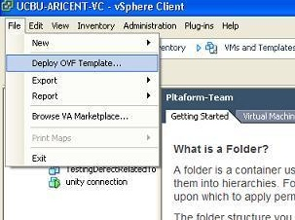
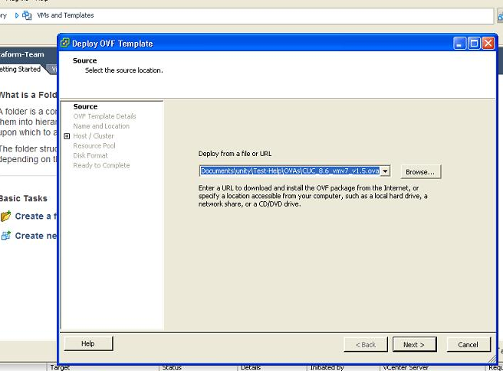
Deploying CUC OVA
From the File Menu in vSphere Client, choose
‘Deploy OVF Template…’.
Now browse to the folder containing downloaded CUC OVA.
Select the OVA and click Next.
Notes:
OVA download link is provided in the “Resources” slide

Slide 8
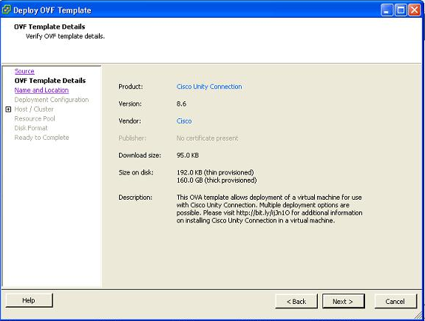
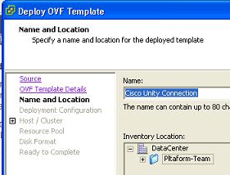
Deploying CUC OVA
Click Next on “OVF Template Details” screen
Provide a Name to VM and select a `DataCenter’ to deploy the OVA.

Slide 9
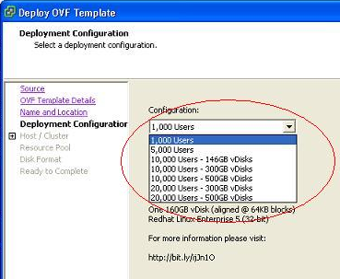
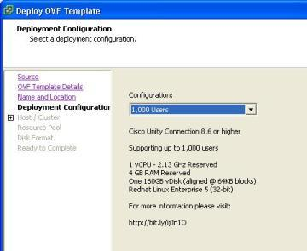
Deploying CUC OVA
In Deployment Configuration, configuration drop down list select the OVA configuration that you want to install
For OVA configuration option selected above, a summary, e.g. number of max users supported, vCPU, RAM, vDisk is displayed.
Click Next

Slide 10
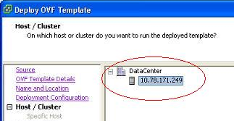
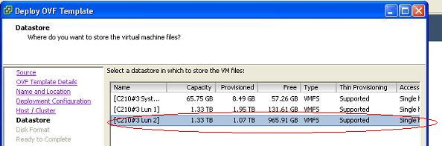
Deploying CUC OVA
Select DataCenter -> Host on which the VM should be deployed, click Next.
In Datastore, select the data store, where the HDD of VM needs to be provisioned.

Slide 11
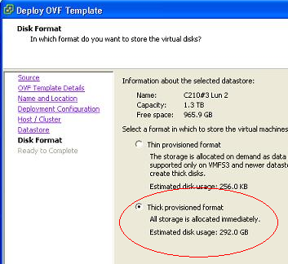
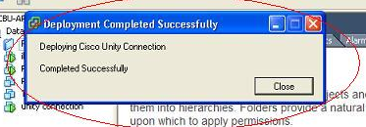
Deploying CUC OVA
Choose Thick provisioned format, in Disk format and click Next
In the next section, re-verify your VM configuration and click Finish
You’ll be presented with a Progress bar. On completion, click Close
Progress can also be monitored in Recent Task Pane in vSphere Client

Slide 12

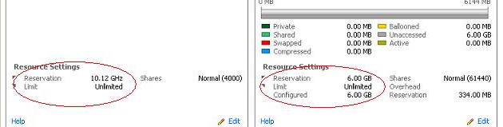
Deploying CUC OVA
You can optionally verify the CPU reservation, and memory reservation from Resource Allocation Tab in vSphere Client
After Verification, the newly created VM is ready for CUC installation

Slide 13
Upgrade from CUC 8.x to CUC 8.6.2 OVAs

Slide 14
Upgrading to 8.6.2 OVA
CUC 8.6.2 OVAs are different from OVAs for prior releases in terms of additional memory and CPU reservations in 8.6.2
Upgrading the existing CUC 8.x Virtual Machine to CUC 8.6.2 Virtual Machine is a manual process and is described in the next few slides

Slide 15
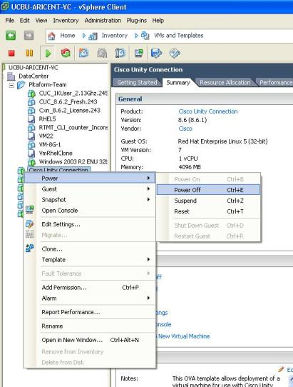
Upgrading to 8.6.2 OVA
To upgrade the VM configurations to 8.6.2, VM needs to be powered off
Right click the VM in vSphere client, Select Power>Power off option

Slide 16
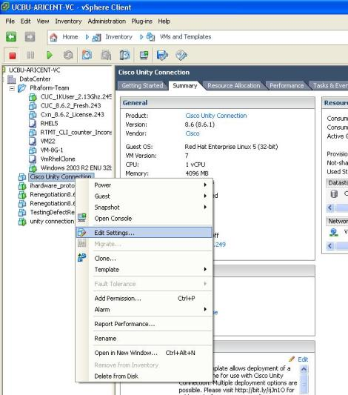
Upgrading to 8.6.2 OVA
Once the VM is powered off, proceed to edit the VM settings
Right click the VM in vSphere client, Select Edit Settings

Slide 17
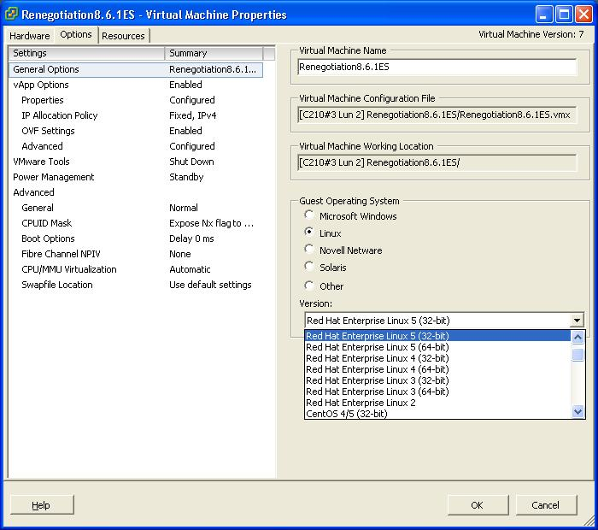
Upgrading to 8.6.2 OVA
To be followed only if the existing version is lower than 8.6.1
In the newly opened Properties window, under the options tab > General Options, choose Guest Operating System as Linux.
In the Version drop down list, select Red Hat Enterprise Linux 5 (32-bit)
Notes:
You will find that the memory reservations are already in place with 8.6.1 OVA. Re-verify the number with 8.6.2 memory reservation requirements.

Slide 18
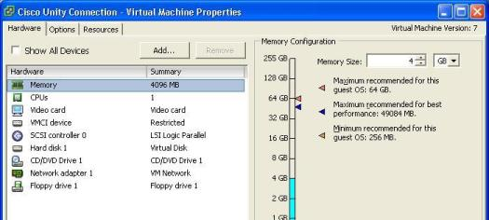
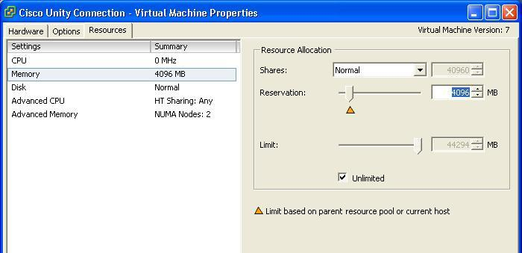
Upgrading to 8.6.2 OVA
In the newly opened Properties window, under the Hardware tab, choose the Memory size as per the OVA specifications table(slide 5)
In Resources tab, Select Memory from the left pane. Go to Reservation field in the right pane. Use the slider or the text box to make the Memory reservations as per the OVA specification table(slide 5)
Notes:
You will find that the memory reservations are already in place with 8.6.1 OVA. Re-verify the number with 8.6.2 memory reservation requirements.

Slide 19
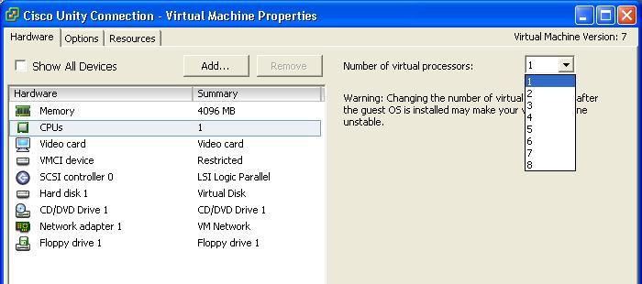
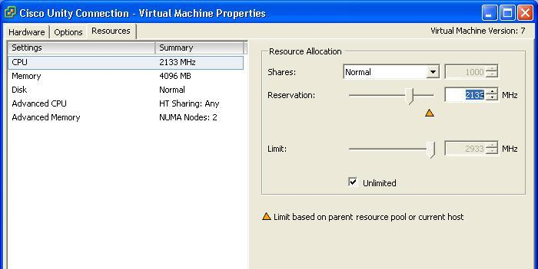
Upgrading to 8.6.2 OVA
Next, choose the number of virtual Processors as per the OVA specifications table(slide 5) in Hardware tab and move to Resources tab
Select CPU from the list in the left pane in Resources tab. Go to Reservation field in the right pane. Use the slider or the text box to make the CPU cycles reservations as per the OVA specifications table(slide 5)
Click ok on the window and power on the virtual machine
VM has been upgraded as per the 8.6.2 OVA. You can now proceed with CUC upgrade

Slide 20
Troubleshooting tips
In order to ensure the proper deployment of OVA CUC 8.6.2, we need to verify the vCPU count, CPU and memory reservations and hard disk size allocated and disk alignment.
There is no such way to check if the VM is deployed from an OVA or its manually configured.
Disk aligned at 64K are still supported, One can use the linux “fdisk -lu” command from root or remote account and observe the output to see if the partitions are aligned or not.
Aligned partitions starts at 128, and for any value other than 128, partitions are not aligned.
  Sample output:
  fdisk -lu
  Disk /dev/sda: 171.7 GB, 171798691840 bytes
  255 heads, 63 sectors/track, 20886 cylinders, total 335544320 sectors
  Units = sectors of 1 * 512 = 512 bytes
  Device Boot Start End Blocks Id System
  /dev/sda1 * 128 60358655 30179264 83 Linuxxxx
  /dev/sda2 60358656 120717311 30179328 83 Linux
  /dev/sda3 120717312 121241599 262144 83 Linux
  /dev/sda4 121241600 335533589 107145995 5 Extended
  /dev/sda5 121241728 125370304 2064288+ 82 Linux swap / Solaris
  /dev/sda6 125370368 335533589 105081611 83 Linux

Slide 21
Troubleshooting tips (contd)
For some hardware related queries, you can refer to this link
http://docwiki.cisco.com/wiki/Specification-Based_Hardware_Support
LRO settings are same. Hence, disabling LRO is still required.

Slide 22
Resources
Specification based hardware support http://docwiki.cisco.com/wiki/Specification-Based_Hardware_Support
OVA location: \\sea-labinstall1\software\Unity\OVA\CUC_8.6.2_vm7_v1.5.ova

Slide 23
Thank You

