Slide 1

Office 365 with Cisco Unity Connection 8.6.2
Isha Gautam

Slide 2
Overview
Microsoft Office 365 – Exchange online
Connectivity through Proxy (Web proxy to access the internet)
Supports Autodiscovery
Voice Mail Syncing
Notes:
It is not mandatory for Cisco Unity Connection to have direct connectivity with internet. However, it is useful for Connection with no direct connectivity with internet to connect to the Hosted Exchange (online).
Since Server IP Address of the Hosted Exchange would not be known, autodiscovery will be needed to search the exchange server.

Slide 3
What is a Microsoft Office 365?
Microsoft Office 365 is Microsoft’s latest hosted solution.
Microsoft Office 365 includes the Microsoft Office suite of desktop applications and hosted versions of Microsoft's Server products ( Exchange Server), the next version of Business Productivity Online Services (BPOS).
Powered by Microsoft Exchange Online, which works on Exchange 2010 SP1 and above.
Notes:
Includes Office Professional Plus, SharePoint Online, Exchange Online and Lync Online
Microsoft Office 365 is licensed on a flexible, per-user per-month subscription plan with predictable annual costs—enabling you to scale the services when it makes sense. Microsoft manages the IT software and you control the user access rights.
Office 365 provides easy-to-use, cloud-based management tools in a single location. Through the administration user interface your IT staff can set up new user accounts, control access to features, and see the status of all Office 365 services and tools in real time.
Supports active sync

Slide 4
What’s New
The previous versions of Cisco Unity Connection (8.6.1, 8.5.x, 8.x, 7.x) contain only two Unified Messaging Service (UMS) Types :
- Exchange/BPOS
- Meeting Place
The new version of Cisco Unity Connection (8.6.2) introduced an additional Unified Messaging Service for Microsoft’s Office 365 as:
  - Office 365
This UMS works on Streaming rather than Push Notification Type unlike previous versions.

Slide 5
How is this different from previous Unified Messaging Services (UMS)?
Microsoft’s Office 365 is a Hosted Exchange rather than on-prem Exchange.
Notification Type is Streaming rather than Push.
In some organizations, HTTPS traffic is routed though a proxy. So, Proxy field on Unified Messaging Service page is added.
Microsoft Exchange Throttling is enabled on Microsoft Office 365 environment by default.
Notes:
Office 365 doesn’t support Microsoft Exchange 2003/2007 but only supported on Microsoft Exchange 2010 SP1 onwards.
Some enterprises uses HTTPS for their traffic which could only be send through a valid proxy.

Slide 6
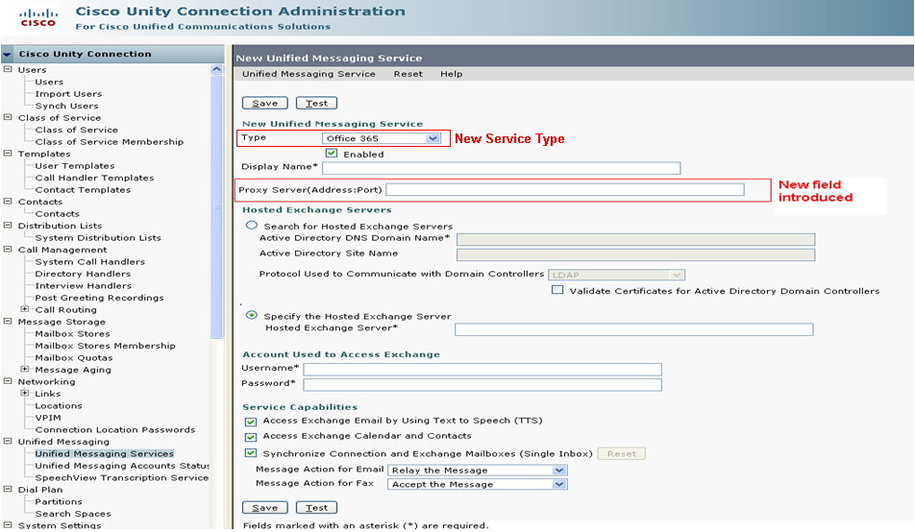
New in Cisco Unity Connection Administrator(CUCA) Page for Office 365
Introduced new Unified Messaging Service page for Office 365
Notes:
Addition of one more Unified Messaging Service Type as ‘Office 365’
Addition of 1 field :
Proxy Server (Address: Port)

Slide 7
CUCA for Microsoft Office 365
Type – ‘Office 365’
Enabled - Check box to allow Cisco Unity Connection to access the Office 365 servers.
Display Name – A descriptive name for the service.
Proxy Server (Address/Hostname : Port) - IP Address/Hostname and port of the Proxy Server.
Search for Hosted Exchange Servers – Active Directory DNS Domain Name is entered to search the Office 365 Exchange Server.
Specify the Hosted Exchange Server – Server name or IP address of Office 365 Exchange Server.
Username – Username of the Domain Service account created on Office 365 server.
Password – Password for the Domain Service account, entered in username field.
Service Capabilities:
  TTS – To use text to speech to listen to Office 365 email
  Access Exchange calendar and contacts - to access Office 365 calendars and contacts .
  SIB - Cisco Unity Connection and Office 365 mailboxes to be synchronized for users .
Message Action for Email - Select the action that Cisco Unity Connection takes when the user receives an email message
Message Action for Email - Select the action that Cisco Unity Connection takes when the user receives an fax message

Slide 8
New Feature for Microsoft Office 365
Changes made to Cisco Unity Connection to configure Microsoft Office 365 Unified Messaging Service
Introduction of Streaming Notification Type
UCxN need to support a EWS notification mechanism that is feasible for Office 365 deployments. In the original version of SIB, UCxN employed EWS “push” notifications. Push notifications have the requirement of the Exchange CAS to be able to initiate HTTP connections back to UCxN. This isn’t feasible in a cloud-based environment. Office 365 leverages Exchange 2010SP1 and with that version, another solution for a notification mechanism exists: Streaming Notifications.
Office 365 supports Microsoft Exchange Server 2010 Service Pack 1 (SP1), which introduces streaming notifications, a new feature that combines push and pull notifications.
Streaming Notification combines both, after establishing notification subscription, the connection remains open to allow the server to push notifications back to the application. No requirement to request updates as for the pull subscription, and no need to create a listener application as for the push notifications.
After the service binding is completed, a subscription is made to the Inbox and the notifications will be sent for new voice mail messages and for items that have been created or deleted in the Inbox.
Notes:
Pull notifications require your application to create a subscription and every now and then request an update from the server.
Push notifications require you to write your own listener application. You create a push subscription with the server and when an event fires, it pushes the notification to your listener application. This works well because you don’t have to keep asking the server for updates, but it does require that you create a separate application to receive the notifications.
After the subscription is created, it’s very easy to reopen the connection. If you don’t want to reopen the connection ,the connection object will be closed.
When a notification is sent back, a message is output to the console. When you get the notification, you also get the binding to the item and get additional information about that item.

Slide 9
Overall Detailed Streaming Call Flow
Cisco Unity Connection
Microsoft Office 365
Subscribe UM User 1
Subscription ID 1, User 1
Subscribe UM User N
Subscription ID N, User N
GetStreaming Request (Subscription ID 1,...,Subscription ID N)
←--------------Streaming Notification1 (Subscription ID 1)-------------
GetStreaming Window
←---------------Streaming NotificationN (Subscription ID N)------------
GetStreaming Response (connection closed)
GetStreaming Request (Subscription ID 1,..,Subscription ID N)

Slide 10
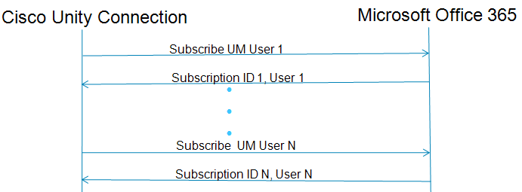
Detailed Streaming Call Flow
User Registration in Cisco Unity Connection (CUC) for Office 365 Unified Messaging Service (UMS)
Step 1:
  Subscription is send for every Office 365 UM user from CUC to Microsoft Office 365 Exchange Server.
  In response, a unique Subscription ID is assigned to every subscribed user from Microsoft Office 365 Exchange to CUC.

Slide 11
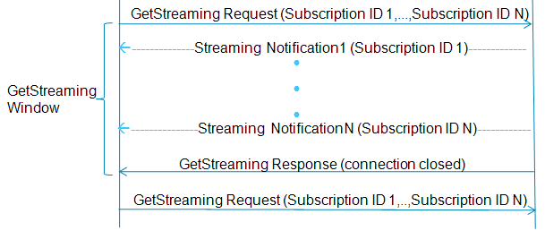
Detailed Streaming Call Flow
Step 2:
  All such Subscription IDs which are configured with same Office 365 UMS and have same Exchange URL will be aggregated in one GetStreaming Request from CUC to Microsoft Office 365 Exchange Server.
  Streaming notifications for the users are received from Microsoft Office 365 to CUC until final GetStreaming Response is received from CUC.
  CUC will send periodic (by default, 1 min) GetStreaming Request to Office 365 Server.

Slide 12
Streaming Call Flow
Streaming Flow
Aggregation of 500 users in one GetStreaming Event
Cisco Unity Connection
User 1
User 2
User 500
Hosted Exchange Office 365
Streaming Thread
Notes:
Cisco Unity Connection aggregates 500 UM users (by default) in one Streaming Thread to retrieve notification from Microsoft Office 365 Exchange Server.

Slide 13

Microsoft Office 365
Configuration
October 2010

Slide 14
Configuration on Microsoft Office 365
Steps
Create one or more service accounts on the Office 365 servers with which Cisco Unity Connection will communicate.
Create New user account or move old on-premise user accounts to Office 365.
Impersonation Rights to Service Accounts could be assigned using steps described in next slides.

Slide 15
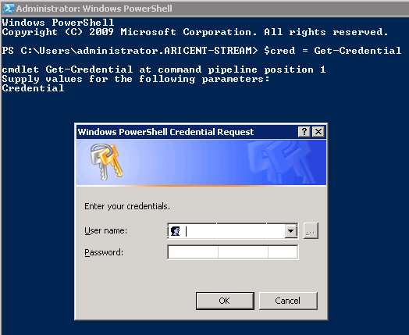
Configuration on Microsoft Office 365 (cont…)
How to change roles on Microsoft Office 365
Create new account, assign privileges.
Step1:
On a Windows PowerShell endpoint, run the following command and enter the Office-365 administrator account credentials for authentication.
$LiveCred = Get-Credential

Slide 16
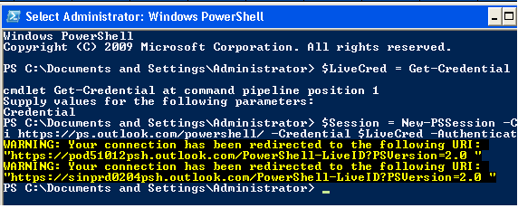
Configuration on Microsoft Office 365 (cont…)
Step 2:
To establish a remote Windows PowerShell session with Office 365, use the New-PSSession Windows PowerShell cmdlet to connect with the generic remote Windows PowerShell endpoint at http://ps.outlook.com/powershell.
Run the following command to create Remote Exchange Shell Session.
$Session = New-PSSession -ConfigurationName Microsoft.Exchange -ConnectionUri https://ps.outlook.com/powershell/ -Credential $LiveCred -Authentication Basic -AllowRedirection

Slide 17
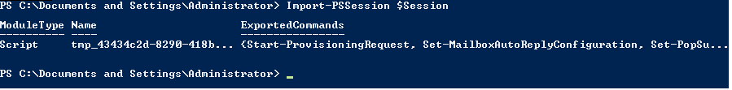
Configuration on Microsoft Office 365 (cont…)
Step 3:
Run the following command to Import all Remote Exchange Shell Commands to the local client side session:
Import-PSSession $Session

Slide 18
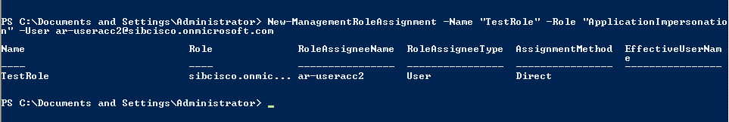
Configuration on Microsoft Office 365 (cont…)
Assigning the Application Impersonation Management Role to Unified Messaging Services Accounts
Step 4
Use "New-ManagementRoleAssignment" Exchange Management Shell cmdlet to grant the service account permission to impersonate all the users in the organization.
new-ManagementRoleAssignment -Name:RoleName -Role:ApplicationImpersonation -User:Account
where:
  –Name parameter specifies the name of the new role assignment, for example, ConnectionUMServicesAcct. The name that you enter for RoleName appears when you run get-ManagementRoleAssignment.
  -Role parameter indicates that the ApplicationImpersonation role is assigned to the user specified by the User parameter.
  –User is the name of the unified messaging services account in alias@domain format.
  For example:
  New-ManagementRoleAssignment –Name "ConnectionUMServicesAcct" –Role "ApplicationImpersonation" –User serviceaccount@example.onmicrosoft.com

Slide 19
Configuration on Cisco Unity Connection (CUC)
Configuration Steps
Steps for configuring Office 356 in Unity Connection are still the same except for one new field in CUCA page for UMS.
Select UM Service type as ‘Office 365’.
Proxy Server
Assign service account to Application Impersonation Role based on previous steps.
Notes:
*Current Beta Version supports this Protocol only. Please note it may support other protocols too in future depending upon the Microsoft Office 365 new versions.

Slide 20
ViewMail for Outlook
If a user has the Single In-box feature enabled for their Exchange account, they will get a VoiceOutbox under their Outbox folder.
For proper operation it is recommended that every Single Inbox user install ViewMail for Outlook into Outlook.
If VMO is installed, there will be a new ViewMail pane on the Outlook Tools/Option dialog, and the VMO options are presented in the new message dialog.
Notes:
The ViewMail for Outlook will be same for Office 365 as it was for On – prim exchange.

Slide 21
Troubleshooting
October 2010

Slide 22
What can go Wrong?
Autodiscovery
Proxy
Sync Services
Configuration gotchas

Slide 23
First Steps
Test Button Result
Test Button on UM Service
Try the “Test” button on the Unified Messaging Service page.
Check for any errors/warnings.
In case of any issues:
Verify connectivity with the Office 365 Server.
  Checks the availability of the Active Directory DNS Domain name using ping.
  This test ensures that the connection is able to find the Office 365 Server via autodiscovery through proxy.
Valid proxy server address and available port number

Slide 24
First Steps (cont…)
Test Button Result
Test Button on User UM Account
Try the “Test” button on the User’s Unified Messaging Account page.
Check for any errors/warnings.
In case of any issues:
Verify connectivity with the Office 365 Server.
  This test ensures that the connection is able to find the mailbox on Office 365 Server via autodiscovery.
Gather micro traces
◦ Tomcat (Cuca) and CuESD

Slide 25
Expected Office 365 Exchange Server errors
HTTP/HTTPS Response errors
401 Unauthorized
  For use when authentication is possible but has failed or not yet been provided.
  Reason: Incorrect input in one or more of the following -
            - Username/Password for UMS account
            User email address (SMTP address)
  Solution: Give the correct username/password and user email address
500 Internal Server Error
  Unable to access an account or mailbox.
  Reason: - Server gets busy.
  - Internet Information Service is unavailable.
  Possible Solution: Contact Microsoft Office 365 support.

Slide 26
Expected Office 365 Exchange server errors
503 Service Unavailable
  Reason: The server is currently unavailable (because it is overloaded or down for maintenance).
  Solution: Generally, this is a temporary state. The frequency of this error will decrease as the load on the server will decrease.

Slide 27
What logs to gather for troubleshooting?
All logs on this slide are located in /var/opt/cisco/connection/log on the Cisco Unity Connection through root CLI
For Syncing related issues between Cisco Unity Connection and Office 365 Exchange 2010:
diag_CuMbxSync_*.uc: contains sync log generated between connection and Exchange. It provides all the notification information generated during syncing for the voice mails.
CsEWS: contains EWS protocol logs for flow of EWS Request with exchange. It will be seen in diag_CuMbxSync_*.uc log file.
diag_Tomcat_*.uc: contains all the CUCA Test Button related logged information.
CuESD: additional Test button logs. It will be seen in diag_Tomcat_*.uc log file only.
CuMTA: decision making of the voice mails is done by parsing, checking the valid format and decides the final receiver location as local or VPIM.

Slide 28
What logs to gather for troubleshooting? (cont…)
When troubleshooting for a cluster, be sure to gather the log sets either from the publisher or the subscriber whichever is primary and on which CuMbxSync and MTA services are running.
Link for troubleshooting guide for Unified Messaging (8.6)
http://www.cisco.com/en/US/docs/voice_ip_comm/connection/8x/troubleshooting/guide/8xcuctsg038.html#wp1079379
For logs analysis: Annotated_diags_for_Streaming

Slide 29
Helpful Resources
Unified Messaging Guide
http://www.cisco.com/en/US/docs/voice_ip_comm/connection/8x/troubleshooting/guide/8xcuctsg038.html#wp1079379
http://ciscounitytools.com/Training/Connection/CUC8_6.html
Reference for Streaming notification:
http://blogs.msdn.com/b/exchangedev/archive/2010/12/22/working-with-streaming-notifications-by-using-the-ews-managed-api.aspx
TOI presentations from Microsoft Office 365
Some IT Pros video links , the overview and some of the Identity and Exchange topics:
http://technet.microsoft.com/en-us/edge/office-365-jump-start-01-microsoft-office-365-overview-for-it-pros
http://technet.microsoft.com/en-us/edge/office-365-jump-start-02-deploying-clients-for-office-365
Notes:
Here are some reference links to show the videos from Microsoft point-of-view
Note : Documents for 8.6.2 release are still under progress.

