Slide 1
Allow System Distribution Lists to be Added as Call Handler Owners
Unity Connection
Release 10.5

Slide 2
Agenda
  This presentation will demonstrate that the Call Handler Owner web page under Cisco Unity Connection Administration has been updated to include a new option to add/search both User and Distribution List.
  This presentation also demonstrates that any member of the selected distribution list (added as a Call Handler Owner) can login to TUI and will be able to modify greetings for that call handler.

Slide 3
Feature overview
  In the existing implementation, only User/s can be added as Call Handler Owners. The Greeting Administrator role is automatically assigned to those owners.
  In the new implementation, Distribution List/s can also be added as the Call Handler Owner and all the members of the selected Distribution Lists are automatically assigned the role of Greeting Administrator. This simplifies the operations performed by the administrator to add or delete multiple call handler owners.
  This feature already existed in Cisco Unity and is now being delivered with Cisco Unity Connection 10.5 and later.

Slide 4
Description
  The administration web page in the Unity Connection server now gives the option to add Distribution List/s as Call Handler owners.
  There are a few considerations under this feature:
  Only the local users in the distribution list/s can be added as Call Handler Owners.
  Nested distribution lists ( distribution list within distribution list) and their members cannot be added as Call Handler Owners.
  Only Local distribution lists can be added as Call handler Owners.
  Multiple distribution lists can be added as Call Handler Owners at a time.
  The members of distribution lists have all the privileges as a call handler user owner has today like recording greeting.
  When distribution list is updated (members are added or deleted), then the call handler ownership is automatically updated.

Slide 5
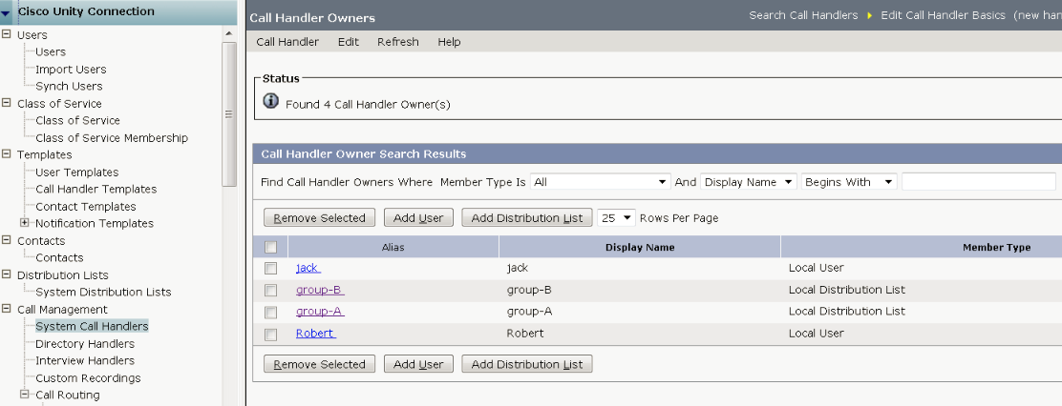
What’s New – Call Handler Owner Administration Web Page Changes
New column for Member Type
New button for Distribution List

Slide 6
What’s new- CUPI REST APIs
  Presently CUPI offers a secure method for adding the Subscribers as Call Handler Owners. The Greeting Administrator role is automatically assigned to the owners.
  In the new implementation existing CUPI API is modified in such a way that Distribution List can also be added as the Call Handler Owner and all the members of Distribution Lists are automatically assigned the role of Greeting Administrator.
  No new CUPI API is created.

Slide 7
Overview of Rest API
The Syntax of existing CUPI API is as:
[/vmrest/handlers/callhandlers/{objectid}/callhandlerowners]
This API offers three method Get ,post and delete.
Details can be found from the following link
http://docwiki-dev.cisco.com/wiki/Cisco_Unity_Connection_Provisioning_Interface_%28CUPI%29_API_--_Call_Handler_Owner_APIs#Add_a_Call_Handler_Owner

Slide 8
Overview of Rest API
Method | Existing Functionality | New Implementation
Get | list out only local users which are the owner of a call handler. | list out all the owners (owner may be Local users or local distribution list)
Post | only local user could be added as the owner of a call handler. | It has the ability to add the both (user & distribution list) as the owner of a call handler.
Delete | only local user could be deleted from the list of a call handler owner | Now both local user and distribution list can be deleted as the owner of a call handler

Slide 9
Troubleshooting Tips
Configuration steps can be found from the following link.
http://www.cisco.com/en/US/docs/voice_ip_comm/connection/10x/gui_reference/guide/10xcucgrg060.html
When admin try to make a subscriber as an owner of call handler thru rest if any duplicity is found rest throws an exception.
<ErrorDetails>
<errors>
<code>DATA_EXCEPTION</code>
<message>Call Handler Owner already exists for this call handler</message>
</errors>
</ErrorDetails>

Slide 10
Troubleshooting Tips
For more details refer to diag_Tomcat_00* traces by enabling the cuca and vmrest microtraces
Snippet of log diag_Tomcat_00
16:23:22.451 |11553,,,VMREST,3,DEBUG [http-bio-443-exec-9] com.cisco.connection.rest.impl.GeneratedCallhandlerOwnerRestImpl - returning session cached authentication information: alias=admin, id=969e5e0d-20af-4909-b604-2b000662cb7a
16:23:22.451 |11553,,,VMREST,3,DEBUG [http-bio-443-exec-9] com.cisco.connection.rest.impl.GeneratedCallhandlerOwnerRestImpl - Calling restImplExtension.beforeCreate
16:23:22.454 |11553,,,VMREST,3,DEBUG [http-bio-443-exec-9] com.cisco.connection.rest.helper.Utilities - Call Handler Owner already exists for this call handler
16:23:22.454 |11553,,,VMREST,3,DEBUG [http-bio-443-exec-9] com.cisco.connection.rest.ResponseFilter - RESPONSE filter IN

Slide 11
Troubleshooting Tips
Log snippet of diag_Tomcat when a distribution list assigned as an owner of a call handler successfully.
16:53:49.041 |11555,,,VMREST,3,DEBUG [http-bio-443-exec-11] com.cisco.connection.rest.impl.GeneratedCallhandlerOwnerRestImpl - returning session cached authentication information: alias=admin, id=969e5e0d-20af-4909-b604-2b000662cb7a
16:53:49.041 |11555,,,VMREST,3,DEBUG [http-bio-443-exec-11] com.cisco.connection.rest.impl.GeneratedCallhandlerOwnerRestImpl - Calling restImplExtension.beforeCreate
16:53:49.120 |11555,,,VMREST,3,DEBUG [http-bio-443-exec-11] com.cisco.connection.rest.impl.GeneratedCallhandlerOwnerRestImpl - created callhandlerowner: CallhandlerOwnerCreateTOImpl[distributionListObjectId=84efb673-c153-4ba1-90cf-791adfffd26e;auditComponent=VMREST;targetHandlerObjectId=c33c9997-e675-414e-9468-d54373e6ba0e;userObjectId=null;objectId=351297ef-ccc5-43a5-8cd9-b3b6572f0ccf;auditAlias=admin;]
16:53:49.120 |11555,,,VMREST,3,DEBUG [http-bio-443-exec-11] com.cisco.connection.rest.ResponseFilter - RESPONSE filter IN

Slide 12
For more information
http://www.cisco.com/en/US/docs/voice_ip_comm/connection/10x/gui_reference/guide/10xcucgrg060.html
http://www.cisco.com/en/US/docs/voice_ip_comm/connection/10x/gui_reference/guide/10xcucgrg060.html

Slide 13
Thanks

