Slide 1
SAN Certificate in Unity Connection
Presenter Name: Bhawna Goel

Slide 2
Agenda –Cluster Wide Single SAN Certificate
  Cluster Wide Single SAN Certificate – High Level Benefits
  Cluster Wide Single SAN Certificate – Over View
  Administrator User Experience Then
  Administrator User Experience Now
  Cluster Wide Single SAN Certificate – Details
  SRSV High Availability change in Unity Connection 10.5 with SAN Certificate
  Troubleshooting
  Backup Slides
    Cluster Wide Single SAN Certificate Configuration
  Additional Information

Slide 3
Cluster Wide Single SAN Certificate – High level Benefits
Supports a single Subject Alternative Name (SAN) certificate per Tomcat certificate across the nodes in a cluster
Reduced TCO for getting public CA signed certificates as only one certificate is needed in the cluster
Improved Admin experience as management of certificate (CSR generation, Certificate upload) can be done from any node in the cluster
Improved end user experience for applications (Jabber, Web Clients) with reduced or no certificate warnings with public CA certificate

Slide 4
Cluster Wide Single SAN Certificate - Overview
Single Cluster-wide certificate for unit : Tomcat
Multi-server CSR can be generated on any server and corresponding Certificate uploaded from any other server in the cluster
Editable parent domain field during CSR generation to allow for greater flexibility - for both Single and multi-server CSR
Editable Common Name to conform to certain Certificate Authorities - for both Single and multi-server CSR
Improved Security
  Default Hash Algorithm changed from SHA1 to SHA256 during “Generate CSR”
  Default Key Length changed from 1024 to 2048 during “Generate CSR”

Slide 5
Administrator User Experience Then
Publisher
Subscriber
For both Publisher and Subscriber Admin needs to do the following:
Login
Generate CSR
Download CSR
Send this CSR to CA (over email, etc.)
Wait for Cert
Upload Cert and all chain certs on that node
Admin

Slide 6
Administrator User Experience Now
Subscriber
Admin needs to do following:
Login to Publisher/Subscriber node
Generate CSR – Automatically distributed to other node in the cluster
Download CSR from any of the node
Send this CSR to CA (over email, etc.)
Wait for Certificate
Upload Certificate and all chain certificates on Publisher/Subscriber – distributed to other node in the cluster
Publisher
Admin

Slide 7
Cluster Wide Single SAN Certificate – Details
Comparison of Single Server vs Multi Server SAN Certificate
Single Server Certificate | Multi Server Certificate
It contains a single FQDN or domain in either the CN field and/or SAN extensions | It contains multiple FQDNs or domains present in SAN extensions
The system uses a single certificate for both Publisher and Subscriber in a cluster | A single certificate identifies both Publisher and Subscriber in the cluster
Generation of single server certificate can become an overhead for the administrator in a cluster because the administrator needs to perform steps such as generate Certificate Signing Request (CSR), send CSR to CA for signing, upload signed certificate etc. on both Publisher and Subscriber server of the cluster | There is less overhead for the administrator in managing multi-server certificates since admin performs the steps only once on a given server, and the system distributes the associated private key and signed certificates to other server in the cluster

Slide 8
Cluster Wide Single SAN Certificate – Details
Certificate Names and Servers
Certificate | Server | Certificate Usage
Tomcat | Unity connection | Following are the application that uses this certificate to verify the Unity Connection Servers. SRSV HTTP(s) Unified Messaging IMAP
Note :-
Wild Card are not supported for SAN Certificates in Unity Connection 10.5.

Slide 9
Cluster Wide Single SAN Certificate – Details
Example for Tomcat Multiserver SAN
Nodes in the cluster are cuc-node-pub.cisco.com, cuc-node-sub.cisco.com
Subject Alternative Names: DNS: cuc-node-pub.cisco.com, DNS: cuc-node-sub.cisco.com

Slide 10
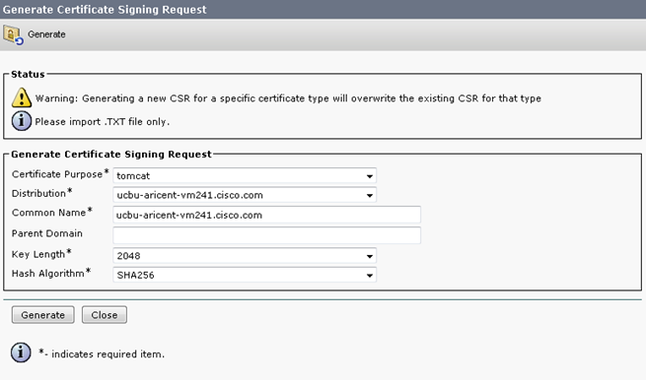
Cluster Wide Single SAN Certificate – Details
Single-Server CSR Changes – Additional flexibility and Security
  Select Security > Certificate Management on OS admin page
Editable
Default Key length 2048
Default AlgorithSHA256
Notes:
For Unity Connection Parent Doman should be left blank as wildcard entries are not supported in Unity Connection.

Slide 11
SRSV High Availability change in Unity Connection 10.5 with SAN Certificate
What will happen if an administrator had configured common DNS A Record for both Publisher and Subscriber for Central Connection Server at Connection SRSV and admin upgraded to Connection SRSV 10.5 ?
The connectivity test between Central Connection Server and Connection SRSV Branch will fail.
Reason :
Due to enhanced security now connection SRSV will validate Central Connection Server certificate. As the value of DNS A record configured on connection SRSV for Central connection server(Publisher and subscriber) is not present in certificate which result in test failure.

Slide 12
SRSV High Availability change in Unity Connection 10.5 with SAN Certificate -Continued
Solution :
Regenerate the Multi San tomcat certificate at Central connection server with the value of DNS A record configured on connection SRSV for Central connection server(Publisher and subscriber) in SAN field of certificate. Also upload the root certificate in tomcat-trust of Connection SRSV.

Slide 13
Troubleshooting
Initial Debugging
Identify topology details:
  Identify hostnames of both the nodes in the connection cluster
  Which node the CSR was generated and pushed from
  Which node the certificate was uploaded from
Ensure that “Cisco Tomcat” and “Platform Administrative Web Service” are running, use CLI:
  utils service list
III. For Unity Connection Administration
  Refer to Tomcat traces by enabling the below Micro Trace Level of cuca.
  General
  Tools
  2. Refer to CUCESync traces for provisioning on Unity Connection SRSV

Slide 14
Troubleshooting
CLI Commands examples:
CLI to list the log files:
file list activelog cuc/diag_Tomcat*
file list activelog cuc/diag_CUCE_Sync*
CLI to collect specific log file
file get activelog cuc/diag_Tomcat_00000001.uc
file get activelog cuc/diag_CUCE_Sync00000001.uc

Slide 15
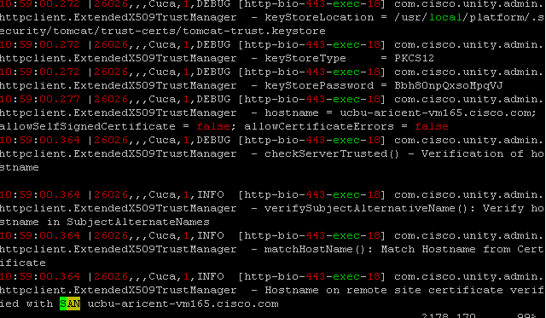
Troubleshooting
For Unity Connection Administration
Snippet of log diag_Tomcat_00000 :-

Slide 16
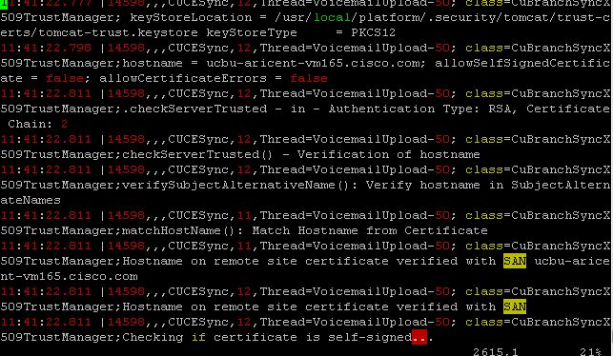
Troubleshooting
Snippet of log diag_CUCESync_00000 :-

Slide 17
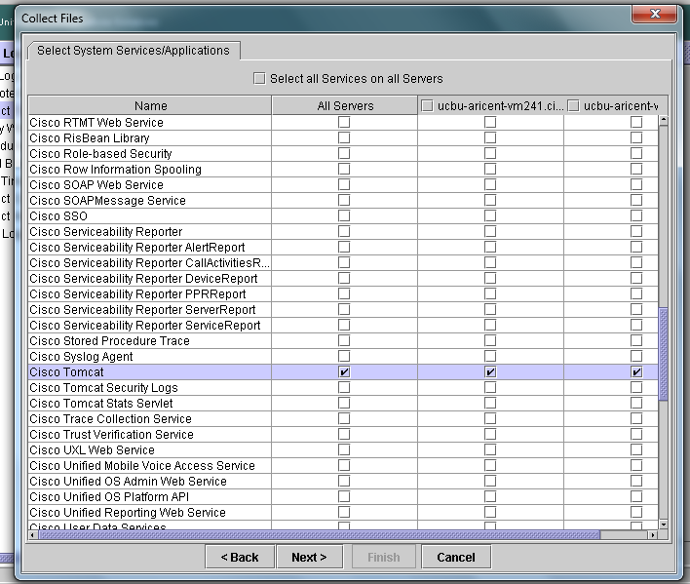
Troubleshooting
Tomcat Logs can also be collected using RTMT :

Slide 18
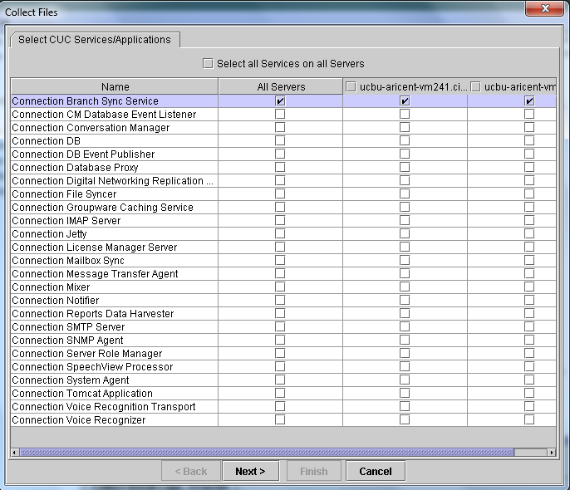
Troubleshooting
CUCESync Logs can also be collected using RTMT :

Slide 19
Troubleshooting
If Connectivity test fails between Central Server and Branch ?
Ensure that same types of certificates (self-signed or Third Party signed ) should be present on Central Server and Branch .
In case of Third Party certificates ensure that root certificates of trusting authority are interchanged.
Hostname/FQDN present in the SAN or CN field of the certificates should be same as that of the hostname/FQDN used for the configuration of Central Server and Branch .
If any failure occurs while adding HTTP(s) links same checklist need to be performed that is mentioned above for all the nodes if HTTP(s) links.

Slide 20
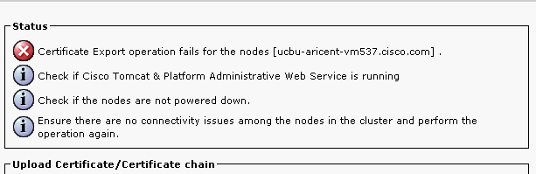
Troubleshooting
Error Message - Incase Tomcat service is down on the remote node
Notes:
The certificates will not be uploaded on any of the node. This is a roll-back feature in SAN.

Slide 21
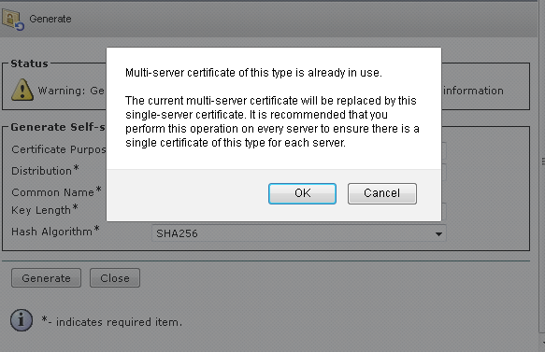
Troubleshooting
Warning Messages
  Message 1 – Incase Admin generates Self-Signed certificate when multi-server certificate is in place

Slide 22
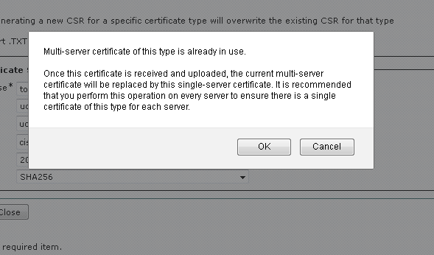
Troubleshooting
Warning Messages
  Message 2 – Incase Admin a single-server CSR, but multi-server certificate is in place

Slide 23
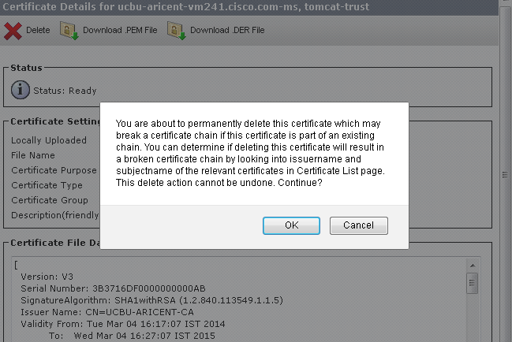
Troubleshooting
Warning Messages
  Message 3 – Incase Admin attempts to delete a Certificate from the Trust store

Slide 24
BACKUP SLIDES

Slide 25
Cluster Wide Single SAN Certificate - Configuration
Steps for generating Multi-Server CA signed Certificate
Step No. | Action
Step 1 | Login to Cisco Unified Communications Operating System Administration window on any Unity Connection using your administrator password
Step 2 | Generate a CSR on the server
Step 3 | Download the CSR to your PC.
Step 4 | Obtain the root CA certificate or certificate chain to upload on the cluster
Step 5 | Upload the root CA certificate and signed CA certificate to the server. Restart Cisco Tomcat service and also restart the processes that are using tomcat certificates.

Slide 26
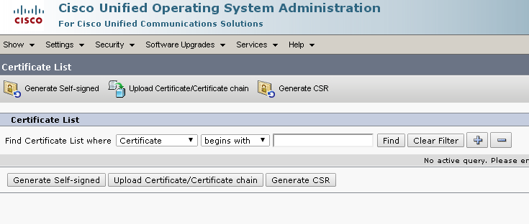
Cluster Wide Single SAN Certificate - Configuration
Steps for generating
  Step 1 - Select Security > Certificate Management on OS admin page
“Generate CSR” button

Slide 27
Cluster Wide Single SAN Certificate - Configuration
Steps for generating Multi Server CSR
  Step 2a: Click Generate CSR. Default Single-Server CSR page

Slide 28
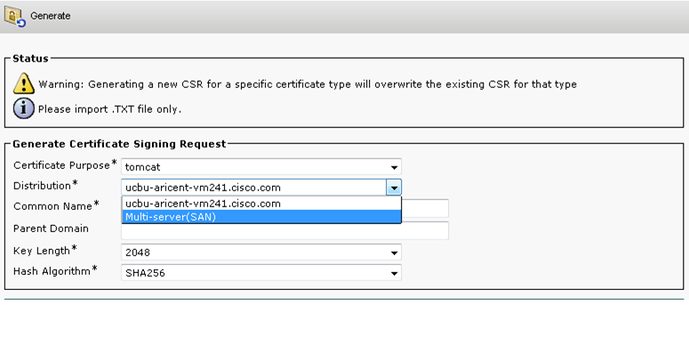
Cluster Wide Single SAN Certificate - Configuration
Steps for generating Multi Server CSR
  Step 2b: From the Certificate Purpose drop-down list box, select the required certificate purpose
Multi-server Option in drop-down

Slide 29
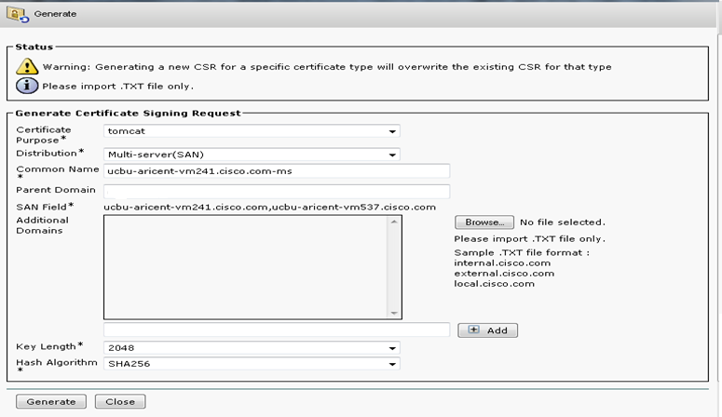
Cluster Wide Single SAN Certificate - Configuration
Steps for generating Multi Server CSR
Step 2c: From the Distribution drop-down list box, select Multi-server (SAN)
Default CN=FQDN-ms (Editable)
Auto-populated list of nodes in the cluster
Ability to add custom DNS values to the CSR via .txt file (max 200)
Ability to add custom DNS values to the CSR manually

Slide 30

Cluster Wide Single SAN Certificate - Configuration
Steps for generating Multi Server CSR
  Step 2d: Click Generate CSR. If Cluster wide OS admin credentials are common
Success message with list of nodes where CSR was transferred

Slide 31
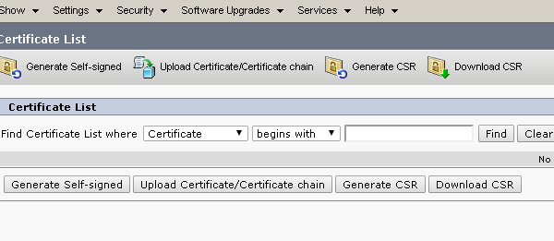
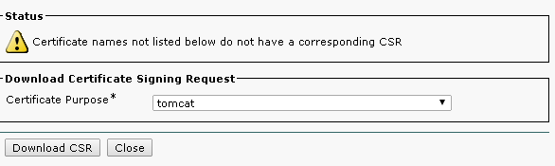
Cluster Wide Single SAN Certificate - Configuration
Steps for Downloading Multi Server CSR (2 options)
Step 3a - Option 1: Click “Download CSR” button on CertManagement Page
Download button
Select unit and download

Slide 32
Cluster Wide Single SAN Certificate - Configuration
Steps for Downloading Multi Server CSR (2 options)
Step 3a: Option 2: Click “Find button to list certs” button on CertManagement Page
Find button
Click Common Name

Slide 33
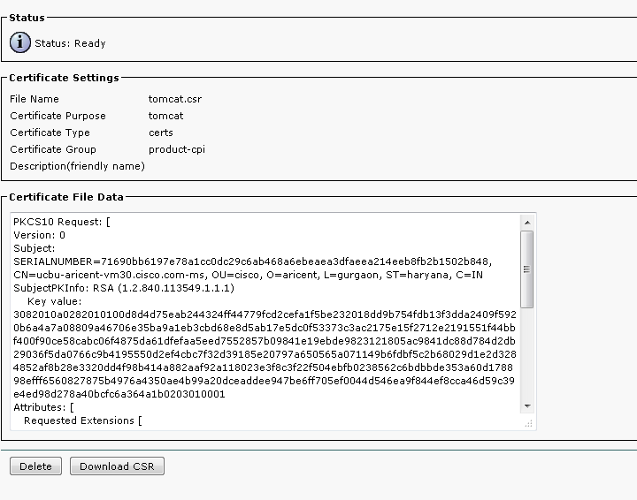
Cluster Wide Single SAN Certificate - Configuration
Steps for Downloading Multi Server CSR (2 options)
Step 3a: Option 2 (contd): Pop-up exposed with download and Delete options
Click Download CSR button

Slide 34
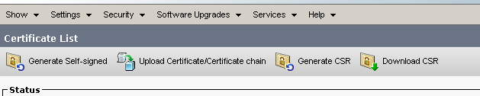
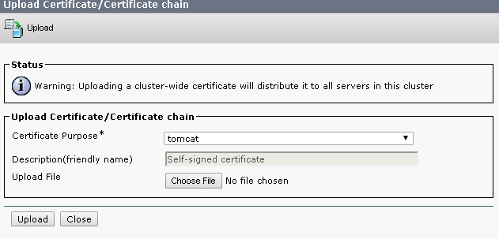
Cluster Wide Single SAN Certificate - Configuration
Steps for Upload of Multi Server CA signed certificate
  Step 5a: Click Upload Certificate/Certificate Chain
Upload Certificate option

Slide 35
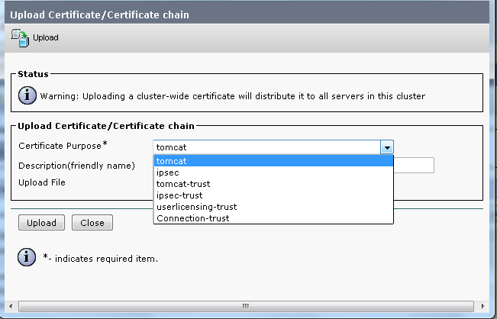
Cluster Wide Single SAN Certificate - Configuration
Steps for Upload of Multi Server CA signed certificate
  Step 5b Select the certificate name from the Certificate Name list
Select tomcat unit

Slide 36
Thank You !

