Slide 1

SRSV MWI Functionality Unity Connection 10.5
Presenter – Saumya S. Gupta (sausaxen)
December 12, 2013

Slide 2
Notice
The information in this presentation is provided under Non-Disclosure agreement and should be treated as Cisco Confidential. Under no circumstances is this information to be shared further without the express consent of Cisco.
Any roadmap item is subject to change at the sole discretion of Cisco, and Cisco will have no liability for delay in the delivery or failure to deliver any of the products or features set forth in this document.
Notes:
2
2

Slide 3
Agenda
What's New
  About
  New UI Changes
MWI functionality
  To demonstrate MWI functionality on SRST topology with SIP integration

Slide 4
What’s New - About
In SRSV mode a Voice messaging user should get MWI notifications when a new message is received and vice versa . Feature has following specifications :-
  MWI light functions in SRSV mode as it is in normal mode
  It works with both SIP and Skinny integration
  SysAgent task "Resynchronize MWIs On All Phone Systems" will now work on branch as well.
  MWI will work with DN E.164

Slide 5
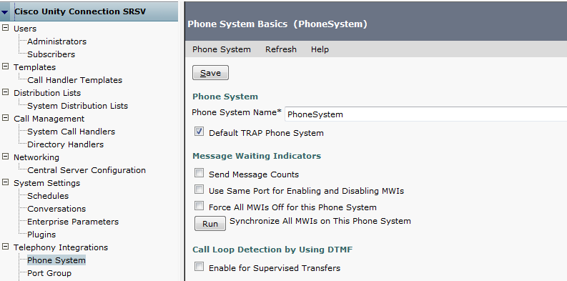
What’s New – Phone System UI Changes
New MWI changes

Slide 6
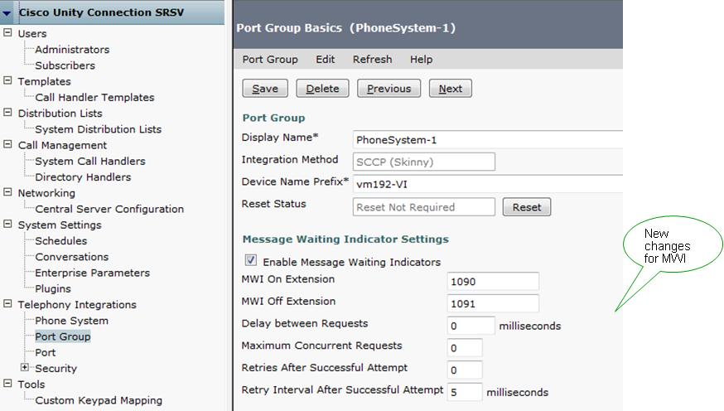
What’s New – Port Group UI Changes

Slide 7
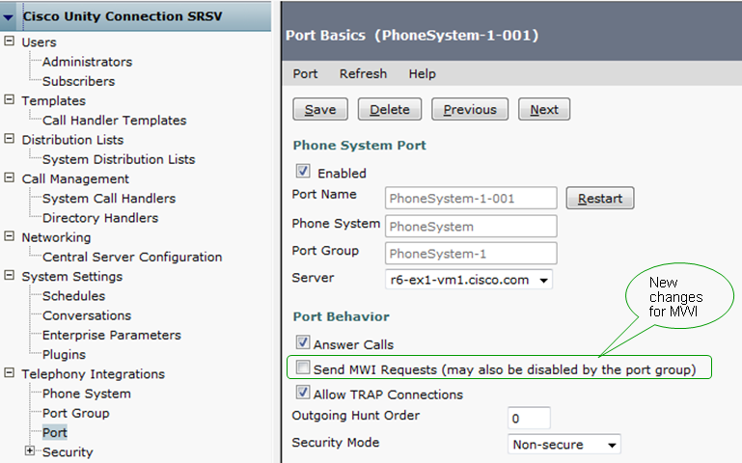
What’s New – Port UI Changes

Slide 8
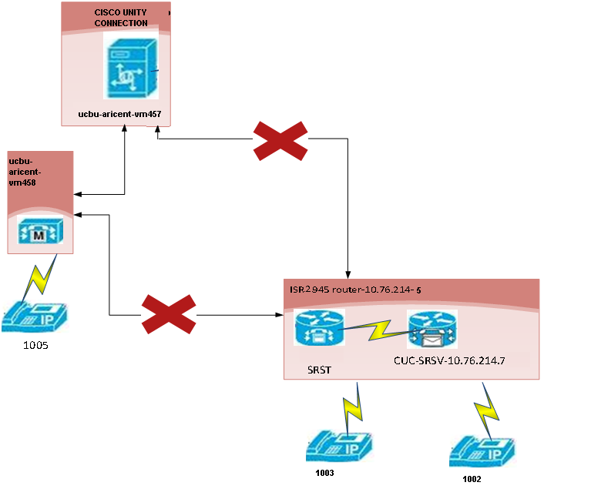
SRST Topology

Slide 9
SRST Demo Case
In SRSV mode, demonstrate MWI functionality on SRST Topology with SIP integration
Action | Result
Drop a message to branch user . | MWI should be ON
Delete the message. | MWI should be OFF
Drop another message and check MWI status from REST API | MWI should be ON
Restore the WAN Outage
Perform VM upload | VM Upload is successful.
Check the MWI status on Central server | MWI should be ON.

Slide 10
Troubleshooting Tips
logs to be referred :-
  SRSV Branch :- /var/log/active/cuc/diag_CuNotifier_*.uc
  /var/log/active/cuc/diag_Tomcat*.uc
  /var/log/active/cuc/diag_CuSysAgent_*.uc

Slide 11
Troubleshooting Tips
Problem | Resolution
MWI is not getting on or off after message is dropped/unread or deleted/Saved | Check for the following on Branch ;- MWI is enabled from Port Group/Port Notifier Service is successfully running on SRSV Run resync MWI task to resynchronize MWI
MWI is not getting on after VMUpload . | Check for the following on Central ;- MWI is enabled from Port Group/Port Notifier Service is successfully running on Central Check if new messages where present while in SRSV mode. Vmupload is succesful.

