Slide 1
Tenant Partitioning Features in Cisco Unity Connection 10.5
Prashant, Ran Vijay

Slide 2
Features Overview
Support for Shared Ports Model in Tenant Partitioned Cisco Unity Connection server
Topologies
Scenarios
Unified Messaging (Office 365) support in Tenant Partitioned Cisco Unity Connection server
Provisioning Unified Messaging using External Service API
Thread Group Allocation & Scheduling in Tenant Partitioning for Office 365
Scenarios
Tenant Active Directory Integration with Partitioned Cisco Unity Connection Server
Bulk License User Support in Cisco Unity Connection server
Overview
Scenarios

Slide 3
Shared Ports Model in Tenant Partitioned Cisco Unity Connection Server

Slide 4
Overview
Shared ports model has been introduced in Tenant Partitioned Unity Connection server in Release 10.5:
PhoneSystem will be shared among the tenants.
Routing rule conditions will be based on Dialed number that will be a Pilot Number for a particular Tenant..
Number of ports configured under the PhoneSystem will be shared among the Tenants.
Highlights about Tenant Creation:
Tenant can be created in Shared ports model with Parameters: Tenant Alias, SMTP domain, Pilot Number, and Media Switch
Tenant will have Unique Pilot Number
Tenant will have Shared Phone System.
Routing Rule conditions will be created based on Pilot Number (as dialed number condition)
Notes:
Tenant can be created tenant in dedicated model
With Parameters : Tenant Alias, Smtp Domain.
Tenant will be having it’s own dedicated Phone System.
Routing Rules conditions will be created based on Phone System.

Slide 5
Topologies Supported
Only Tenants with Dedicated Phone System.
Only Tenants with Shared Phone System.
Combination of Tenants where few are using Shared Phone System and few are using Dedicated Shone system.

Slide 6
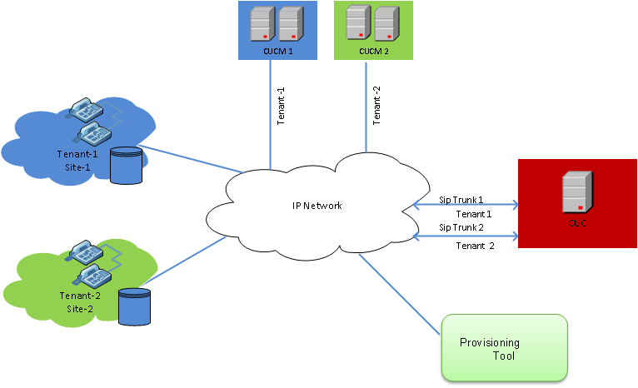
Topology-1 : Tenants with Dedicated Phone System Configuration

Slide 7
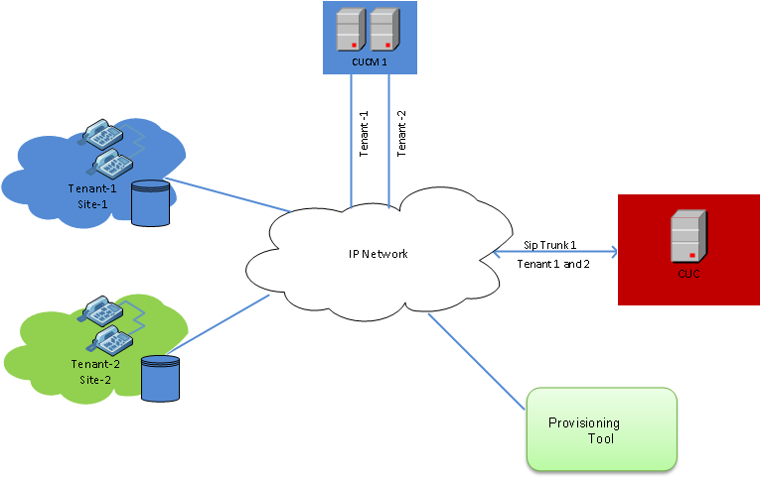
Topology-2 : Tenants with Shared Phone System Configuration

Slide 8
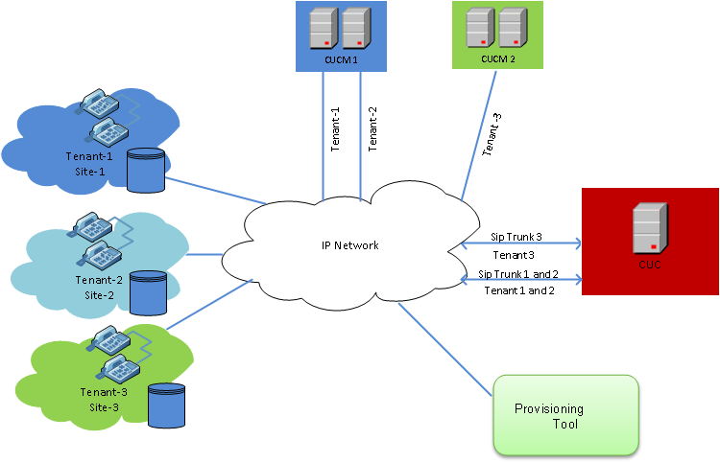
Topology-3 :Dedicated and Shared PhoneSystem based Tenant Configuration

Slide 9
Tenant Provisioning using APIs
Create SIP Security Profile
Create SIP Profile
Create Voice Mail Pilot and Voice Mail Profile
Create SIP Trunk
Create Route Pattern and associate with Trunk
CUCM Settings
Call Pilot Number
Create Tenant with pilot number as specified in CUCM
Create Required Port Group/Ports
Record Greetings
Configure User for the tenant
CUC
Settings
Notes:
Except the tenant creation and the integration step, all the steps are same as given in 10.0 release .
Note: For detailed information about provisioning APIs, visit the following link:
http://docwiki.cisco.com/wiki/Cisco_Unity_Connection_Provisioning_Interface_%28CUPI%29_API

Slide 10
Create Tenant
To create a tenant, an HTTP POST request should be sent to the URI
https://<connection-server>/vmrest/tenants
The request should contain values for the following fields:
Alias: Represents the alias of the tenant.
SMTPDomain: Represents the corporate SMTP Domain of the tenant.
Pilot Number : Represents the unique number on which tenant can be accessed.
MediaSwitchObjectId : Represents object Id of the Phonesytem to which this tenant is to be associated.
To fetch the ‘MediaSwitchObjectId’ perform GET operation on API
URI GET: :https://<connection_server>/vmrest/phonesystems

Slide 11
Tenant Creation Example
To create a tenant with alias “Texoma”, an HTTP POST request should be sent to the URI
https://ucbu-aricent-vm435.cisco.com/vmrest/tenants
With following request body:
<Tenant>
<Alias>Texoma</Alias>
<Description>Tenant for Texoma Inc</Description>
<SmtpDomain>Texoma.com</SmtpDomain>
<PilotNumber>1290</PilotNumber>
<MediaSwitchObjectId>9886f764-ef4e-41c3-bd47977aed91ebc4</MediaSwitchObjectId>
</Tenant>

Slide 12
Snapshot of Routing Rule of Tenant
Fgsgssgsdgs
Above snapshot shows Tenant “Texoma” is created having 1290 as dialed Number in Routing rules.

Slide 13
Unified Messaging (Office 365) Support in Tenant Partitioned Cisco Unity Connection Server

Slide 14
Overview
Unified Messaging Service REST API has been introduced to create, list, modify, delete, and reset Unified Messaging Services (also known as external services). Each Unified Messaging Service Accounts created for a user is based on a Unified Messaging Service.
Unified Messaging Service for Tenant will be based on the Office 365.

Slide 15
Pre-Conditions
The pre-conditions are:
Tenant should have Microsoft License for Office 365 , to use Office 365 services.
Each Tenant should have it’s own unique Unified Messaging Service. If there are N-tenants configured on Unity Connection, then there should be N different Unified services.

Slide 16
Create Unified Messaging Service
To create a Unified Messaging Service , an HTTP POST request should be sent to the URI
https://<connection-server>/vmrest/externalservices
The request must contain values for the following fields:
DisplayName: A descriptive name for the Unified Messaging Service.
ServiceAlias : Represents the Active Directory username of the unified messaging services account in the format : user@domain
ServicePassword: The password for the Active Directory account that you entered in the ServiceAlias field.
ServerType: The type of Unified Messaging Service ,its value is 5 for Office 365.
ExchDoAutodiscover: Flag indicating whether Unity Connection is permitted to search the network for the URL, to log in to Office365. Unity Connection may use the Exchange Autodiscovery feature in combination with LDAP and DNS calls to identify the EWS URL.
ExchOrgDomain:Represents root of the domain to search for autodiscovery.

Slide 17
Associating Unified Messaging Service with User
To associate Unified Messaging Service with user, an HTTP POST request should be sent to the URI
https://<connection-server>/vmrest/users/<User-objectid>/externalserviceaccounts
The request should contain values for the following fields:
ExternalServiceObjectId: The unique identifier of the Unified Messaging Service object will be associated with the user.
EmailAddress: The user's primary SMTP address already existing on Office 365.

Slide 18
Resetting Unified Messaging Service
To Reset Unified Messaging Service
Perform GET operation Unified Messaging Service API.
GET: :https://<connection_server>/vmrest/externalservices
Fetch the object Id of service from response.
Perform reset operation on above fetched service PUT: :https://<connection_server>/vmrest/externalservices/<object-id>/reset

Slide 19
Tenant Active Directory Integration with Partitioned Cisco Unity Connection Server

Slide 20
AD LDS Support for Multiple Tenants
Presently Cisco unity connection provides support for 20 LDAP integration and authorization .But In case of Tenant partitioned unity connection where each tenant can have unique LDAP , integration of LDAP with unity connection would not be possible due to restriction of LDAP integration supported by connection.
To overcome this issue , Active Directory Application Mode can be used with unity connection to provide directory services in Tenant partitioned unity connection .In this case Tenant partitioned cisco unity connection will synchronize with ADAM server for user import and authentication and ADAM server will sync with Tenant’s LDAP for authentication
Active Directory Lightweight Directory Service (AD LDS), formerly known as Active Directory Application Mode, can be used to provide directory services for directory-enabled applications.
AD LDS can be used in conjunction with AD DS so that multiple tenants can have a central location for security accounts (AD DS) and another location to support the application configuration and directory data (AD LDS).

Slide 21
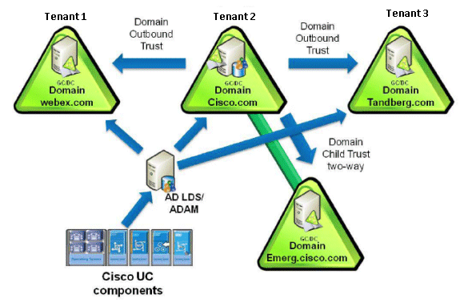
AD LDS Support for Multiple Tenants

Slide 22
AD LDS Support for Multiple Tenants
For the purpose of explaining the AD LDS support, we imagine a scenario where large Enterprise A (Cisco Systems) is hosting multi-tenancy solution for two or more tenants (SMB enterprises)). Enterprise B and C will act as Tenants supported by the Enterprise A. The user directory of enterprise B and C can be imported into the AD LDS server running under Enterprise A.
Enterprise A has a single domain (Multi-tenant supported unity connection) that has Domain Controller that is also a Global Catalogue, and it is hosted in a Windows 2008 Server with SP2, or equivalent Windows server running AD LDS.
Enterprise Tandberg (Tenant 1), say, has a single domain that has Domain Controller that is also a Global Catalogue, and it is hosted in a Windows 2008 Server with SP2.

Slide 23
AD LDS support for Multiple Tenants
Enterprise WebEx (Tenant 2), say, has a single domain that has a Domain Controller. This Domain Controller is also a Global Catalog and is hosted in a Windows Server .
Install the AD LDS in the DC of the enterprise hosting the multi-tenant solution. Other enterprises that are acting as tenants will need to setup inter-domain trust relationship between their DC/GC and the AD LDS for authentication.
Note : For Detailed information ,Please visit the following link
https://supportforums.cisco.com/docs/DOC-16356
http://www.cisco.com/en/US/products/sw/voicesw/ps556/products_configuration_example09186a0080b2b103.shtml

Slide 24
Import LDAP Users in Tenant Partitioned Cisco Unity Connection Using API
To import the users from LDAP using REST API, Please follow the below steps
Step 1: Fetch the list of users from LDAP
REST Operation: GET URI : http://<server>/vmrest/import/users/ldap
Step 2: Import the list of users (Response of step-1) in Unity Connection
REST Operation: POST URI :http://<server>/vmrest/import/users/ldap?templateAlias=<voicemailusertemplate of the tenant under which the user is to be imported>
Note : For detailed information, please visit the following link :
http://docwikidev.cisco.com/wiki/Cisco_Unity_Connection_Provisioning_Interface_(CUPI)_API_--_User_Import

Slide 25
Bulk License User API Support

Slide 26
Overview
Bulk License User Support API has been introduced to fetch all the users along with the license detail of each user. The API response will contain users which are using any kind of license.
Main Features:
Fetch all the users using any kind of license in the unity connection.
Works for both Multi Tenant Mode and Non Multi Tenant Mode.
rowsPerPage and pageNumber query parameters can be used to fetch users based on pagination.
Query parameters can be used to fetch license used by one user.

Slide 27
Scenarios
Fetch User Licenses using the paginations
To fetch user licenses using the pagination , an HTTPs GET request should be sent to the URI
URI : https://<connection-server>/vmrest/userlicenses?rowsPerPage=1&pageNumber=1
Fetch count of users using any kind of license
Total Number of users using any kind of licenses can be fetched by setting the pageNumber field to 0.
URI : https://<connection-server/vmrest/userlicenses?pageNumber=0
Fetch all Users using only one kind of license
Query parameter can be used to fetch the total number of users using only one kind of license:
URI : https://<connection-server/vmrest/userlicense?query=(Messaging is CUC_BasicMessaging
For further query following document can be referred:
http://wikicentral.cisco.com/display/UNITYTRANS/Bulk+User+License+API+Docwiki+Reference

Slide 28
Troubleshooting

Slide 29
Unified Messaging (Office 365) Support in Tenant Partitioned Unity Connection
For issues in Office 365 please refer the following documents.
http://wikicentral.cisco.com/display/UNITYTRANS/Diagnostic+Traces+for+Unified+Messaging%28Office+365+%29+support+in+Tenant+Partitioned+Cisco+Unity+Connection
http://www.cisco.com/c/en/us/td/docs/voice_ip_comm/connection/10x/troubleshooting/guide/10xcuctsgx/10xcuctsg039.html
For issues in AD LDS support in Tenant Partitioned Cisco Unity Connection refer the following documents
https://supportforums.cisco.com/docs/DOC-16356
http://www.cisco.com/en/US/products/sw/voicesw/ps556/products_configuration_example09186a0080b2b103.shtml

Slide 30
Thanks

