Slide 1

URI Dialing
Unity Connection 10.5
Presenter – Isha Gautam (igautam)
April 2, 2014

Slide 2
Notice
The information in this presentation is provided under Non-Disclosure agreement and should be treated as Cisco Confidential. Under no circumstances is this information to be shared further without the express consent of Cisco.
Any roadmap item is subject to change at the sole discretion of Cisco, and Cisco will have no liability for delay in the delivery or failure to deliver any of the products or features set forth in this document.
Notes:
2
2

Slide 3
Agenda
URI Overview
URI Dialing support as an Alternate Extension
URI Provisioning
  CUCA and REST API
  Import from LDAP Directory
  Import from Cisco Unified Communication Manager
URI for CUC Clients :
  VMO
  Web Inbox
  CPCA/Media Master
URI support over Notification Devices
Call flow
Troubleshooting

Slide 4
Overview – URI Dialing
URIs are aliases for the device numbers. A call to/from the URI behaves as if the call was made directly to/from the device number.
SIP entities are identified using URI (Uniform Resource Identifier).
A URI has form of username@domain or username@IPv4_Address, for instance, john@cisco.com or john@10.10.10.1.

Slide 5
URI Dialing Support as an Alternate Extension
Cisco Unity Connection supports URI as an alternate extension for the subscribers. Subscriber’s device URI can be added as an Alternate extension.
When a URI is specified for an alternative extension, Connection handles all calls from that URI in the same way that it handles calls from an E164 alternate extension.

Slide 6
URI Dialing Support as an Alternate Extension (Cont...)
CUCM delivers calling and connected party identity information in these forms:
  Deliver via DN only
    Remote-Party-ID:<sip:+91234@server.cisco.com>;party=calling
  Deliver via URI only
  Remote-Party-ID:<sip:john@server.cisco.com>;party=calling;
  Deliver URI and DN between URI-enabled CUCs (Blended addressing)
    Remote-Party-ID:<sip:john@server.cisco.com; x-cisco-number=1000>; party=calling

Slide 7
URI Supported Format
Cisco Unity Connection supports the following formats in the user portion of a URI (the portion before the @ symbol):
  Accepted characters are a-z, A-Z, 0-9, !, $, %, &, *, _, +, ~, -, =, \, ?, \, ‘, ,, ., /, “.
  The user portion is case sensitive.
Cisco Unity Connection supports the following formats in the host portion of a URI (the portion after the @ symbol):
  Supports IPv4 addresses or fully qualified domain names.
  Accepted characters are a-z, A-Z ,0-9, hyphens, and dots.
  The host portion cannot start or end with a hyphen.
A URI has a maximum length of 40 characters

Slide 8
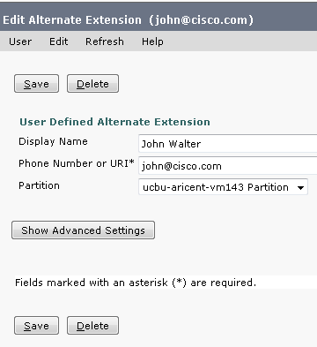
URI Provisioning: CUCA and REST APIs
CUCA:
  URI as an alternate extension can be added in the ‘Phone number or URI’ field of the “Alternate Extension” page.

Slide 9
URI Provisioning: REST APIs and CUCA
REST API:
  To create Alternate Extension, use following REST API:
  /vmrest/users/{objectid}/alternateextensions
    <AlternateExtension>
    <DtmfAccessId>abc@cisco.com</DtmfAccessId>
    </AlternateExtension>

Slide 10
URI Provisioning: Import from LDAP Directory
LDAP Directory URI field synchronizes with Directory URI on the User Basic page and also as an Alternate extension of the User.
Directory URI gets synced via LDAP with following settings:
  msRTCSIP-primaryuseraddress (in case of Active Directory)
  mail
Notes:
Works the same as all other LDAP fields, LDAP values that have a corresponding CUC value are synchronized.
When none is used, the directory uri is not synched and can be edited on the user page
msRTCSP only available for Microsoft Active Directory

Slide 11
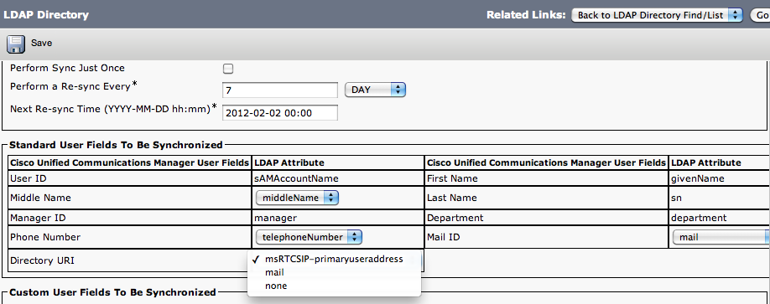
URI Provisioning: Import from LDAP Directory
(Cont…)
Notes:
Works the same as all other LDAP fields, LDAP values that have a corresponding CUC value are synchronized.
When none is used, the directory uri is not synched and can be edited on the user page
msRTCSP only available for Microsoft Active Directory

Slide 12
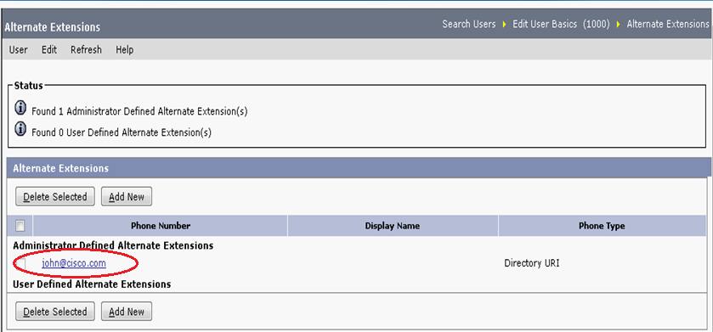
URI Provisioning: Import from LDAP Directory
(Cont…)
Example of LDAP imported synchronized directory URI field in Alternate Extension of the user.

Slide 13
URI Provisioning: Import from CUCM
When an administrator imports users from the Cisco Unified Communications Manager into the Unity Connection server, alternate extension is populated with a URI of the user that is synchronized with the “End User Directory URI”.

Slide 14
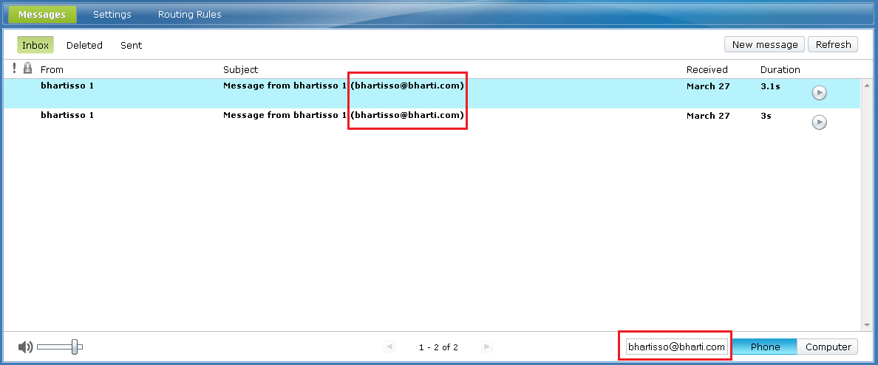
URI for CUC Clients
Out dial calls can be made via following CUC Clients:
  Web Inbox and Mini Inbox: Message can be recorded or playback using URI configured in “Phone Number” field.
Notes:
Previously, only phone number could be used for TRAP calls. Now, we can do the same thing via URI as well.
REST APIs are supported for all CUC Clients.

Slide 15
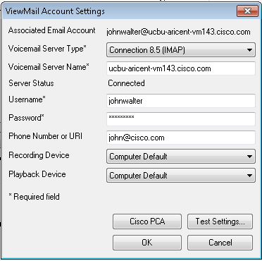
URI for CUC Clients (cont…)
  VMO: View Mail for Outlook can be configured with URI in the ‘Phone Number or URI’ field in
  these wizards:
        Initialize Cisco View Mail
        Options

Slide 16
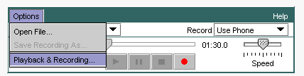
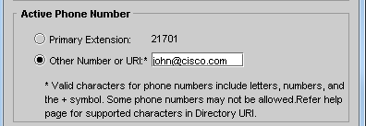
URI for CUC Clients (cont…)
  CPCA/Media Master: Message can be recorded or playback using URI configured in
  “other number or URI” field:
      Options → Playback & Recording
      Other Number or URI

Slide 17
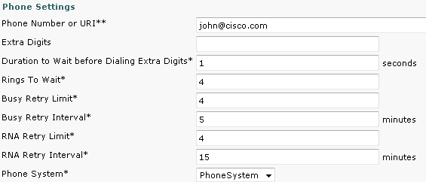
URI for Notification Devices
Notification dial out calls can be made on the configured URI in the ‘Phone Number or URI’ field in following notification devices:
  Work Phone
  Home Phone
  Note : MWI is not supported via URI.
Notes:
MWI is not supported via URI.
Notification dial-out calls will land on the configured URI

Slide 18
URI Alternate Extension replication over HTTPS, Digital and CCI Network
Alternate Extension URI field can be replicated over HTTPS, Digital and CCI Network to all the remote nodes being on version 10.5 and above and will not be replicated on nodes with version 10.0 and below.
This can be used for Cross server Sign In and Cross server transfer.
Notes:
Note: For all the nodes on 10.0 version and below, URI is not supported. So, URI value will be restricted on all those nodes and only be replicated on 10.5 and above nodes.

Slide 19
URI call flow for Incoming Call (Attempt Sign In)
Incoming Sip Message<-- INVITE sip:488@10.76.214.68:5060 SIP/2.0
Via: SIP/2.0/TCP 10.76.214.100:5060;branch=z9hG4bK1a86c3d83f3
From: <sip:john@server.cisco.com>;tag=20221~f6087d99-cf0c-4330-b5d3-f89c37d3f76f-17256706
To: <sip:488@10.76.214.68>
Date: Thu, 21 Nov 2013 08:33:31 GMT
Call-ID: 98d74500-28d1c55b-154-64d64c0a@10.76.214.100
Supported: timer,resource-priority,replaces
Min-SE: 1800
User-Agent: Cisco-CUCM9.0
Allow: INVITE, OPTIONS, INFO, BYE, CANCEL, ACK, PRACK, UPDATE, REFER, SUBSCRIBE, NOTIFY
CSeq: 101 INVITE
Expires: 180
Allow-Events: presence
Supported: X-cisco-srtp-fallback,X-cisco-original-called
Cisco-Guid: 2564244736-0000065536-0000000007-1691765770
Session-Expires: 1800
P-Asserted-Identity: <sip:john@cisco.com>
Remote-Party-ID: <sip:john@server.cisco.com;x-cisco-number=1003>;party=calling; screen=yes; privacy=off
Contact: <sip:john@10.76.214.100:5060;transport=tcp>;video;audio
Max-Forwards: 69
Content-Length: 0
Notes:
The Incoming Call Flow for Attempt Sign In shows that with option 3 (recommended) enabled on SIP trunk, the call searches for the URI of the user and tries to connect via it. In this case, URI of the user is <sip:john@server.cisco.com> and hence establishes the call flow via URI. After searching for the URI, it will search for user’s extension (DN) to connect.

Slide 20
URI call flow for Incoming Call (RNA)
Incoming Sip Message<-- INVITE sip:488@10.76.214.68:5060 SIP/2.0
Via: SIP/2.0/TCP 10.76.214.100:5060;branch=z9hG4bKa4f352bfe8d
From: <sip:john@server.cisco.com>;tag=48087~f6087d99-cf0c-4330-b5d3-f89c37d3f76f-17256846
To: <sip:488@10.76.214.68>
Date: Thu, 28 Nov 2013 06:38:23 GMT
Call-ID: ac3e5f00-2961e4df-8dd-64d64c0a@10.76.214.100
Supported: timer,resource-priority,replaces
User-Agent: Cisco-CUCM9.0
Allow: INVITE, OPTIONS, INFO, BYE, CANCEL, ACK, PRACK, UPDATE, REFER, SUBSCRIBE, NOTIFY CSeq: 101
Expires: 180
Allow-Events: presence
Supported: X-cisco-srtp-fallback
Supported: Geolocation
Cisco-Guid: 2889768704-0000065536-0000000046-1691765770
Session-Expires: 1800
Diversion: <sip:harry@server.cisco.com;x-cisco-number=1010>;reason=no-answer;privacy=off;screen=yes
P-Asserted-Identity: <sip:john@cisco.com;x-cisco-number=1000>
Remote-Party-ID: <sip:john@server.cisco.com;x-cisco-number=1000>;party=calling;screen=yes;privacy=off
Contact: <sip:john@10.76.214.100:5060;transport=tcp>;video;audio
Max-Forwards: 69
Content-Length: 0
Notes:
The Incoming Call Flow RNA shows that with option 3 (recommended) enabled on SIP trunk, the call searches for the URI of the user and tries to connect via it. In this case, URI of the user is <sip:john@server.cisco.com> and hence establishes the call flow via URI. After searching for the URI, it will search for user’s extension (DN) to connect and then establishes a connection to record the message for the user.

Slide 21
URI call flow for Outgoing call
Outgoing Sip Message--> INVITE sip:john@cisco.com SIP/2.0
From: sip:10.76.214.67:5060;tag=8ec00d2a6a974c5fa2616258feee1f1a
To: sip:john@cisco.com
Via: SIP/2.0/TCP 10.76.214.67:5060;branch=z9hG4bK1ca64a9847ce46edac2a79df684503c2
Max-Forwards: 70
User-Agent: Cisco-UnityConnection/8.5
Contact: <sip:<CUC IP>7:5060;transport=tcp>
Call-ID: fa7f5fc5f4d649bb932c0e4593517ba1@cisco.com
CSeq: 200 INVITE
Allow-Events: kpml
Allow: ACK,BYE,CANCEL,INVITE,NOTIFY,OPTIONS,REFER,REGISTER,SUBSCRIBE
Content-Length: 264
Content-Type: application/sdp
Notes:
URI outgoing call flow for Notification Devices is same as trap or any other outgoing call flow for URI.

Slide 22
Troubleshooting
Called party voice mail not reachable or User login fail via URI supported client?
  Verify that the URI mentioned in the alternate extension field on the Cisco Unity Connection is same as in the Directory URI field for the corresponding DN on CUCM.
  Check that the CUC hostname or IP is correctly mentioned in the SIP Trunk “Hostname”.
  Check the calling and connected party info format for SIP Trunk on CUCM should be either “Deliver via URI only” or “Deliver URI and DN between URI-enabled”
  Check that Pilot number is mentioned in the user’s no answer call values.
  Ensure that Incoming Call received with URI in the “CallerID” field as shown:
11:41:06.336 |14521,PhoneSystem-1-001,52AA878FB2174CD39909C3627AEEC295,Arbiter,-1,Incoming Call [callerID='john@cisco.com 'callerName='' calledID='ken@cisco.com 'redirectingID='' altRedirectingID='' lastRedirectingID=''altLastRedirectingID='' reason=1=Direct lastReason=1024=Unknown] port=PhoneSystem-1- 001 portsInUse=1 ansPortsFree=3 callGuid=52AA878FB2174CD39909C3627AEEC295
Notes:
In case of HTTPS, DigiNet or CCI, check that the USN values for all the nodes are updated and the users are replicated successfully. Verify that the users are replicated successfully over the remote nodes.

Slide 23
Troubleshooting (Cont…)
Unable to see the sender’s URI in the subject field of the voice message left?
  Check that (%CALLERID%) is mentioned in the “User to User Messages” option under Subject Line Formats in System settings.
URI not imported via LDAP and is an editable field?
  Check that “none” is not selected as Directory URI option in the LDAP Directory Synchronize page. Due to this “None” option, directory URI will not be synched and can be edited on user basic page.
  Make sure that either “msRTCSIP-primaryuseraddress (in case of Active Directory) or mail” is selected as Directory URI option in the LDAP Directory Synchronize page.
URI not imported via CUCM ?
  In case of CUCM imported users, check that the URI value is present in the directory URI field of the end user on CUCM and not in the email address field.

Slide 24
Troubleshooting (Cont…)
For further debugging:
Ensure that following services are running using CLI “utils service list”
  Cisco Tomcat
  Connection Conversation Manager
  Connection Digital Networking Replication Agent (in case of Digital Network)
  Connection HTTPS Directory Feeder (in case of HTTPS Network)
  Connection System Agent (in case of HTTPS, Digital Network or CCI)
  Cisco DirSync (in case of LDAP)

Slide 25
Troubleshooting (Cont…)
Traces and CLI Commands examples:
Traces to be enabled:
  MiuSipStack (trace level 10, 11)
  MiuSip (trace level 10, 11)
  CUCA
  CuReplicator (all trace level)
CLI to list the log files:
  file list activelog cuc/diag_Tomcat*
  file list activelog cuc/diag_CuCsMgr*
  file list activelog cuc/diag_CuReplicator*
CLI to collect specific log file:
  file get activelog cuc/diag_Tomcat_00000001.uc
  file get activelog cuc/diag_CuCsMgr_00000001.uc
  File get activelog cuc/diag_CuReplicator_00000001.uc

Slide 26
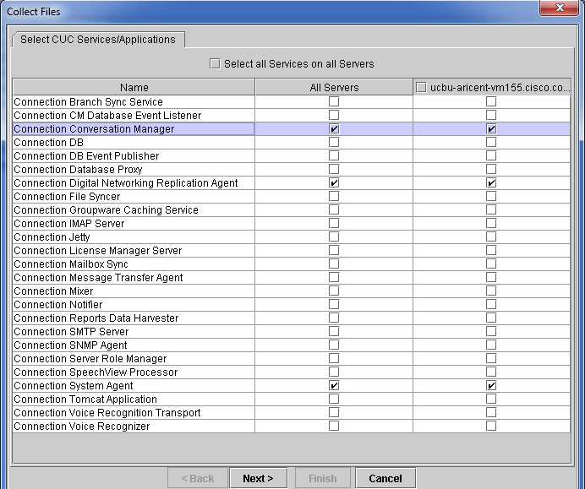
RTMT Logs

Slide 27
References
URI support at CUC:
  http://www.cisco.com/c/en/us/td/docs/voice_ip_comm/connection/10x/user_mac/guide/10xcucmacx/10xcucmac040.html
  http://www.cisco.com/c/en/us/td/docs/voice_ip_comm/connection/10x/gui_reference/guide/10xcucgrgx/10xcucgrg010.html
  http://www.cisco.com/c/en/us/td/docs/voice_ip_comm/connection/10x/gui_reference/guide/10xcucgrgx/10xcucgrg100.html
  http://www.cisco.com/c/en/us/td/docs/voice_ip_comm/connection/10x/administration/guide/10xcucsagx/10xcucsag040.html

