Slide 1
Voice Mailbox Quota Notification 10.0(1)
TOI for Voice Mailbox Quota Notification Feature
EDCS Number - EDCS-1289412
August 13 2013

Slide 2
Notice
The information in this presentation is provided under Non-Disclosure agreement and should be treated as Cisco Confidential. Under no circumstances is this information to be shared further without the express consent of Cisco.
Any roadmap item is subject to change at the sole discretion of Cisco, and Cisco will have no liability for delay in the delivery or failure to deliver any of the products or features set forth in this document.
Notes:
2
2

Slide 3
Agenda
Feature Overview
Feature Configuration
Mailbox Quota Settings
System-wide Settings
User Specific Settings
Mailbox Quota Alert Text Configuration
Default Alert Text
Customized Alert Text
Locale Specific Alert Text
SysAgent Task Overview
Quota Notification Mail‘ Task
Task Results
Notification Mail Template
REST API’s
Troubleshooting
References

Slide 4
Feature Overview

Slide 5
Feature Overview
The feature aims at providing a system generated notification mail to the users on their corporate email address, whenever their voice mailbox size exceeds quota warning threshold, specified by the administrator.
The goal is to notify user via emails that the mailbox is reaching the maximum size allowed, in case the user is not accessing interfaces like TUI or web-inbox.
The ‘Quota Notification Mail’ task has been provided to send notification mails to all the users having quota overflow.
Administrator has been facilitated with a web-interface, through which the content of notification mails can be configured.

Slide 6
Feature Configuration

Slide 7
Feature Configuration
Includes the following sections:
Mailbox Quota Settings – To help control the size of user voice mailboxes, Cisco Unity Connection lets administrator specify quotas, or limits, on the maximum size of voice mailboxes.
System Wide Settings
User Specific Settings
Mailbox Quota Alert Text Configuration – To customize the alert texts to be sent in notification mails to the users, a web-interface is provided to the administrator.
Default Alert Text
Customized Alert Text
Locale Specific Alert Text

Slide 8
Mailbox Quota Settings

Slide 9
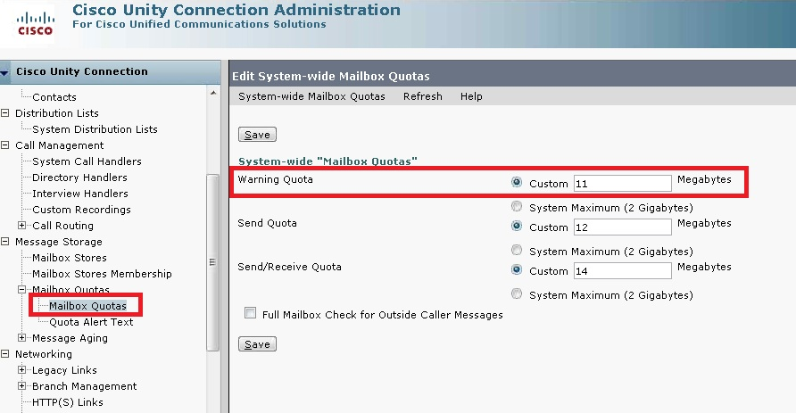
System-wide Mailbox Quota Settings
With the installation of UCxN, system-wide settings for mailbox quota are preconfigured. The default warning quota is 11 Megabytes.

Slide 10
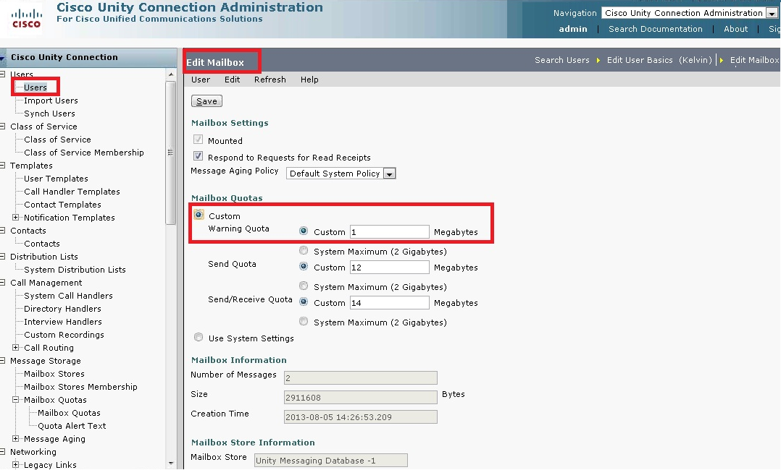
User Specific Mailbox Quota Settings
Mailbox Quota size can be customized at user level by modifying user’s mailbox settings.
By default, user is configured to use system settings for mailbox quotas.

Slide 11
Mailbox Quota Alert Text Configuration

Slide 12
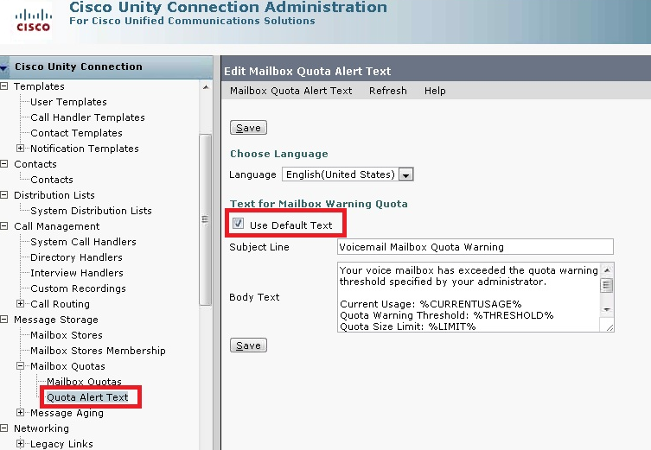
Default Alert Text
‘Quota Alert Text’ page on CUCA can be used to specify the template for notification mail content.
Default subject and body texts are preconfigured with the installation of UCxN and can not be modified.

Slide 13
Customized Alert Text
Uncheck the ‘Use Default Text’ check box in order to customize the Subject Line and/or Body Text of the message quota alert emails that are sent to users.
In addition to regular text, Body Text field accepts the following parameters, which are replaced with applicable values when the alert messages are sent:
%CURRENTUSAGE% - replaced with the current voice mailbox size of the user.
%THRESHOLD% - replaced with the warning quota size, specified by administrator.
%LIMIT% - replaced with the maximum size allowed for voice mailbox (Send/Receive Quota).
Note: Above configurable parameters are not applicable in the ‘Subject Line’ field.

Slide 14
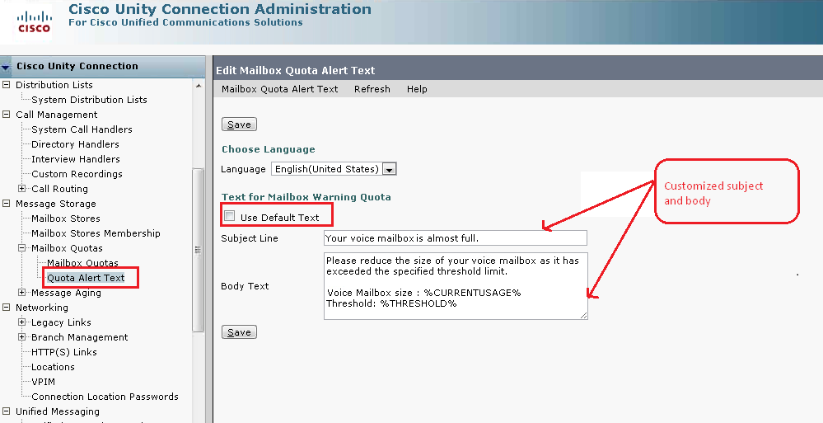
Customized Alert Text (cont...)

Slide 15
Locale Specific Alert Text
‘Language’ drop down on “Quota Alert Text” page, displays all the installed languages on UCxN.
Particular language can be selected from drop down to customize locale specific alert template.
Localization framework is in place but since the locale for 10.0 release are not available, the feature has been tested only with default language.

Slide 16
SysAgent Task Overview

Slide 17
Quota Notification Mail Task
The ‘Quota Notification Mail’ task sends a notification mail to the configured corporate addresses of the users, whose voice mailbox has reached the size specified for warning quota.
Notification mails will not be sent to the users whose corporate email address is not configured.
The task is scheduled to run at 11:00 PM. Same can be set up to run at a regular schedule.
An alternate way to run the task is through CLI using command
‘run cuc sysagent task Umss.QuotaNotificationMailTask’.
Administrator can disable this task from CUCA to ward off sending notification mails.
To reduce voice mailbox size, users need to permanently delete few of their voicemails.

Slide 18
Task Results

Slide 19
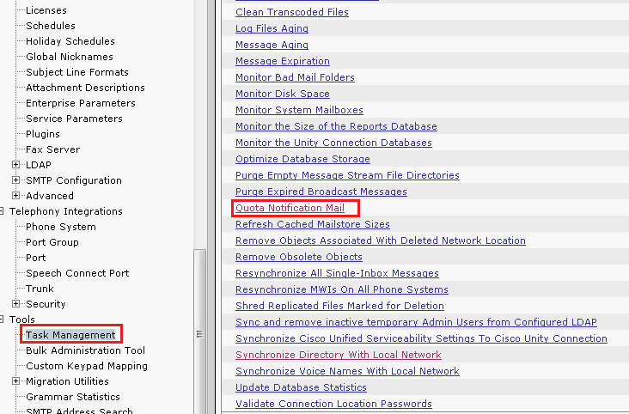
Task results
Go to ‘Task Management’ page.
Click on ‘Quota Notification Mail’ task.

Slide 20
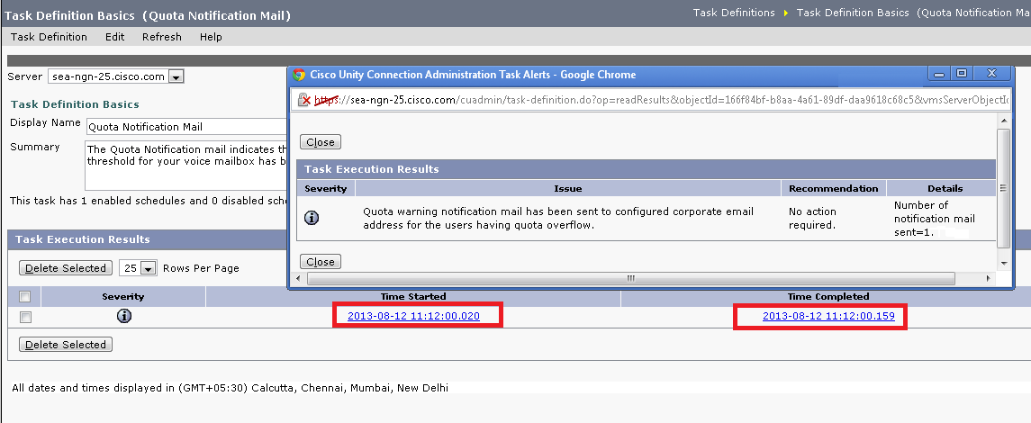
Task results (cont…)
On ‘Task Definition Basics’ page select an appropriate entry of task results for more details.
Note: As per the above results, only one user’s mailbox has exceeded the warning quota. Hence only 1 notification mail is sent.

Slide 21
Notification Mail Template

Slide 22
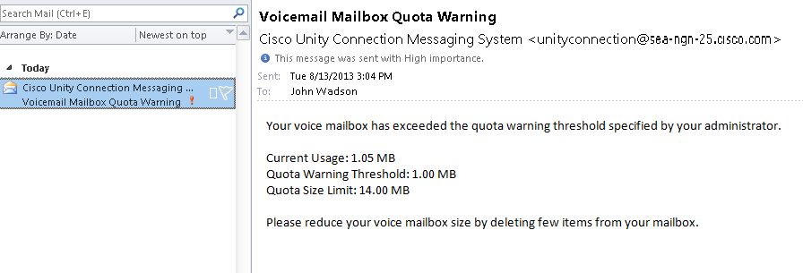
Notification mail received with default template

Slide 23
Notification mail received with customized template

Slide 24
Rest API's

Slide 25
Introduction
Voice Mailbox Quota Notification provides 2 rest API’s which are capable of retreiving and updating the quota alert text with specified language. Admin credentials need to be provided to access the details.
GET API:
/vmrest/mailboxquotatexts (Ex - https://sea-ngn-25/vmrest/mailboxquotatexts) –
used to fetch the list of mailbox quota alert templates.
vmrest/mailboxquotatexts/<mailboxQuotaTextObjectId> (Ex - https://sea-ngn-25/vmrest/mailboxquotatexts/<mailboxQuotaTextObjectId>) –
used to fetch the language specific quota alert template.
PUT API:
vmrest/mailboxquotatexts/<mailboxQuotaTextObjectId> (Ex - https://sea-ngn-25/vmrest/mailboxquotatexts/<mailboxQuotaTextObjectId>) –
used to update the subject and body of quota alert text for specified language.
Notes:
NOTE that system administrator role is required to hit the API

Slide 26
REST Request: GET /vmrest/mailboxquotatexts
GET request to fetch the list of Mailbox Quota alerts that will be used as email notification alert texts for end user.
Currently, there is only one Quota Alert Text which is used when warning quota is reached and can be configured for all installed languages.
Response:
<MailboxQuotaTexts total="1">
<MailboxQuotaText>
<URI>/vmrest/mailboxquotatexts/da9d6130-baf7-4b8b-8aa5-1d973567d0b6</URI>
<ObjectId>da9d6130-baf7-4b8b-8aa5-d973567d0b6</ObjectId>
<Body/>
<DefaultBody>Your voice mailbox has exceeded the quota warning threshold specified by your
administrator.\n\nCurrent Usage: %CURRENTUSAGE%\nQuota Warning Threshold:
%THRESHOLD%\nQuota Size Limit: %LIMIT%\n\nPlease reduce your voice mailbox size by deleting few items from your mailbox.</DefaultBody>
<DefaultSubject>Voicemail Mailbox Quota Warning</DefaultSubject>
<LanguageCode>1033</LanguageCode>
<Subject/>
<UseDefault>true</UseDefault>
<RuleDescription>Text for Mailbox Warning Quota</RuleDescription>
</MailboxQuotaText>
</MailboxQuotaTexts>

Slide 27
REST Request:
GET /vmrest/mailboxquotatexts/<mailboxQuotaTextObjectId>
GET request to fetch the specific Mailbox Quota alert text.
<mailboxQuotaTextObjectId> for this GET request is the same that is obtained by /vmrest/mailboxquotatexts.
Response:
<MailboxQuotaText>
<URI>/vmrest/mailboxquotatexts/da9d6130-baf7-4b8b-8aa5-1d973567d0b6</URI>
<ObjectId>da9d6130-baf7-4b8b-8aa5-d973567d0b6</ObjectId>
<Body/>
<DefaultBody>Your voice mailbox has exceeded the quota warning threshold specified by your administrator.\n\nCurrent Usage: %CURRENTUSAGE%\nQuota Warning
Threshold: %THRESHOLD%\nQuota Size Limit: %LIMIT%\n\nPlease reduce your
voice mailbox size by deleting few items from your mailbox.</DefaultBody>
<DefaultSubject>Voicemail Mailbox Quota Warning</DefaultSubject>
<LanguageCode>1033</LanguageCode>
<Subject/>
<UseDefault>true</UseDefault>
<RuleDescription>Text for Mailbox Warning Quota</RuleDescription>
</MailboxQuotaText>

Slide 28
REST Request:
PUT /vmrest/mailboxquotatexts/<mailboxQuotaTextObjectId>
XML request to customize Mailbox Quota alert text.
<mailboxQuotaTextObjectId> for this PUT request is the same that is obtained by /vmrest/mailboxquotatexts.
Request:
<MailboxQuotaText>
<Body> changed body content </Body>
<Subject> Changed subject line </Subject>
<UseDefault> false </UseDefault>
</MailboxQuotaText>
Response:
HTTP response code : 204

Slide 29
PUT Request (Cont…)
In order to modify the Mailbox Quota alert text to contain its default values, use the following XML request:
Request:
<MailboxQuotaText>
<UseDefault> true </UseDefault>
</MailboxQuotaText>
Response:
HTTP response code : 204

Slide 30
Troubleshooting

Slide 31
Troubleshooting Steps
Scenario:
User is not receiving notification mails for quota overflow.
Steps to resolve:
Check for NDR in sender’s(unityconnection user) mailbox.
Verify that specified corporate email address of the user is valid and correctly spelled.
Check that the corporate mailbox of the user has some free space.

Slide 32
Logs to enable:
SysAgent logs :
SysAgent and UmssSysAgentTasks
Tomcat logs :
CUCA and VMREST
SMTP logs
SysAgent (diag_CuSysAgent_*.uc), SMTP (diag_SMTP_*.uc) and Tomcat (diag_Tomcat_*.uc) logs will be located in /var/opt/cisco/connection/log on the connection through root CLI.

Slide 33
References

Slide 34
References
Cisco Unity Connection Administration Guide
Design Guide
CLI Guide
REST API Doc Wiki
http://wikicentral.cisco.com/display/UNITYTRANS/Design+-+REST+API+support+for+Mailbox+Quota+alert+text

