Slide 1
Unity Connection Qualification for Prime Collaboration Development
Release 10.0

Slide 2
Agenda
About PCD
Cisco Prime Collaboration Deployment
Supported CUC Releases
Steps for PCD Setup
Overview of PCD Setup
Overview of Cluster Discovery
Supported PCD Features for CUC
Configuration
Cluster Discovery
L2 Upgrade
Switch Version
Restart
Email Notification

Slide 3
Agenda (Contd.)
Troubleshooting
Log Files (PCD)
Log Files (CUC)
Common Issues
Required Services

Slide 4
About Prime Collaboration Deployment
Notes:
Configuration for upgrade feature

Slide 5
Cisco Prime Collaboration Deployment
Cisco Prime Collaboration Deployment (PCD)
An application that can be used to manage the migration of legacy CUC clusters (7.1.5, 8.x, 9.x) to new VM based servers on 10.0, allowing Cisco customers to easily migrate to virtual servers.
It can also be used to
Upgrade UC app software (8.6.1+)
Install cop files (locales or device packs) on a cluster (8.6.1+)
Switch versions
Reboot
Readdressing
Fresh install a new Unified Communication, or IM&P cluster
Notes:
Cicso Prime Collaboration Deployment (CPD) – internally referred to as UCMAP
Primary new feature is migration capability, to help customers get from legacy systems to 10.x without going through multiple steps
Difference between upgrade and migration – upgrade is software only. Migration is software upgrade + move to new hardware.
Also replaces the PAWS_M app that was used in 9.1, to upgrade, switch version and reboot clusters of CUCM and CUP (8.6.1 and higher)
Also, new cluster hostname/IP change (10.x and higher)

Slide 6
Supported CUC Releases
PCD Feature | CUC 8.5(1) | CUC 8.6(2) | CUC 9.1(1) / 9.1(2)
Upgrade (From xx To 10.x and onwards) | - | Yes | Yes
Switch Version | - | Yes | Yes
Server restart | - | Yes | Yes
Note:
Upgrades can be performed on clusters 8.6.1 and up to any release that is a valid upgrade, including 10.x. (PCD as a replacement for PAWS_M)
Notes:
Table shows versions that can be upgraded. Since the SOAP APIs for Upgrade/switch version/restart were not added to CUCM until 8.6.1, only versions 8.6.1 and up can be upgraded using PCD.
Although PCD replaces PAWS_M as a tool, there is no upgrade of data from PAWS_M to PCD.

Slide 7
Steps for PCD Setup
Rack/Stack deploy hardware and install ESXi (Vmware)
Deploy PCD virtual machine (delivered as virtual appliance)
Configure PCD:
Download necessary .ISO images for target release
Add ESXi hosts to PCD inventory(required for installation/migration via PCD)
“Discover Cluster” – PCD connects to source cluster and retrieves cluster information.

Slide 8
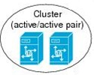
Overview of PCD Setup
PCD
Administrator
CUC Cluster
ISO & OVA
Notes:
Customer (here will an existing cluster of 4 nodes), will first install their new blade/ rack servers
Deploy PCD VAPP (ova with pre-installed PCD software) to create new VM, running PCD
PCD has data store to hold iso files
Customer will sftp the iso (CUCM 10.x iso) to be used in the migration onto the PCD fresh_install directory. Customer will download 10.x ova to laptop or data store.
Customer will then use CUCM 10.x ova to create 4 new blank VMs (one for each node in the existing cluster)

Slide 9
Overview of Cluster Discovery
PAWS API
PCD
CUC Cluster
ISO & OVA
Discovered
Source
Cluster
Notes:
Customer enters the hostname/IP and credentials of the pub into PCD.
Customer initiates “cluster discovery” on the cluster. PCD will “discover” the existing cluster topology (number of nodes,their product type, hostname/IP).
As part of discovery, a cop file is installed on each node, that will be used later during migration.

Slide 10
Supported PCD features for CUC

Slide 11
Supported PCD Features for CUC
Discovery
L2 Upgrade
Switch Version (from CUC 8.6.1+)
Restart (from CUC 8.6.1+)
Email Notification (of task start, status, completion)
Readdressing
Notes:
Main features of Prime Collaboration Deployment
Migration - moving from old servers to new, plus installing 10.0.1
2 kinds – very similar, but administration is slightly different
Simple migration – move from one cluster to another, keeping all hostnames/IP the same
Migration with Network Migration – move to new cluster, and change some hostname/IP settings at the same time.
Upgrade, switch version, restart – same operations as today, but you can control them from PCD. Gives user the ability to control the upgrade for entire cluster from one admin screen.
Readdress – update the hostname/IP of one node or all nodes in a cluster from one administration screen on PCD.
Email notification – can indicate no email, error only, or status email. Note: today, you get a lot of emails for one task. We are working to reduce.
Dashboard – easy way to see the status of all tasks. User can pick one to investigate in more detail.
Datastore – user sftp files there before migration or upgrade. Later, user can use this screen to manage files.

Slide 12
Configuration Cluster Discovery
Notes:
Configuration for upgrade feature

Slide 13
Inventory - Clusters
Clusters screen – holds the cluster inventory.
This includes existing clusters (that will be migrated or upgraded),
Cluster definitions to be migrated to, or Cluster definitions to be fresh installed.
To add an existing cluster to your inventory, click on “Discover Cluster” button.
Notes:
Menu categories: Monitoring, Tasks, Inventory, Administration
Inventory - you need a cluster in your inventory before you can use any tasks.
Upgrade needs one cluster.

Slide 14
Inventory – Cluster Discovery
Notes:
Use cluster discovery to add existing cluster to inventory. (Click on the “Discover Cluster” button to start the Cluster Discovery wizard.)
Choose a Cluster “nickname” (this is a name PCD will use to identify the cluster)
Enter hostname or IP address for publisher, as well as Admin username and password, and click Next.

Slide 15
Inventory – Cluster Discovery
Notes:
PCD automatically detects first node.
Click on “Assign Functions” button to add other roles.
(These roles are used to create a migration sequence, but will not affect which services are activated on the CUCM, etc.)

Slide 16
Inventory – Cluster Discovery
Notes:
Once discovery is complete, cluster appears in inventory. You can click on arrow to expand cluster, and see all the nodes in it.
Each node had an Edit, and Refresh Node link. This can be used if the node had an error in discovery, or if something about the node has changed (login/password).
If user cancels in the middle of discovery, better to delete cluster, and rediscover. Since cop file is being installed, best to NOT cancel out of a discovery.

Slide 17
Configuration L2 Upgrade
Notes:
Configuration for upgrade feature

Slide 18
Create Upgrade Task
Make sure cluster to be upgraded is in Cluster inventory
Choose Task -> Upgrade – to begin upgrade task wizard
Cluster must be at least 8.6.1 (or higher)
Notes:
Make sure cluster to be upgraded is already in Cluster inventory. If not, use Cluster Discovery, to discover the cluster.
Upgrade Task – Choose Task -> Upgrade to go to Upgrade Task page.
Click on “Add Upgrade Task” button, to add a new upgrade task upgrade wizard.

Slide 19
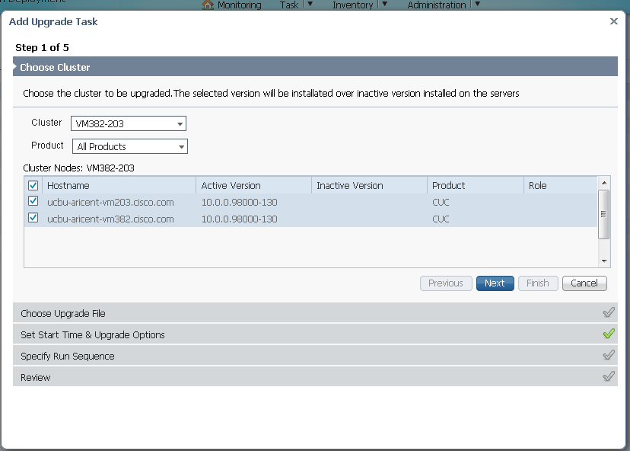
Create Upgrade Task – Choose Cluster
Notes:
Step 1 – choose the cluster to be upgraded. Click Next.

Slide 20
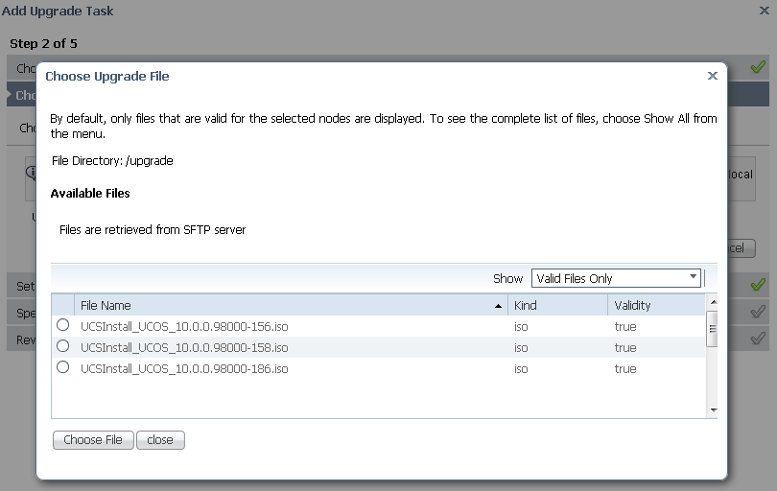
Create Upgrade Task – Choose upgrade file
Notes:
Step 2 – Choose upgrade file. Click on “Choose File”.
Note – if you choose an .iso file, the server will be upgraded.
You may also choose a .cop file to install locale or device pack files.
For upgrade , iso file should be present at location /common/adminsftp/upgrade in UCMAP.

Slide 21
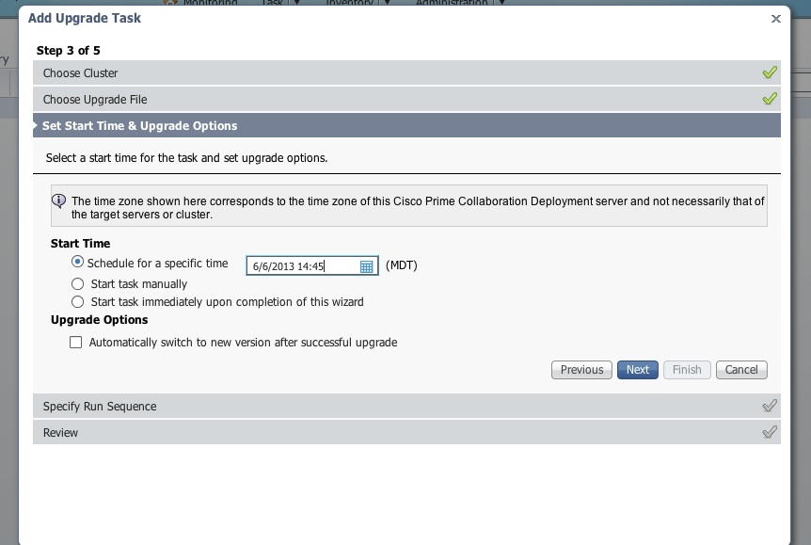
Create Upgrade Task – Choose Start Time
Notes:
Step 3 – Set a Start time – you can start the upgrade at a specific time (Note, this time is PCD time, not CUCM server time zone).
User can also choose to start task manually (schedule the task, but wait until user presses the “Start Task” button.)
Or, user can choose to start upgrade immediately.

Slide 22
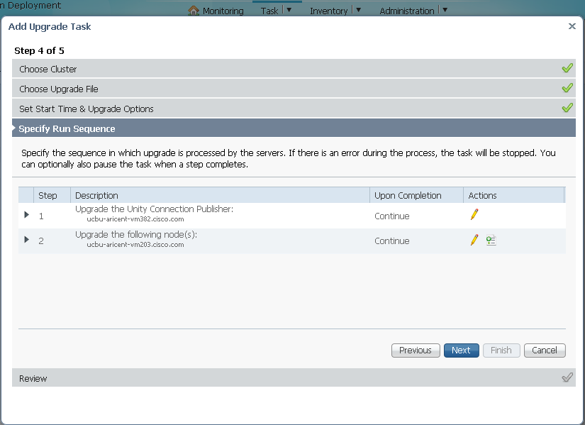
Create Upgrade Task – Run Sequence
Notes:
Step 4. Specify Run sequence. Since connection supports only one PUB and one SUB integration So, there are two steps (upgrade pub, upgrade sub).
You can choose to have PCD pause after any step, if desired.

Slide 23
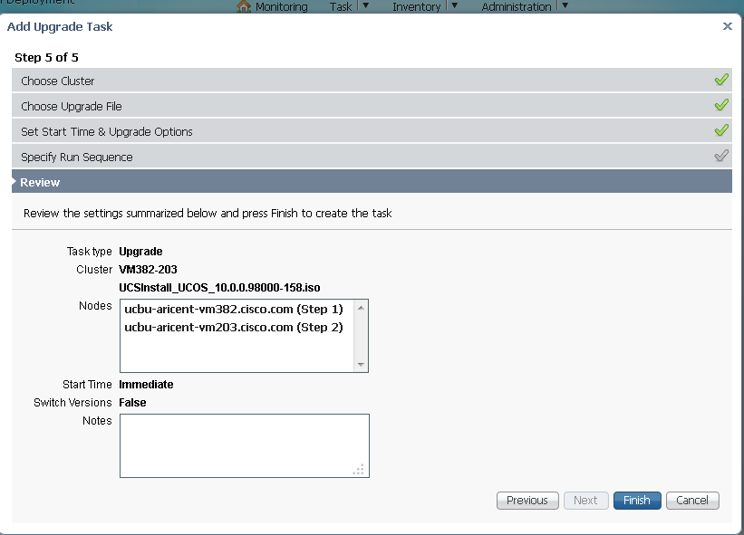
Create Upgrade Task - Review
Notes:
Review pane lets user review the options. Click “Finish” to schedule task as is, or click “Previous” to go back and change options.

Slide 24
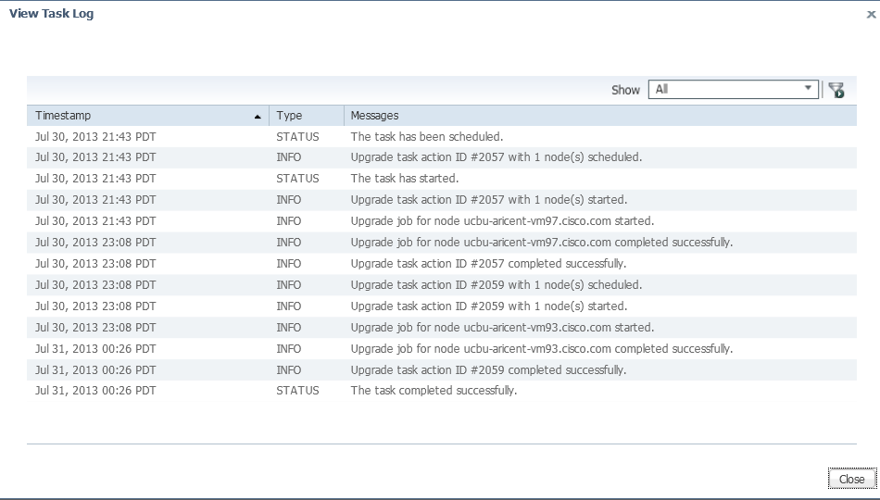
Upgrade Task - Status
Notes:
Click on upgrade task and for which you need to see status click on “view details” and then logs can be viewed by clicking on “view log”

Slide 25
Configuration Switch version
Notes:
Configuration for upgrade feature

Slide 26
Create Switch Version Task- Choose Cluster
Notes:
Discover Cluster – PCD connects to cluster you wish to switch version, and retrieves cluster information. If cluster is already in cluster list, no need to rediscover.
Choose Task-> Switch Versions. Click on “Add Switch Version Task” button to start the wizard.

Slide 27
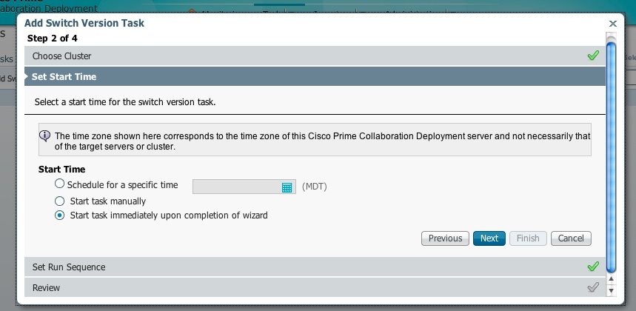
Create Switch Version Task -Choose Start Time
Notes:
Choose version to switch to, or just “inactive version”.
Choose time to start switch versions task.
If more than one node in the cluster, choose sequence options

Slide 28
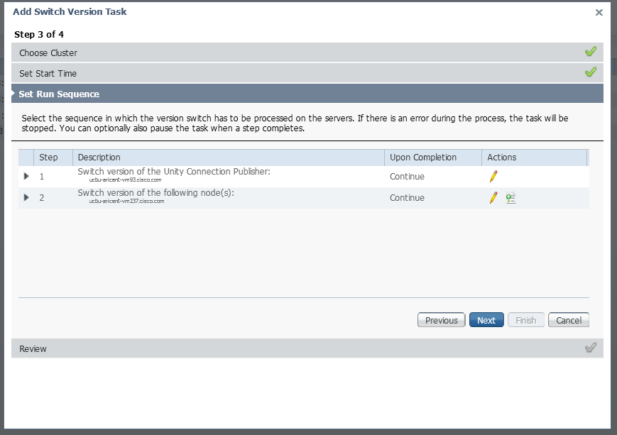
Create Switch Version Task – Run Sequence
Notes:
Step 4. Specify Run sequence. Since connection supports only one PUB and one SUB integration So, there are two steps (switch version pub, switch version sub).
You can choose to have PCD pause after any step, if desired.

Slide 29
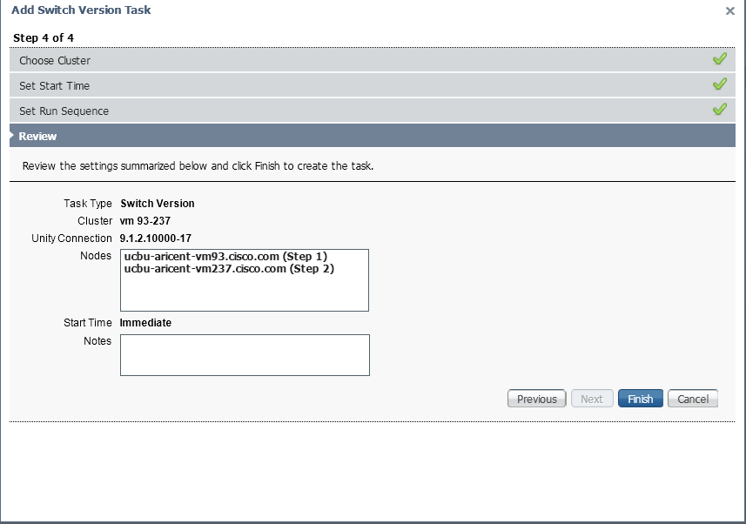
Create Switch Version Task- Review
Notes:
Review pane lets user review the options. Click “Finish” to schedule task as is, or click “Previous” to go back and change options.

Slide 30
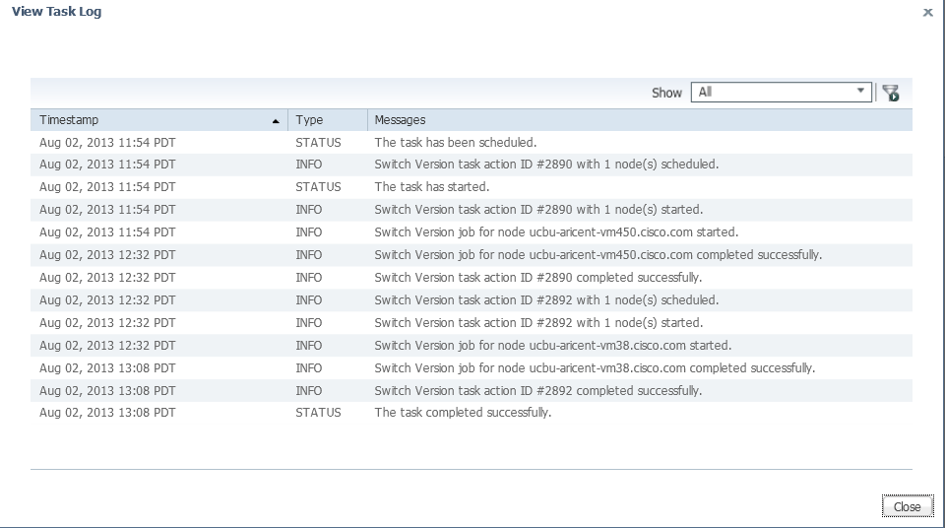
Switch Version Task - Status
Notes:
Click on switch version task and for which you need to see status click on “view details” and then logs can be viewed by clicking on “view log”

Slide 31
Configuration Restart
Notes:
Configuration for upgrade feature

Slide 32
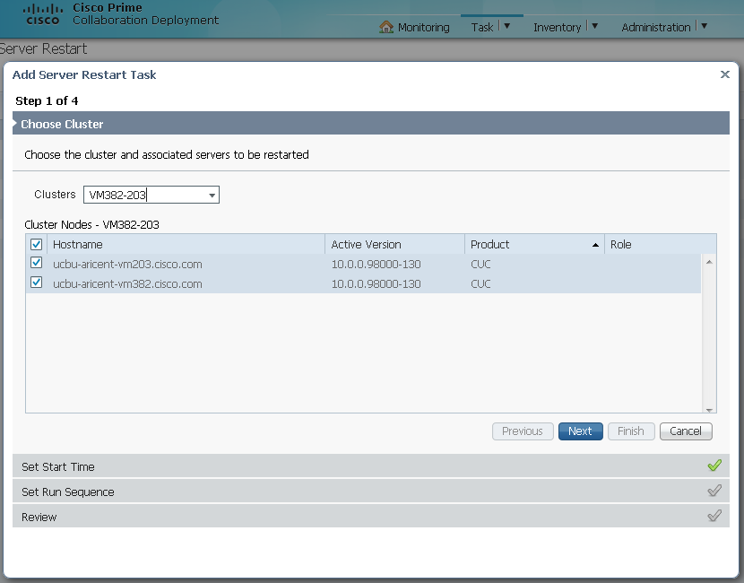
Create Server Restart Task
Notes:
Check that cluster you wish to restart is in Cluster inventory. If not, go to Cluster Inventory page, and Discover Cluster.
Create Server Restart Task – Choose Task -> Server Restart. Then Click on “Add Server Restart Task” to begin Restart Wizard.
Choose nodes to restart, and Start options (Set a start time, start immediately, or start task Manually).
If more than one node in the cluster, choose sequence options.
Review task options, and click Finish to schedule task.

Slide 33
Configuration Email Notification
Notes:
Configuration for upgrade feature

Slide 34
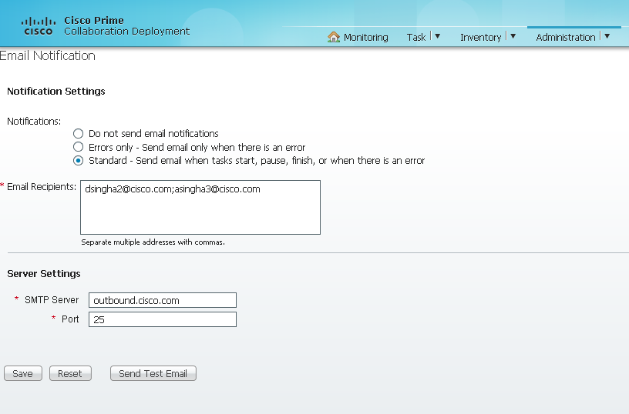
UI – Administration – Email Notification
Notes:
Administration
Email Notification – set up to get emails when errors occur, or when a task starts, changes state, or completes. (Lots of emails right now.)

Slide 35
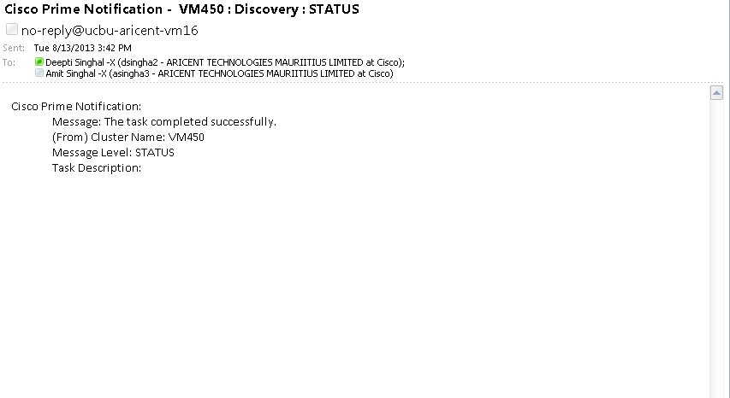
Email Notification – Status Message
Notes:
What an email alert looks like –
From noreply@<PCD server>
Tells the task status.

Slide 36
Troubleshooting
Notes:
Configuration for upgrade feature

Slide 37
Log Files (PCD)
Main application log
file get activelog tomcat/logs/ucmap/log4j/*
Contains
REST requests from the browser
SOAP requests to UC servers
Database requests
Scheduler events (e.g. – scheduled, started, failed, etc...)
Specific job events (e.g. – node XYZ started)
Exceptions & errors

Slide 38
Log Files (CUC Servers)
Main application log
file get activelog tomcat/logs/platform-api/log4j/*
Contains
SOAP requests from PCD
Platform API requests
Results from OS components

Slide 39
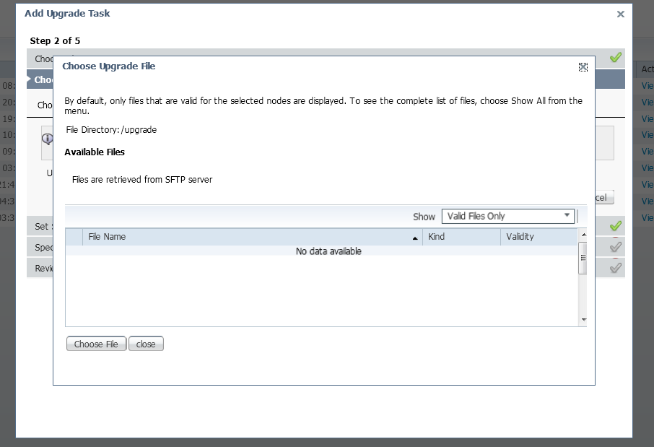
Common Issues
1. No ISO to Upgrade: If ISO is not copied to the valid location then admin would get the following screen
Notes:
If ISO is not copied to the correct location then admin won’t get any files in display screen. Correct location of iso for Upgrade over PCD is /common/adminsftp/upgrade

Slide 40
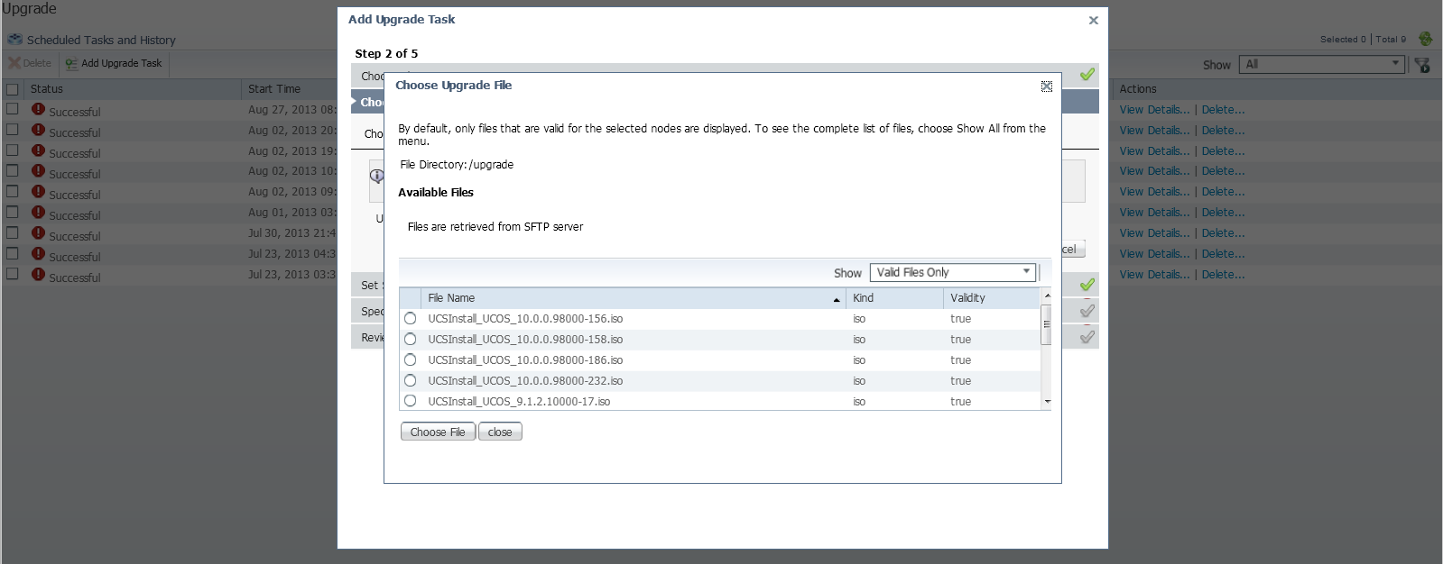
Common Issues (Contd.)
Expected Behavior
Notes:
After adding files to the location /common/adminsftp/upgrade

Slide 41
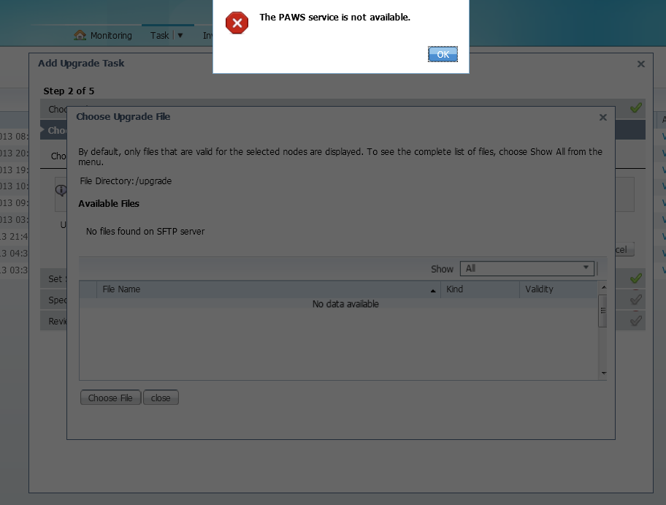
Common Issues (Contd.)
2. PAWS Service Not Available: If “Platform SOAP Services” is not activated then admin will get the following error while scheduling PCD tasks:
Notes:
By default “Platform SOAP Services” is not started prior to 9.1, if admin tries to schedule a task that it will not get scheduled. Admin needs to start “Platform SOAP Services” by accessing “Cisco unified Servicibilty” over both the nodes.

Slide 42
Required Services
PCD
Cisco Prime Collaboration Deployment Service
Cisco Tomcat
UC Servers for upgrade, reboot, switch version
Platform Administrative Web Service
Platform SOAP Services(prior to 9.1)
Cisco Tomcat
Use the CLI to activate/start services if needed
utils service activate
utils service start
Verify the services are running then pull the logs

Slide 43
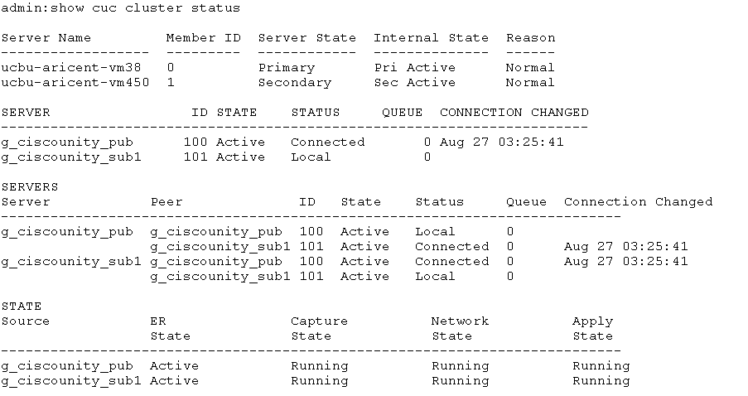
Required Services (Contd.)
Use the CLI to check system in healthy state before initiating PCD tasks
utils cuc cluster status

