Slide 1
64 bit RHEL 6 Update 2 OS Upgrade
RHEL TEAM
25-01-2013

Slide 2
Agenda
OS upgrade to 64 bit RHEL 6 Update 2
Architectural Changes
Filesystem
Requisites for installing Unity Connection 10.0
Upgrade Paths
Migration from Hardware Installation to VMware
Troubleshooting

Slide 3
OS Upgrade to 64 bit RHEL 6.2
OS is being upgraded to 64 bit RHEL6 update 2 for Unity Connection 10.0.
OS upgraded to 64 bit while the Unity Connection applications remain on 32 bit.
Unity Connection shares VOS platform with CUCM therefore Unity Connection 10.0 platform is also upgrading to 64 bit.
Following core libraries will also be upgraded to support 64 bit platform
JDK (Version) – 1.6 to 1.7
Tomcat (Version) – 7.0.20 to 7.0.25
Informix (Version) – 11.5 to 11.7
Jetty (Version) – 7.0.0.0 to 8.1.11
Note : JDK, Tomcat, Informix, Jetty will be running as 32 bit.

Slide 4
Architectural Changes
No core architectural changes were made to the Unity Connection software for the move to RHEL6 64 bit platform.
Many new architectural changes have been done for VOS architecture in RHEL6.
File system moved from ext3 to ext4 for Virtual VMWare images.
Notes:
Mounting is happening twice in RH 6
File type of product.img in RHEL 5 is Compressed ROM File System while in RHEL 6 is cpio + gz

Slide 5
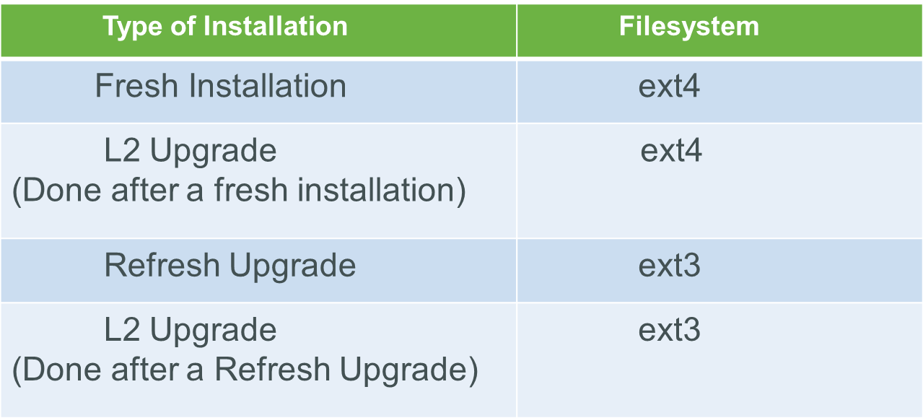
Filesystem for Virtual Machines

Slide 6
Requisites for Installing Unity Connection 10.0
Unity Connection 10.0 will work only on Virtual Machines.
If installing on Virtual Machine, need to use the 64 bit OVA.
Fresh Installation – 64 bit OVA has to be used to create the Virtual Machine, where the Guest OS will be 64 bit RHEL6.
Refresh Upgrade – When upgrading from 32 bit RHEL5 to 64 bit RHEL6 , Guest OS needs to be changed to 64 bit RHEL6 after the upgrade completes successfully.

Slide 7
64 bit OVA
If VMware is ESXi4.1
OVA template to be used : CUC_10_vmv7_v1.5.ova
If VMware is ESXi5.0 or Higher
OVA template to be used : CUC_10_vmv8_v1.5.ova
You can download the OVAs from CCO.

Slide 8
Virtual Machine settings for Refresh Upgrade (RU) to 10.0
Once the Refresh upgrade is done, below steps need to be done for changing the Guest OS on the Virtual Machine –
Using the vSphere client, shut down and power off your Virtual Machine.
Once powered off, select your Virtual Machine and click “Edit Settings”.
Click on the Options tab, and modify the “Guest Operating System” on the right side of the screen. It should be set to “Red Hat Enterprise Linux 6 (64-bit)”.
Click OK.
Power on your Virtual Machine.
NOTE : After the upgrade completes , we would prefer the Guest OS be set properly so that when the Virtual Machine tools are updated we get any updates that might be 64bit specific.

Slide 9
Upgrade paths
The possible upgrade paths are -
Upgrade Path | Type of upgrade
10.0 to 10.0 | L2 Upgrade
9.0 to 10.0 | Refresh Upgrade(cop file is not needed)
9.1 to 10.0 | Refresh Upgrade(cop file is not needed)
8.6 to 10.0 | Refresh Upgrade(cop file is not needed)
8.5 to 10.0 | Refresh Upgrade(cop file needed)
8.0.2+ to 10.0 | Refresh Upgrade(cop file needed)
7.1.5 to 10.0 | Refresh Upgrade(cop file needed)

Slide 10
Upgrade paths [CONTINUED]
Refresh Upgrade (RU) –
If the “from” version is 8.6 and above
No cop file needed.
If the “from” version is less than 8.6
COP file needs to be installed before initiating RU.
The COP file to be used –
(1) V1.1 Unsigned COP - ciscocm.refresh_upgrade_v1.1.cop
(2) V1.1 Signed COP - ciscocm.refresh_upgrade_v1.1.cop.sgn
Final cop files will be published on CCO.

Slide 11
Migration from Hardware installation to VMWARE
Unity Connection 10.0 will work only on Virtual Machines.
Migration procedure from Unity Connection Physical Server to Unity Connection Virtual Machine for 10.x remains same as that of Unity Connection 9.x.
http://www.cisco.com/en/US/docs/voice_ip_comm/connection/9x/upgrade/guide/9xcucrug025.html
Note:- Migration from Hardware installation to VMware is yet to be documented for 10.0, process from 9.0 documentation can be followed.

Slide 12
Troubleshooting
Install/Upgrade: /var/log/install
install.log for fresh install
Install_<date>.log for upgrades
System-history.log for system history
Cuc-install.log for CUC installation failures
System level: /var/log/active/syslog/messages
Kernel logs: run dmesg command
CLI logs: /var/log/active/platform/log/cli/cli*.log
CUC alarms: /var/log/active/syslog/CiscoSyslog
Servm logs: /var/log/active/platform/log/servm*.log
CUC services: /var/log/active/cuc/diag_<service>*.log
Platform API: /var/log/active/tomcat/logs/platform-api/log4j/platform-api*
Kernel panic : Collect vmcore under “/common/log/install/crash/”
** Troubleshooting remains the same as of earlier Cisco Unity Connection releases

