Slide 1

PROMPTING RECIPENTS WHILE REPLYING
AND
PROMPTING MESSAGE SENSITIVITY
TOI CONNECTION
Presentation_ID © 2012, Cisco Systems, Inc. All rights reserved. Cisco Confidential

Slide 2
PROMPTING RECIPENTS WHILE REPLYING FEATURE

Slide 3
Prompting Recipients list while replying
Existing Functionality in Connection
What’s New
Provisioning via CUCA
Truth table for Prompts while Reply and Reply to all with the “Prompting recipients list while replying “ feature introduced
Troubleshooting Tips

Slide 4
Existing Functionality
Currently there is a configurable field in CUCA, which specifies the maximum number of recipients before Reply-All-Warning.
In the current implementation, if the maximum number of recipients before Reply-All-Warning is set to N, then below are the prompts played for different scenarios.
Presentation_ID © 2012, Cisco Systems, Inc. All rights reserved. Cisco Confidential

Slide 5
TUI-Prompts for existing functionality
 | Prompts while Reply to all | Prompts while Reply (independent of threshold value)
Reply list <threshold value(N) | Record your reply to all at the tone, then press pound”. | Record your reply at the tone, then press pound
Reply list >=threshold value(N) | This reply to all contain many recipients. To continue recording press 1 To review the original recipient list press 2 To cancel press *”.When user presses respective key to reply , the prompt echoed is “ ”Record your reply to all at the tone, then press pound”. | Record your reply at the tone, then press pound

Slide 6
VUI-Prompts for existing functionality
 | Prompts while Reply to all | Prompts while Reply (independent of threshold value)
Reply list <threshold value(N) | Okay Reply to the Message Record your Reply to All at the Tone Then Press Pound. | Okay Reply to the Message Record your Reply at the tone then hold or press pound.
Reply list >=threshold value(N) | This Reply to all contain many recipients are u sure u want to reply to all. YES Okay Reply to the Message Record your Reply to All at the Tone Then Press Pound | Okay Reply to the Message Record your Reply at the tone then hold or press pound.

Slide 7
What’s New
Connection does not automatically plays recipient list, while replying to a message, though there is an option available at connection for playing original recipients list.
To prompt recipient list while Reply and Reply to all ,a checkbox/flag at administrative interface under System Settings -> Advanced -> Conversations is being introduced, which admin should be able to enable or disable(Disable by default ). The recipient list can be DL and Contacts also and in case of DL , distribution list name is prompted.
    Announce Recipients list to User(s) while Replying -> specifies whether recipient list shall be echoed or not, while replying to a message.
Presentation_ID © 2012, Cisco Systems, Inc. All rights reserved. Cisco Confidential

Slide 8
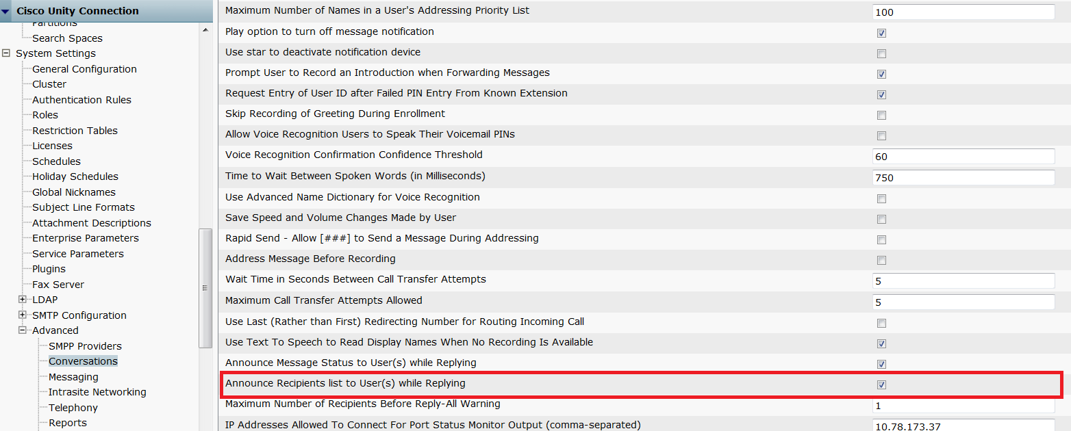
Provisioning via CUCA

Slide 9
Truth table for Recipient list Prompt -TUI
Announce Recipients list to User(s) while Replying is Enabled | Prompts while reply to all | Prompts while reply (independent of threshold value)
Reply list < Threshold number | Message to <recipient list>. Record your reply to all at the tone, then press pound”. | Message to <recipient >. Record your reply at the tone, then press pound”.
Reply list >= Threshold number | No Change(Default Prompt) | Message to <recipient >. Record your reply at the tone, then press pound”.

Slide 10
Truth table for Recipient list Prompt -VUI
Announce Recipients list to User(s) while Replying is Enabled | Prompts while reply to all | Prompts while reply (independent of threshold value)
Reply list < Threshold number | Message to <recipient list> Okay Reply to the Message Record your Reply to All at the Tone Then Press Pound | Message to <recipient >. Okay Reply to the Message Record your Reply at the tone then hold or press pound
Reply list >= Threshold number | No Change(Default Prompt) | Message to <recipient >. Okay Reply to the Message Record your Reply at the tone then hold or press pound

Slide 11
Cucsmgr logs
12:06:43.182 |14189,PhoneSystem-2-001,E01D31207DB748B4882EA7D33B12A960,ConvSub,3,Reply_OnEntry: ICsNamedProps::SetPropBool(AnnounceRecipientsList) to value: true returned 0x00043210 S_NP_PROP_REPLACED [Src/PlayMsg.cpp:1786]
12:06:30.647 |14189,PhoneSystem-2-001,E01D31207DB748B4882EA7D33B12A960,ConvSub,3,CheckReplyAllRecipientCount_OnEntry: ICsNamedProps::SetPropLong(WarnOnRecipientCountForReplyAll) to value: 4 returned 0x00000000 S_OK [Src/PlayMsg.cpp:3310]
0,ConvSub,3,CheckReplyAllRecipientCount_OnEntry: ICsNamedProps::SetPropLong(RecipientDistributionListSize) to value: 0 returned 0x00000000 S_OK [Src/PlayMsg.cpp:3407]
12:06:30.779 |14189,PhoneSystem-2-001,E01D31207DB748B4882EA7D33B12A960,ConvSub,3,CheckReplyAllRecipientCount_OnEntry: ICsNamedProps::SetPropLong(ReplyAllRecipientListSize) to value: 2 returned 0x00000000 S_OK [Src/PlayMsg.cpp:3409]
16:30:13.868 |2926,PhoneSystem-2-001,16D751E0028C40298B41802D574F9FDD,ConvSub,1,CheckReplyAllRecipientCount_OnEntry: Recipient list contains less than 4 addresses [Src/PlayMsg.cpp:3422]
Presentation_ID © 2012, Cisco Systems, Inc. All rights reserved. Cisco Confidential

Slide 12
Cucsmgr logs
16:30:13.868 |2926,PhoneSystem-2-001,16D751E0028C40298B41802D574F9FDD,ConvSub,5,CheckReplyAllRecipientCount_OnEntry: ICsEventQueue::PushFrontID(PLAYRECIPIENT_EVENT) returned 0x00000000 S_OK [Src/PlayMsg.cpp:3423]
:168]
16:30:13.869 |2926,PhoneSystem-2-001,16D751E0028C40298B41802D574F9FDD,CDE,10,CCsStateMachine::Execute : Calling OnEntry for state [/opt/cisco/connection/share/tui/SubMsgPlay.cde!PlayReplyAllRecipients] [Src/CsStateMachine.cpp:139]
12:06:32.310 |14189,PhoneSystem-2-001,E01D31207DB748B4882EA7D33B12A960,PhraseServer,1,CCsPhrase::Play() : [12:06:32 PM 07/08/2013] PhraseID - ListRecipients [Src/CsPhrase.cpp:318]
12:06:32.310 |14189,PhoneSystem-2-001,E01D31207DB748B4882EA7D33B12A960,PhraseServer,6,CCsPhrase::ConvertStrFileName() : Prompt Name - /opt/cisco/connection/share/prompts/ENU/PCM/SubMsgPlay/AvSubMsgPlayENU166.wav [Src/CsPhrase.cpp:1374]

Slide 13
Troubleshooting Tips
While using the feature ,enable the Flag.
Advanced->conversations
Announce recipient list to users while replying
For feature to work the number of recipient need to be less than threshold value.
For more details refer to diag_CuCsMgr_00* traces by enabling the ConvSub PhraseServer microtraces.
Presentation_ID © 2012, Cisco Systems, Inc. All rights reserved. Cisco Confidential

Slide 14
PROMPTING MESSAG SENSITIVITY WHILE REPLYING FEATURE

Slide 15
Prompting Message status while replying
Existing Functionality in Connection
What’s New
Provisioning via CUCA
Truth table for Prompts while Reply and Reply to all with the “Prompting Message status” feature introduced
Troubleshooting Tips

Slide 16
Existing Functionality
Currently Connection does not plays message status while replying to a message.
Presentation_ID © 2012, Cisco Systems, Inc. All rights reserved. Cisco Confidential

Slide 17
What’s New
To prompt message status while Reply and Reply to all a checkbox/flag at administrative interface under System Settings -> Advanced -> Conversations is being introduced, which admin should be able to enable or disable(Disable by default ).
    Announce Message Status to User(s) while Replying -> specifies whether message urgency and sensitivity status shall be echoed or not, while replying to a message.
Presentation_ID © 2012, Cisco Systems, Inc. All rights reserved. Cisco Confidential

Slide 18
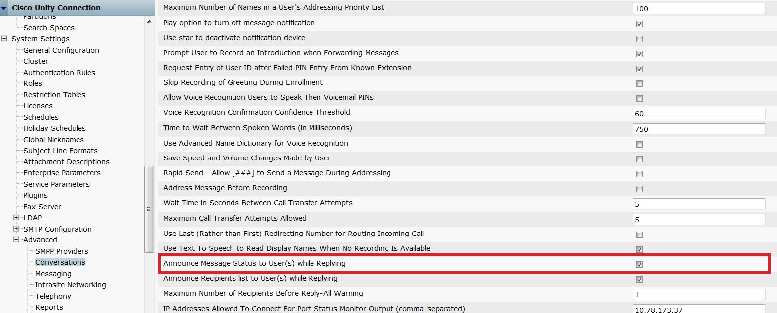
Provisioning via cuca

Slide 19
Truth table for Message Status Prompt-TUI
Announce Message Status to User(s) while Replying | Prompts while Reply To All | Prompts while Reply
Enabled | “ Marked <message urgency>. Marked <message sensitivity>”Record your reply to all at the tone, then press pound”. | Marked <message urgency>. Marked <message sensitivity>Record your reply at the tone, then press pound”.
Disabled | Record your reply to all at the tone, then press pound”. | Record your reply at the tone, then press pound”.

Slide 20
Truth table for Message Status Prompt-VUI
Announce Message Status to User(s) while Replying | Prompts while Reply To All | Prompts while Reply
Enabled | “ Marked <message urgency>. Marked <message sensitivity>” Okay Reply to the Message Record your Reply to All at the Tone Then Press Pound | Marked <message urgency>. Marked <message sensitivity> Okay Reply to the Message Record your Reply at the tone then hold or press pound.
Disabled | Okay Reply to the Message Record your Reply to All at the Tone Then Press Pound. | Okay Reply to the Message Record your Reply at the tone then hold or press pound.

Slide 21
Cucsmgr logs
12:06:43.182 |14189,PhoneSystem-2-001,E01D31207DB748B4882EA7D33B12A960,ConvSub,3,Reply_OnEntry: ICsNamedProps::SetPropBool(PlayMessageStatus) to value: true returned 0x00043210 S_NP_PROP_REPLACED [Src/PlayMsg.cpp:1787
14:39:14.530 |11377,PhoneSystem-2-001,AEF17BC29D784A9AB75F71AC86E044A1,CDE,11,JS_EXT::GetPropString: ICsNamedProps::GetPropString() found property MsgPriority = Urgent. GetPropString() returned 0x00000000 S_OK [Include/JsExtensions.h:217]
14:39:14.495 |11377,PhoneSystem-2-001,AEF17BC29D784A9AB75F71AC86E044A1,ConvSub,3,Reply_OnEntry: ICsNamedProps::SetPropBool(bOrigMsgSecure) to value: true returned 0x00043210 S_NP_PROP_REPLACED [Src/PlayMsg.cpp:1900]
14:39:14.531 |11377,PhoneSystem-2-001,AEF17BC29D784A9AB75F71AC86E044A1 ,PhraseServer,6,CCsPhrase:: ConvertStrFileName() : Prompt Name - /opt/cisco/connection/share/prompts/ENU/PCM/StreamlinedSendMsg/StreamlinedSendMsgENU023.wav [Src/CsPhrase.cpp:1374]
14:39:14.531 |11377,PhoneSystem-2-001,AEF17BC29D784A9AB75F71AC86E044A1, PhraseServer,6,CCsPhrase:: ConvertStrFileName() : Prompt Name - /opt/cisco/connection/share/prompts/ENU/PCM/StreamlinedSendMsg/ StreamlinedSendMsgENU046.wav [Src/CsPhrase.cpp:1374]
Presentation_ID © 2012, Cisco Systems, Inc. All rights reserved. Cisco Confidential

Slide 22
Troubleshooting Tips
While using the feature ,enable the Flag.
Advanced->conversations
Announce Message status to users while replying
For more details refer to diag_CuCsMgr_00* traces by enabling the ConvSub PhraseServer microtraces.
Presentation_ID © 2012, Cisco Systems, Inc. All rights reserved. Cisco Confidential

Slide 23
For more Information
EDCS link: http://wwwin-eng.cisco.com/Eng/VTG/ UCBU/ Unity_Connection/Oz/Program_Plans/ReplyToAll_and_Urgency_DesignDoc.docx
Doc no : EDCS-1274458
Documentation link : To be shared later ….CCO Posting
Presentation_ID © 2012, Cisco Systems, Inc. All rights reserved. Cisco Confidential

Slide 24
          Thank You
Presentation_ID © 2012, Cisco Systems, Inc. All rights reserved. Cisco Confidential

