Slide 1

HTTP(S) NETWORKING TOI
10.0(1)
TOI for HTTP(S) Networking
EDCS Number - 1225140
March 13 2013

Slide 2
Notice
The information in this presentation is provided under Non-Disclosure agreement and should be treated as Cisco Confidential. Under no circumstances is this information to be shared further without the express consent of Cisco.
Any roadmap item is subject to change at the sole discretion of Cisco, and Cisco will have no liability for delay in the delivery or failure to deliver any of the products or features set forth in this document.
Notes:
2
2

Slide 3
Agenda
HTTP(S) Networking
Introduction to HTTP(S) Networking
Understanding Legacy networking solution: Digital Networking
Disadvantages of Legacy Digital Networking
Legacy Intersite Networking Current Architecture
Voice Profile for Internet Mail (VPIM)
Hub – Spoke Topology in HTTP(S) Networking : 3 Nodes
Voice Message and Directory Synchronization
Features of HTTP(S) Networking
Comparison : HTTP(S) Networking and Digital Networking
OVA/Hardware support for HTTP(S) Networking
Network Design Guidelines
Network Design Parameters
Network Design Guidelines
Network Topology Examples
Topology example 1: Hubs connected to parent HUB
Topology example 2: 25 nodes
Topology example 2 extended: 25 nodes with VPIM
Supported directory size in HTTP(S) Networking

Slide 4
Agenda
Building blocks in HTTP(S) Networking
FeedReader – Feeder introduction
Feeder
FeedReader
Internal Database overview
    Mediator – Neighbor relationships
    Tbl_NetworkTopology on Node B
    Adding Nodes in HTTP(S) Networking
    Pre-Requisites and recommendations for Adding nodes in HTTP(S) Networking
    Setup for Adding
    Adding nodes in HTTP(S) Networking on CUCA
    Requirements for configuration
Synchronization in HTTP(S) Networking
Setup for Synchronization between nodes
HTTP(S) Links on CUCA
Locations on CUCA
Objects replicated and associated FeedReader task
Difference in attributes for replication
    Synchronization, Re-Synchronization & Clear Recorded names

Slide 5
Agenda
    Synchronization :
    - Automatic
    - Manual
    - Summary
    Review FeedReader task results for all local networks
    Requirements for configuration
    Sending voicemail in HTTP(S) Networking
    Introduction to messaging in HTTP(S) Networking
    Example - Sending a message from inbox
    Requirements for configuration
    Removing in HTTP(S) Networking
    Introduction
    Removing : Design summary
    Removing
    Requirements for configuration
    Serviceability in HTTP(S) Networking
    Voice Network Map
    Network Analyzer

Slide 6
Agenda
High Availability in HTTP(S) Networking
HA (High Availability) Methodology
Alert Mode
Alert and Standard mode example
CUCA page for HA
CUCA home page warning in HA
Rest API's in HTTP(S) Networking
Introduction
Vmrest/httpslinks
Vmrest/vmsservers
Debug logs in HTTP(S) Networking
Logging in HTTP(S) Networking
    Limitations of HTTP(S) Networking
    Migration
    Introduction
    Single Site Digital Networking to HTTP(S) Networking
    Example: 5 node Digital Networking to HTTP(S) Networking
    Migrating CCI Network to HTTP(S) Networking
    Example : Migrating CCI Network to HTTP(S) Networking using Manual Flash Cut approach
    Migrating UCI Network to HTTP(S) Network

Slide 7
Agenda
    Future Plans
Extended Topology
HA Surrogate Mode
Migration
IPv6 Support
References

Slide 8
HTTP(S) Networking

Slide 9
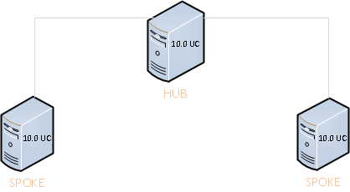
Introduction to HTTP(S) Networking
The goal of HTTP(S) Networking feature is to increase the scale of Unity Connection deployments so that more users can communicate effectively with each other. HTTP(S) networking uses the Hub-Spoke topology which enables data replication using a tree structure.
New Networking Architecture focuses on Enterprise Scale
HTTP(S) Networking

Slide 10
Introduction to HTTP(S) Networking
Similar to previous versions of Digital Networking, HTTP(S) Networking allows for multiple Unity Connection nodes to share a common user directory.
Nodes exchange information using a custom XML feed sent via the HTTP(S) protocol and the data is inserted into the database, using a process similar to Digital Networking/VPIM Directory.
Objects are replicated, allowing to view both local and remote objects returned in search results on any node of the network.
We can view high level details for these objects on any node of the network, but changes can only be made on whatever node they are local to.
As a result of the common directory, users can exchange messages (reply, forward, etc.) without needing to know what server the user is homed on.

Slide 11
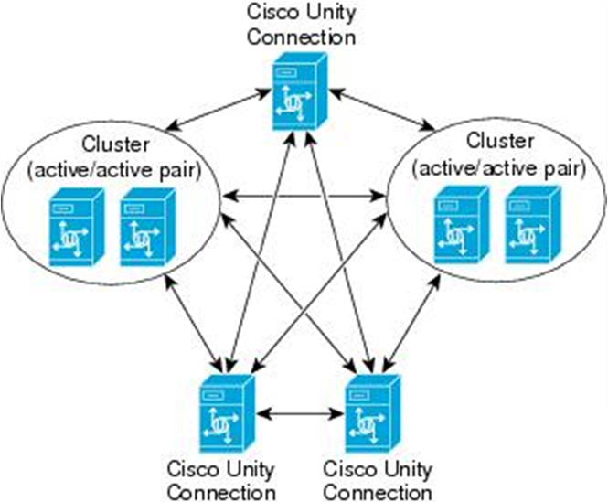
Understanding Legacy networking solution :
Digital Networking
Digital Networking is the legacy solution for connecting multiple Unity Connection nodes and enable sharing of common user directory.
Digital Networking allows several Unity Connection servers to communicate with each other.
HTTP(S) networking does what Legacy Digital Networking does but using different architecture and different protocols
Notes:
By “Legacy” we are addressing the old networking solution. In future slides we will call digital networking as Legacy digital networking. Also “Legacy Networking” is a reference to both Digital networking and Intersite networking.
NOTE : To avoid confusion, VPIM will not be addressed as a part of “Legacy Networking” as VPIM will be used in HTTP(S) Networking as well.

Slide 12
Disadvantages of Legacy Digital Networking
Due to the usage of SMTP protocol for replicating data, a lot of error handling code was written in Digital networking and thus the replication times increased.
Push Based Model – The push based model for replication can load the receiving location during startup if suddenly multiple locations push their replication information.
Fixed Topology – Only the full mesh topology is supported for connecting different locations in a site. Full mesh topology has advantages that it requires only a single hop for transferring information between any two nodes and it is more resilient when one of the nodes goes down. But the number of links per node increase as the size of site increases. This can lead to higher egress traffic.
Scalability – The suggested scalability is10 locations providing 100,000 directory object support. Increasing the number of nodes leads to problems in synchronization of nodes.
Lack of High Availability – The CuReplicator process runs only on publisher in an Active-Active cluster. This results in the Intra-site replication not being highly-available, when the primary is down.

Slide 13
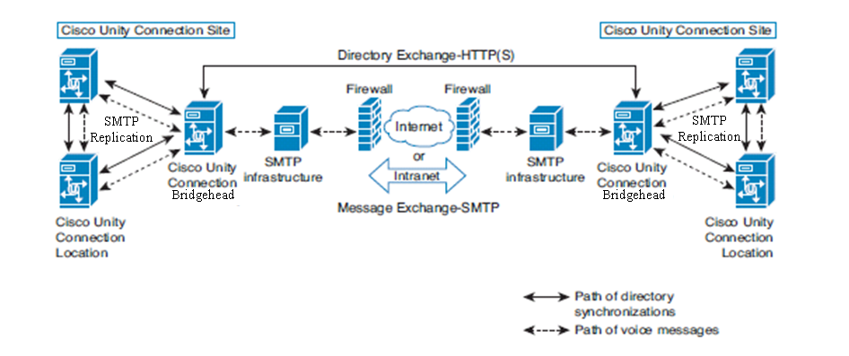
Legacy Intersite Networking Current Architecture
Unity Connection 8.0 enabled Connection of 2 Digital networks
Uses HTTP(S) transport for directory replication between digital networks (Versus nodes)
  - Connects only 2 digital networks
Only scales to 20 nodes, 100K users
High Availability Not Available
  - Replication only runs on Publisher
Minimal replication set
  - Distribution list membership details and Contacts are not replicated over Intersite.

Slide 14
Voice Profile for Internet Mail (VPIM)
Cisco Unity Connection supports the Voice Profile for Internet Mail (VPIM) protocol, which is an industry standard that allows different voice messaging systems to exchange voice and text messages over the Internet or any TCP/IP network. VPIM is based on the Simple Mail Transfer Protocol (SMTP) and the Multi-Purpose Internet Mail Extension (MIME) protocol.
VPIM is supported with HTTP(S) Networking.
One node in HTTP(S) Networking can act as a VPIM Bridgehead and only with this dedicated node we can connect VPIM locations.
All other locations in the HTTP(S) Network receive Contacts of the VPIM locations via the VPIM bridgehead.
The messaging is done via the VPIM bridgehead. So if any user in the HTTP(S) Network wants to send a voicemail to a contact on VPIM location, it is done via VPIM bridgehead. (Voicemail details in the following slides)

Slide 15
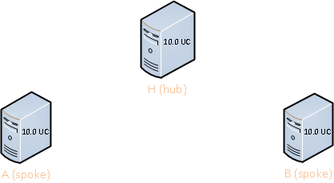
Hub – Spoke Topology in HTTP(S) Networking : 3 Nodes
A’
H’ + B’
  Hub
    Hub is the point of contact for any spoke who wants to gather directory information of the network beyond the Hub. One Hub can have many spokes. In this example H is the HUB.
  Spoke
    Spoke is a leaf node which receives and sends directory information via its Hub. A spoke can have only one Hub. In this example A and B are spokes. Every spoke sends its information to a HUB labeled H and receives data of the rest of the network from the same HUB.
    The spoke nodes A and B are connected to Hub node H. If A needs to fetch any directory information, it will query H for that. H will replicate not only its own information but also for other spoke node B as well. The same would be the case for all other spoke nodes. The hub node H would communicate with all the spoke nodes but the spoke nodes communicate only with the hub node.

Slide 16
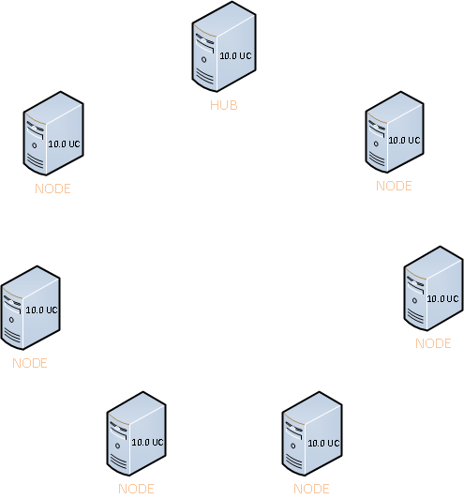
Voice Message and Directory Synchronization
Every node in the network has sufficient information for SMTP message routing and thus a full-mesh topology is used. All nodes can send SMTP messaging traffic to any destination directly.
The example figure on right depicts the voice message and directory replication paths.
  Directory synchronization path
  Voice message path

Slide 17
Features of HTTP(S) Networking
There will be only one site in HTTP(S) Networking
A maximum of 25 nodes can be connected in the same site
Directory replication of 100K users spread over different nodes is supported
100 VPIM locations ,150K contacts spread over different nodes.
150k total distribution lists with total membership per list not exceeding 25K and global membership not exceeding 1.5 million across all system distribution lists
There is a separation of directory replication from messaging, using HTTP(S) and SMTP, respectively.
High availability of nodes when clusters are used in the network
Message routing in HTTP(S) Networking is the same as in Digital Networking
Provides for better conflict resolution and faster replication rate
For a network of n nodes, only (n-1) routes are necessary to connect all nodes
  E.g. network with 10 nodes, the hub-spoke topology requires only 9 routes to connect all nodes, while a full-mesh topology would require 45 routes
  Flooding the network will be much less problematic in HTTP(S) networking because of the Hub-spoke topology
Notes:
NOTE that nested lists within distribution lists cannot exceed 20.

Slide 18
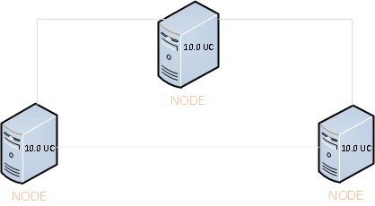
Comparison : HTTP(S) Networking and
Digital Networking
Hub – Spoke Topology
Full Mesh Topology
HTTP(S) Networking
Directory Replication – HTTP(S) Protocol
Scalable – 25 Nodes.
Hub – Spoke Topology
Directory size of 100K users & 150K contacts
Digital Networking
Directory Replication - SMTP Protocol
Scalability – 10 Nodes
Full mesh topology.
Directory size of 100K users + contacts
Similarities
        Both use SMTP protocol for voice messages
        Both use point to point messaging for voicemails

Slide 19
Comparison : HTTP(S) Networking and
Digital Networking services
HTTP(S) Networking
2 entities are used for communication and replication of data - Feeder and FeedReader.
Feeder is a java servlet.
FeedReader is a Sysagent task which is scheduled to run in 15 mins time frame.
Uses HTTP(S) protocol
Pull based network.
Digital Networking
Single service is used for communication and replication of data – CuReplicator.
CuReplicator is an independent java service, which pushes data to its peer nodes after every 15 sec.
Uses SMTP protocol
Push based network
Note:
In-depth explanation of Feeder and FeedReader are explained in later section of the presentation.

Slide 20
OVA/Hardware support for HTTP(S) Networking
HTTP(S) networking OVA configuration. (TBD)

Slide 21
Network Design Guidelines

Slide 22
Network Design Parameters
Before you start setting up a network, you need to create an HTTP(S) network map based on the following considerations:
Number of locations
Number of HTTP(S) links per location
Depth of the HTTP(S) network
Configuration of the locations
Number of homed subscribers on each server

Slide 23
Network Design Guidelines
In an HTTP(S) network, the Unity Connection locations are joined together as per hub and spoke topology. Below are the design guidelines for setting up an HTTP(S) Network:
No. of direct HTTP(S) links to any location must be less than or equal to 5.
Depth of the HTTP(S) Network must be less than or equal to 2.
While deciding the number of hubs and spokes, try to associate equal number of HTTP(S) links with every location (except spokes) in the network.
Location that has the highest OVA should act as primary or first level hub.
If two or more locations have same OVAs then the location that has the least number of homed subscribers should act as primary or first level hub.
Similarly, from the rest of the locations, the locations that have the highest OVA and least number of homed subscribers (if the OVA size of two or more locations is same) should act as intermediate or second level hub(s).
The remaining locations should act as spokes connected to the intermediate hubs.

Slide 24
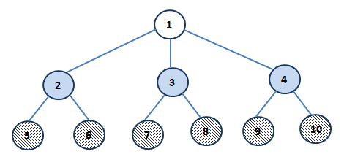
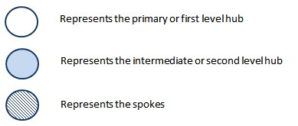
Network Design Guidelines Contd …
For a 10 node network with the OVA and no. of homed subscriber defined as per the table on right side, below network topology would be recommended in accordance with the design guidelines defined:
Location Name | OVA Size | No. of Subscriber
Location 1 | 7 VCPU | 10 K
Location 2 | 7 VCPU | 15 K
Location 3 | 4 VCPU | 8 K
Location 4 | 4 VCPU | 10 K
Location 5 | 4 VCPU | 10 K
Location 6 | 2 VCPU | 4 K
Location 7 | 2 VCPU | 5 K
Location 8 | 2 VCPU | 5 K
Location 9 | 2 VCPU | 5 K
Location 10 | 2 VCPU | 5 K

Slide 25
Network Topology Examples

Slide 26
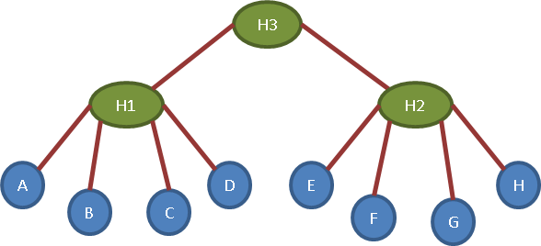
Topology example 1: Hubs connected to parent HUB
Every node exchanges directory information with its directly connected nodes.
The data routing functionality would be same at all hubs, i.e., transfer own and children information (excluding requesting node/hub and its children).
Spoke nodes A, B, C & D are connected to hub H1 and get directory information through H1.
Spoke nodes E, F, G & H are connected to hub H2 and get directory information through H2.
The hubs H1 and H2 are in turn connected to their parent hub H3.
The hub H1 would fetch its child nodes (A,B,C,D) information by directly communicating with them. Similarly H2 would fetch its child nodes (E,F,G,H) information.
When H3 pulls data from H1, the hub H1 gives directory information for itself and its child nodes(A,B,C,D). Similarly H2 gives directory information for itself and its child nodes(E,F,G,H)
When H1 pulls data from H3 it gets directory information of H3 along with H2 and its child nodes = H3 + H2 + Child Nodes (E,F,G,H)
When H2 pulls data from H3 it gets directory information of H3 along with H1 and its child nodes = H3 + H1 + Child Nodes (A,B,C,D)

Slide 27
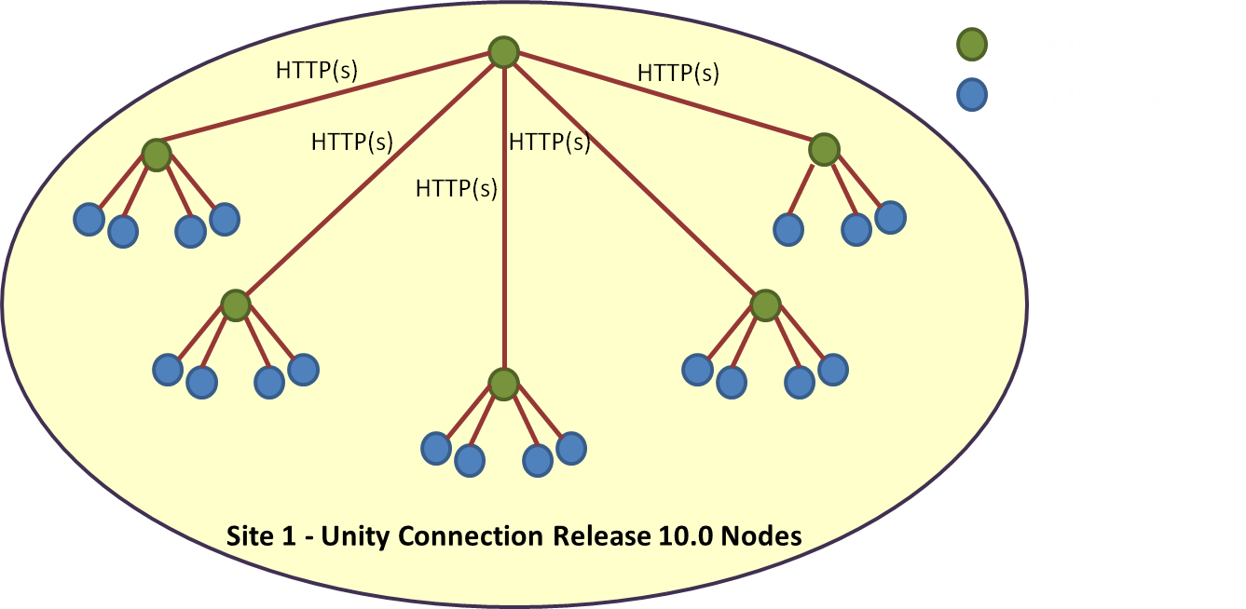
Topology example 2: 25 nodes
The topology for a 25 nodes network would look like the figure below. Spoke nodes connect to their hub nodes which in turn connect to their parent hub. In the depicted topology, there would be 19 spoke nodes, 5 inner level hubs and one top level hub.
Notes:
Every node in the network is connected over HTTP(S) Networking.

Slide 28
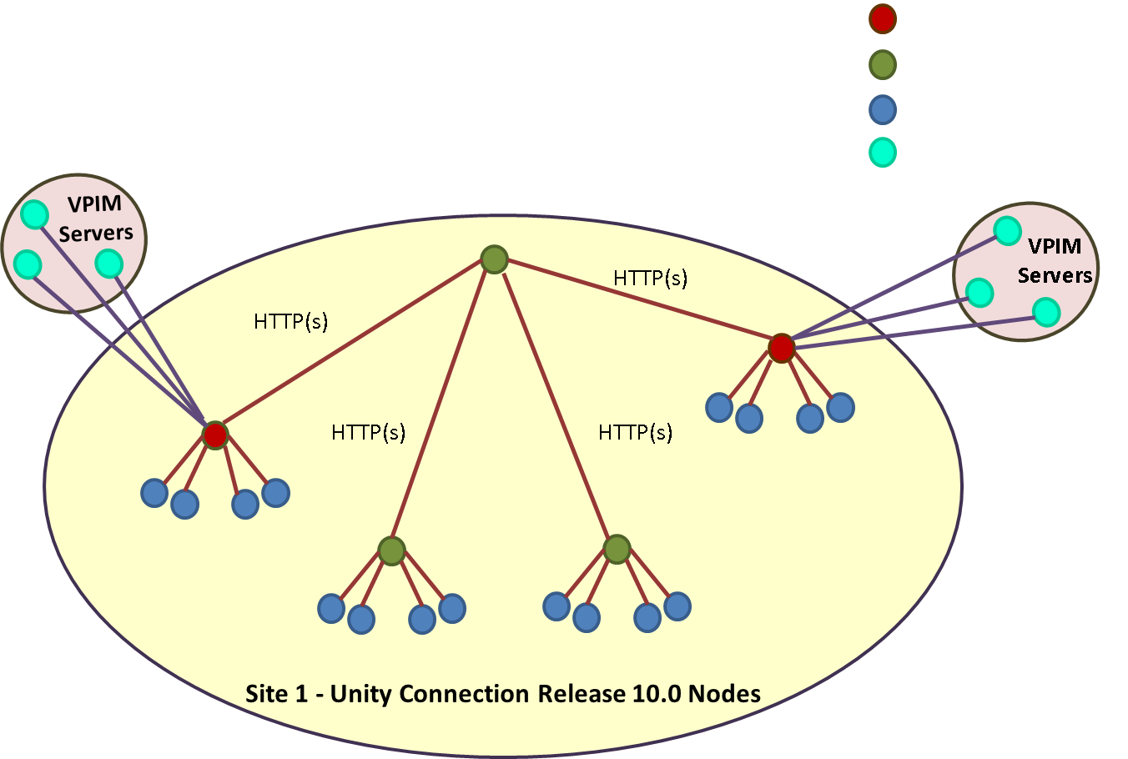
Topology example 2 extended: 25 nodes with VPIM
The topology of 25 nodes network has been extended and 3 VPIM servers have been added to a VPIM bridgehead.
Notes:
Note that VPIM servers can be connected in the network as well. The node with which a VPIM server is connected is the VPIM bridgehead for the network.

Slide 29
Topology example 2 extended: 25 nodes with VPIM
Any node in the network can be designated as VPIM Bridgehead. Also there can be more than one node acting as VPIM Bridgehead in the network.
VPIM Server and Contacts data are replicated through VPIM bridgehead to rest of the network.
Every node in the network communicates with VPIM Servers via the VPIM bridgehead only.

Slide 30
Supported directory size in HTTP(S) Networking
25 nodes supported in 10.0(1) release, more in future release
100K users supported in 10.0(1) release, more in future release
100 VPIM locations supported in 10.0(1) release.
150K VPIM contacts supported in 10.0(1) release.
2 level tree and 5 nodes per hub maximum recommendations for the networking topology.
Digital networking can still be used on 10.0(1) but we cannot use Digital networking and HTTP(S) networking simultaneously. Same holds true for Intersite networking.
Notes:
NOTE that VPIM networking can be used simultaneously with HTTP(S) Networking.

Slide 31
Building blocks in
HTTP(S) Networking

Slide 32
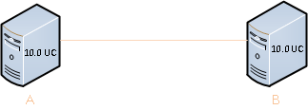
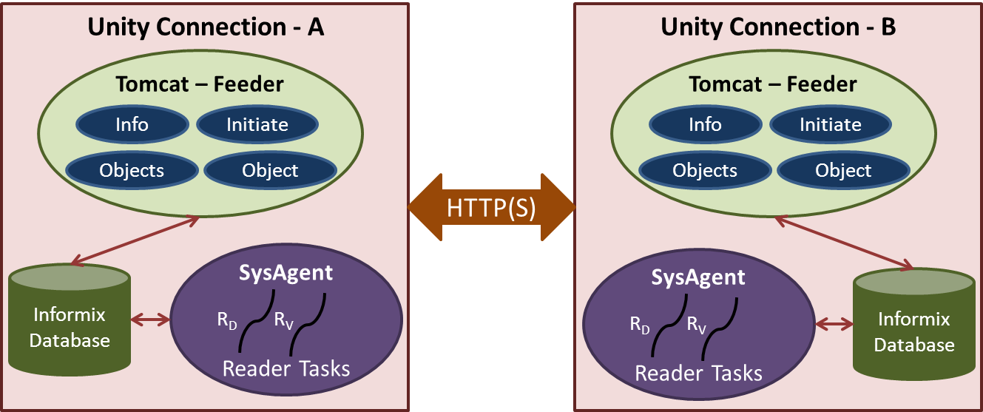
FeedReader – Feeder Introduction
Notes:
Every Unity Connection box has a FeedReader and a feeder. The FeedReader has 2 subtasks as Directory synchronizer and Voicename synchronizer.
NOTE that FeedReader may also be referred as Reader for simplicity

Slide 33
Feeder
At a high level, the Unity Connection Feeder is a collection of Java servlets that are deployed as a web archive within a servlet container. The servlet container that is used on the VOS platform is Apache Tomcat/7.X Servlets will be deployed on both primary and secondary node.
Following four servlets make up the entirety of the Feeder :
InfoServlet, accepts GET HTTP(S) requests [/feeder/info] - Responds with an XML document that contains information of the locations and object counts.
InitiateServlet, accepts POST HTTP(S) requests[/feeder/initiate] - Provides a mechanism for a location to auto-link with any other location through administrative page
ObjectsServlet, accepts GET HTTP(S) requests [/feeder/objects] - Provide a detailed feed of the object changes to the FeedReader as per request.
ObjectServlet, accepts GET HTTP(S) requests [/feeder/object] - Provide a feed of the specific attribute value for a specific object to the FeedReader as per request.
Notes:
Every Unity Connection box has a FeedReader and a feeder. The FeedReader fetches (requests) data and Feeder feeds(responds) data.

Slide 34
FeedReader
The Unity Connection FeedReader is a SysAgent task that requests object changes from a remote node Feeder.
It also processes the feed received from the corresponding Feeder component and updates the database with directory data.
Number of FeedReader instances running on a node of the network is equal to the number of nodes directly connected with that node. But on a particular node there is always one Feeder instance which responds to all the FeedReader requests.
FeedReader is further broken up into 2 tasks:
  Directory Synchronizer – This task fetches the location and data objects (user, contacts, DL etc ) from the remote node.
  Voicename Synchronizer – This task fetches the Voicenames of the data objects if configured.

Slide 35
Internal database overview
Tbl_LocalNetwork
This table is used to track information necessary for synchronizing directory information within directly connected locations. Any node in the network has entries for all the directly connected nodes with that node.
Important Columns:
ObjectId: The object id of a local network entry.
Deleted: Local Network is marked for deletion or not.
Basefeedurl: URL used by FeedReader to fetch the Directory data.
Displayname: Display name of the local network.
Lastusn: Last USN Synced.
Status: Indicates the status of directory synchronization (Idle or Syncing)

Slide 36
Internal database overview
Tbl_NetworkTopology
This table has information to define the topology of the network. Any node in the network has entries for self as well as all the other nodes in the network.
ObjectId: The object id of a location in the network.
Deleted: Location is marked for deletion or not.
MediatorLocationObjectId: Location object id of the mediator location
NeighbourLocationObjectId Location object id of the neighbor location.

Slide 37
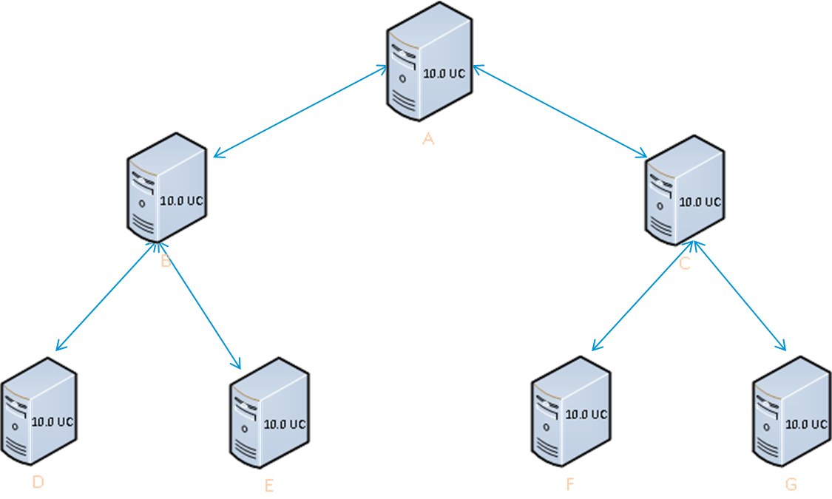
Mediator – neighbor relationship
Each node in the network has its own set of mediator - neighbor relationships with every other nodes in the network.
Note that both mediator and neighbor relationships should be seen from the point of view of a particular node.
Mediator – “Via whom do I know a location?”
    Example – On node B I know node G via node A
Thus on node B, mediator of node G is node A.
Neighbor – “Via whom does a location know me?”
    Example – Node G knows node B via node C
    Thus on node B, neighbor of node G is node C.
Notes:
The synchronization happens via the mediator in HTTP(S) Networking. A directly connected node fetches data of the farther and indirectly connected nodes via the mediator for that sub-network

Slide 38
Tbl_NetworkTopology on Node B
Table on the right side is tbl_NetworkTopology on node B.
B is known to itself via B only. Also all the directly connected nodes (A, D, E) with B are also known to B via B only. Thus the mediator for them will be B.
C is known to B via A, thus the mediator for C will be A. Again C knows B via A, thus the neighbor for C will again be A.
F and G are known to B via A, thus
the mediator for F and G will be A.
Nodes F and G knows B via C,
thus the neighbor for F and G
will be C.
Location | Mediator | Neighbor
B | B | B
A | B | B
D | B | B
E | B | B
C | A | A
F | A | C
G | A | C

Slide 39
Adding nodes in
HTTP(S) Networking

Slide 40
Pre-Requisites and recommendations for Adding nodes in HTTP(S)
  All Unity Connection versions must be on 10.0(1).
  "There should be no existing legacy network" – Nodes connected over VPIM are acceptable but not Digital networking or Intersite Networking.
  Our recommendation is to draw a hub-spoke topology for your network, and finalize the plan for all nodes before beginning the process of adding your nodes in an HTTPS network.
  Recommended to let the automatic synchronization run after configured interval ( default after every 15 min) and synchronize the objects across the network.
  Note that in the event that you want to remove one or more nodes from the HTTP(S) network, you need to perform a remove operation. Remove is an unrecoverable option and should be exercised in off-peak hours
  DNS is mandatory for configuring network in HTTPs over ssl.
Notes:
Un-joining in a busy network is not recommended as a lot of calls might then produce NDR’s due to inaccessibility of users from the un-joined node. It is better to un-join in off-peak hours.

Slide 41
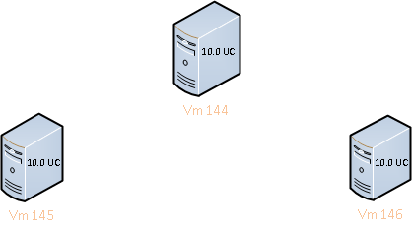
Setup for Adding
Using 3 independent nodes named Vm144, Vm145, Vm146.

Slide 42
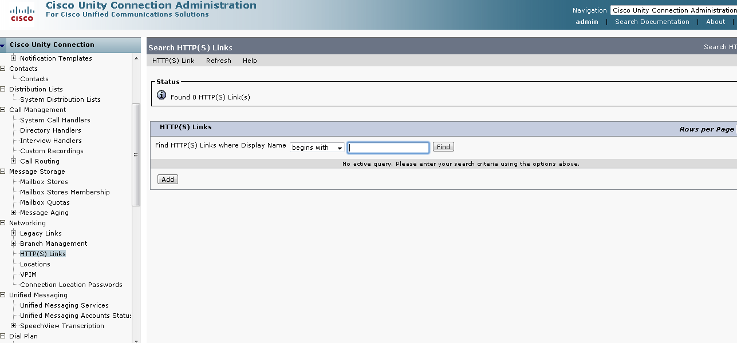
Adding nodes in HTTP(S) Networking on CUCA
Login to CUCA of Vm144.
Navigate to Networking ➔ HTTP(S) Links and click on "Add"

Slide 43
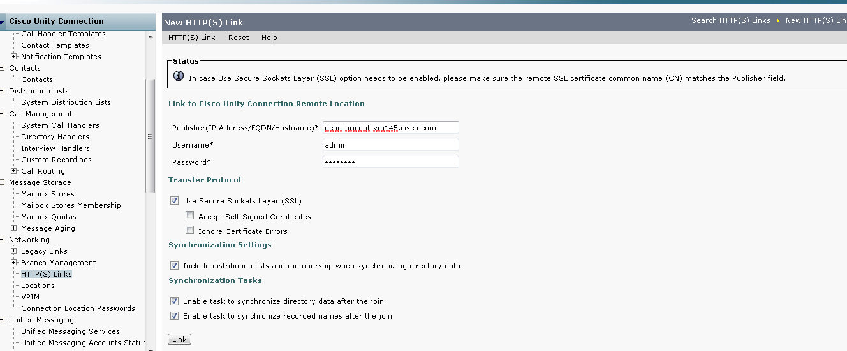
Adding nodes in HTTP(S) Networking on CUCA
Fill the required information and click “Link”.
If the administrator does not check the “Include distribution lists…” option initially, it can be enabled at any time after add is completed. However once the option is enabled, it can no longer be disabled.
Notes:
NOTE that “Manual Link” is not supported anymore unlike legacy networking.

Slide 44
Requirements for configuration
In order to link nodes over SSL , the full FQDN must be provided.
To disable “Accept Self Signed Certificates” during linking, ensure that all nodes have installed 3rd party certificates. (http://www.cisco.com/en/US/docs/voice_ip_comm/Connection/8x/networking/guide/8xcucnet010.html)

Slide 45
Synchronization in HTTP(S) Networking

Slide 46
Setup for Synchronization between nodes
Using 3 nodes named Vm144, Vm145, Vm146 which are now added using HTTP(S) Networking
HTTP(S) Link
HTTP(S) Link

Slide 47
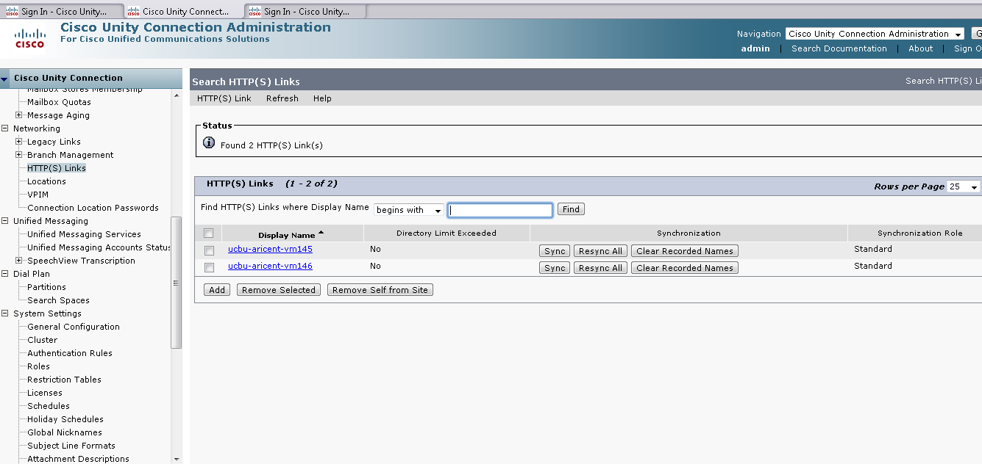
HTTP(S) Links on Vm144 CUCA
On the HUB node ( Vm144), 2 HTTP(S) links are found.

Slide 48
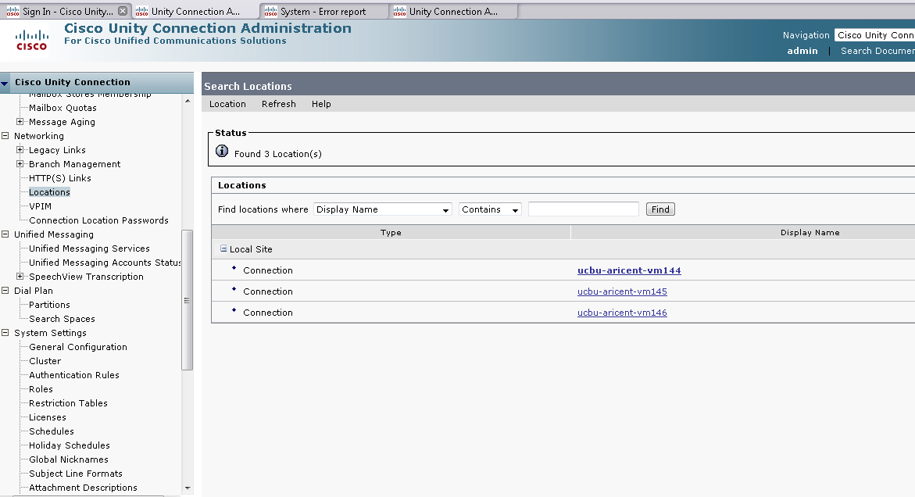
Locations on CUCA of Vm144
On any node of the network ( e.g. Vm144), 3 Locations are found.

Slide 49
Objects replicated with associated FeedReader task
Synchronize Directory with Local Network:
Users
Contacts
Distribution Lists and Member Info
Partitions
Search Spaces and Member Info
VMS Locations
VPIM Locations
Synchronize Voicename with Local Network :
Voicenames for the objects
Notes:
The Voicenames can be stored for Users, Contacts, Distribution lists and VPIM Location.

Slide 50
Difference in attributes of replication
Replicated objects are the same but the attributes for some of the above mentioned objects might differ from what they were in Legacy Digital Networking
For example – In Legacy Digital Networking, more number of attributes were replicated for Contacts as compared to HTTP(S) Networking. In the next 3 slides we will see the difference in attributes for a fully populated contact replicated in Legacy Digital networking and HTTP(S) Networking
The contact is homed on Vm144 where all the attributes were populated. But we will see that HTTP(S) networking replicates fewer attributes and thus other nodes will have the contact with fewer fields populated on administrator page.

Slide 51
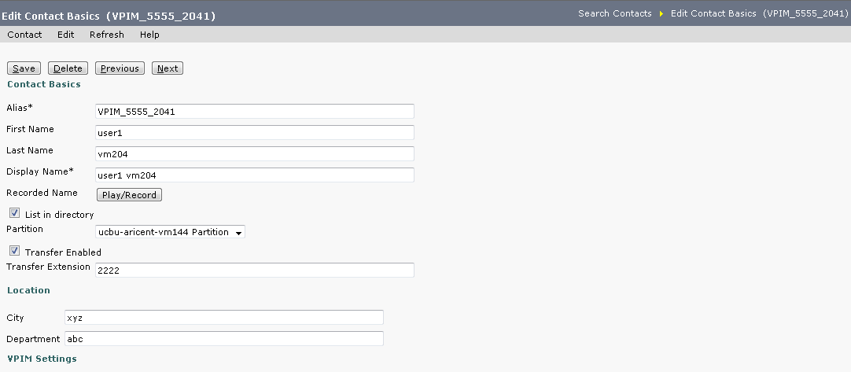
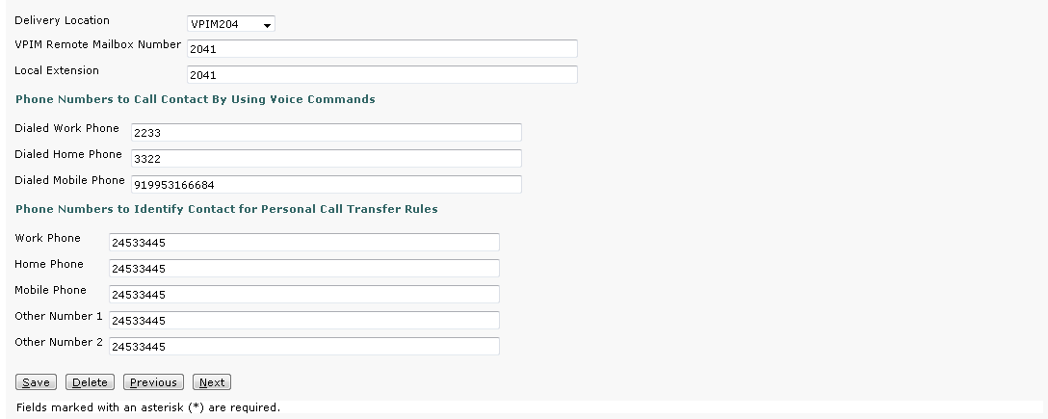
A Contact (VPIM_5555_2041) on home location(VPIM BRIDGEHEAD) Vm144

Slide 52
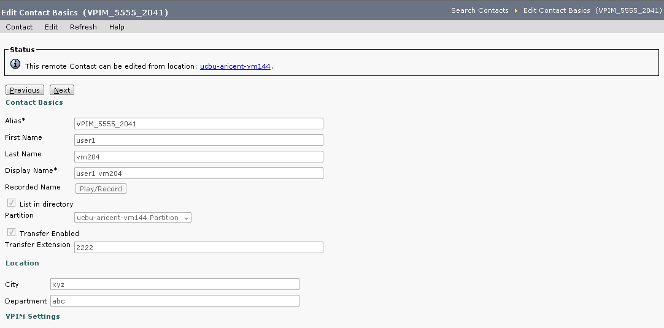
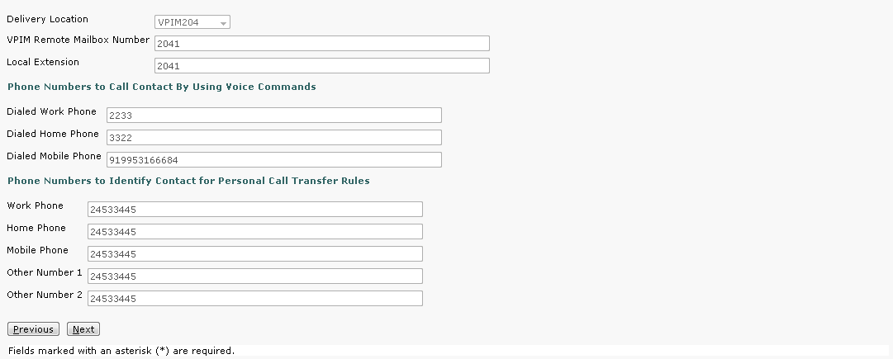
A Contact (VPIM_5555_2041) on remote location in
LEGACY DIGITAL NETWORKING
We can see that all fields are populated.

Slide 53
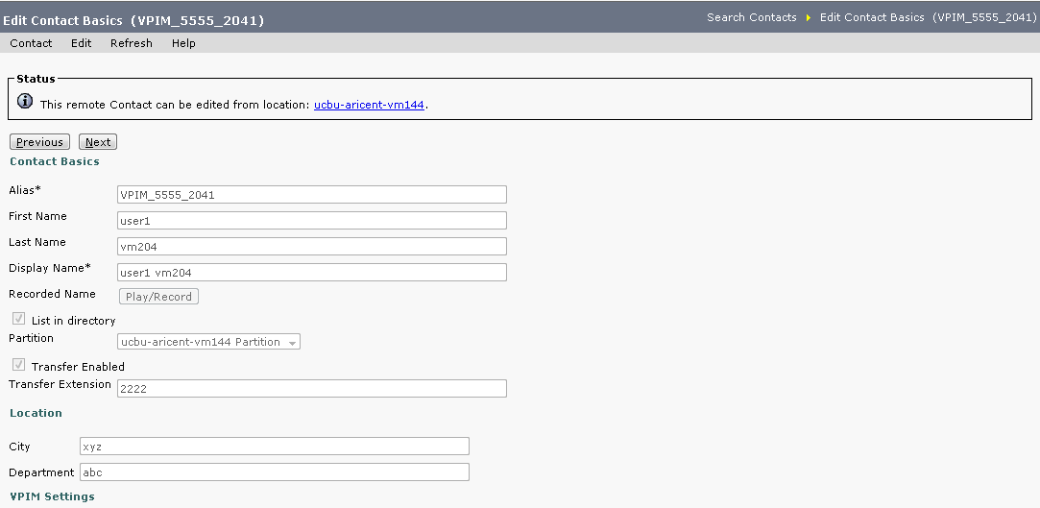
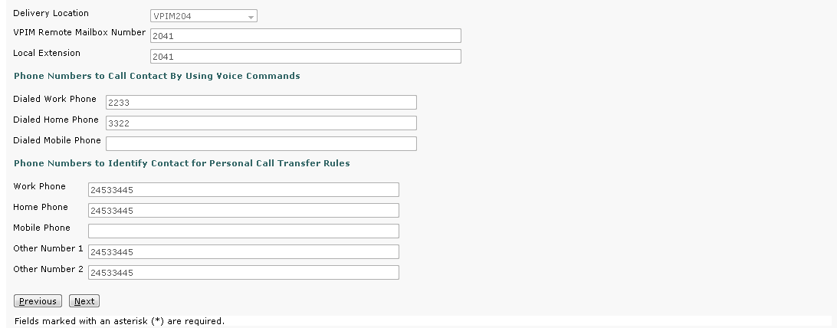
A Contact (VPIM_5555_2041) on remote location in
HTTP(S) NETWORKING
2 attributes not populated

Slide 54
Synchronization, Re-Synchronization and
Clear Recorded names
Synchronization: It is the process of fetching directory data from the concerned local network (directly connected location and its sub tree) and inserting it into the local database. It can be of below types:
  Full Synchronization: When this process is done for the first time, it pulls all the directory data present on the local network at that particular time and is known as Full Synchronization.
  Regular Synchronization: Any successive synchronization fetches the newer object changes since the last synchronization and is known as Regular Synchronization.
Re-Synchronization: If discrepancy in directory data exist, there would be a need to synchronize all the data again. Re-Synchronization is the process which does that. It pulls all the directory data again from the concerned local network, compares it with the local database entries and does the modification if required. The purpose of re-synchronization is to re-synchronize and correct the existing location’s directory.
Clear Recorded Names: When Voicenames received from a local network are to be removed we can use the “Clear Recorded names”. This Is done when we change the outgoing codec for recorded names on the remote node, the local node will not update its files because the change does not affect filenames. In order to pull updated copies of recorded names in this case, we must clear all existing recorded names from the local node and then do a full resynchronization by using the Clear Recorded Names button and the Resync All button.
Notes:
Re-synchronization fetches all data from the directly connected location and thus it must be performed in off-peak hours.
TBD – Networking guide link for clear recorded names

Slide 55
Automatic Synchronization
As FeedReader is a SysAgent task with periodicity of 15 minutes (default setting, configurable ), so an automatic synchronization request is triggered periodically as per the configured time interval. It can be of below types:
  Automatic Full Synchronization: First automatically triggered synchronization request through SysAgent framework fetches all the directory data present on the local network at that particular time and is known as Automatic Full Synchronization.
  Automatic Regular Synchronization: Any successive automatically triggered synchronization request through SysAgent framework fetches the newer object changes since the last synchronization and is known as Automatic Regular Synchronization.
  Automatic Re-Synchronization: During a regular synchronization, if a node detects a change in replication set of the local network location, it initiates a automatic re-synchronization request. It pulls all the directory data again from the concerned local network, compares it with the local database entries and does the modification if required.
Notes:
  The periodic interval for automatic synchronization is configurable.
  Automatic synchronization can be disabled by disabling the Sysagent task.
  A replication set is a UUID, which gets changed whenever any node does a software rollback or restores a DRS backup. Using replication set we can communicate to other directly connected nodes that data already replicated is no longer valid and there is a need to do a Re-synchronization.
Notes:
Note that the feedreader is a combination of 2 tasks that work together. One synchronizes directory objects and the other synchronizes voice names.

Slide 56
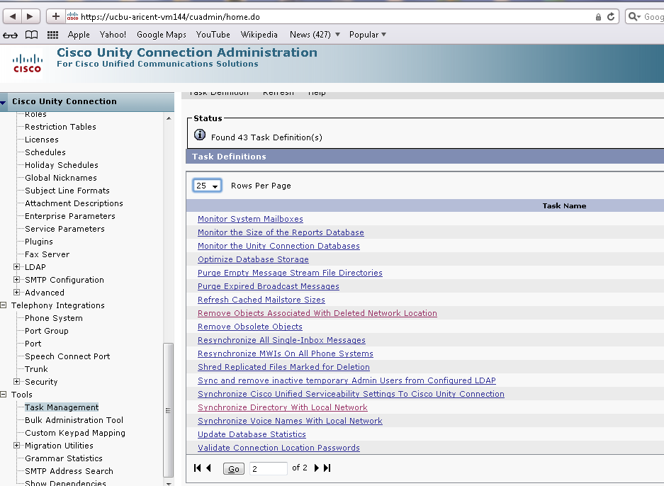
Automatic Synchronization
Automatic Synchronization starts after 1 minute of linking and there after every 15 minutes
We can schedule the Synchronization frequency and schedule from Task Management:

Slide 57
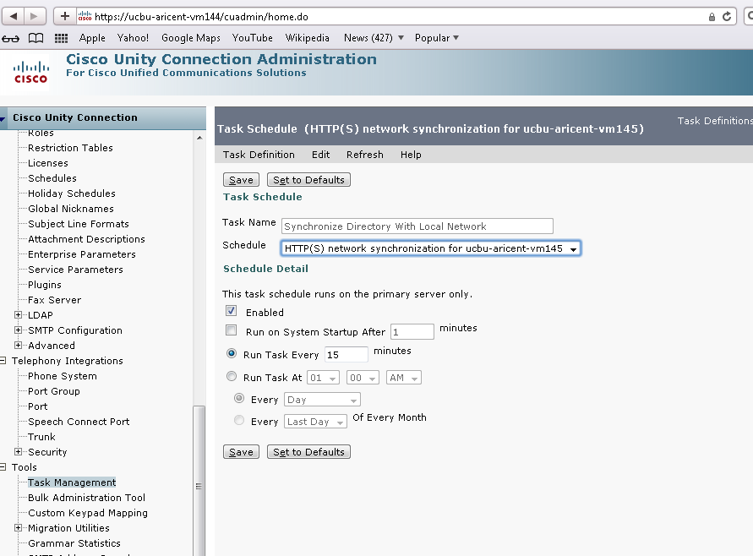
Automatic Synchronization
To edit the task schedule click on Task management -> Synchronize Directory with Local Network ->Edit -> Task schedules

Slide 58
Manual Synchronization
From CUCA page, we have option to trigger a manual synchronization request on HTTP(S) Links page. It can be of below types:
  Manual Full Synchronization: Pressing the “Sync” button on CUCA HTTP(S) Links page for the first time after adding fetches all the directory data present on the local network at that particular time and is known as Manual Full Synchronization.
  Manual Regular Synchronization: Any successive request triggered by pressing the “Sync” button on CUCA HTTP(S) Links page fetches the newer object changes since the last synchronization and is known as Manual Regular Synchronization.
  Manual Re-Synchronization: Pressing the “ReSync All” button on CUCA HTTP(S) Links page initiates a re-synchronization request. It pulls all the directory data again from the concerned local network, compares it with the local database entries and does the modification if required.
  Clear Recorded Names: When Voicenames received from a local network are to be removed we can use the “Clear Recorded names” functionality.
  Notes:
  The advantage of manual mode is that the administrators can choose when they want to update the directory. This aspect can be used in off-hours to synchronize / re-synchronize data as required.

Slide 59
Manual Synchronization

Slide 60
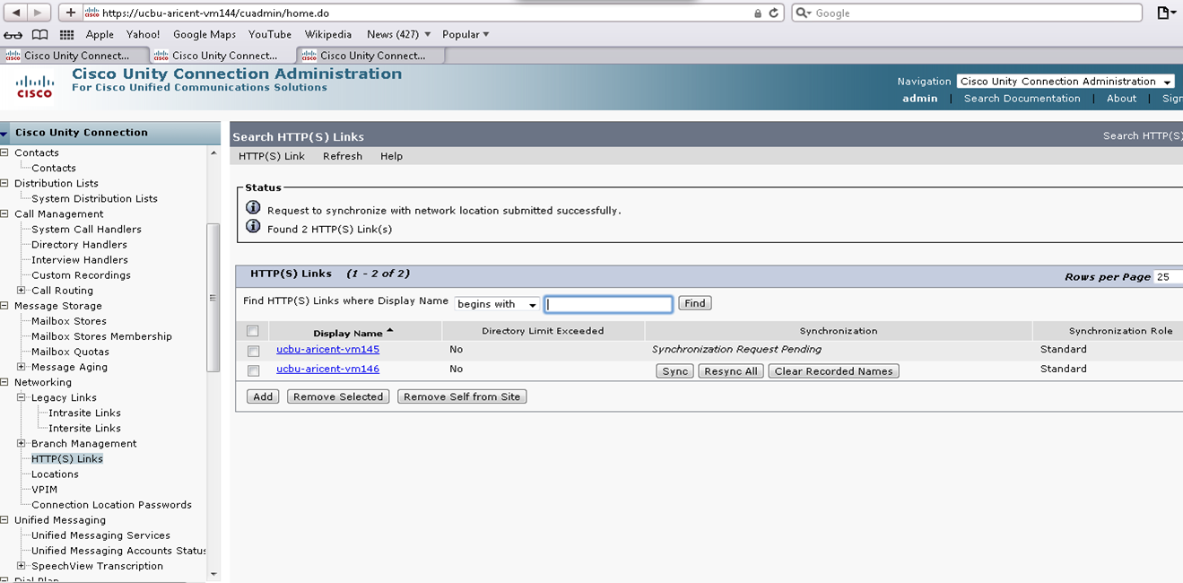
Manual Synchronization
Login to CUCA on Vm144
Go To Networking ➔ HTTP(S) Links
Press “Sync” for Vm145
Notes:
When we press “Sync” , immediately synchronization request pending turns up as the request is submitted to the sysagent framework for synchronization.

Slide 61
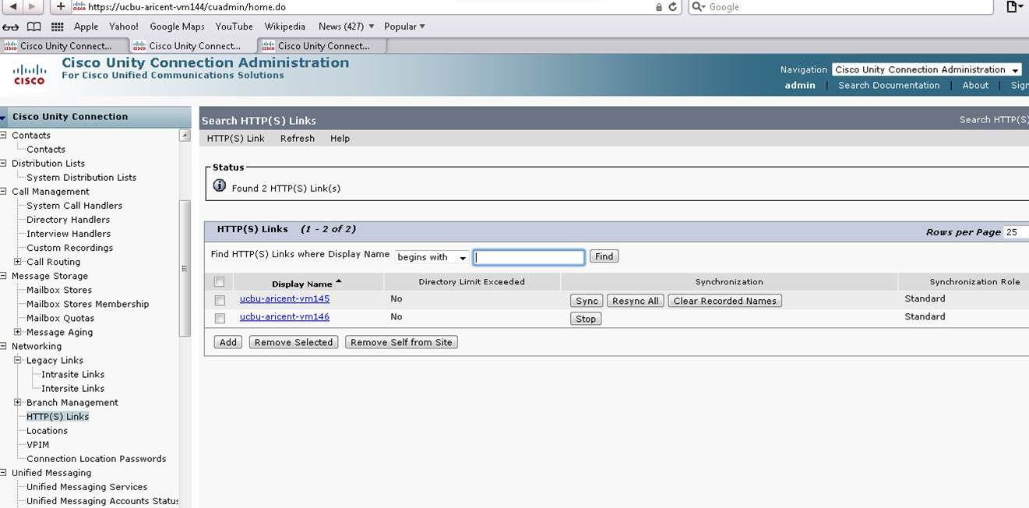
Manual Synchronization
Also a stop button comes up when the synchronization is in progress
Press “Sync” for Vm146 and when we refresh the page, a stop button is displayed after “synchronize request pending”
Notes:
The stop button might not be visible if the number of objects to be synced is small and the refresh of the page is delayed. This is because Synchronization would have been done by the time page is refreshed

Slide 62
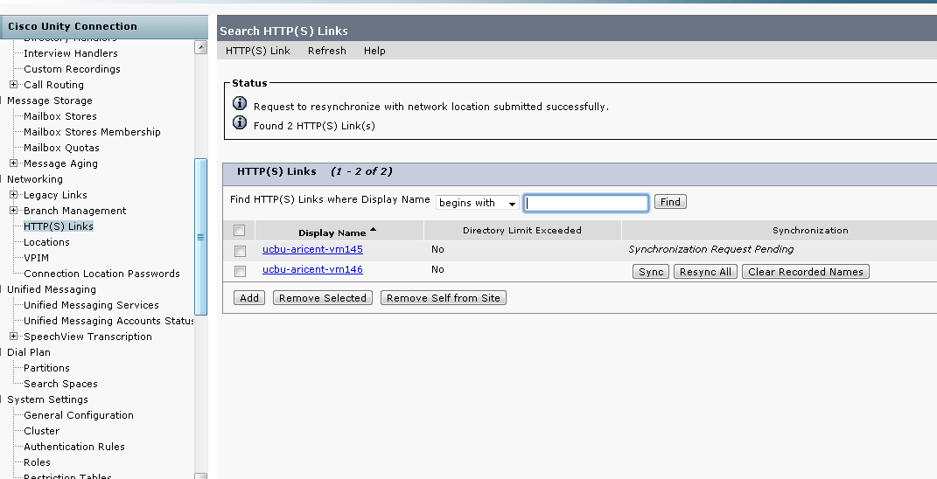
Manual Synchronization
Login to CUCA on Vm144
Go To Networking ➔ HTTP(S) Links
Press “ReSync all” for Vm145
Notes:
When we press “ReSync all” , immediately synchronization request pending turns up as the request is submitted to the sysagent framework for re-synchronization.

Slide 63
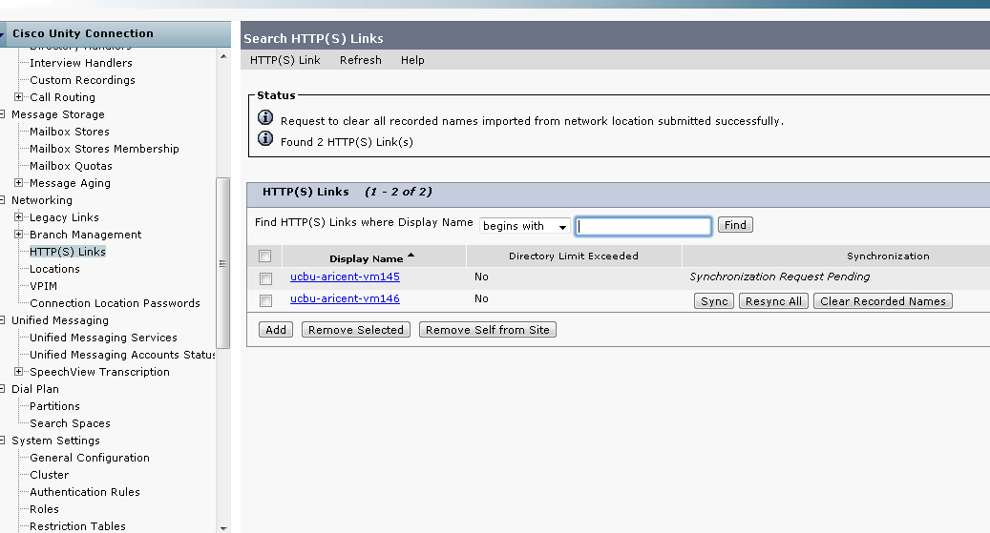
Manual Synchronization
Login to CUCA on Vm144
Go To Networking➔HTTP(S) Links
Press “Clear Recorded Names” for Vm145
Notes:
When we press “Clear recorded Names” , immediately synchronization request pending turns up as the request is submitted to the sysagent framework for clearing the recorded names/Voicenames which were received from location Vm145.

Slide 64
Synchronization Summary
The following figure summarizes the types of synchronizations at a high level.
It may be noted that “Clear recorded names” can only be triggered manually
Types of Synchronization | Automatic | Manual
Resynchronization | Replication set change | Press button
Synchronization | Sysagent task in every 15 mins* | Press button
Clear recorded names | N/A | Press button
Notes:
* The scheduled task runs after every 15 minutes is default setting. Also note that the first automatic synchronization happens 1 min after link.

Slide 65
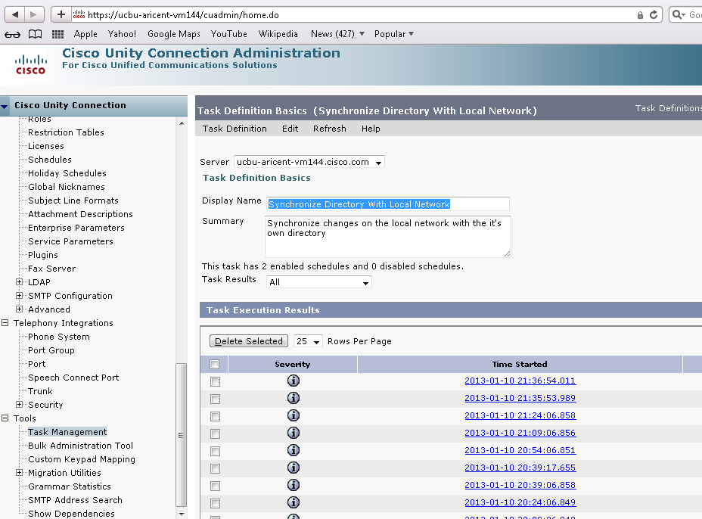
Review FeedReader task results for all local networks
Click on Task management-> Synchronize Directory with Local Network we can see all the task results.
It shows task results for all the local networks.
Notes:
The local network locations here are only directly connected locations. Indirectly connected locations are not synchronized directly but via their respective HUBS.
Also note that all automatic or manual synchronization results will be documented here in task results.

Slide 66
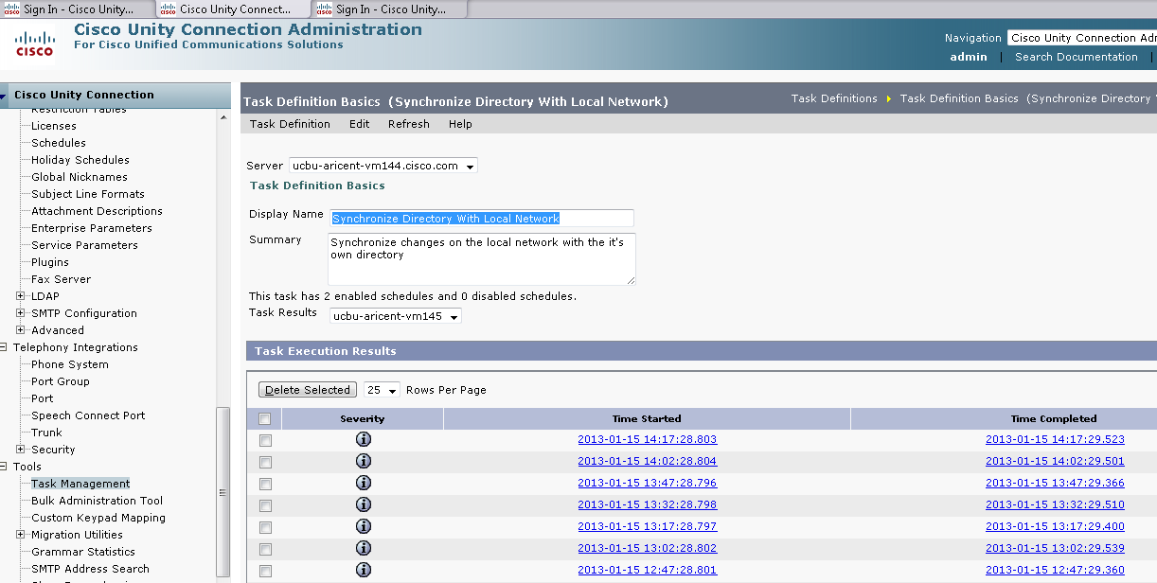
Review FeedReader task results for a local network
We can see task results for a particular local network location as well.
From ”task results” , select the concerned local network

Slide 67
Requirements for configuration
During synchronization in HTTP(S) Networking Distribution lists might not replicate. In such scenarios the first step should be to check the local network settings and make sure that “Include distribution lists and membership when synchronizing data” is checked. Also note that once this option is enabled, it cannot be disabled again.

Slide 68
Sending voicemail in
HTTP(S) Networking

Slide 69
Introduction to messaging in HTTP(S) Networking
Sending a message to a user in HTTP(S) networking utilizes the existing MTA.
The messaging rules/restrictions apply to HTTP(S) networking in the same way as they apply to Legacy Digital networking.
Users can login to their mailbox, and send a message to:
  Local users
  Remote users
  Distribution lists
  Private distribution lists
  Local contacts
  Remote contacts
  Any combination of these recipients.
  Distribution lists which contain any combination of these objects.
In order to send a message to a remote user, then recipient (remote user) partition should be part of sender’s search space.
Notes:
For sending messages to remote users, the partition - search space setting is necessary for messaging from Webinbox and TUI interface
Also note that Distributions lists are system distribution lists.

Slide 70
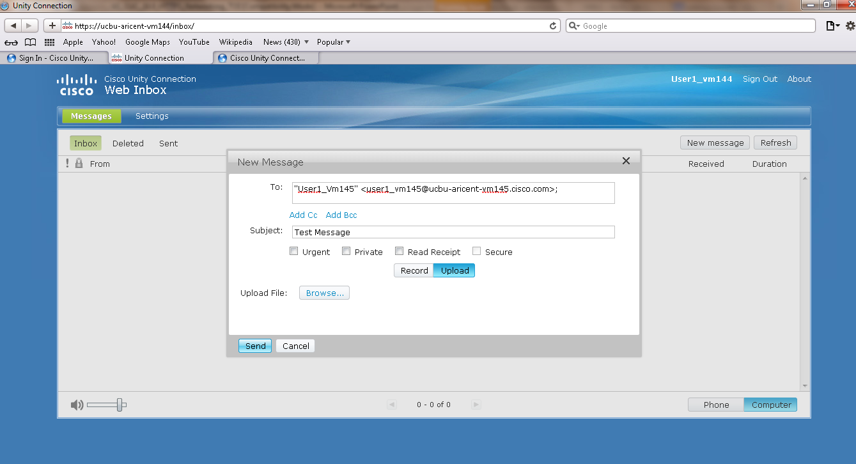
Example - Sending a message from inbox
Login to the inbox of a user – User1_Vm144
Compose the message by either recording or uploading the recording
Select the recipient
Click on send

Slide 71
Requirements for configuration
Sending a message to a remote user R1 from local user U1 is possible from the sending node even if the remote user R1 is deleted on the remote side, but the sender will receive a NDR. This scenario happens when the deleted remote user R1 has yet not synchronized with the node which has U1.
The same occurs for remote DL’s and contacts too.
While sending a message to a user, the “TO” field in the message header might not show the remote user that needs to be accessed. Such a situation may arise when the remote user to whom we want to send the message, is not accessible to the sender due to search space settings. In such a situation the partition of the remote user should be a part of the search space to which the local user belongs.
The local users are by default part of the default partition which is added to a default search space. Also this information is replicated to other nodes. Thus locally the users can send message to users/Dl’s belonging to their search space. But since the remote users have arrived from other node, they are not part of the partition and search space to which the local user belongs and therefore remote user partitions need to be added to local search space to enable messaging.
Thus synchronization and partition/searchspace settings can generate temporary messaging issues till the time we don’t configure partition and search spaces on the sending node.

Slide 72
Removing in
HTTP(S) Networking

Slide 73
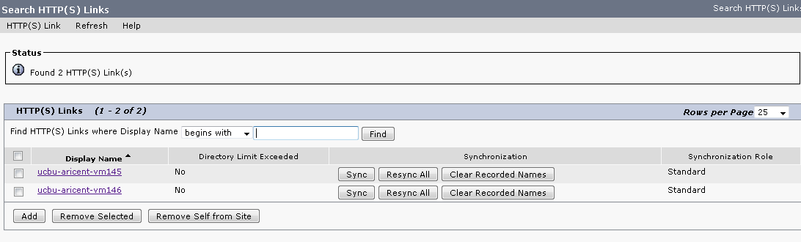
Introduction
When an administrator wants to remove a node from network, there are two options available
  Remove a directly connected node from any node (Remove Selected)
  Remove the node itself from the network (Remove Self from Site)
When a node is completely removed, all the directory objects e.g. users, contacts etc. homed on that node get deleted from every other node in the network. If any of these users are part of any system distribution list or private distribution list owned by any other node, then this membership information will also get deleted.
Removing also needs to be done on running nodes when a publisher/standalone hardware fails and to bring the node back into the network it is reinstalled and relinked.
Notes:
When a node’s hardware fails , the adjoining nodes cannot access it. Thus to bring this failed node we have to reinstall it on a fresh machine. Also the adjoining nodes will un-join the earlier connected node which is inaccessible. Then the adjoining nodes add the newly installed node

Slide 74
Removing : Design summary
Directly connected nodes get informed about the un-join via synchronization with the node on which un-join action was done.
Indirectly connected nodes get informed about an un-join in the network via their respective mediators.
Objects removal of the deleted node ,from the database ,is done by a sysagent task which runs daily at 10 pm by default; in the local time zone
Example – If on Vm145 “Remove Self from Site” was selected then
  Vm144 gets to know about un-join of Vm145 via synchronization with Vm145
  Vm146 gets to know about un-join of Vm145 via synchronization with Vm144 (Vm144 is the mediator for the rest of the network for Vm146)
The removal of objects associated with Vm145(Users,DL etc) from database, on Vm144 and Vm146 will be done by their respective sysagent task “Remove objects associated with deleted network location” at 10 Pm
HTTP(S) Link
HTTP(S) Link
HTTP(S) Link
Notes:
In a large topology (Say 25 nodes) the information of un-join may take time to replicate to every node. This is because synchronization (By Default) runs in every 15 minutes and so the information synchronization will take time to go to farther nodes. So in some scenarios we might see the information of the deleted node still persisting on farther nodes for a long time. The time will depend on the directory size of the deleted node.

Slide 75
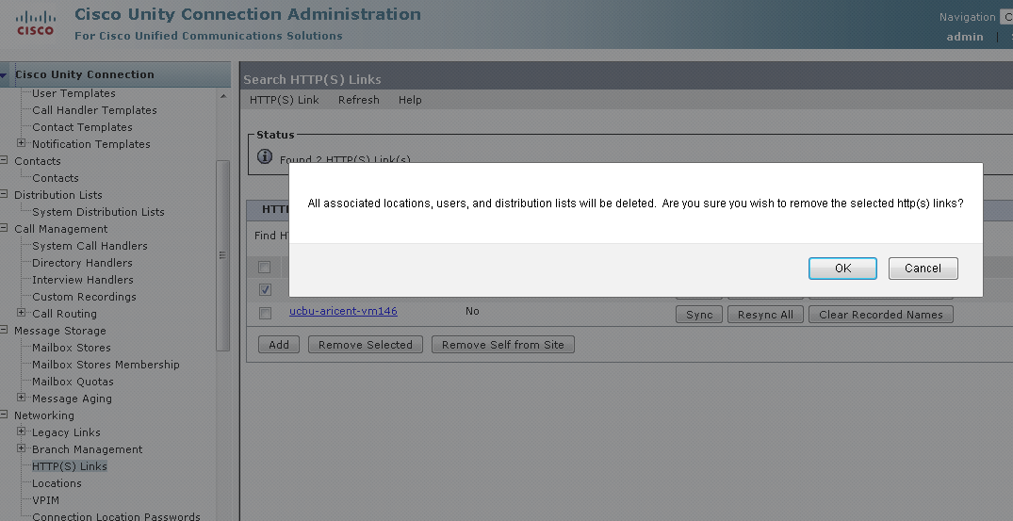
Removing
Login to CUCA on Vm144 which is the HUB.
Go To Networking ➔ HTTP(S) Links
Check a location say Vm145 and press “Remove Selected”.
Notes:
Also when “Remove self from site” is done, we remove the location triggering it from the entire network. Example – If on Vm144 we checked remove self from site then Vm144 will be removed from the network and in our example it will break the entire network since it is the Hub of the network.

Slide 76
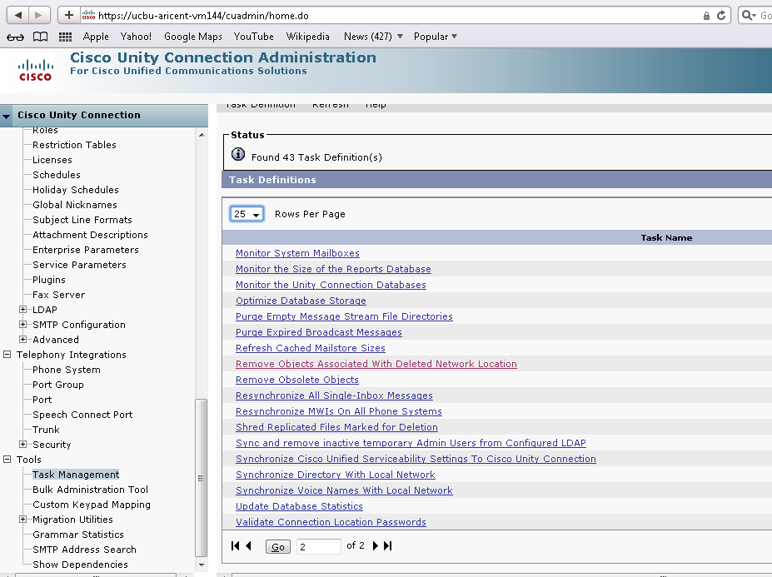
Removing
Once you click ok , then the actual removal of objects is completed by the “Remove Objects Associated with Deleted Network Location” sysagent task.
The task can be accessed by going to Task management .

Slide 77
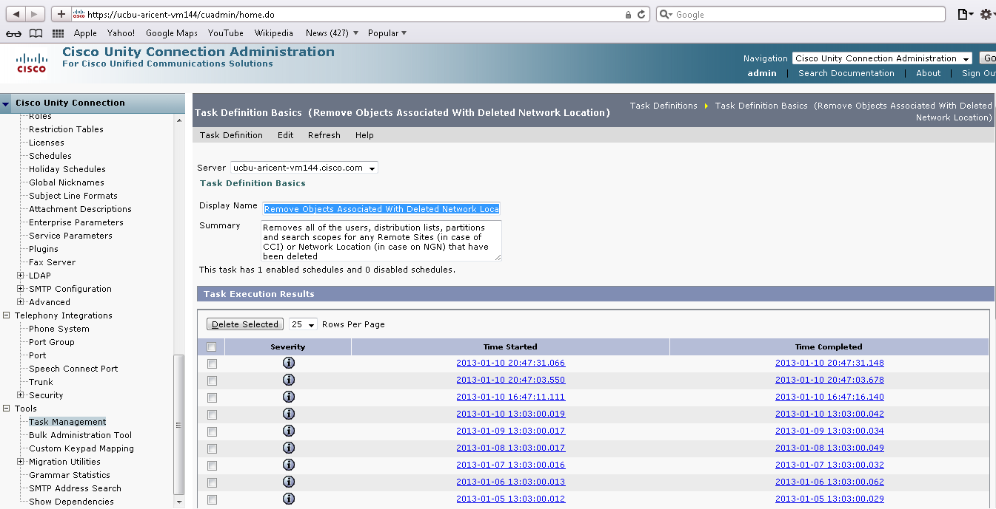
Removing
After clicking on “Remove Objects Associated with Deleted Network Location” task we can see all the results of the previous tasks that were run.
Notes:
Note that if during deletion of objects if there are any errors, the task results will show the details.

Slide 78
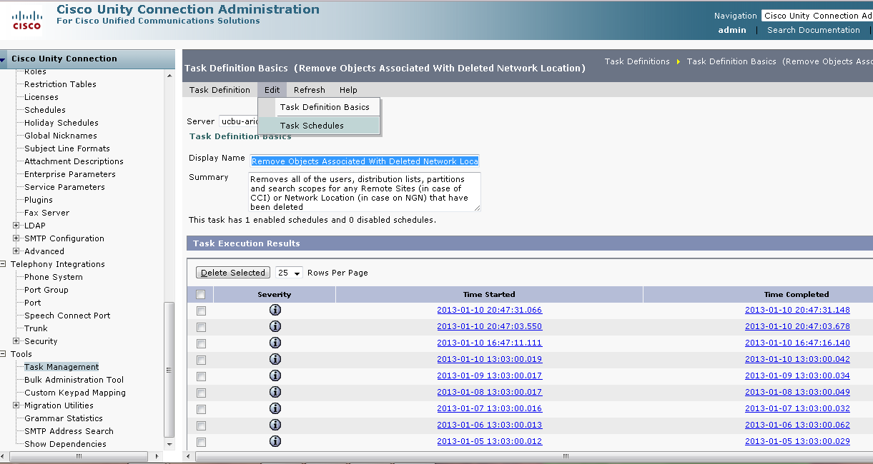
Removing
We can edit the default run time of the network remover task by clicking on edit->Task schedules.
Notes:
It is recommended to keep this task scheduled for 10Pm in the night as that is when the call load on unity Connection is low due to off hours in office.

Slide 79
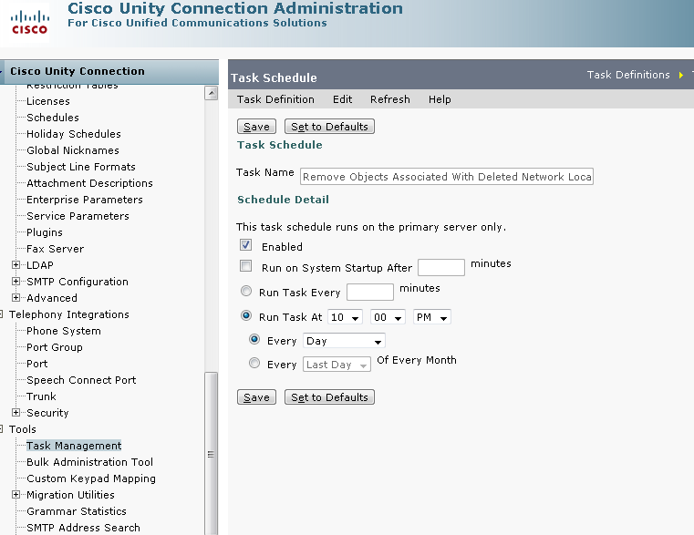
Removing
By default this task is scheduled to run in the off-peak hours because deleting objects is heavy operation and may impacts CPU.
Notes:
Note that all objects belonging to the deleted location will be removed once the “Remove objects…” task runs. To check if all the objects have been removed successfully we need to check the “task results” for this task. We can also check that objects have been removed by checking the local network page to ensure that the location has been removed completely.

Slide 80
Requirements for configuration
If a node is un-joined, then the directly connected nodes of the un-joined node get to know about the un-join when they synchronize with it. So if "Remove Objects Associated with Deleted Network Location" is run before the un-join information is replicated to other nodes via synchronization, then the other nodes will never get to know about the remove. Thus we must ensure that every node replicates un-join information to its directly attached nodes before network remover runs on them. Therefore you should not un-join near the 10pm scheduled time of “Remove Objects Associated with Deleted Network Location” sysagent task.
If the un-join information is not replicated to the directly connected nodes before “Remove Objects Associated with Deleted Network Location” runs then as a workaround we can un-join this deleted node manually from the directly connected nodes.
Notes:
“Remove Objects Associated with Deleted Network Location” can also be referred as “Network Remover”.

Slide 81
Serviceability in
HTTP(S) Networking

Slide 82
Voice Network Map
The Voice Network Map tool provides a consolidated visual representation of the health of the locations in a Cisco Unity Connection site.
With the tool, you can quickly locate replication problems in a site, and get information about the status of replication between any two locations in the site.
The tool includes a site display, a data display, and a key that explains the meaning of the icons that you may see in the site display.
To check the status of the network , we can go to “Cisco Unity Connection serviceability” -> Tools -> Voice Network Map

Slide 83
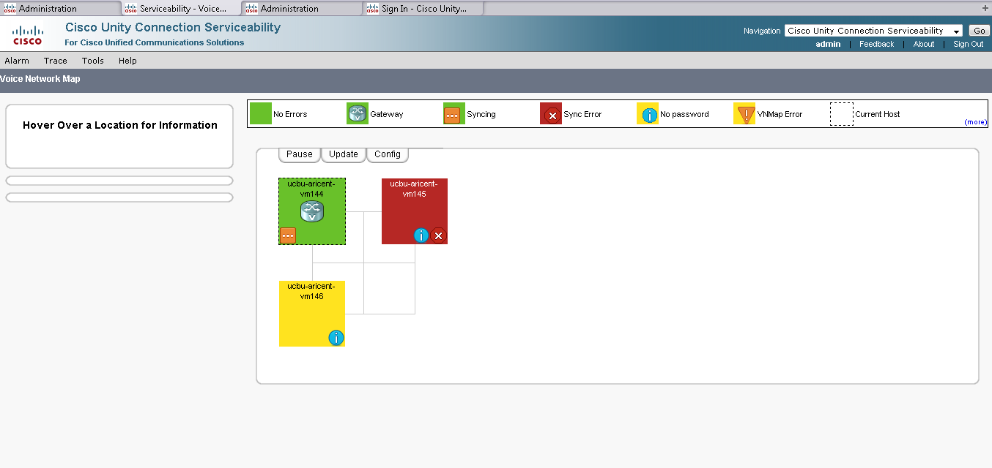
Voice Network Map
On Vm144 serviceability page we can see that syncing with Vm145 is in erroneous state and with Vm146 also it is recovering. If all the nodes are green then synchronization is successful without errors.

Slide 84
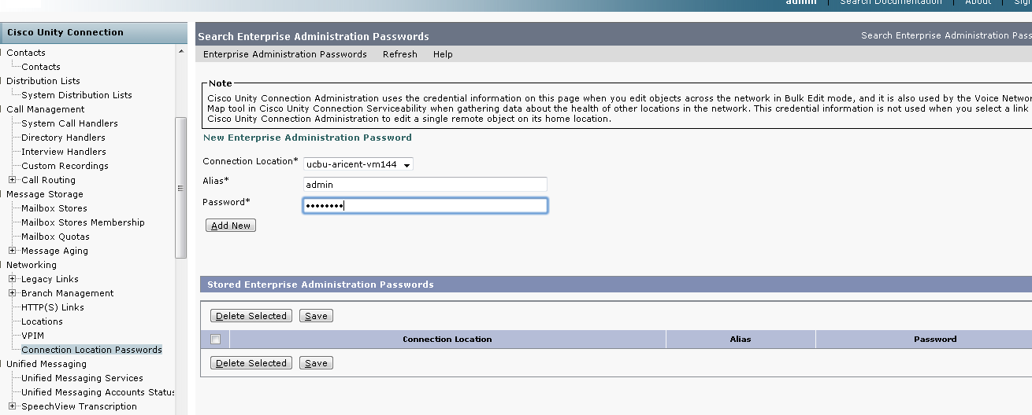
Voice Network Map
Ideally the Network map must show green for all locations.
NOTE – Connection Location Passwords are essential to ensure proper function of the Network Map. Update Connection Location passwords for all locations on every node in the network to ensure full connectivity.

Slide 85
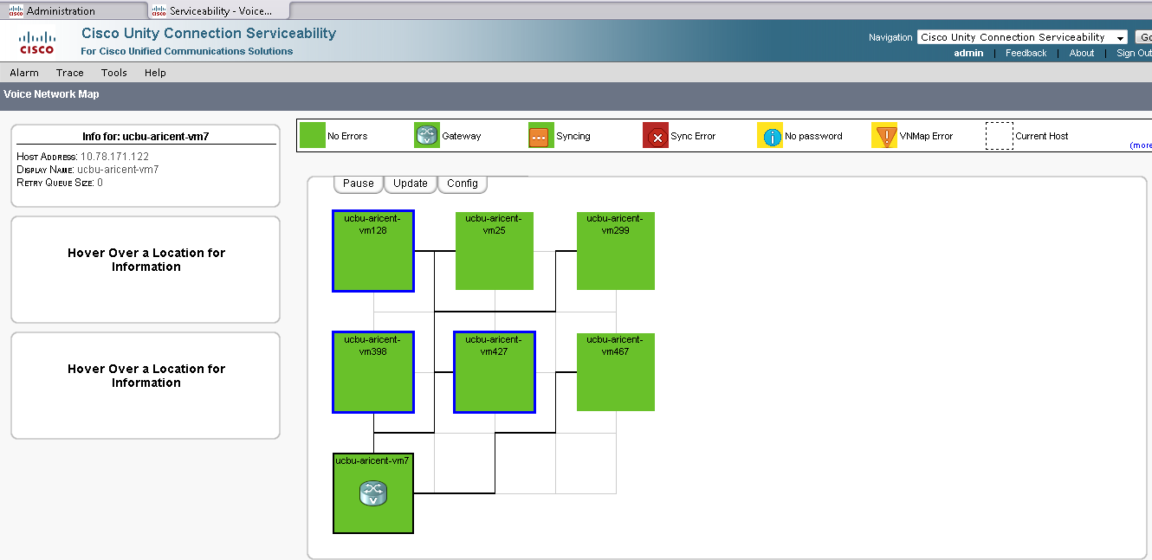
Voice Network Map
In a 7 node topology we can see that when we click on a location, its directly connected locations are outlined in blue color. In the figure below when Vm7 was clicked, Vm398,Vm427 and Vm128 were outlined with blue.
VPIM bridgehead
Notes:
Note that Vm7 has a logo on it which indicates a VPIM bridgehead. Thus Vm7 is connected to a VPIM location.

Slide 86
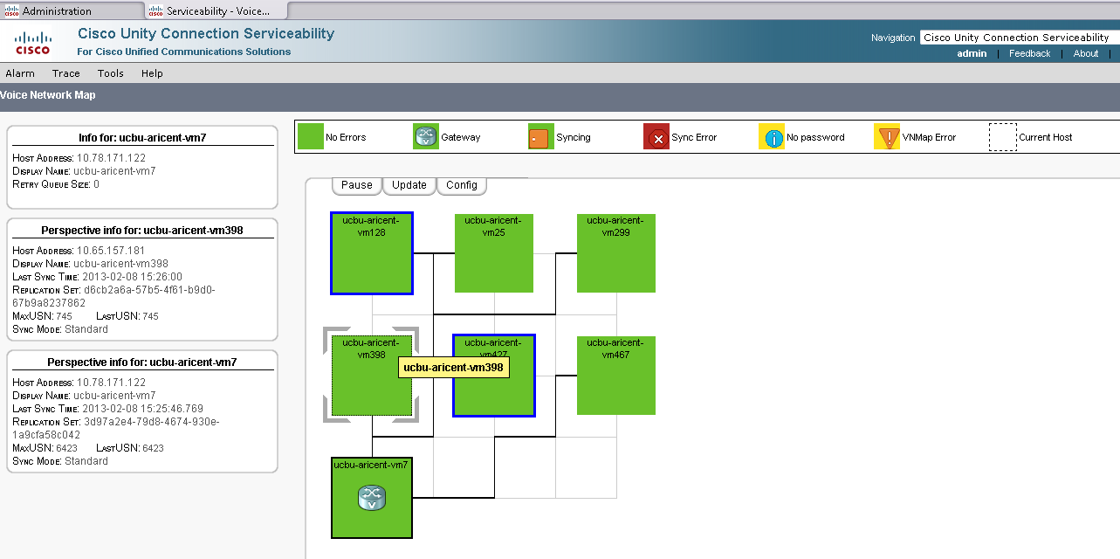
Voice Network Map
Also when we click Vm7 and if we hover over location Vm398(Or any other location), we can see the information details of there synchronizations with each other. Here we can see that LastUsn received from Vm398 on Vm7 Is 6423
Notes:
NOTE that USN is a Unique sequence number which is assigned to objects (Users, contacts etc) on a location. When 2 nodes synchronize with each other, they map the accuracy of synchronization via LastUSN and MaxUSN.
LastUSN = The last USN received from the remote location.
MaxUSN = The maximum USN available on the remote location.
If LastUSN < MaxUSN then that means there are more objects that need to be fetched from the remote location.

Slide 87
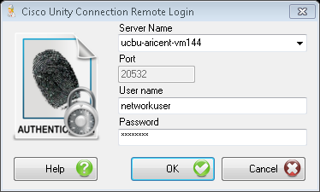
Network Analyzer
The Network Analyzer is a tool that allows admins to analyze the state of the network and keep a sanity check on every node via a visual representation of the network topology.
It also enables administrators to synchronize the data in HTTP(S) networking via the tool itself.
To setup and start Network Analyzer, following steps need to be followed (Refer help guide of the Tool for details) –
  Task 1: Configure a User without a mailbox with the Remote Administrator and System Administrator roles
  Task 2: Set the Database Proxy Service Shutdown Time
  Task 3: Activate the Remote Database Proxy Service
  Task 4: Login to the Remote Server
Notes:
Please find the detailed steps for Network analyzer setup in the help guide for the tool.

Slide 88
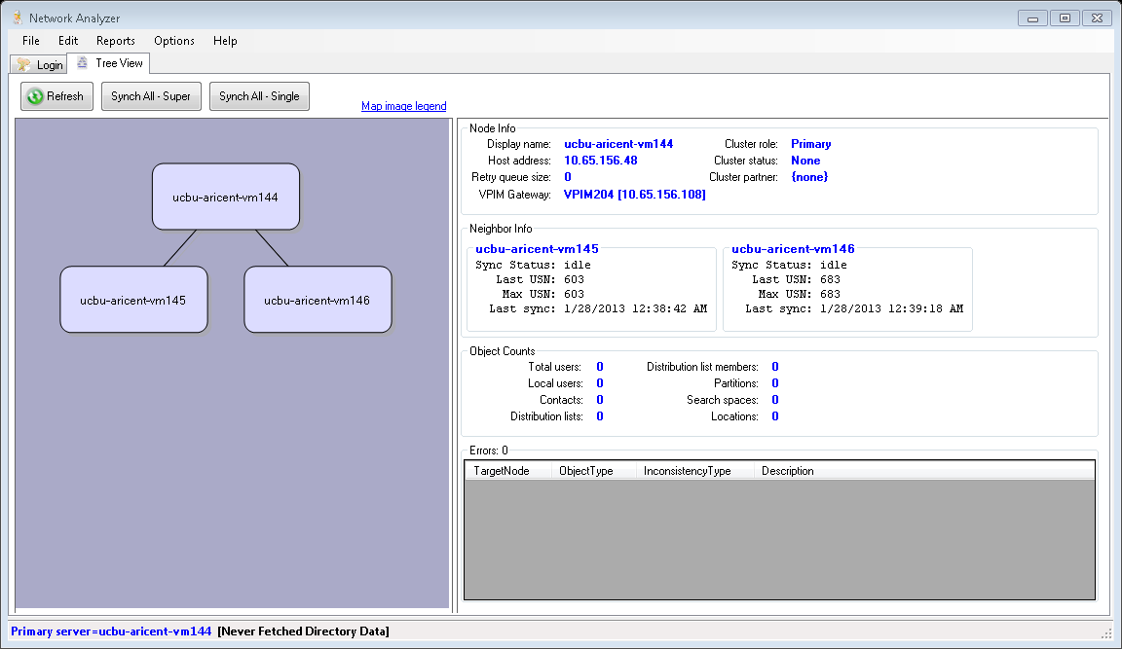
Network Analyzer
After logging into machines we can see the “Tree View” of the Network
By clicking on the node we can see information of the node on the right hand side
As major functionalities the admin can trigger the following -
  “SynchAll-Super”
  “SynchAll-Single”

Slide 89
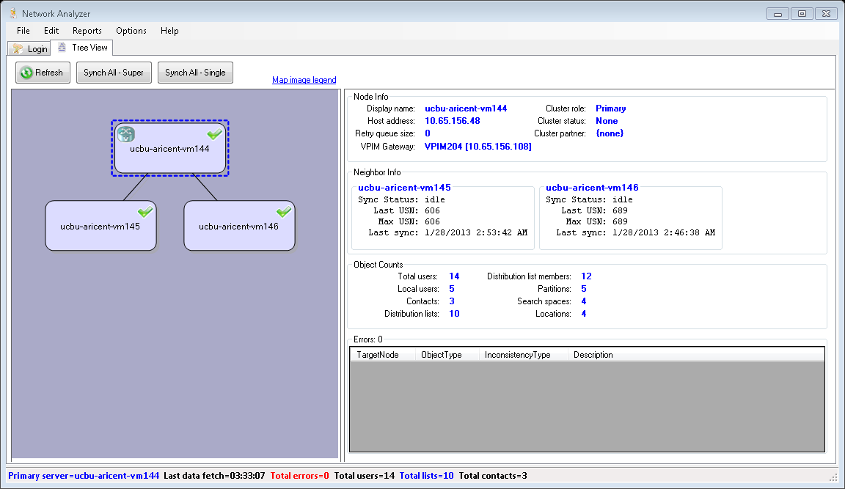
Network Analyzer
  “SynchAll-Super” – Initiates incremental synchronization in the network such that the entire network is synchronized and every node has all data of every other node in the network.
  “SynchAll-Single” – Initiates incremental synchronization with the directly connected node(s) on every node in the network.
Notes:
Please find the detailed study and features of Network analyzer in the help guide for the tool.

Slide 90
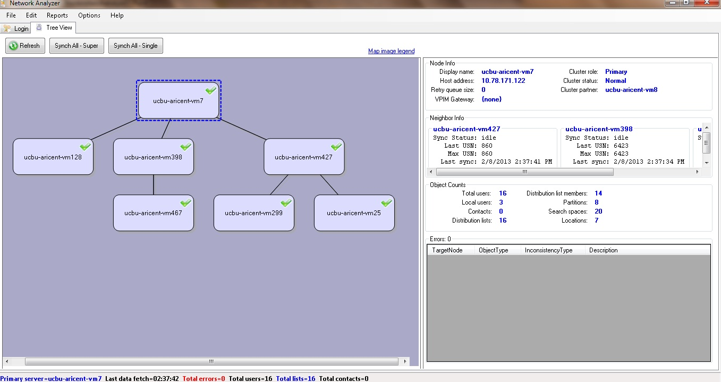
Network Analyzer
  Here we can see the topology of nodes
  On the right we can see the details of Vm7 being Primary in a cluster with Vm8 as other partner. Also Vm7 is connected over VPIM to Vm144.
Notes:
Please find the detailed study and features of Network analyzer in the help guide for the tool.

Slide 91
High Availability in
HTTP(S) Networking

Slide 92
High Availability (HA) Methodology
“If Publisher node is down, Subscriber performs limited directory replication”
The above statement is the basis of HA in HTTP(S) Networking with cluster nodes. Directory replication occurs through Publisher node in Unity Connection, but if Publisher goes down then directory replication stops via this cluster node. To provide high availability, directory replication will continue via Subscriber when the Publisher is down.
The Directory synchronization can be categorized into 2 modes
STANDARD Directory synchronization done by Publisher node.
ALERT Directory synchronization done by Subscriber node, when Publisher is down.

Slide 93
High Availability (HA) Methodology
Important points for HA –
When publisher goes down in a cluster, every directly connected node of this cluster, in HTTP(S) networking, tries to synchronize with the publisher first and then connects with the Subscriber. This happens every time a synchronization is to be completed.
If the publisher node has failed and there needs to be a replacement for that particular node a remove and relink process has to be done on its directly connected nodes. The failed node is rejoined via new machine. The overhead for such failures is the complete process of synchronizing data on/via that failed node.
Thus there is no facility for promoting subscriber to a publisher or for repointing directly connected nodes to the new installed publisher and bringing network to sanity.
HA should not be considered as an acceptable state anywhere in the network. It is an erroneous state and needs to be corrected.
Notes:
Example for point 2 and 3 -> Let us say we have a network with 3 locations A----B----C where B is a cluster. If publisher of B fails and cant be brought back to running mode then we have to do a remove on B’s directly connected nodes : A and C. Since B was the HUB, in this scenario the network is completely broken with A and C becoming standalones. Now node B’s publisher is reinstalled on a new machine and then its linked with node A and C. Now A----B----C will have to synchronize with each other from the beginning to have each other’s directory.

Slide 94
Alert Mode
Whenever Publisher is down, connected nodes will synchronize limited directory information with Subscriber machine. Limited directory information contains directory information which is present on Subscriber that is synchronized with Publisher till the time it was up. When Publisher comes up again, directly connected nodes will synchronize updated directory data through Publisher.
Alert mode will provide the following functionality:
Remotely connected nodes will have capability to fetch feed from Subscriber machine of cluster node.
Subscriber machine will provide limited feed to connected nodes.
Directory changes done on Subscriber node will not be replicated with connected node.
Subscriber machine will not fetch feed from the connected nodes.
Notes:
NOTE that when the publisher comes up, the node goes into Split brain recovery mode (SBR) for sometime. During SBR the publisher does not fetch data from any node. When SBR is complete, publisher begins fetching data from the directly connected nodes.

Slide 95
Alert Mode
Advantages of Alert mode:
Nodes will be in sync with the faulty Publisher node’s data even if the Publisher is down.
Nodes can perform Re-synchronization operation, even though Publisher is down.
Disadvantages of Alert mode:
All currently updated directory information on subscriber node will not be replicated during the duration when publisher is down.
FeedReader does not run on Subscriber thus the failed node wont be able to pull fresh data from directly connected nodes and hence a part of network wont be able to pull fresh data from other part of the network.
There is a little overhead of retries when publisher is down. Every directly connected node is trying to establish Connection with the publisher every time a synchronization is done.
Notes:
When the faulty publisher comes up, other machines can synchronize again with the publisher directly and can now access all the newly changed data.

Slide 96
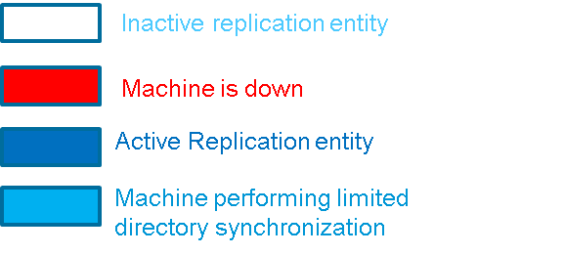
Alert and Standard mode example
In the example below Cluster Vm144(Pub)__Vm145(Sub) was connected to 2 other clusters in HTTP(S) networking. The spokes were:
Vm151(Pub)__Vm152(Sub)
Vm355(Pub)__Vm356(Sub)
Every node in the network is in Standard
Mode
Standard
Pub-Vm144
Sub-Vm145
HTTP(S)
HTTP(S)
Standard
Standard
Pub-Vm355
Pub-Vm151
Sub-Vm356
Sub-Vm152

Slide 97
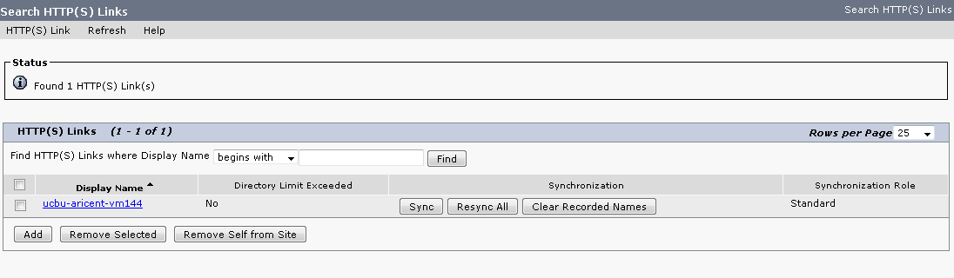
CUCA page for HA
The HTTP(S) links of Vm355 has 1 node
We can see that Synchronization role with Vm144 is in “Standard” mode
Similarly on Vm151 also “Standard” mode appears

Slide 98

Alert and Standard mode example
Now if Vm144(Publisher) goes down then we can see that cluster node of Vm144 is in Alert mode.
When Vm355 synchronizes with Vm144, the Connection
times out and hence Vm355 establishes Connection
with Subscriber – Vm145
Thus on Vm355, local network Connection for Vm144 will show in Alert mode.
Similarly on Vm151 local network Connection for Vm144 will show in Alert mode.
Notes:
When Pub – Vm144 goes down and Vm355 tries to synchronize with it, the Connection times out and then Vm355 connects with Sub-Vm145. As soon as the Connection is established the alert mode comes up for Vm144 on Vm355.Now since the HUB is in Alert mode hence no fresh information can be synchronized via it and thus Vm355 wont get fresh information of Vm151 and vice – versa.

Slide 99

CUCA page for HA
We can see that on Vm355, Synchronization Role with Vm144 is in “Alert” mode.

Slide 100

CUCA home page warning in HA
Also we can see the warning message for Alert mode appearing at the top on Vm355 when logged in as administrator.

Slide 101
CUCA page for HA
When Vm144 comes up, the Alert mode will not appear on Vm355 and Vm151. Thus directory replication resumes with all data.

Slide 102
Rest API's in
HTTP(S) Networking

Slide 103
Introduction
HTTP(S) Networking provides 2 rest API’s which can be used to fetch network information from the database. Admin credentials need to be provided to access the details.
vmrest/httpslinks (Ex - https://ucbu-aricent-vm7/vmrest/httpslinks) - This API is used to fetch details of all the directly connected nodes in HTTP(S) Networking.
vmrest/vmsservers (Ex - https://ucbu-aricent-vm7/vmrest/vmsservers) - This API is used to fetch the status of the cluster.
Notes:
NOTE that system administrator role is required to hit the API

Slide 104

Vmrest/httpslinks
In the example below we can see that there are 3 HTTP(S) Links on Vm7.
Notes:
Note that only one HttpsLink has been expanded as otherwise it is not possible to keep information in one snapshot

Slide 105

Vmrest/httpslinks
In the example below we can see that Vm7 is a cluster with Vm8 as the subscriber.

Slide 106
Debug Logs in
HTTP(S) Networking

Slide 107

Logging in HTTP(S) Networking
Logging levels can be enabled and disabled from the serviceability page.
Log levels are for the following 2 concerned modules in HTTP(S) Networking:
        Feeder
        FeedReader
s

Slide 108

Logging in HTTP(S) Networking
To enable logs, go to Trace -> Micro traces

Slide 109

Logging in HTTP(S) Networking ( Contd … )
Select “Feeder” from the Micro Trace dropdown to access Feeder trace level settings.

Slide 110

Logging in HTTP(S) Networking ( Contd … )
Select “Feedreader” from the Micro Trace dropdown to access Feedreader trace level settings.

Slide 111
Logging in HTTP(S) Networking ( Contd … )
FeedReader logs path on Cisco Unity Connection:
/var/opt/cisco/Connection/log/diag_CuSysAgent*
Feeder logs path on Cisco Unity Connection:
/var/opt/cisco/Connection/log/diag_Tomcat*
FeedReader logs path via RTMT:
Tools -> Trace and Log Central -> Collect Files -> Select CUC Services/Applications -> Connection System Agent
Feeder logs path via RTMT:
Tools -> Trace and Log Central -> Collect Files -> Select CUC Services/Applications -> Connection Tomcat Application

Slide 112
Logging in HTTP(S) Networking ( Contd … )
Annotated logs for various scenario's in HTTP(S) Networking are documented at below wiki link:
http://zed.cisco.com/confluence/display/UCET/Annotated+diagnostics+for+HTTP%28s%29+Networking

Slide 113
Migration

Slide 114
Introduction
Migration path from Legacy Networking to HTTP(S) Networking:
HTTP(S) Networking will follow the Hub-Spoke model to perform the Directory synchronization whereas the message routing will be point to point. Hence from Release Oz onwards, if any customer wants to deploy the HTTP(S) network, he has to transform all of the locations to form a single site. The scenarios wherein the site is to be converted can be –
Entire network is composed of only one site, all locations in a single Digital Network
Network Contains 2 sites added over the CCI link
Network Contains 2 sites added over the UCI link
NOTE : All nodes need to be on 10.0 for the migration to be possible. Also a downtime window is required for migration steps such as collapsing the existing network, creating a new HTTP(S) network including directory synchronization and restore of DL membership. Downtime interval will vary depending upon the number of locations and the directory scale.
Another important point is that Connection rollbacks aren't supported after upgrading to 10.0 and migrating to HTTP(S) networking.
But we can remove any node from HTTP(S) Network and do a rollback on it.
The migration tool is To Be Done.
Notes:
NOTE – If there is still a need for testing migration in a lab setup, we can do a COBRAS backup of the SMTP networked servers and restore them to a system that is configured for HTTP networking on a separate network. Such a migration scenario is not yet tested. Moreover a more sophisticated “standing migration” will come later.

Slide 115
Single Site Digital Networking to HTTP(S) Networking
Whenever the network deployment is having a single site of digitally networked locations, the migration from Digital Network to HTTP(S) Network is going to be a Flash Cut approach. It can be performed in two ways:
  Manual Approach which means un-joining the existing network and add the locations one by one using the decided network topology (based on Hub Spoke model). Explained in detail in coming sections
  Using a migration tool <TBD>
Below steps are required for Flash Cut manual approach:
When Admin decides to change the replication technology to HTTP(S) networking, he needs to decide the network topology
Take backup of DL (Private/System) homed on each location
Make sure all nodes are in sync with each other and collapse the existing network (i.e. Remove all locations)
Now start linking locations in HTTP(S) network using the designed network topology.
Once all nodes have linked and synchronized in HTTP(S) Networking, restore the private/public DL membership from the backup on every node.
At this point the earlier site has fully migrated to HTTP(S) technology
A downtime window is required for migrations steps such as collapsing the existing network, creating a new HTTP(S) network including directory synchronization and restore of DL membership. Downtime interval will vary depending upon the number of locations and the directory scale.
Notes:
NOTE that downtime starts as soon we remove the first location. Also to test the basic health after migration –
1. Send a dummy message to all location to make sure that network is properly synchronized.
2. Create a dummy user and synchronize the locations to make sure that directory syncing is working correctly.

Slide 116

Example: 5 node Digital Networking to HTTP(S) Networking
A typical 5 nodes site in full mesh can be moved to below topology. Spokes can be linked with a Hub one by one
Digital Networking
HTTP(S) Networking

Slide 117
Migrating CCI Network to HTTP(S) Networking
In such a customer deployment where a network is composed of 2 sites linked over CCI, the migration approach will be somewhat similar to Flash Cut approach except that two sites will be merged and a single site will evolve :
Upgrade all nodes to Connection 10.0(1)
Take backup of Public DL and private DL membership. Before taking the backup make sure that services such as CuReplicator and SMTP server are running on all the Intra locations and all the nodes are in sync with each other. Also make sure that Intersite locations are in sync with each other.
This is required to make sure that the backup is correct.
Un-join the CCI network.
Un-join the Digital networks.
Add the locations as per the defined network topology
Make sure that each node is in sync i.e.
  On clicking (CUCA -> Networking -> Locations menu) contains all added locations.
  Networking -> HTTPS Locations contains the directly connected locations and Synchronization status is “Sync” rather than “Syncing”
  Send a dummy message to all location to make sure that network is properly added.
  Create a dummy user and synchronize the locations to make sure that directory synchronization is working correctly.
Once the Network is UP and synchronized. Restore the DL membership information

Slide 118
Example : Migrating CCI Network to HTTP(S) Networking using Manual Flash Cut approach
Delete the CCI link
Un-join the locations in each site and add the locations as per HTTP(S) network topology
Notes:
NOTE that Automatic flash cut approach<TBD>

Slide 119
Migrating UCI Network to HTTP(S) Network
Migrating a UCI network to HTTP(S) network will again be a Flash Cut which is similar to CCI migration.
Start by breaking the UCI bridgehead connection
Below example depicts a UCI network
UCI bridgeheads
Unity Connection servers
Unity servers
Remove the UCI bridgehead
connection

Slide 120
Migrating UCI Network to HTTP(S) Network
Then perform a single site migration for existing
Digital network using automatic or manual migration approach
UCI bridgeheads
Unity Connection servers
Unity servers
Migrate Connection site via flash cut
Start migrating Unity servers one by one to Connection server :
  Take Backup of Public DL and private DL
  Take COBRAS backup of Unity Server - http://www.cisco.com/en/US/docs/voice_ip_comm/Connection/7x/upgrade/guide/7xcucrug022.html
  Take a Connection target server and install Connection 10.x
  Restore Unity COBRAS backup on that Connection server

Slide 121
Migrating UCI Network to HTTP(S) Network
Add the newly created Connection servers (Migrated from Unity to Connection), as per decided topology in the HTTP(S) network. Make sure that new nodes are in sync i.e. :
  On clicking (CUCA -> Networking -> Locations menu) contains all added locations.
  Networking -> HTTP(S) Locations contains the directly connected locations and Synchronization status is “Sync” rather than “Syncing”
  Send a dummy message to all location to make sure that network is properly synchronized.
  Create a dummy user and synchronize the locations to make sure that directory syncing is working correctly.
Migrate all Unity Servers to Connection servers and keep
on adding those nodes in the HTTP(S) network.

Slide 122
Limitations of HTTP(S) Networking
Hub can be a single point of failure for its sub-part of the network.
Hubs need to have a higher end CPU as compared to spoke nodes.
In comparison, full mesh topology has only one hop for data transfer between any two nodes but in HTTP(S) Networking it can be more than one in many scenarios where we have a hierarchy of Hubs-Spokes in the network. Thus complete data replication takes more time to replicate till the farther nodes in the network.
IPv6 is not supported.
Once upgrade to 10.x has been done and HTTP(S) Networking migration is done, it is not possible to rollback to pre-10.x levels
Notes:
NOTE – By complete replication we mean data of the entire network. The directly connected nodes can exchange data without any intermediate hops but the subsequent nodes in the network receive the data via hops and thus the entire data takes time to reach other indirect nodes in the hierarchy.

Slide 123
Future Plans

Slide 124
Extended Topology
Topology with 40 nodes - The first level hubs connect to top most hub. In the depicted topology, there would be 33 spoke nodes, 6 first level hubs and one top level hub (Bridgehead).
UCxn 10.X Hub
UCxn 10.X Leaf Node
Unity Connection Release 10.X Nodes
UCxn 10.X Bridgehead
HTTP(s) Replication

Slide 125
HA Surrogate Mode
Not scheduled in 10.0(1) timeframe; would be looked at post 10.0(1)
Subscriber machine is to be provided the role of directory replication when Publisher machine is down for prolonged duration. Subscriber machine will support following functionality in Surrogate mode:
Subscriber machine will fetch feed from the connected nodes. FeedReader task will also run on subscriber machine.
Subscriber node will provide all latest directory information as feed to its connected nodes. This will include the following information
    The provisioning changes done on Subscriber machine during the time Publisher is down.
    Latest updated feed of peer connected nodes in the network fetched by the Subscriber’s FeedReader task
Remotely connected pub nodes will fetch latest information from Subscriber machine from failed publisher cluster node.

Slide 126
Migration
The migration tool is To Be Done.
Notes:
NOTE – If there is still a need for testing migration in a lab setup, we can do a COBRAS backup of the SMTP networked servers and restore them to a system that is configured for HTTP networking on a separate network. Such a migration scenario is not yet tested. Moreover a more sophisticated “standing migration” will come later. The migration tool is yet to be done.

Slide 127
IPv6 Support
HTTP(S) Networking does not support IPv6 in the 10.0(1) release but might be planned for in future releases.

Slide 128
References

Slide 129
References
HTTP(S) Networking FDS (EDCS 1159514):
http://wwwin-eng.cisco.com/Eng/VTG/UCBU/Unity_Connection/Oz/SW_Specs/FDS-Oz-NextGen-Networking.docx
Cisco Unity Connection Networking Guide:
http://www.cisco.com/en/US/docs/voice_ip_comm/Connection/9x/networking/guide/9xcucnetx.html
Directory limits:
http://www.cisco.com/en/US/docs/voice_ip_comm/Connection/9x/requirements/9xcucsysreqs.html#wp188152
HTTP(S) Networking Annotated logs:
http://zed.cisco.com/confluence/display/UCET/Annotated+diagnostics+for+HTTP%28s%29+Networking
HTTP(S) Networking Guide 10.0
<Link> <TBD>

