Slide 1
Tenant Partitioning feature for Cisco Unity Connection 10.0
TOI for Tenant Partitioning feature for Cisco Unity Connection
EDCS-1279930
Mon DD, YYYY

Slide 2
Notice
The information in this presentation is provided under Non-Disclosure agreement and should be treated as Cisco Confidential. Under no circumstances is this information to be shared further without the express consent of Cisco.
Any roadmap item is subject to change at the sole discretion of Cisco, and Cisco will have no liability for delay in the delivery or failure to deliver any of the products or features set forth in this document.
Notes:
2
2

Slide 3
Agenda
Tenant Partitioning Feature for Cisco Unity Connection
      Overview
Supported Topologies
Working with Tenant Partitioning Feature
Migration
Backup, Restore and Upgrade
Troubleshooting
References

Slide 4
Introduction to Tenant Partitioning Feature for Cisco Unity Connection

Slide 5
Overview
Tenant partitioned Cisco Unity Connection can be thought of as a cloud based voice mail solution where service providers can provide voice mail service to multiple SMBs on single installation of CUC.
A Tenant is a logical grouping of objects within the Unity Connection appliance that together make an independent tenant (customer) hosted on the server. Unity Connection will let you have more than one tenant on a single installation. These tenants will exist as islands within the server and would have no knowledge of each other.
Tenant Partitioning is the Unity Connection feature that enables the appliance to host more than one tenant.

Slide 6
Feature Highlights
This feature offers an effective voice messaging solution targeting the SMBs having up to 100 users (50 Users on a standalone Unity Connection Server).
Multiple tenants, each corresponding to an SMB, can be configured on a single CUC installation.
Maps many types of objects like Partition, Phone System, COS and Schedule Set to a tenant.
Introduces corporate email address as Alias to enable alias uniqueness across tenants.
Separate CUC SMTP domain for each tenant.
Currently provides voicemail only solution; unified messaging and LDAP integrations will be supported in later releases.
Administrator would manage the tenant objects using the designated provisioning tool.

Slide 7
Association of Objects with the Tenant
One tenant will have only one Partition, one Search Space, one Phone System but could have multiple User Templates and other objects.
Tenant
Partition
Phone System
Schedule Sets
COS
Users
User Templates
Search Space Members
Distribution Lists
System CH
Directory Handlers
Interview Handlers
Search Space
Routing Rules
Routing Rule Conditions
Port Groups
Ports
PS Associations
PG Servers
PG Codecs
Schedule Set Members
Schedules
Schedule Details
Operator User

Slide 8
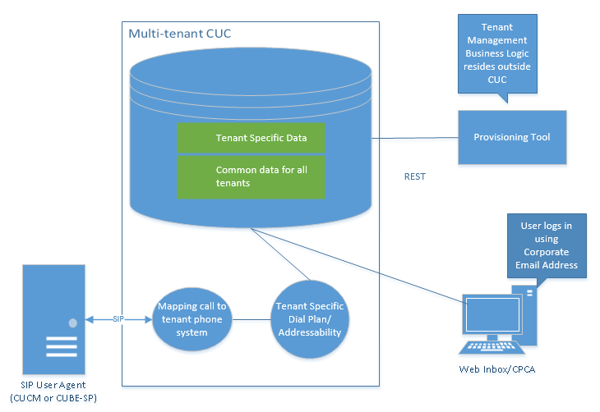
Solution Approach

Slide 9
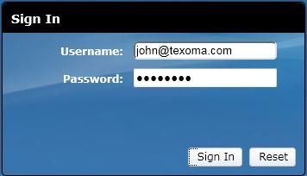
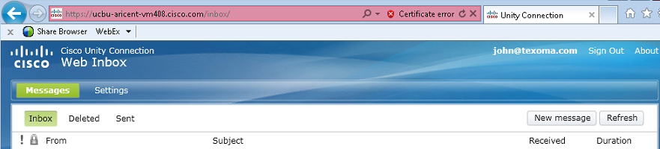
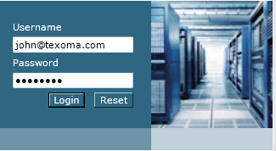
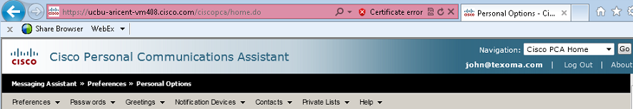
Corporate Email Address as Alias
To login onto CUC Web Interfaces like Web Inbox, CPCA and VM REST, each user belonging to any tenant would use the corporate email address. Users will not have access to the SA webpage and it would not be used provision tenants.
As an example for tenant Texoma, user john@texoma.com would login onto Web Inbox and CPCA as shown in the picture.

Slide 10
System Requirements
Different Virtual Platform Overlays allow creation of different number of tenants.
For information related to the system requirements, you can refer to the Supported Platform list Guide:
http://www.cisco.com/en/US/docs/voice_ip_comm/connection/9x/supported_platforms/9xcucspl.html
Note: Links to Supported Platform List guiders for 10.X guides will be updated later.
OVAs that can be Used
20,000 Users
10,000 Users
5,000 Users
1000 Users

Slide 11
Supported Topologies

Slide 12
Topology
Each Tenant will be assigned unique Phone System to identify inbound and outbound voice mail traffic. Also,
All inbound and outbound traffic related to a Tenant will be mapped to that particular phone system only.
Each tenant will have its own routing rules, Call handlers etc. to manage calls accordingly.

Slide 13
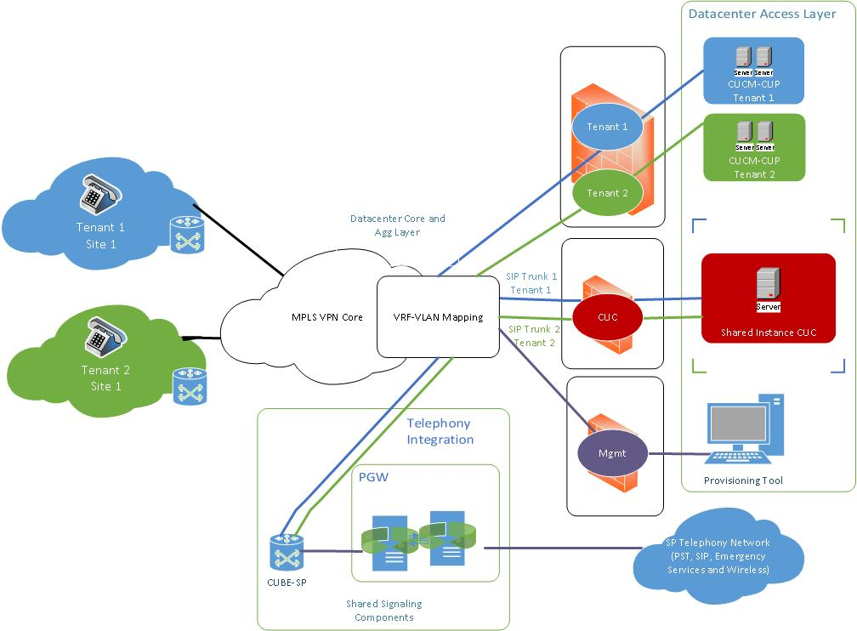

Slide 14
Working with Tenant Partitioning Feature

Slide 15
Tenant Provisioning using API
How to provision a Tenant and get it working?
Create Tenant
Create Ports
Call Pilot Number
Create Port Group
Record Greetings
Integrate with CUCM
Create User for the tenant

Slide 16
Create Tenant
Create Tenant
Create Ports
Call Pilot Number
Create Port Group
Record Greetings
Integrate with CUCM
Create User for the tenant

Slide 17
Create Tenant
For tenant provisioning, a new API has been introduced in CUC. Highlights about Tenant creation
Tenant creation is an atomic operation and all its associated objects are created by executing a single API request.
If operation fails at any point in time, the entire process will be rolled back.
More objects like COS, Schedule Sets etc. can be associated with the tenant later.

Slide 18
Create Tenant
To create a tenant, an HTTP POST request should be sent to the URI
https://<connection-server>/vmrest/tenants
The request should contain values for the following fields:
Alias: Represents the alias of the tenant.
SMTPDomain: Represents the corporate SMTP Domain of the tenant.
Description [Optional]: Description of the tenant.
MailboxStoreObjectId [Optional]: Object ID of the Mailbox Store.
Language [Optional]: Language of the tenant, and of the default objects created with the tenant.
Timezone [Optional]: Time zone of the tenant, and of the default objects created with the tenant.
Note: For the optional parameters, if no value is specified then system default values will be used.

Slide 19
Create Port Group
Create Tenant
Create Ports
Call Pilot Number
Create Port Group
Record Greeting
Integrate with CUCM
Create User for the tenant

Slide 20
Create Port Group
To create a port group, an HTTP POST request should be sent to the URI
https://<connection-server>/vmrest/portgroups
The request should contain values for the following fields:
DisplayName: Display name of the port group.
MediaSwitchObjectId: Object Id of the phone system.
MediaPortGroupTemplateObjectID: ObjectId of the template for the Port group.
TelephonyIntegrationMethodEnum: Value “2” to create SIP port Group
HostorIpAddress: Hostname or IP Address of the CUCM server.
Note: Tenant Partitioning supports SIP integration only.

Slide 21
Create Ports
Create Tenant
Create Ports
Call Pilot Number
Create Port Group
Record Greetings
Integrate with CUCM
Create User for the tenant

Slide 22
Create Ports
To create a port, an HTTP POST request should be sent to the URI
https://<connection-server>/vmrest/ports
The request should contain values for the following fields:
MediaPortGroupObjectId: The Object Id of the MediaPortGroup object to which this port would belong to.
VmsServerObjectId: The Object Id of the of VMSServer to which this port would belong to.
NumberOfPorts: Number of ports that you want to create.

Slide 23
Integrate with CUCM
Create Tenant
Create Ports
Call Pilot Number
Create Port Group
Integrate with CUCM
Create User for tenant
Record Greetings

Slide 24
Integrate with CUCM
Create SIP Security Profile
Create Trunk to Unity Connection
Create Route List
Create SIP Profile
Create Route Group
Create Route Pattern
Create Voice Mail Pilot and Voice Mail Profile
NOTE: For detailed information, please visit the Cisco Unified Communications Manager SIP Integration Guide for Cisco Unity Connection
http://www.cisco.com/en/US/docs/voice_ip_comm/connection/9x/integration/guide/cucm_sip/cucintcucmsip.html

Slide 25
Create User for the tenant
Create Tenant
Create Ports
Call Pilot Number
Create Port Group
Integrate with CUCM
Create User for the tenant
Record Greetings

Slide 26
Create User for the Tenant
To create a user, an HTTP POST request should be sent to the URI
https://<connection-server>/vmrest/users?templateAlias=<TenantUserTemplate)
User template specified in the URI should be the one that belongs to the tenant you are creating user for.
The request should contain values for the following fields:
Alias: A unique text name for User.
DtmfAccessId: The DTMF access id (i.e., extension) of the user.

Slide 27
Record Greetings
Create Tenant
Create Ports
Call Pilot Number
Create Port Group
Integrate with CUCM
Create User for the tenant
Record Greetings

Slide 28
Record Greetings
To record a greeting follow this 3-step process:
Create a temporary place-holder WAV file on CUC via POST operation on the URI
https://<connection-server>/vmrest/voicefiles
Use the temporary file name created in Step 1 to PUT the new audio. The HTTP content type is "audio/wav" and the payload content is the audio data.
        https://<connection-server>/vmrest/voicefiles/<TemporaryFileName>
Assign temporary audio WAV file to the target resource. Perform a POST operation on the following URI:
        https://<connection-server>/vmrest/handlers/callhandlers/<TenantCallHandlerObjectId>/greetings/Standard/greetingstreamfiles/1033

Slide 29
Call Pilot Number
Create Tenant
Create Ports
Call Pilot Number
Create Port Group
Integrate with CUCM
Create User for the tenant
Record Greetings
Configuration is now complete. Dial the pilot number. You will hear the recorded opening greeting.
Note: For detailed information about provisioning APIs, visit the following link:
http://docwiki.cisco.com/wiki/Cisco_Unity_Connection_Provisioning_Interface_%28CUPI%29_API

Slide 30
Migration

Slide 31
Overview
Consolidated Object Backup and Restore Application Suite (COBRAS) is a set of tools designed to allow administrator to migrate the data from one CUC to another.
COBRAS for Tenant Partitioning allows administrator to backup and restore tenant data and all the objects which are directly or indirectly associated with it.
COBRAS will support migration of following scenarios in Tenant Partitioning deployment:
  Tenant migration from a Tenant Partitioned CUC to another Tenant Partitioned CUC.
  Tenant migration from a Tenant Partitioned CUC to a Standalone CUC.
  Data migration (Subscribers only) from a Standalone CUC to a Tenant Partitioned CUC.

Slide 32
COBRAS: Backup
Backup
        If CUC supports the Tenant Partitioning feature, then while taking backup COBRAS Export tool will provide option to select a tenant. This backup will export all the objects which are directly or indirectly mapped with the selected tenant.
  COBRAS will create the backup files with the following naming convention
  UnityDBData_Backup_<Connectionserver>_<TenantAlias>_<year><month><day>_<hour>_<minute>_<second>.mdb
  UnityMessage_Backup_<Connectionserver>_<TenantAlias>_<year><month><day>_<hour>_<minute>_<second>.mdb
        NOTE: For detailed information, please visit the following online help link for COBRAS support for Tenant Partitioning
    http://www.ciscounitytools.com/Applications/General/COBRAS/COBRAS.html

Slide 33
COBRAS: Backup(cont.)
Diagram shows the dependency of all the objects backed up via the COBRAS Export tool. The objects on the left are prerequisites for backing up objects on the right.
Tenant
Partition
Schedule Sets
COS
Phone System
Call Handler/Call Handler Templates
Directory Handler
Interview Handler
User/User Templates
Search Spaces
Public Distribution List
Restriction Tables
Schedules
Menu Entry
Greetings
Transfer Rules
Alternate Extension
Notification Devices
Alternate Contact Number
MWI
Private Distribution List
SMTP Proxy
Authentication Rules
Mailboxes

Slide 34
COBRAS: Restore
  For multi-tenant system, COBRAS import tool supports restore of selected objects which are different for each migration scenario.
  The number of pages in COBRAS Import wizard is also different for each migration scenario. COBRAS Import wizard is divided into the following parts:
  Select which backed up objects administrator want to restore.
  Resolve conflicts restoring any of the objects which administrator selected during part 1.
  Resolve link references for any objects that administrator choose to restore in part 1.
    NOTE: For detailed information, please visit the following online help link for COBRAS support for Tenant Partitioning
    http://www.ciscounitytools.com/Applications/General/COBRAS/COBRAS.html

Slide 35
Scenario 1: Tenant migration from a Tenant Partitioned CUC to another Tenant Partitioned CUC
Login to COBRAS Import Tool
Administrator wants to migrate the tenant specific data from a multi-tenant Unity Connection to another multi-tenant Unity Connection.
Prerequisites: Administrator has to create a Tenant in the target CUC as a prerequisite for restore process. This tenant should have the same Alias and Domain as that present in the backup file of the exported data.
Select the Backup file to restore
Login to COBRAS Export Tool
Select “Import backup in a multi-tenant system”
Select the Tenant to take backup
Select Object to restore in CUC
Start the Export Process
Resolve conflicts for the selected objects
UnityBackupdta_Tenant1_2013_08_96.mdb
Resolve link references of the selected objects
Start the Import Process

Slide 36
Scenario 2: Tenant migration from a Tenant Partitioned CUC to Standalone CUC
Login to COBRAS Import Tool
Administrator wants to migrate the tenant specific data from a multi-tenant Unity Connection to Standalone Unity Connection.
Prerequisites: Administrator can either
  create new partition, search space, phone system, COS, Subscriber templates, call handler templates in the target CUC to map the objects during Import process or
  administrator can map the imported objects with the default system objects present in the target CUC.
Select the Backup file to restore
Login to COBRAS Export Tool
Select “Import backup in a standalone system” option
Select the Tenant to take backup
Select Object to restore in CUC
Start the Export Process
Resolve conflicts for the selected objects
UnityBackupdta_Tenant1_2013_08_96.mdb
Resolve link references of the selected objects
Start the Import Process

Slide 37
Scenario 3: Data migration(Subscribers only) from a Standalone CUC to a Tenant Partitioned CUC
Login to COBRAS Import Tool
Administrator of standalone Unity Connection exports the data and restores the same into multi-tenant Connection system.
Prerequisites: Administrator has to create a tenant in the target CUC with unique Tenant alias and SMTP domain. While restoring, administrator can only select subscribers except default users.
Select the Backup file to restore
Login to COBRAS Export Tool
Select “Tenant to restore” backup
Select the export options as per the backup requirement
Select Subscribers to restore in CUC
Start the Export Process
Resolve conflicts for the Subscribers
UnityBackupdta_2013_08_96.mdb
Resolve link references of the Subscribers
Start the Import Process

Slide 38
Troubleshooting
For debugging the issue , you can refer the logs at the following path:
Log Path: <Installation Directory>\Logs
For any issues related to COBRAS, you can refer to the following online help
  http://www.ciscounitytools.com/Applications/General/COBRAS/COBRAS.html

Slide 39
Backup, Restore and Upgrade

Slide 40
Backup and Restore
The Disaster recovery tool (DRS) installed with along Unity Connection is used for Backup and Restore.
The Backup and Restore procedure is the same and no changes have been made for Tenant Partitioning feature.
Tenants can be successfully backed up and restored.
For any other information related to CUC DRS backup and restore, you can refer to the Backup and Restore Guide:
http://www.cisco.com/en/US/docs/voice_ip_comm/connection/9x/drs_administration/guide/9xcucdrsag.html
Note: Links to Installation and Troubleshooting Guides for 10.X will be updated later

Slide 41
Upgrade
The upgrade process is responsible for the orderly upgrade of the system from one version to the next.
The upgrade process is same as before and no changes have been introduced with this feature.
Unity connection release with Tenant Partitioning feature can only be upgrade to higher version of Unity Connection release with Tenant Partitioning feature.
Tenant partitioning feature is supported from 10.0.
Upgrade is supported from previous Unity Connection release
  However, to use the Tenant Partitioning feature on a server upgraded to Unity Connection 10.0 version, delete all the existing data from the system and then create tenants.
10.0

Slide 42
Upgrade
For any other information related to CUC Upgrade, you can refer to the Upgrade Guide:
http://www.cisco.com/en/US/docs/voice_ip_comm/connection/9x/upgrade/guide/9xcucrugx.html
You can also take a look at the Troubleshooting Guide:
http://www.cisco.com/en/US/docs/voice_ip_comm/connection/9x/troubleshooting/guide/9xcuctsgx.html
Note: Links to Upgrade and Troubleshooting Guides for 10.X will be updated later.

Slide 43
Troubleshooting

Slide 44
Installation
The installation process is same as before and no changes have been introduced with this feature.
For any issues related to CUC installation, you can refer to the Installation Guide:
http://www.cisco.com/en/US/docs/voice_ip_comm/connection/9x/installation/guide/9xcucigx.html
You can also take a look at the Troubleshooting Guide:
http://www.cisco.com/en/US/docs/voice_ip_comm/connection/9x/troubleshooting/guide/9xcuctsgx.html
Note: Links to Installation and Troubleshooting Guides for 10.X will be updated later.

Slide 45
Diagnose traces
For details on how to view diagnostic traces, you can refer the guide below:
http://www.cisco.com/en/US/docs/voice_ip_comm/connection/9x/troubleshooting/guide/9xcuctsg010.html

Slide 46
Tenant Configuration – Case 1
Problem Statement:
Tenant creation API fails on a freshly installed system, or a system without any tenants
Action Required:
Check that Unity connection system does not have users of any partition other than a tenant partition; it should only have default users. To do this, you can run the following HTTP GET request:
      https://<connection-server>/vmrest/users
      Undeliverablemessagesmailbox
      Operator

Slide 47
Tenant Configuration – Case 1
When we try to create Tenant in a connection system having users of any other partition, error will occur as :
“Invalid parameter. Parameter = [Non-Tenant users exists on Unity Connection.Cannot proceed with Tenant creation.], Value = [tbl_user]”

Slide 48
Tenant Configuration – Case 2
Problem Statement:
You hear Opening Greeting on dialing the pilot number instead of being asked for the PIN number.
Cause:
This would happen when Opening Greeting routing rule is above the Attempt Sign-in routing rule for the tenant in the order of routing rules.

Slide 49
Tenant Configuration – Case 2
Action Required:
Open Port Status Monitor and then dial the pilot number.
On Port Status Monitor, you would see that the call is going directly to the Opening Greeting as shown below:

Slide 50
Tenant Configuration – Case 2
To check this, you can get the list of routing rules for the tenant by sending a GET request to the URI and check the value for Rule Index field:
    https://<connection-server>/vmrest/routingrules?query=(SearchSpaceObjectId%20is%20<TenantSearchSpaceObjectId>
      To correct this, see the CUPI APIs documentation for Routing Rules API.
  http://docwiki.cisco.com/wiki/Cisco_Unity_Connection_Provisioning_Interface_%28CUPI%29_API

Slide 51
Tenant Configuration – Case 3
Problem Statement:
  Users from one tenant are able to send messages to users from other tenants.
Cause:
  This problem may occur when the Tenant’s Search Space contains partition(s) belonging to other tenants.
Action Required:
  Check the tenant’s search space as To find out the Search Space and Partition associated with a tenant, do the following:

Slide 52
Tenant Configuration – Case 3
Run an HTTP GET request on the URI below to get Search Space Object Id for the tenant:
    https://<connection-server>/vmrest/searchspacesmembers?query=(PartitionObjectId%20is%20<TenantPartitionObjectId>)
Run an HTTP GET request on the URI below to get the object id for partitions belonging to the tenant’s search space:
    https://<connection-server>/vmrest/searchspacesmembers?query=(SearchSpaceObjectId%20is%20<TenantSearchSpaceObjectId)

Slide 53
Tenant Configuration – Case 3
  For example, Texoma tenant’s search space contains the partitions:
    Texoma_Partition_1 (belongs to tenant Texoma)
    Donald_Partition_1 (belongs to tenant Donald)
  Users belonging to tenant Texoma will be able to send messages to users belonging to tenant Donald. You can correct this by changing the association.

Slide 54
Tenant Configuration – Case 4
Problem Statement:
You get option to select users from other partitions in directory results.
Action Required:
Check Search Scope for the directory handler that belongs to the tenant. To do this, you can run the following HTTP GET request:
      https://<connection-server>/vmrest/handlers/directoryhandlers?query=(PartitionObjectId%20is%20<TenantPartitionObjectId)
      If the value of SearchScope field is set to zero then it means that the Search Scope is set to Entire Server. Set the search scope to appropriate value to resolve the issue.

Slide 55
Tenant Configuration – Case 4
Enable Micro Traces for General Method returns and Parameter values(01), Data access(02), Named property access(03) level ConvSub logs and Named props access(11), CDL Access(12), MIU Access(13) and Search Space(04) level CDE logs from Cisco Unity Connection Serviceability. For all the aliases that you hear over the call there will be an entry in diag_ CuCsMgr_*.uc with the phone system attached to the users. Below is an extract for a user with the alias john@tenant.com:

Slide 56
Tenant Configuration – Case 4
Search space can contain multiple partitions. To check if there are multiple partitions in search space, you can run the following HTTP GET request:
    To GET the search space: https://<connection-server>/vmrest/searchspaces/<searchspace-objectid>/searchspacemembers?query=(PartitionObjectId%20is%20<TenantPartitionObjectId>
    From the above URI search space object id of a tenant will be obtained and it can be used to find the associated partitions with the URI below:
    To GET the search space: https://<connection-server>/vmrest/searchspaces/<searchspace-objectid>/searchspacemembers?query=(SearchSpaceObjectId%20is%20<SearchSpaceObjectId>

Slide 57
Tenant Configuration – Case 4
  Check if the search space selected in Search scope of directory handler belongs to the same tenant or not. To do this run the following HTTP GET request:
  https://<connection-server>/vmrest/handlers/directoryhandlers/<directoryhandler-objectid>
  Check the search scope object id, it should be same as that of the tenant.

Slide 58
Tenant Configuration – Case 5
Problem Statement:
  On trying to delete a tenant, the error message “COS is referenced by at least one user or user template.” is returned.
  This case is applicable for other objects associated with the tenant also .
Cause:
  This issue may occur when objects mapped to a tenant like COS is associated with users belonging to other tenants.

Slide 59
Tenant Configuration – Case 5
Action Required:
  To investigate this:
  Get ObjectIds of the COS objects associated with the tenant using the URI:
  https://<connection-server>/vmrest/tenants/<TenantObjectId>/coses
  The following steps need to be repeated for all the resultant COS ObjectIds.
  Get the list of user templates associated with the COS Object Id using the URI:
    https://<connection-
    server/vmrest/usertemplates?query=(CosObjectId%20is%20<CosObjectId>)

Slide 60
Tenant Configuration – Case 5
    Here, replace <CosObjectId> with the COS Object Id that belongs to the tenant. Now, to get the list of user templates that belongs to the tenant, use the URI below:
  https://<connection- server>/vmrest/usertemplates?query=(CosObjectId%20is%20<CosObjectId>%26PartitionObje ctId%20is%20<PartitionObjectId)
    Comparing results of the GET operations would provide list of user templates that are associated with the Tenant’s COS but are not a part of Tenant’s partition. You can correct this by changing the COS association for these user templates.

Slide 61
Tenant Configuration – Case 5
  Get the list of users associated with the COS Object Id using the URI:
  https://<connection-server>/vmrest/users?query=(CosObjectId%20is%20<CosObjectId>)
      Here, replace <CosObjectId> with the COS Object Id that belongs to the tenant. Now to get the list of users that belongs to the tenant, use the URI below :
  https://<connection- server>/vmrest/users?query=(CosObjectId%20is%20<CosObjectId>%26PartitionObjectId%20 is%20<PartitionObjectId)
      Comparing results of the GET operations would provide list of users that are associated with the Tenant’s COS but are not a part of Tenant’s partition. You can correct this by changing the COS association for these users.

Slide 62
Response Codes
2xx : Success Response .
3xx : Redirection of Request .
4xx : Client Error.
5xx : Server Error.

Slide 63
Integration with CUCM – Case 1
Problem Statement:
You hear the Fast Busy tone on dialing the pilot number. This tone is played in the following two cases:
Ports require reset
Ports are busy or locked

Slide 64
Integration with CUCM – Case 1
Action Required:
Check if any port require a reset. You can check this on CUCA on the Port Groups page or using the Port group API. If for any Port Group, value for Needs Reset field is Yes/ True, then reset the Port Group.
To investigate if ports are busy:
Check if ports are busy
    number of incoming calls is significantly high in peak hours
    or number of incoming calls is high all the time
    Then based on tenant’s requirement there might be a need to add additional ports.

Slide 65
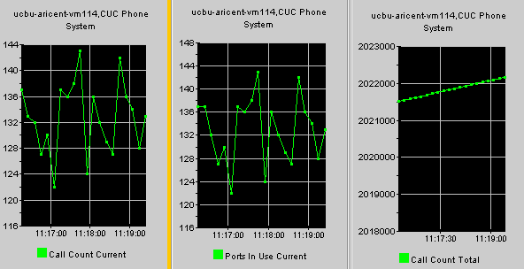
Integration with CUCM – Case 1
Check CUC phone system: ports in Use Counter on RTMT to see if ports are busy.

Slide 66
Integration with CUCM – Case 1
The ports may be marked busy even if the ports are locked. To verify the same check on RTMT if the port frees up after a call ends and that it also answers other incoming calls.
You can also check the counter CUC phone system: Ports locked to check for any locked ports. Also, ports can be reset to resolve the port locking up.
Ports locked counter in RTMT can be checked in the CUC Phone System counter.

Slide 67
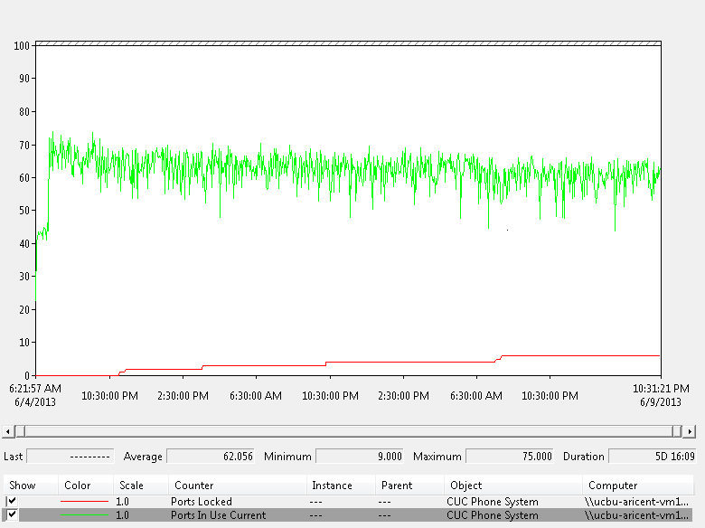
Integration with CUCM – Case 1
RTMT log for Port locked and Port in use :

Slide 68
Integration with CUCM – Case 2
Problem Statement:
You hear the message “The system is temporarily unable to complete your call” on dialing the pilot number.
Action Required:
This issue can occur when CUC does not have appropriate routing rules to process the call. To check this, enable Threads(11) and Ports(13) level Micro Traces for Arbiter on Cisco Unity Connection Serviceability and check the diag_CuCsMgr_*.uc log file for the following:
‘Failed to find routing rule=Texoma_PhoneSystem_1’
      Here, Texoma_PhoneSystem_1 is name of the phone system under consideration.

Slide 69
Integration with CUCM – Case 2
Incase, no routing rules exist for the tenant then you can add them using the POST operation on the Routing Rules API.
Direct rules handle calls from users and unidentified callers that are dialed directly to Connection.
Forwarded rules handle calls that are forwarded to Connection from either a user extension or from an extension that is not associated with a user account
You may also use the Port Status monitor to see the type of the call. If Port Status Monitor shows that the call doesn’t contain a Redirecting Id and value for the Reason field is Direct then Direct Routing Rule will be reached. See the screenshots below:

Slide 70
Integration with CUCM – Case 2
Also, if Routing Rule Condition has been removed or is missing from a Routing Rule on CUC then Routing Rules that come later in the order, will never be reached.
Example:
Suppose, there are three routing rules and Routing Rule Condition does not exist for the second one then the third routing rule in the sequence will never be reached.
To check if this is the case or to investigate the issue:
Check if Tenant’s phone system is added as a Routing Rule Condition in the Routing Rules for that tenant.
Enable the Micro Traces for Routing Rules and Arbiter on Cisco Unity Connection Serviceability and check the logs for any errors or issues.

Slide 71
Integration with CUCM – Case 2
Check the phone system configuration like phone system, port groups, Ports and SIP Security Profile CUC. You can check the following:
      Verify that the port number specified in SIP Trunk profile on CUCM and the Port Group on CUC are same.
      Verify that SIP Trunk Security Profile on CUCM has the correct incoming port number.
      Verify the CUCM IP Address or Hostname specified in Port Group on CUC.

Slide 72
References

