Slide 1
Cisco Unity Connection
Audit Logging
EDCS - 1572374 May 23 2016

Slide 2
Notice
The information in this presentation is provided under Non-Disclosure agreement and should be treated as Cisco Confidential. Under no circumstances is this information to be shared further without the express consent of Cisco.
Any roadmap item is subject to change at the sole discretion of Cisco, and Cisco will have no liability for delay in the delivery or failure to deliver any of the products or features set forth in this document.

Slide 3
Agenda
Introduction
What's new
Use cases
References

Slide 4
Introduction

Slide 5
Introduction
At Cisco Unity Connection, with audit logging we monitor and log any configuration change to the system by a user or as a result of the user action.
Supported audit events :–
  Application audit log
  DB audit log
  VOS audit log
System Administrator or Audit Administrator can configure above logs.
Audit events can be redirected to an RTMT or a Remote Syslog server.

Slide 6
What's New

Slide 7
What's NEW
Enhancements made in Unity Connection Release 11.5 and onwards:
Audit logging of a Remote Account Admin user
Audit logs transmission to remote syslog server over TCP
Audit alerts triggered on failure of audit log transfer through TCP mode
Audit Logging for Remote Admin account can be logged over Log Stash Server

Slide 8
CLIs for Audit Logs
To check transmission mode of audit logs to remote server:
utils remotesyslog show protocol
To change the transmission mode of audit logs to UDP protocol:
utils remotesyslog set protocol udp
To change the transmission mode of audit logs to TCP protocol:
  utils remotesyslog set protocol tcp
  Note: Default mode of communication is UDP. In EnhancedSecurity Mode, it changes to TCP

Slide 9
Use Cases

Slide 10
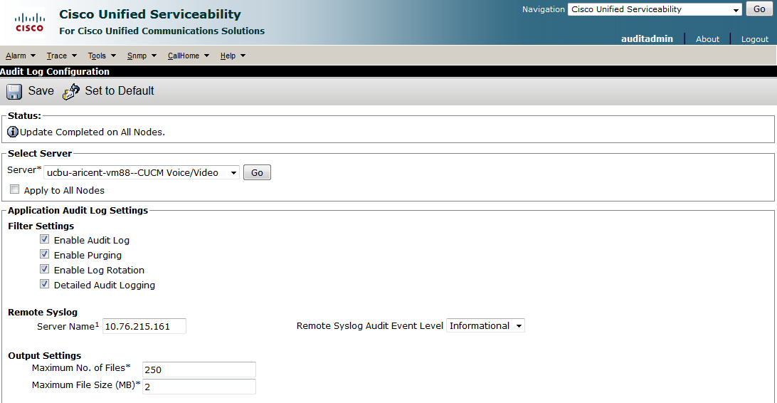
Use Case 1 – Application Auditing
System Admin / Audit Admin can configure audit logs from Cisco Unified Serviceability webpage.

Slide 11
Use Case 1 – Contd.
Application Audit logs transmission to a remote syslog server can be configured from the Cisco Unified Serviceability webpage
A scenario of Failed/Successful login to a CUC web application
Login Failure Audit Log:
03:08:00.296 |LogMessage UserID : admin ClientAddress : 10.77.250.47 Severity : 4 EventType : UserLogging ResourceAccessed: Cisco Unity Connection Serviceability EventStatus : Failure CompulsoryEvent : No AuditCategory : AdministrativeEvent ComponentID : Cisco Unity Connection CorrelationID : AuditDetails : Failed to login to Cisco Unity Connection Serviceability App ID: Cisco Tomcat Cluster ID: Node ID: ucbu-aricent-vm175

Slide 12
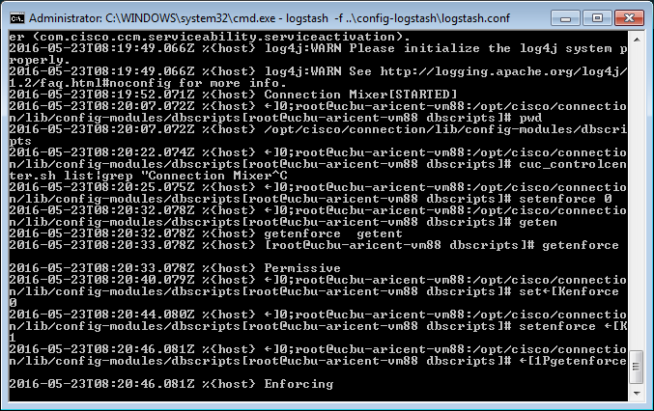
Use Case 2 – Remote Account Activity Auditing
Audit logs of operations done by a Remote Account Admin can be seen at the Log Stash Server.

Slide 13
Use Case 2 – Contd.
CLI commands to configure a Remote LogStash Server:
To configure the LogStash Server details
utils filebeat config
To enable the remote account auditing
utils filebeat enable
To disable the remote account auditing
utils filebeat disable
To check the status of remote account auditing
utils filebeat status
Note: The operations done by TAC on system using remote_account are now recorded and can be viewed only over LOG Stash Server.

Slide 14
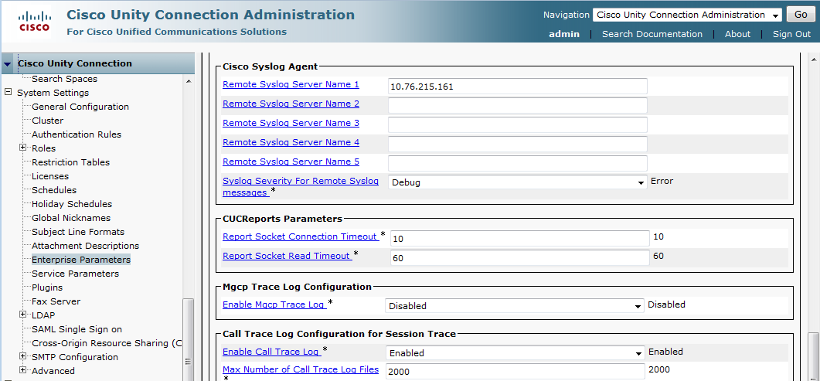
Use Case 3 – When a Critical Service Goes Down
Transmission of Cisco Syslogs to a remote syslog server can be configured from Cisco Unity Connection Administration webpage.
Shutdown of a critical service say ‘Connection Mixer’, alarms are generated and transferred to the Syslog Remote server.

Slide 15
Use Case 3 – Contd.
Audit alarm and alert generated when a critical service stops.
Critical Service down Audit Log:
May 19 14:02:13 ucbu-aricent-vm88 local7 3 : 1: ucbu-aricent-vm88.cisco.com: May 19 2016 08:32:13 AM.535 UTC : %UC_UCSRM-3-CriticalServiceDown: %[AppID=CuSrm][ClusterID=][NodeID=ucbu-aricent-vm88]: Critical Service Connection Mixer is down.

Slide 16
Use Case 4 – RTMT Alarm When Audit Logs Transmission Fails
Audit alarms generate if audit logs fail to transmit on TCP to the remote server configured.
RTMT Alert Audit Log:
May 23 09:49:21 ucbu-aricent-vm88 local7 2 : 110: ucbu-aricent-vm88.cisco.com: May 23 2016 04:19:21 AM.698 UTC : %UC_RTMT-2-RTMT_ALERT: %[AlertName=TCPRemoteSyslogDeliveryFailed][AlertDetail= At Mon May 23 09:49:21 IST 2016 on node ucbu-aricent-vm88, the following TCPRemoteSyslogDeliveryFailed events generated: #012RemoteSyslogServerIP : 10.76.215.161#012RecommendedTCPPort : 601#012Source : 1#012AppID : Cisco Syslog Agent#012ClusterID : #012NodeID : ucbu-aricent-vm88#012 TimeStamp : Mon May 23 09:49:13 IST 2016][AppID=Cisco AMC Service][ClusterID=][NodeID=ucbu-aricent-vm88]: RTMT Alert

Slide 17
References

Slide 18
References
Annotated logs wiki:
Troubleshooting Guide for Cisco Unity Connection:
https://wiki.cisco.com/display/12341/CUC+Audit+logs
http://www.cisco.com/c/en/us/td/docs/voice_ip_comm/connection/10x/troubleshooting/guide/10xcuctsgx.pdf

