Slide 1
Cisco Unity Connection Auto Advance to Next Message After Forward
EDCS-1524420

Slide 2
Notice
The information in this presentation is provided under Non-Disclosure agreement and should be treated as Cisco Confidential. Under no circumstances is this information to be shared further without the express consent of Cisco.
Any roadmap item is subject to change at the sole discretion of Cisco, and Cisco will have no liability for delay in the delivery or failure to deliver any of the products or features set forth in this document.

Slide 3
Agenda
Introduction
What's new
Configuration
Demo
Troubleshooting Tips

Slide 4
Introduction

Slide 5
Introduction
After forwarding the message, Unity Connection plays “After Message Menu” and wait for user input to perform action such as save, delete and forward, then move to the next message.
With this new feature, administrator can configure Unity Connection to automatically move to the next message without playing After Message Menu options while forwarding the message.

Slide 6
What’s new
A new option added on CUCA under:
User Settings: User Basic Page -> Edit -> Playback Message Settings
User Template Settings:
User Template Basic Page -> Edit -> Playback Message Settings

Slide 7
Configuration

Slide 8
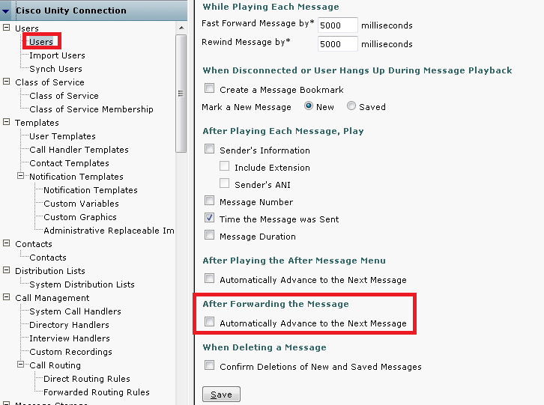
Configuration on CUCA
To enable/disable field “After Forwarding the Message“, go to User Basic Page -> Edit -> Playback Message Settings.
Default value for "After Forwarding the Message" field is set to false.
Note: Same Configuration applies on User Template

Slide 9
Demo

Slide 10
CURRENT CALL FLOW ON FORWARD
Tom drops a message to Adam
Adam starts playing of messages
Message is played, followed by after message menu
Adam presses 5 to forward this message
Unity Connection ask for the user name or extension to whom message is to be forwarded
Adam confirms and press # to forward this message
After forward message menu gets played repeatedly
Wait for user to perform some operation
Advances to next message based on user inputs
Notes:
As per existing behavior, after forward of message, call flow remains on same message and it expects users to perform some more operation on current message.

Slide 11
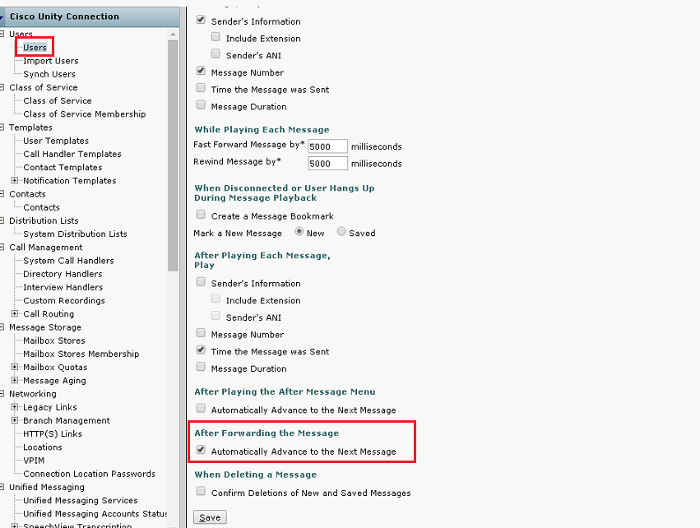
Enable field “After Forwarding the Message”

Slide 12
NEW CALL FLOW ON FORWARD
Tom drops a message to Adam
Adam starts playing of messages
Message is played, followed by after message menu
Adam presses 5 to forward this message
Unity Connection ask for the user name or extension to whom message is to be forwarded
Adam confirms and press # to forward this message
After forward message menu gets played repeatedly
Wait for user to perform some operation
Current message gets saved and flow advances to next message immediately
Notes:
As per new behavior, after forward of message, current message gets saved and flow advances to next message immediately.

Slide 13
Troubleshooting

Slide 14
Troubleshooting
Problem Statement:
“After Message Menu Options” getting played while forwarding the message.
Action Required:
Verify that “After Forwarding the Message” is enabled on CUCA.
User Basic Page -> Edit -> Playback Message Settings
Annotated logs wiki: http://wikicentral.cisco.com/display/UNITYTRANS/Annotated+diagnostics+for+Auto+Advanced+to+Next+Message+After+Forward

Slide 15
Reference
Cisco Unity Connection Administration Guide:
http://www.cisco.com/c/en/us/td/docs/voice_ip_comm/connection/11x/administration/guide/11xcucsagx.html

