Slide 1
CARE
CONNECTION ADVANCE REPLICATION ESTABLISHMENT
EDCS-1563089

Slide 2
Need
Unity Connection currently does not contain CLI’s through which connection replication can be defined or corrected.
Significantly high number of GAMES are received in an year in relation to this issue which needs BU intervention. This can be avoided by implementation of this feature.

Slide 3

Description
Replication CLI features :
  utils cuc dbreplication reset_all
  utils cuc dbreplication 01_tear_down
  utils cuc dbreplication 02_define_servers
  utils cuc dbreplication 03_define_db_template
  utils cuc dbreplication 04_sync_database

Slide 4
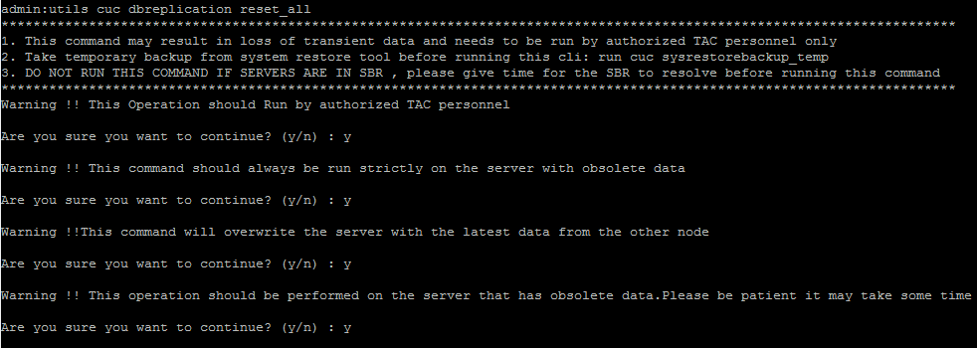
  NOTE : This CLI should be run by authorized TAC personnel only
  The above set of authorization checks guarantees that the disclaimers are acknowledged before proceeding towards execution of each CARE CLI.

Slide 5
Disclaimers before CLI execution
This command may result in loss of transient data and needs to be run by authorized TAC personnel only
Take temporary backup from system restore tool before running this cli: run cuc sysrestorebackup_temp
DO NOT RUN THIS COMMAND IF SERVERS ARE IN SBR , please give time for the SBR to resolve before running this command
This Operation should Run by authorized TAC personnel
This command should always be run strictly on the server with obsolete data
This command will overwrite the server with the latest data from the other node
This operation should be performed on the server that has obsolete data.Please be patient it may take some time
THE TAC HAS TO APPROVE THE ABOVE DISCLAIMERS BEFORE IT CAN PROCEED. ANY FAILURE TO DO SO WILL CANCEL THE EXECUTION OF CLI.

Slide 6
utils cuc dbreplication reset_all
This Command Line feature performs function of the below CLIs in the order specified below and resets the replication in one go.
  utils cuc dbreplication 01_tear_down
  utils cuc dbreplication 02_define_servers
  utils cuc dbreplication 03_define_db_template
  utils cuc dbreplication 04_sync_database

Slide 7
utils cuc dbreplication 01_tear_down
This Command Line feature provides us an option to tear down the replication and connectivity between two CUC servers in a cluster.
It also makes sure that the CDR build up is cleaned out in case of massive CUC database CDR queue buildup.
It gives a clean ground to establish server connectivity in the CUC cluster and for further establishment of replication between them.

Slide 8
utils cuc dbreplication 02_define_servers
This Command Line feature establishes the network connectivity between the two servers in a cluster.
This connectivity can also be used to track and report the network CDR traffic from one server to another.
This establishment is also very important for role negotiation during SBR process.

Slide 9
utils cuc dbreplication 03_define_db_template
This Command Line feature negotiates the table templates of Unity Databases on which the replication scheme needs to be established.
It is essential as it lists all tables and defines templates on basis of which the data is negotiated and synced between the servers.

Slide 10
utils cuc dbreplication 04_sync_database
This Command Line feature syncs the database from the remote server to the local server on which the CLI is run.
The replication command CLIs need to be run on the server that has obsolete data so that the sync database copies the recent data and replaces the old data on current server.

Slide 11
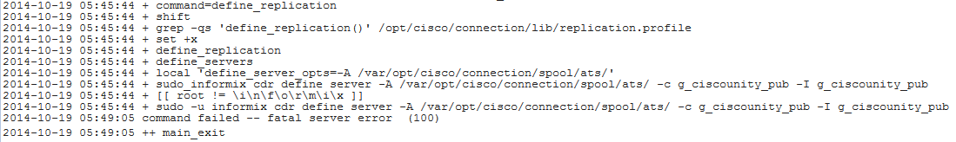
Use Cases :
Use case 1 : Switch version failure :
  During switch version failure if you see the below error message on Sub :
OR
  This implies that the define_server has failed and needs a CUC replication reset.

Slide 12
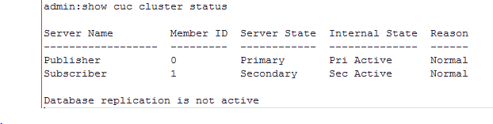
Before attempting to switch version again please try following steps :
  Verify using show cuc cluster status , what is the status of the CDR queue and server connectivity
  To break the replication and clear CDR queues we would need to run :
  utils cuc dbreplication 01_tear_down
  Proceed with switch version after verifying that the cdr queues have been cleaned and the servers are not connected anymore by running CLI show cuc cluster status .

Slide 13

Use case 2 : Subscriber / Publisher out of sync due to unplanned shutdown/outage :
  In case of an unplanned shutdown or outage if either publisher or subscriber goes down . There can be two situations :
  The CDR queue grows very large :
    Please verify if the cdr queue is filled up and server shows as disconnected.
    To clean up the queues and reinstate the replication we can run the command
    utils cuc dbreplication reset_all to reset all the replication and re establish the
    replication with the subscriber /publisher server.

Slide 14
      In case the reset all attempt fails the commands need to be run individually as per the below sequence to record the point of failure :
        utils cuc dbreplication 01_tear_down
        utils cuc dbreplication 02_define_servers
        utils cuc dbreplication 03_define_db_template
        utils cuc dbreplication 04_sync_database
      NOTE : The commands should not be run when the servers are in SBR mode . Please wait for the SBR to resolve after the server comes back up.

Slide 15
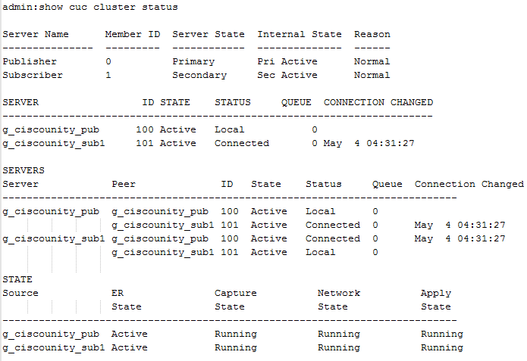
When servers are out of sync and data is not consistent :
  Before a manual sync can be initiated we would need to verify the state of the servers , proceed only if state shows as below in the result of show cuc cluster status CLI:
  To do a manual sync of the servers we can run the command utils cuc dbreplication 04_sync_database : this command should always be run on the node having the obsolete data. It copies the data from the server with latest information on to the server that was down during the outage.

Slide 16
Situations
CARE can be used to fix DB Replication issues pertaining to :
  Sub/Pub Rebuild failure
  CUC Upgrade failure
  Switch Version failure
  CDR queue build up causing high CPU
  Overwrite DB failure
  Renegotiate failure
  DRS restore failures
  UC hardware or network outage
  Follow the below techzone for a list of USE case scenarios and solutions :
  https://techzone.cisco.com/t5/Platform/CONNECTION-ADVANCE-REPLICATION-ESTABLISHMENT-CARE-Use-Cases/td-p/924418

Slide 17
Troubleshooting

Slide 18
Troubleshooting
utils cuc dbreplication 01_tear_down
  In SBR this command would report back 908 SQL connect error as database is in quiescent mode. Please ensure that SBR gets resolved from SRM logs before this command can be run.
  Before Tear down command make sure that the servers are reachable through network to each other. Check messages and syslog logs for network troubleshooting.
  Ensure connection DB service is online so that tear down CLI doesn’t fail due to DB connectivity. Check Informix logs in case the DB is not online.
  DO NOT STOP THE PROCESS DURING THE PROCESSING OF THE CLI. If ctrl C is pressed accidently please reboot server and run tear down CLI again.

Slide 19
Troubleshooting
utils cuc dbreplication 02_define_servers
  Firewall should have sufficient privileges for data to flow from publisher to subscriber and vice-versa. Check messages/Ciscosyslog logs.
  Ensure the servers are reachable through network. We can run CLI "utils diagnose module validate_network" to check their connectivity. Check platform CLI logs in case of any exceptions or errors.
  Make sure DB has correct and legit entries for the Publisher and subscriber server. Entries in tbl_vmsserver , unitydirdb in Connection database must correspond to entries in table processnode in Ccm Database.
…

Slide 20
… Continued
Ensure that the host files have correct hostname and IP address of the servers in the cluster. Check below host files
    /home/informix/.rhosts
    /usr/local/cm/db/informix/etc/sqlhosts
    /home/tomcat/.rhosts
    /opt/cisco/connection/.rhosts
    /etc/hosts
    /opt/cisco/connection/.ssh/known_hosts
Make sure that the cuc_er_dbspace and cuc_er_sbspace have free space. This can be determined by command "show cuc dbserver disk" from admin CLI. Check platform CLI logs in case the command fails.

Slide 21
Troubleshooting
utils cuc dbreplication 03_define_db_template
  Ensure that the consistency of the databases is good using CLI "show cuc dbconsistency“. Check Platform CLI logs and SRM logs in case of inconsistency.
  Ensure that the cluster is not hitting an issue where the cdr_deltab exceeds count and errors out with error code 57 : https://wiki.cisco.com/display/UCET/Replication+fails+with+error+-+Due+to+excess+cdr_deltab+table+creation

Slide 22
Troubleshooting
utils cuc dbreplication 04_sync_database
  In case the sync is slow make sure that the network connectivity is good. Please check if LRO and network adapter settings are compliant to the UC version.
  Make sure that define servers and define templates have run successfully before initiating the sync. Server connectivity can be confirmed using CLI "show cuc cluster status“
  Ensure that none of the servers are running out of DBspace or Disk Space using CLI "show cuc dbserver disk" / "show diskusage"

Slide 23
Troubleshooting
utils cuc dbreplication reset_all
  Run each command individually and ensure that the troubleshooting steps are followed for each CLI.
Consolidated CLI Console Logs Wiki: https://wiki.cisco.com/display/UNITYTRANS/CARE+Console+Logs+wiki

Slide 24
NOTE
Ensure that we have a system restore temp backup before proceeding with any of the CLI mentioned above.
In case any of the CLI fails please ensure that the screen log information is collected along with command line logs and Escalate to the BU.
Above CLI needs to be run by TAC only and are not for customer use.
The CLI needs to be run on server with obsolete data because the sync would delete any data that clashes the information flowing from the other server.
The loss of transient data is eminent so the server on which the CLI would run needs to contain obsolete data. The CLI should not be run on server with fresh data.

Slide 25
Thank You

