Slide 1
Cisco Unity Connection Common PIN
February 2016 EDCS No. - 1544039

Slide 2
Notice
The information in this presentation is provided under Non-Disclosure agreement and should be treated as Cisco Confidential. Under no circumstances is this information to be shared further without the express consent of Cisco.
Any roadmap item is subject to change at the sole discretion of Cisco, and Cisco will have no liability for delay in the delivery or failure to deliver any of the products or features set forth in this document.

Slide 3
Abbreviations
CUCA – Cisco Unity Connection Administration
CUCM – Cisco Unified Communications Manager
CUC – Cisco Unity Connection
CPCA – Cisco Personal Communications Assistant
TUI – Telephone User Interface
BAT – Bulk Administration Tool

Slide 4
Agenda
Introduction
What's new
Pre-requisite
Configuration
Demo
Troubleshooting Tips

Slide 5
Introduction

Slide 6
Introduction
In 11.0 and earlier releases:
A user, integrated with CUCM uses separate PIN to sign in to CUC and CUCM.
Whenever user updates the PIN on CUC, the PIN is not synchronized with CUCM.
With 11.5 release and later:
A new feature Common PIN, is introduced, which allows administrator to configure CUC to synchronize the PIN between CUC and CUCM.
If this feature is enabled, whenever administrator or user updates the PIN on CUC, the PIN automatically gets updated on the associated CUCM.
Note: This feature is applicable only for the users that are integrated with CUCM. In case of local users (CUC only), the PIN is updated only on CUC.

Slide 7
Introduction(contd.)
PIN gets automatically synchronized with CUCM whenever administrator or user updates the PIN using either of the following interfaces on CUC:
BAT
CUCA
Cisco PCA
TUI
VMREST

Slide 8
Pre-requisite
To support PIN synchronization, CUC should be integrated with a Communications Manager AXL server using valid username and password.
Administrator should manually align PIN policies of CUC and CUCM to reduce possible error conditions.

Slide 9
Configuration

Slide 10
Configuration on CUCA
New option added to:
Enable/Disable end user phone PIN synchronization with CUCM
Option are added on CUCA under Edit AXL Servers page:
Phone System Basics Page -> Edit -> Cisco Unified Communications Manager AXL Servers

Slide 11
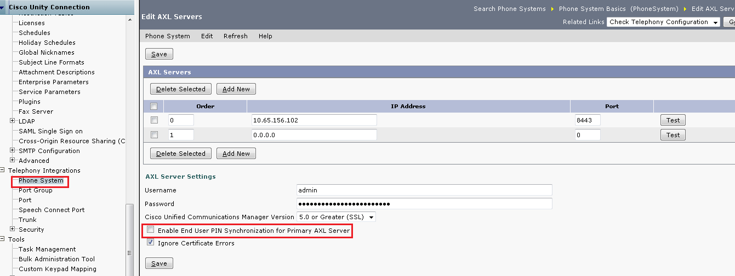
Configuration(contd.)
Check the “Enable End User PIN Synchronization for Primary AXL Server” check box for PIN synchronization

Slide 12
Demo

Slide 13
Use Case 1
PIN is updated only on CUC
Pre-requisite: The “Enable End User PIN Synchronization for Primary AXL
Server” check box is not checked on CUCA
User signs in to CUC through TUI and updates the PIN.
PIN is updated only on CUC.

Slide 14
Use Case 2
PIN is Synchronized between CUC and CUCM
Pre-requisite:
The “Enable End User PIN Synchronization for Primary AXL Server” check box is checked on CUCA
User is integrated with CUCM
User signs in to CUC through TUI and updates the PIN.
PIN is updated on CUC and CUCM both.

Slide 15
Use Case 3
PIN Synchronization is Failed on CUCM
Pre-requisites:
The “Enable End User PIN Synchronization for Primary AXL Server” check box is checked on CUCA.
CUC and CUCM have different Credential Policies .
User is integrated with CUCM.
User signs in to CUC through TUI and updates the PIN.
User hears the “your PIN has not been changed, for help press 0 or contact to your system administrator” prompt when PIN is not updated on CUCM.

Slide 16
Troubleshooting

Slide 17
Troubleshooting
Problem Statement:
While updating user PIN; the PIN is getting updated only on Unity Connection.
Action Required:
  Verify that “Enable End User PIN Synchronization for Primary AXL Server” is enabled on the Edit AXL Servers page of CUCA. To do this, navigate to Phone System Basics Page -> Edit -> Cisco Unified Communications Manager AXL Servers.
Troubleshooting References:
Annotated logs wiki: http://wikicentral.cisco.com/display/UNITYTRANS/Annotated+diagnostics+for+Common+PIN
Troubleshooting Guide for Cisco Unity Connection: http://www.cisco.com/c/en/us/td/docs/voice_ip_comm/connection/11x/troubleshooting/guide/11xcuctsgx.html

Slide 18
Reference
Design Guide for Cisco Unity Connection : http://www.cisco.com/c/en/us/td/docs/voice_ip_comm/connection/11x/design/guide/11xcucdgx.html
Cisco Unified Communications Manager SIP Integration Guide : http://www.cisco.com/c/en/us/td/docs/voice_ip_comm/connection/11x/integration/guide/cucm_sip/cucintcucmsip.html
Cisco Unified Communications Manager SCCP Integration Guide : http://www.cisco.com/c/en/us/td/docs/voice_ip_comm/connection/11x/integration/guide/cucm_sccp/cucintcucmskinny.html
Security Guide for Cisco Unity Connection : http://www.cisco.com/c/en/us/td/docs/voice_ip_comm/connection/11x/security/guide/11xcucsecx.html

