Slide 1
Cisco Unity Connection Customized Log-on Message
EDCS-1559070

Slide 2
Notice
The information in this presentation is provided under Non-Disclosure agreement and should be treated as Cisco Confidential. Under no circumstances is this information to be shared further without the express consent of Cisco.
Any roadmap item is subject to change at the sole discretion of Cisco, and Cisco will have no liability for delay in the delivery or failure to deliver any of the products or features set forth in this document.

Slide 3
Agenda
Introduction
Configuration
Demo
Troubleshooting Tips

Slide 4
Introduction

Slide 5
Introduction
The OS administrator can configure Cisco Unity Connection to display a Customized Log-on Message.
In Release 11.0 and earlier
The message is displayed on the login screen of the following interfaces:
  Cisco Unity Connection Administration
  Cisco Unity Connection Serviceability
  Cisco Personal Communication Assistant
  Real-Time Monitoring Tool
  Command Line Interface
With Release 11.5(1) and later
The configured message can be additionally displayed in a Pop-up window on the above interfaces as well as Web Inbox before login.
User must explicitly acknowledge the Pop-up window by clicking OK.
Note: In case of Web Inbox, the message is displayed only in Pop-up window.

Slide 6
Configuration

Slide 7
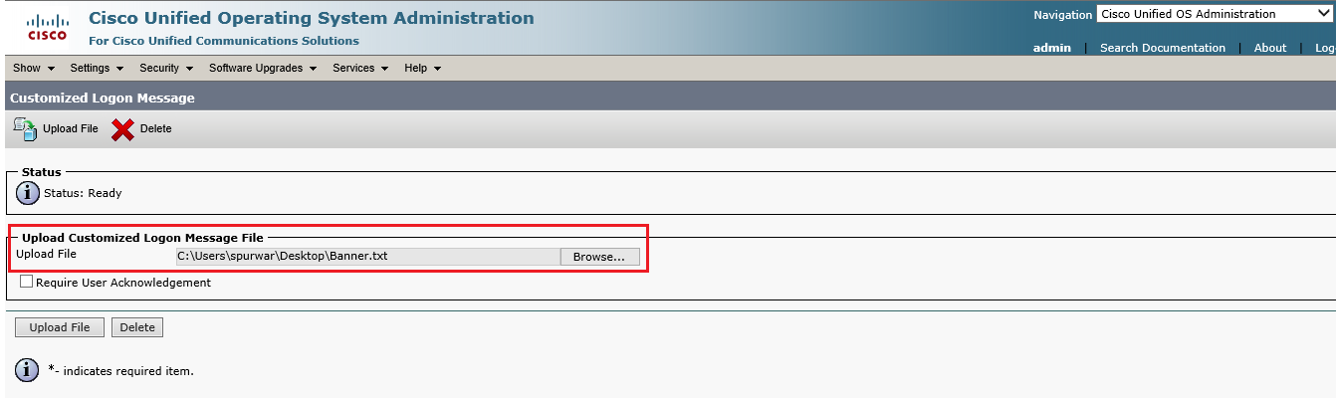
Configuration on Cisco Unified OS Administration
Go to: Software Upgrade -> Customized Logon Message.
Click Browse to select the text file that contains the customized log-on message.
Click Upload File.
Note: In case of cluster, you should upload the Customized Logon Message separately on both the servers.

Slide 8
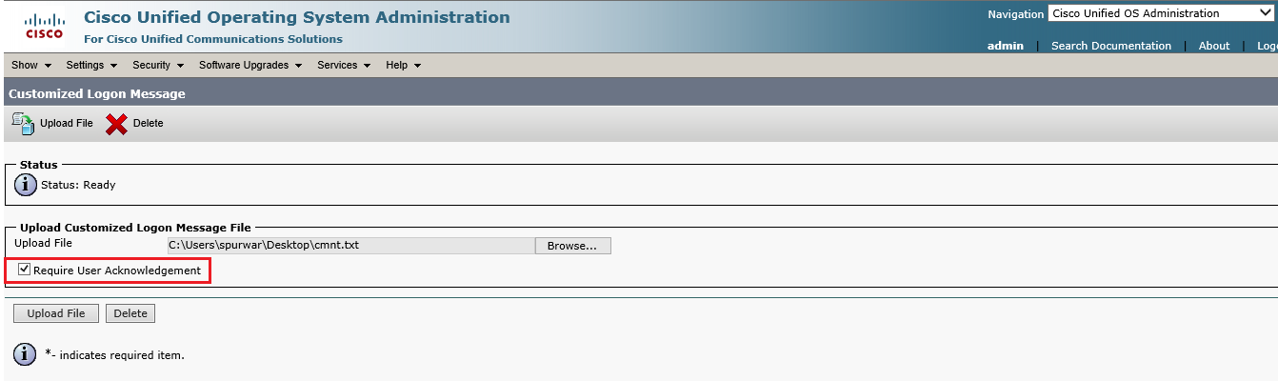
Configuration (contd.)
(optional) Check the “Require User Acknowledgment” check box to display the Customized Log-on Message in Pop-up window as well.
.
Note: It is recommended to clear the browser cache before uploading the log-on message.

Slide 9
Demo

Slide 10
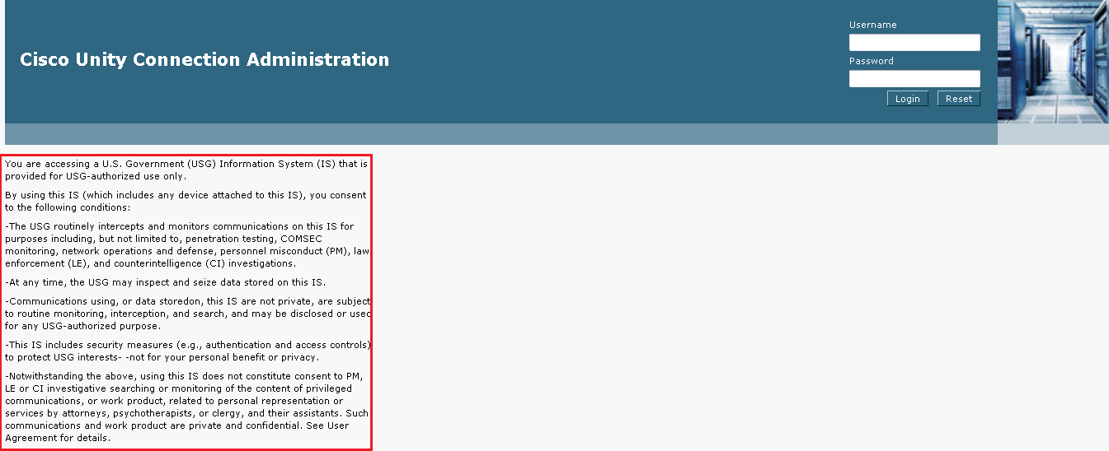
Scenario 1: Customized Log-on Message is Displayed only on Login Screen
Upload a text file that contains a Customized Log-on Message.
Do not check the “Require User Acknowledgment” check box.
Access the Cisco Unity Connection Administration.
The uploaded log-on message is displayed on the login screen as well as home screen.
Same message is displayed on other interfaces.

Slide 11
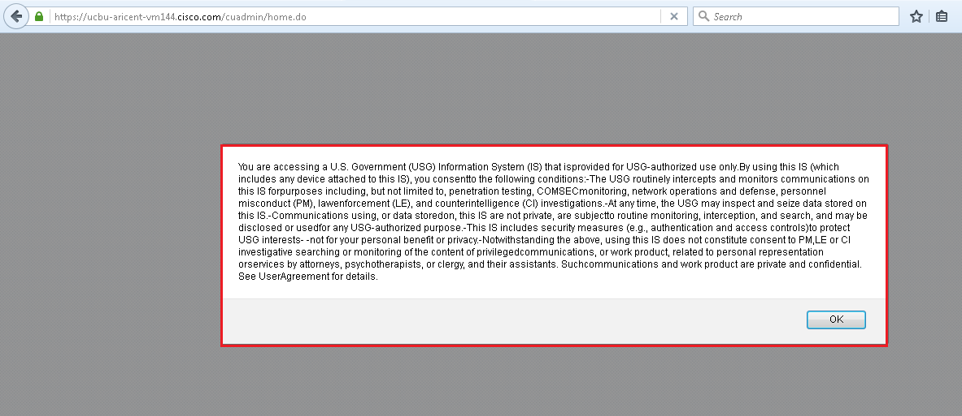
Scenario 2: Log-on Message is Displayed in Pop-up Window
Upload a text file that contains a Customized Log-on Message.
Check the “Require User Acknowledgment” check box.
Accesses the Cisco Unity Connection Administration.
The uploaded log-on message is displayed in Pop-up window as well.
Click OK to acknowledge the message.

Slide 12
Troubleshooting

Slide 13
Troubleshooting
Problem Statement:
Customized Log-on Message is not displayed in Pop-up window while accessing the different interfaces of Cisco Unity Connection.
Action Required:
Collect CMPlatformxx.log to troubleshoot.
Login to the Cisco Unity Connection server with root account.
Go to the “/usr/local/platform/conf/cli” path and verify that the following files exist in the location:
  loginWarning.txt
  ack.txt
  If any of the above file is found missing, go to Customized Logon Message page and upload the message again. Also, check the “Require User Acknowledgment” check box.

Slide 14
References
Cisco Unified Communications Operating System Administration Guide for Cisco Unity Connection https://www.cisco.com/c/en/us/td/docs/voice_ip_comm/connection/11x/os_administration/b_11xcucosagx.html

