Slide 1
Cisco Unity Connection
Disable Inactive Users Accounts
TOI
PART I-TUI Interface
EDCS-1549495 April 4 2016

Slide 2
Notice
The information in this presentation is provided under Non-Disclosure agreement and should be treated as Cisco Confidential. Under no circumstances is this information to be shared further without the express consent of Cisco.
Any roadmap item is subject to change at the sole discretion of Cisco, and Cisco will have no liability for delay in the delivery or failure to deliver any of the products or features set forth in this document.

Slide 3
Agenda
Introduction
What's new
Rest API
Demo
Audits
Troubleshooting
References

Slide 4
Introduction

Slide 5

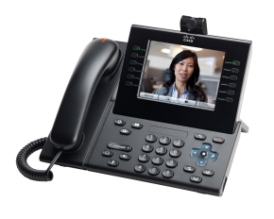
Introduction
Telephony (TUI/VUI) is one of the interfaces of Unity Connection used to access Voicemails
To comply with FEDRAMP requirements, access to the TUI/VUI interface will not be allowed if a user does not login to his account for pre-configured number of days
The configuration setting applies system wide

Slide 6
What’s New

Slide 7
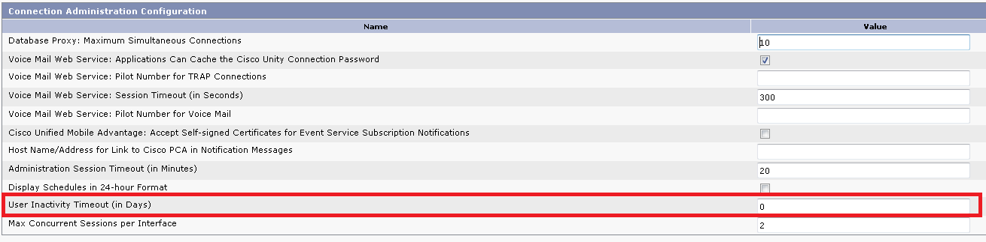
Configuring the Inactivity Timeout Period
Under System Settings -> Advanced -> Connection Administration Configuration:
A new field 'User Inactivity Timeout (in days)’ has been added on CUCA
Default Value*: 0 days (Minimum 0 and Maximum 9999)
*Note: Default Value is 35 days in FedRamp mode

Slide 8
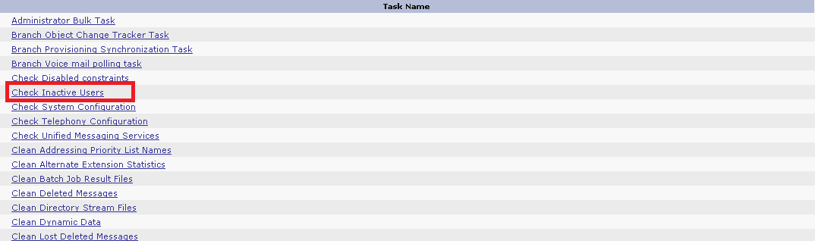
New SysAgent Task
A new SysAgent task has been added named “Check Inactive Users” which is scheduled to run daily and marks the users as Inactive whose last log-in is more than configured number of days

Slide 9
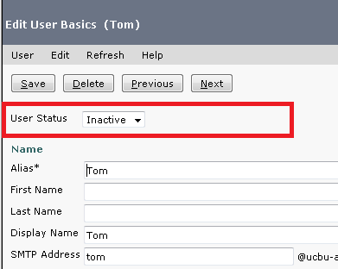
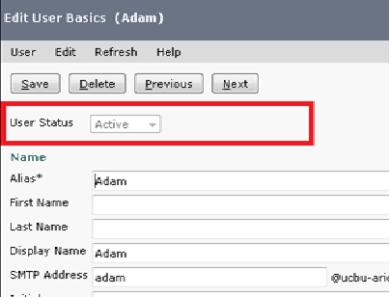
View User Current Status
Under Edit User Basics
A new drop-down for ‘User Status’ has been added to specify the current status of user:
  Inactive : User Account is Deactivated due to Inactivity
  Active : User Account is active

Slide 10
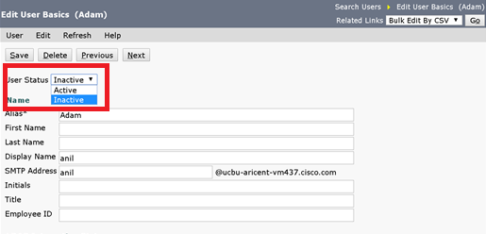
Reactivate the Inactive User
Under Edit User Basics -> User Status
The drop down gets enabled in case of Inactive Users
An administrator can select ‘Active’ field to mark User Active

Slide 11
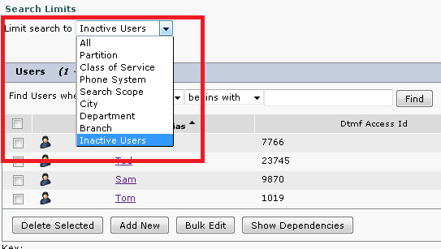
List Down all Inactive Users
At Search Users page
Under ‘Limit Search to’ drop-down list a new option for ‘Inactive Users’ has been added
An administrator can select this option to filter out the list of all Inactive Users

Slide 12
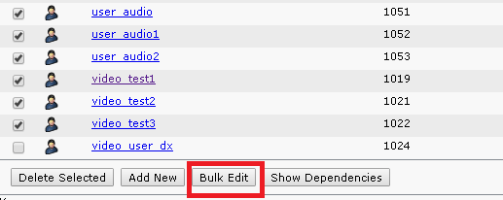
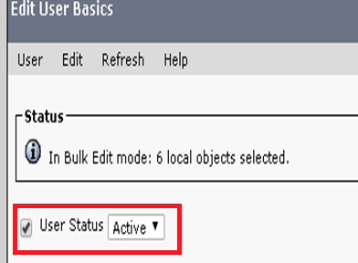
Bulk Edit all Inactive Users
At Search Users page
Under ‘Limit Search to’ drop-down select ‘Inactive Users’ to list all inactive users
An administrator can select ‘Bulk Edit’ option to mark all inactive users as active

Slide 13
REST API

Slide 14
REST API FOR USER INACTIVITY TIMEOUT
Added “System.SA.UserInactivityTimeout ” configuration value that is use to view or update User Inactivity Timeout using the following APIs:
  API to View the Current Value of User Inactivity Timeout
    GET
    /vmrest/configurationvalues/System.SA.UserInactivityTimeout
  API to Update the Value of User Inactivity Timeout
  PUT
  /vmrest/configurationvalues/System.SA.UserInactivityTimeout
Reference:
http://docwiki.cisco.com/wiki/Cisco_Unity_Connection_Provisioning_Interface_%28CUPI%29_API_--_Configuration_Values#Listing_and_Viewing
/vmrest/configurationvalues/System.SA.UserInactivityTimeout
/vmrest/configurationvalues/System.SA.UserInactivityTimeout

Slide 15
REST API FOR REACTIVATING INACTIVE USER
Added the Rest API to mark User Active.
GET
PUT
Reference: http://docwiki.cisco.com/wiki/Cisco_Unity_Connection_Provisioning_Interface_%28CUPI%29_API_--_User_API#Listing_the_Users
https://<connection-server>/vmrest/users/<user-objectid>
https://<connection-server>/vmrest/users/<user-objectid>
<User>
<Inactive>false</Inactive>
</User>

Slide 16
Demo

Slide 17
Scenario 1
Configuring Inactivity Timeout and Login Behavior of Inactive Users via TUI/VUI
Set “User Inactivity Timeout (in Days)” value to 2 on CUCA
Run sysagent task
Users whose last login time is more than 2 days will be marked as inactive
Now, login to User’s mailbox through TUI/VUI
The prompt will be played “Your account is locked and cannot be opened. For help please contact System Administrator”

Slide 18
Scenario 2
Re-activating the Inactive User
Administrator lists the inactive users over CUCA
Go to Edit User Basics -> User Status and select Active
Save the user
Now, login to Users mailbox through TUI is successful

Slide 19
Scenario 3: Deleting Inactive Users
Administrator lists the inactive users over CUCA
Multi select and delete the inactive users

Slide 20
AUDITS

Slide 21
Audit Logs
Audit log: When user is marked Active
Audit log: When user is marked Inactive
LogMessage UserID : admin ClientAddress : 10.126.212.167 Severity : 6 EventType : GeneralConfigurationUpdate ResourceAccessed: cuadmin EventStatus : Success CompulsoryEvent : No AuditCategory : AdministrativeEvent ComponentID : Cisco Unity Connection CorrelationID : AuditDetails : User with Alias user4 has been marked active App ID: Cisco Tomcat Cluster ID: Node ID: ucbu-aricent-vm437
LogMessage UserID : CuSysAgent ClientAddress : 10.65.157.252 Severity : 5 EventType : GeneralConfigurationUpdate ResourceAccessed: Cisco Unity Connection EventStatus : Success CompulsoryEvent : No AuditCategory : AdministrativeEvent ComponentID : Cisco Unity Connection CorrelationID : AuditDetails : User with alias Adam marked inactive since the user has not logged in since last 2 days. App ID: Cisco Unity Connection Cluster ID: Node ID: ucbu-aricent-vm437

Slide 22
Audit Logs-Contd
Audit log: When an Inactive User tries to login into account
ucbu-aricent-vm437 local7 6 : 18: ucbu-aricent-vm437.cisco.com: %UC_UCEVNT-6-EvtSubAccountInactive: %[AppID=CuCsMgr][ClusterID=][NodeID=ucbu-aricent-vm437]: User account is inactive due to inactivity timeout. Details - Adam [1235].

Slide 23
Troubleshooting Tips

Slide 24
Troubleshooting Scenario 1
Problem Statement:
User gets a prompt "Your account is Locked" due to inactivity timeout over TUI/VUI interface
Action Required:
Check in CiscoSysLog for Event “EvtSubAccountInactive”
EvtSubAccountInactive signifies User is inactive due to inactivity timeout
Administrator can also check the user status from CUCA
The user cannot login through TUI/IMAP, but can login through other interfaces.

Slide 25
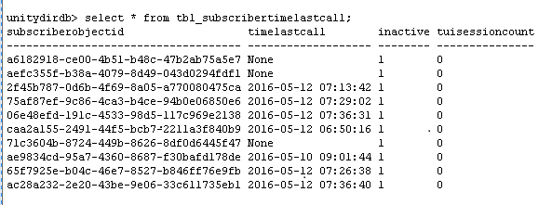
Troubleshooting Scenario 1: Contd.
Check the Inactive field in tbl_subscribertimelastcall against the subscriberobject ID, ‘1’ means user is Inactive

Slide 26
Troubleshooting Scenario 3
Problem Statement:
User gets a prompt "Your account is Locked" due to max invalid attempts
Action Required:
Check in CiscoSysLog for Event “EvtSubAccLockedMaxHack”
EvtSubAccLockedMaxHack signifies user is locked due to maximum invalid attempts
Administrator can also check the user status from CUCA

Slide 27
Troubleshooting Scenario 4
Problem Statement:
Users are not marked as inactive after pre-configured days
Action Required:
Check if SysAgent “Check Inactive Users” is enabled
Check the status and result of last run of Sysagent Task on CUCA
If the run fail, check for diag_CuSysAgent_* logs

Slide 28
References
Annotated logs wiki:
Troubleshooting Guide for Cisco Unity Connection:
https://wiki.cisco.com/display/UNITYTRANS/Annotated+diagnostics+for+Disable+Idenfiers+after+Preconfigured+inactivity+forTelephony+Interface
http://www.cisco.com/c/en/us/td/docs/voice_ip_comm/connection/11x/troubleshooting/guide/11xcuctsgx.html

