Slide 1
Cisco Unity Connection
Logon Session Limit – TUI/VUI
EDCS No. - 1550113
February 2016

Slide 2
Notice
The information in this presentation is provided under Non-Disclosure agreement and should be treated as Cisco Confidential. Under no circumstances is this information to be shared further without the express consent of Cisco.
Any roadmap item is subject to change at the sole discretion of Cisco, and Cisco will have no liability for delay in the delivery or failure to deliver any of the products or features set forth in this document.

Slide 3
Agenda
Introduction
What's new
Rest API
Demo
Troubleshooting Tips
References

Slide 4
Introduction

Slide 5

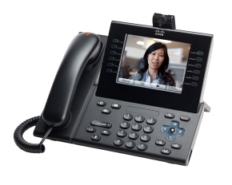
Introduction
Telephony (TUI/VUI) is one of the interface of Unity Connection used to access Voicemails
Current design imposes no limit on the concurrent TUI sessions
The number of concurrent TUI/VUI sessions will now be restricted to a configurable limit
This limit will be configurable system wide

Slide 6
What’s New

Slide 7
What’s new
Max Concurrent Session limit is configurable from CUCA
A user can now have configured number of concurrent TUI sessions, after that any further call will be dropped
By Default this feature will remain in disabled state on CUC
Note:
This limit is not applicable on
  Trap call
  Visual Voicemail(VVM) except in following conditions:
    Voicemail pin expiration
    Self-enrollment during VVM access

Slide 8
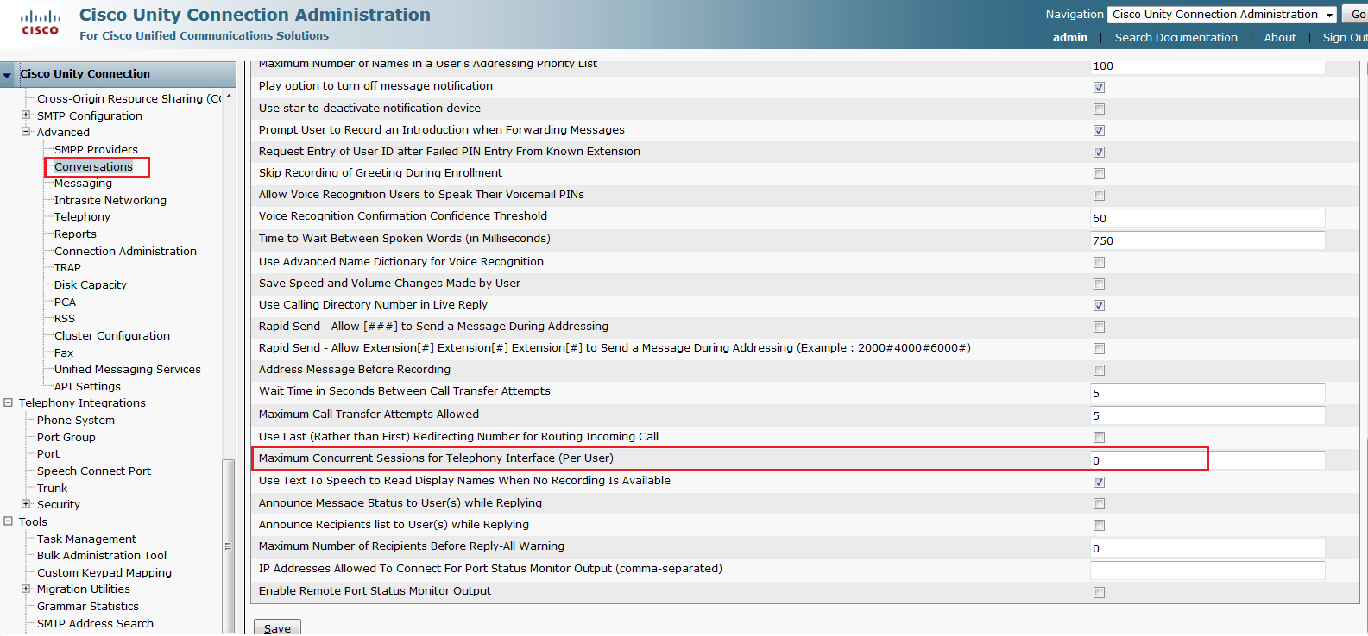
What’s new on CUCA
Admin can now set 'Max Concurrent Sessions for Telephony Interface’ on CUCA
Go to: System Settings -> Advanced -> Conversation
Default Value*: 0 (Minimum 0 and Maximum 99), here 0 implies that feature is disabled

Slide 9
FedRAMP mode
To comply with FedRAMP requirements, this feature will be enabled by default with FedRAMP CLI.
Enable FedRAMP mode using CLI 'utils fedRAMP enable'
In FedRAMP mode the default value of 'Max Concurrent Sessions for Telephony Interface’ parameter sets to 2
You could verify the same from CUCA , Go to: System Settings -> Advanced -> Conversation
Note: If FedRAMP mode is disabled then value of “'Max Concurrent Sessions for Telephony Interface” does not revert to default value 0.

Slide 10
REST API

Slide 11
REST API For Maximum Concurrent Sessions
A new field “System.Conversations.UserMaxConcurrentSessionsTUI” added in /vmrest/configurationvalues API
API to View the Current Value of Maximum Concurrent Sessions
    GET
API to Update the Value of Maximum Concurrent Sessions
PUT
Request Data :
    /vmrest/configurationvalues/System.Conversations.UserMaxConcurrentSessionsTUI
/vmrest/configurationvalues/System.Conversations.UserMaxConcurrentSessionsTUI
<ConfigurationValue>
<Value>3</Value>
</ConfigurationValue>

Slide 12
Demo Scenario

Slide 13
Scenario 1: Login attempt fails after TUI session limit is reached
Set Max Concurrent Session value to 1 on CUCA
User Tom logs in to his Voicemail from TUI, let the session remain open
As soon as Tom tries to login again from second phone the call disconnects

Slide 14
Scenario 2: VUI Scenario
User Jane with VUI capability login into her voicemail (Max Concurrent Session is 1)
Jane tries to login again from another phone, the call disconnects

Slide 15
Scenario 3: Behavior when feature is in disabled state
Set Max Concurrent Session value to 0 on CUCA
User Tom logs in to his Voicemail from TUI, let the session remain open
Tom tries to login again from second phone, tom able to login successfully into second session of voicemail

Slide 16
Troubleshooting Tips

Slide 17
Troubleshooting Scenario 1
Problem Statement:
User gets disconnected after successful login without any prompt
Action Required:
Check in CiscoSysLog:
    Check in CiscoSysLog for Event “EvtTUILogonSessionLimitExceeded”
    User may be disconnected because of MaxSession reached for current user
Administrator can also check active call count from tbl_subcribertimelastcall
    run cuc dbquery unitydirdb select * from tbl_subscribertimelastcall where subscriberobjectid="<object-id>"

Slide 18
References
Annotated logs wiki: https://wiki.cisco.com/display/UNITYTRANS/Annotated+diagnostics+for+Limit+Logon+Session+For+Telephony+Interface​
Troubleshooting Guide for Cisco Unity Connection: http://www.cisco.com/c/en/us/td/docs/voice_ip_comm/connection/11x/troubleshooting/guide/11xcuctsgx.html
DocWiki for VMRest API: http://docwiki.cisco.com/wiki/Cisco_Unity_Connection_Provisioning_Interface_(CUPI)_API_--_Configuration_Values

Slide 19
Thank You

