Slide 1
Cisco Unity Connection
Video Messaging TOI
11.5(1)
EDCS-1520974
September 03, 2015

Slide 2
Notice
The information in this presentation is provided under Non-Disclosure agreement and should be treated as Cisco Confidential. Under no circumstances is this information to be shared further without the express consent of Cisco.
Any roadmap item is subject to change at the sole discretion of Cisco, and Cisco will have no liability for delay in the delivery or failure to deliver any of the products or features set forth in this document.

Slide 3
Agenda
Introduction
What’s new
How it works
Network Topology
Supported End-Points
Configuration
Deletion of Video Service
Demo
Performance Counters
Limitations
Troubleshooting Tips
References

Slide 4
Introduction

Slide 5
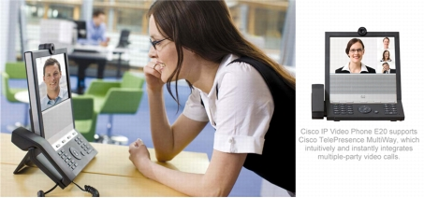
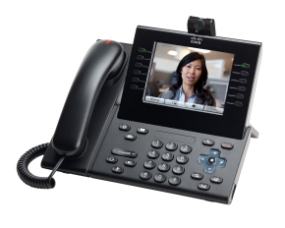
Introduction
Cisco Unity Connection 11.5 (Connection) is a feature-rich voice messaging platform that provides the immersive experience of Video Messaging.
Users will now be able to record and playback Video Messages in case of Ring Not Answered (RNA) via the Telephony User Interface (TUI).

Slide 6
What’s new
Cisco Unity Connection now allows the users to send Video Messages in case of RNA.
Users can playback the Video Messages after signing in to Cisco Unity Connection mailbox using TUI.
Administrator can set the expiration days for the Video Message Recordings.
Administrator can delete the Video Service even if it has the video recordings associated with user(s).

Slide 7
How it works?
The pre-requisites for establishing a Video call are same as the pre-requisites of Video Greetings. Please go through the references mentioned at the end.
When a call is not answered, the caller hears a recorded greeting from the called user*. After the greeting is played, the caller can record a Video Message for the called user through TUI.
  If the Video Message is not delivered to the called user, the user receives a non delivery receipt (NDR) with audio part of the message attached into it.
  User can playback new and saved Video Messages after signing in to Cisco Unity Connection mailbox using TUI.
  User can save or delete Video Messages during message playback or after listening to the entire message.
  .
Notes:
*As per the configurations done by the Called User.

Slide 8
How it works? (Continued)
User can set the number of days for Video Message Recording Expiration. User can specify the expiration days for Video Messages, after which the Video part of the message is expired and only the audio part is retained as a voice message.
User need to schedule a SysAgent task “Message Expiration” to enforce Message Recording Expiration policy. User does not receive any intimation before expiration of the message recording.
In order to delete the orphan Videos from Mediasense (MS), a SysAgent task “Clean Orphan Video Recordings” has been created in Connection. This task sends the delete request to MS for deletion of the Video files and removes the orphan Video Session IDs from Database.

Slide 9

Notes:
9

Slide 10


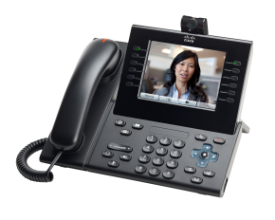
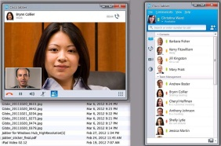
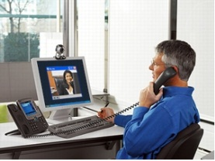
Call manager
Cisco Unity Connection (11.5.1)
Node A
SIP
HTTPS
RTP
SIP
RTP
Cisco MediaSense
server
Video Phones
Node B
Data Path
Jabber Client
Cisco Unified Video Advantage
Control Path
Video End Points
Notes:
-Node A/B could be a standalone or cluster setup.
-Only SIP Integration will be supported between CUC and CUCM.
10

Slide 11
Supported End-Points
Unity Connection supports the following Video enabled end-points:
Cisco DX series endpoints.
Cisco 99XX and 89XX series endpoints.
Cisco 8865 and 8845 series endpoints.
Cisco 79XX and 69XX series endpoints.
Cisco Jabber for Windows 9.2(3) or later.
Cisco Jabber for Mac 9.2(1) or later.
Cisco Jabber for iPad 9.3(21386) or later.

Slide 12
Configuration

Slide 13
Video Messaging Configuration Steps at CUC
Integrate Unity Connection with MediaSense.
Create Video Service Accounts for Connection Users.
Enable Video Messaging Capabilities on Class Of Service Page.
Set Video Message Recording Expiration days
Step 1
Step 2
Step 3
Optional
Configuration steps 1-3 are required for establishing Video Call*.
Notes:
For detailed configuration steps, please see the Video Greetings TOI mentioned in references.

Slide 14
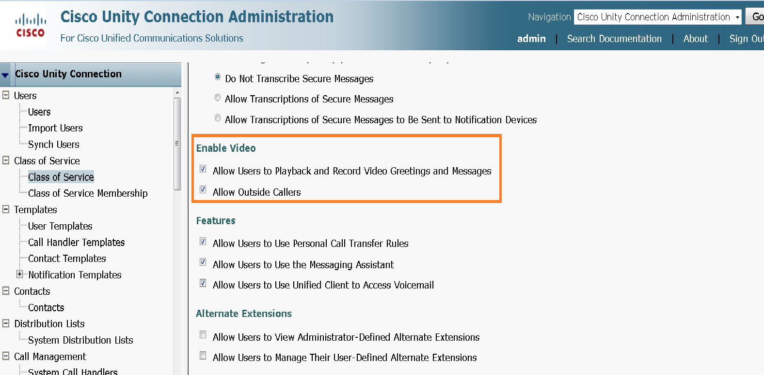
Enable Video Messaging Capabilities on COS
On CUCA page, go to Class of Service > Search Class of Service and select the COS which is selected for the user.
On Edit Class of Service page, check the attributes under “Enable Video”.

Slide 15
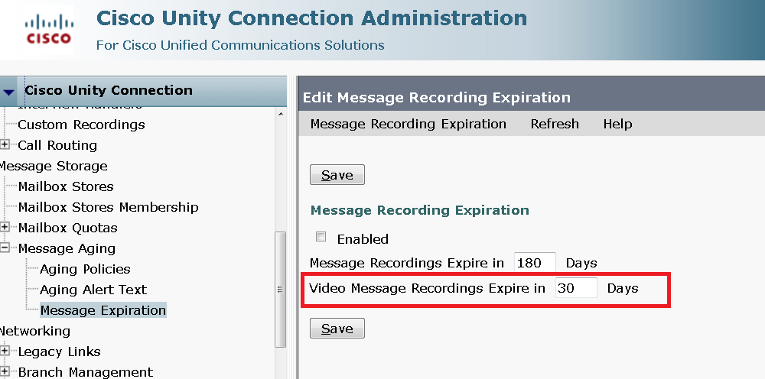
Video Message Recording Expiration Field
Users can now see “Video Message Recording Expires in ___ Days" field on Edit Message Recording Expiration page.
The default value is 30 days.
Notes:
** All the prerequisites of Video should be satisfied
** All configuration with respect to Video is done.

Slide 16
Deletion of Video Service

Slide 17
Deletion of Video Service
  Pre-Requisite: All the Video Service Accounts associated with a Video Service should be removed before deleting the service.
On deletion of a Video Service:
  All associated Video Recordings remain stored on the Video Server (MS).
  All the information related to Video Recordings remain stored on the Unity Connection.
  Such Video Recordings are played as audio only.
On adding the same Video Service again:
  The Recordings will be played as video again.
On adding a new Video Service:
  The Video Recordings will be played as audio.

Slide 18
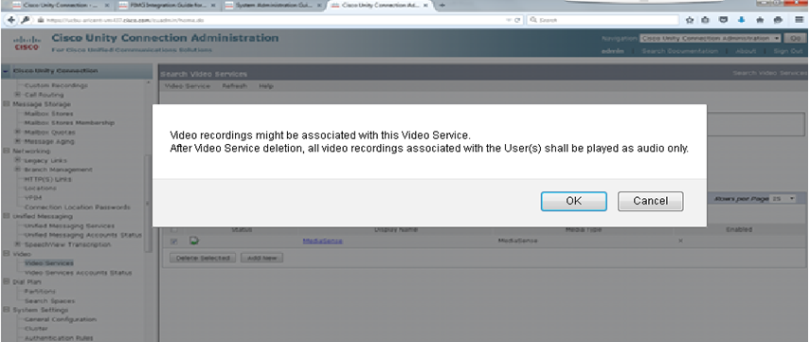
Configuration for Video Service Deletion
On CUCA page, go to Video > Video Services. On Search Video Services page check the checkbox for the Video Service that needs to be deleted and select Delete Selected.
A prompt is displayed. Select OK to continue further.
Notes:
** All the prerequisites of Video should be satisfied
** All configuration with respect to Video is done.

Slide 19
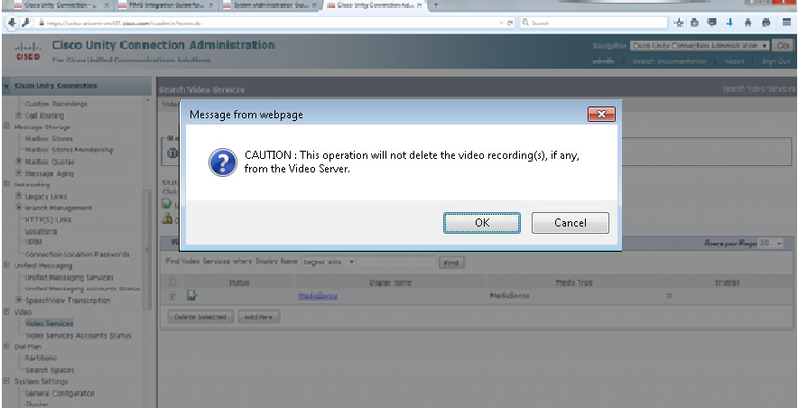
Configuration for Video Service Deletion
Select OK to delete the Video Service.
A warning message is displayed on CUCA page to restart the Conversation Manager services after the deletion.
Notes:
** All the prerequisites of Video should be satisfied
** All configuration with respect to Video is done.

Slide 20
Demo

Slide 21
Scenarios – Video Messaging
Leaving a Video Message in RNA
User A and User B are video enabled Users.
MS gets down during Video Recording
The recording hangs up in between.
A calls B, Call gets forwarded to Unity Connection.
User A leaves a Video Message for User B.
User A presses any key and call gets downgraded to audio with the prompt “Video Services are not available, using Audio for the duration of call”.
The Video gets hanged during playback.
MS gets down during Video Playback
Playback of Video Messages
User B signs in to mailbox through a Video enabled phone.
Call gets established as Video.
User A can proceed with recording an audio message.
Playback the Video Message from User A.
User B presses any key and the After Message Menu starts getting played..
User B can proceed listening to other Video messages (if any) in case MS comes up during the call).

Slide 22
Performance Counters

Slide 23
Video Messaging Counters
Following is the list of new counters added for Video Messaging:
Counter | Category | Description
Video Messages Delivered Total | CUC Message Store | The total number of Video Messages delivered since the last restart of the MTA server.
Delete Request sent to Media Sense Total | CUC System Agent | The total number of delete requests sent to MS server since the last restart of Unity Connection.
Media Sense Timeout While Delete | CUC System Agent | The total number of connection timeouts in response to the delete requests sent to MS server since the last restart of Unity Connection.
Media Sense Timeout Total | CUC Session Video | The total number of connection timeout errors while connecting to MS server since the last restart of Cisco Unity Connection. This counter is applicable for the following events: During a Video call At the time of sign in During exchange of media capabilities with the MS server.

Slide 24
Video Messaging Counters (Continued)
Following is the list of new counters added for Video Messaging:
Counter | Category | Description
Video Message Play Failed Total | CUC Session Video | The total number of video messages that are played as audio messages since the last restart of Cisco Unity Connection..
Video Messages Delivered Per Minute | CUC Message Store | The total number of video messages delivered per minute since the last restart of the MTA server..
Video Messages Processed by MTA Total | CUC Message Store | The total number of video messages processed by the MTA server since the last restart of the server.
Video Messages Processed by MTA Per Minute | CUC Message Store | The total number of video messages processed by the MTA server per minute since the last restart of the server.

Slide 25
Limitations

Slide 26
Limitations
User can send/receive Video Messages over TUI only. VUI is not supported with Video.
Video Messaging is supported over SIP Trunk integration only.
A user can receive Video Message from an identified as well as outside caller. However, a Video Message cannot be sent to an outside caller.
User can reply to a Video Message in an Audio Message format only.
User cannot append any recording to a Video Message.
User can forward only the audio part of a Video Message.
User can pause the Video Message at any point during message playback but it cannot be resumed from that point. The Video Message will get played from the starting.

Slide 27
Limitations
While playing a Video Message, if a user tries to change the playback volume or playback speed using phone custom keypad, the recording starts playing from the beginning without changing the playback volume or speed. However, volume can be increased or decreased using volume button of the phone.
If a Video call is downgraded to audio, it cannot be restored again as a Video.
User cannot send a Video Message as a broadcast or dispatch message.
In case of Supervise Transfers, Video call will remain Video if answered and call will be downgraded to Audio if forwarded to connection.
In case of Cross Box Logins, Video call will be downgraded to Audio.

Slide 28
Troubleshooting Tips

Slide 29

Enable following traces to troubleshoot Video related issues:
Micro Traces | Description | Level
CDE | Conversation State Machine traces | 0,10-17,20,21
ConvSub | Conversation Call Progress traces | 1-5
MiuIO | Input/output traces from MIU | 11-13, 25,27
Miu Sip/Miu Sip Stack | SIP Protocol Messages | ALL
MiuMethods/MiuCall | Diags for the Call processing in media Module | ALL
Mixer | Diags of Audio/Video Channels for data transmission | 01-04
Video | Video Processing and messages exchanged with VideoServer | 10,11,13
Log files to be collected : diag_CuCsMgr* and diag_CuMixer* from RTMT

Slide 30
Annotated Traces for Video Messaging
Annotated traces for Video Messaging can be found at the following link:
Important trace information to look for during a Video call is discussed in brief at the following link
http://wiki.cisco.com/display/UNITYTRANS/Annotated+Traces+for+Video+Messaging
MS APIs and their respective response codes are discussed in brief at the following link
http://wiki.cisco.com/display/UNITYTRANS/MS+APIs+with+response+Codes
Notes:
*Need to change the wiki links

Slide 31
Configuration Issues – Case 1
Problem Statement:
Call from Video capable user, established as Audio.
Action Required:
Check if:
Cisco Camera and Video Capabilities are enabled for the device in Cisco Unified Communications Manager.
"Connection Conversation Manager” is restarted after updating Video Service page.
MS is up and running using test button on Edit Video Service page.

Slide 32
Configuration Issues – Case 2
Problem Statement:
Video call downgrades to audio.
Action Required:
Check if:
MS is up and running using test button on Edit Video Service page
Video Service Account is created for the user(s) in question.
“Map Video Service” is enabled in Video Service Account for the user
In Case of Connection User, check whether “Allow Users to Playback and Record Video Greetings and Messages” is enabled in Class of Service for calling user.

Slide 33
Call downgrade Issues
Problem Statement:
Call gets downgraded to audio with the prompt “Video Services are not available, using Audio for the duration of call” while Recording/playing Video Message.
Action Required:
Please check if Cisco MS is UP and running using test button on Video Services page and Video Services Account Page.
Call gets downgraded in case any error response is received from MS in response to the startRecord()/startSessionPlayback() or stopRecord()/ stopPlayback() request. Please look for the respective error response in logs.
User can proceed with the Audio call or establish the call again to re-record the Video Message.

Slide 34
Playback Issues – Case 1
Problem Statement:
Playback hangs in between.
Action Required:
Press # button on phone to end the playback and continue with the call.
Playback could hang due to missing "Playback_Stopped" event from MS. Please check the conversation logs for this event.
Please report in case the issue is persistent with the CuCsMgr diags at the requested trace levels.

Slide 35
References
For basic Video configurations, please refer EDCS: EDCS-1279430 :” Unity Connection Video Greetings Feature TOI 10.0(1)”
MS API at, http://www.cisco.com/c/en/us/td/docs/voice_ip_comm/cust_contact/contact_center/mediasense/11/Developer_Guide/CUMS_BK_ms-dev-guide-11/working_with_cisco___mediasense_apis.html
Chapter “Video” of the Design guide for Cisco Unity Connection at, http://www.cisco.com/c/en/us/td/docs/voice_ip_comm/connection/11x/design/guide/11xcucdgx/11xcucdg070.html
Chapter “Video” of the System Admin guide for Cisco Unity Connection at, http://www.cisco.com/c/en/us/td/docs/voice_ip_comm/connection/11x/administration/guide/11xcucsagx/11xcucsag150.html
Chapter “Managing Video Messages” of the User Phone Interface guide of Cisco Unity Connection at, http://www.cisco.com/c/en/us/td/docs/voice_ip_comm/connection/11x/user/guide/phone/b_11xcucugphone/Voicemail_Basics.html

