Slide 1

Missed Call Notification
Unity Connection 11.0
EDCS-1475140

Slide 2
Notice
The information in this presentation is provided under Non-Disclosure agreement and should be treated as Cisco Confidential. Under no circumstances is this information to be shared further without the express consent of Cisco.
Any roadmap item is subject to change at the sole discretion of Cisco, and Cisco will have no liability for delay in the delivery or failure to deliver any of the products or features set forth in this document.
Notes:
2
2

Slide 3
Abbreviations
CUCA – Cisco Unity Connection Administration
CPCA – Cisco Personal Communications Assistant
RNA – Ring No Answer

Slide 4
Agenda
Overview of Missed Call Notification
Configurations for Missed Call Notification
Use Cases
Troubleshooting

Slide 5
Overview of Missed Call Notification

Slide 6
Overview of Missed Call Notification
User receives Missed Call Notifications for calls which reach the user’s mailbox but the caller ends up not leaving a voice message.
Can happen:
  If the caller hangs up while the user greeting is being played.
  If the recipient's mailbox quota is full and Unity Connection caller hangs up before leaving voice message, the recipient receives a Missed Call Notification.
User gets an email notification for missed call.

Slide 7

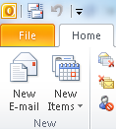
Missed Call Flow Diagram
5
User2’s greeting playing
Call dropped
while playing
CUCM
4
CUC
6
Call landed on CUC
3
Call not answered
1
2
Call Initiated
CIPC
7
HTML Notification for Missed Call sent to User 2
CIPC
User 1
User 2
Outlook

Slide 8
Configurations for Missed Call Notification
Missed Call Template
Added a new template ‘Default_Missed_Call’.
This template contains the “%MISSED_CALL%” tag.
Flexibility to the Admin to create customized Missed Call template.
Any new template should contain %MISSED_CALL%” tag.

Slide 9
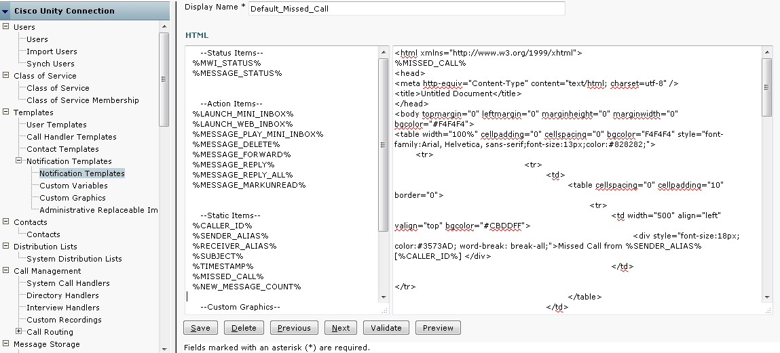
Default Missed Call Notification Template Page
This is new tag introduced for Missed Call Notification
Email body will have sender alias with its caller Id

Slide 10
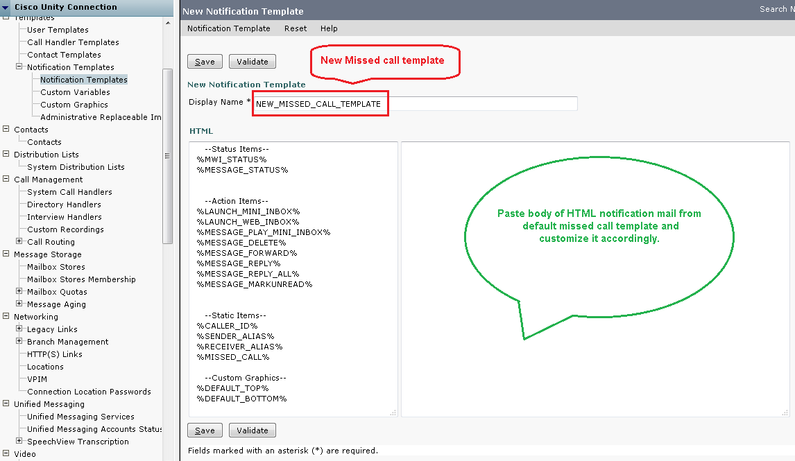
Creating New Missed Call Notification Template

Slide 11
Configurations for Missed Call Notification(cont..)
Missed Call HTML Device
Added a new device ‘HTML Missed Call’.
This device will be associated with “Default_Missed_Call” template and “Missed Call” event mask.
Any new Missed call html device should associate with any Missed call template and “Missed Call” event mask.

Slide 12
Default Missed Call Device Page

Slide 13
Configurations for Missed Call Notification (Cont ..)
  Associate template with HTML Device
Using CUCA - Assign available Missed Call Template to a user’s HTML device.
Using CPCA – End User can select from available Missed call templates.
Notes:
Note :
Administrator has privilege to enable missed call feature for multiple users using Bulk Edit and BAT feature.

Slide 14
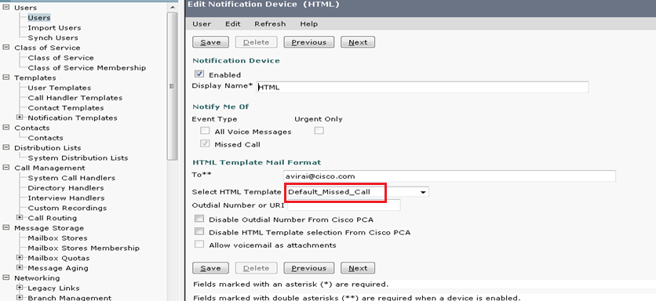
Missed Call Notification Template Selection for HTML Device

Slide 15
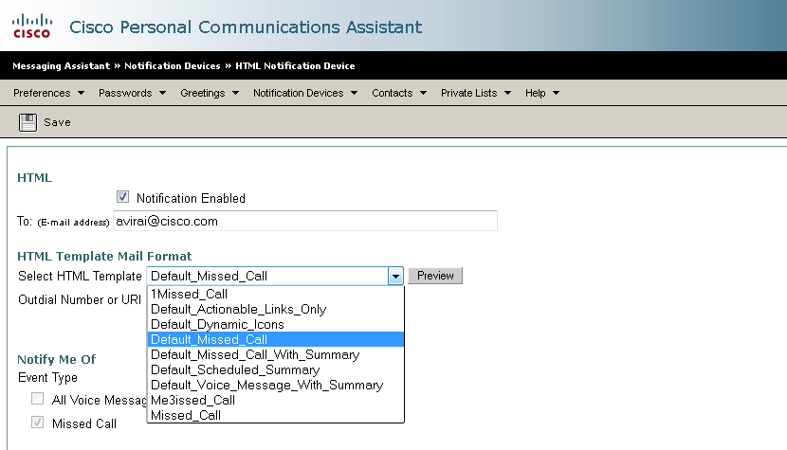
Missed Call Notification Template Selection for an HTML Device from CPCA

Slide 16
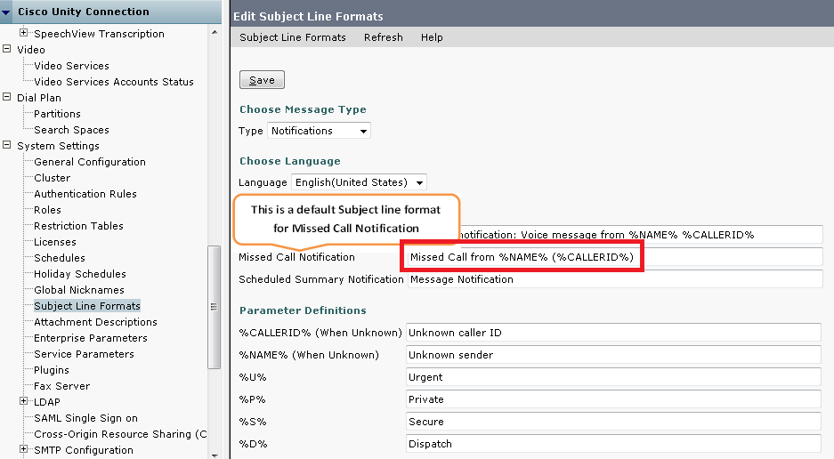
Subject Line Format Page - Default

Slide 17
Use Case 1
Missed Call Notification with Default Subject Line Format
Pre-requisite: Configure user1 with following notification devices:
  HTML Notification associated with Missed Call Template
By default, Subject Line Format for Notification type has following format:
  “Missed Call from %NAME% %CALLERID%”
Drop the call when caller reach the called party greeting
  Called user would get HTML notification with default subject line.

Slide 18
Customizing Subject Line Format
In addition to the regular text, the Subject Line Formats fields can accept the following parameter definitions:
Parameter | Replaced with
%CALLERID% | Caller Id of the sender when known. OR Text configured on CUCA when unknown.
%NAME% | Display Name of the sender when known. OR Text configured on CUCA when unknown.
%TIMESTAMP% | Delivery time of the message as per the recipient’s time zone.
Notes:
%CALLERID% - Can also be the SIP URI of the user.

Slide 19
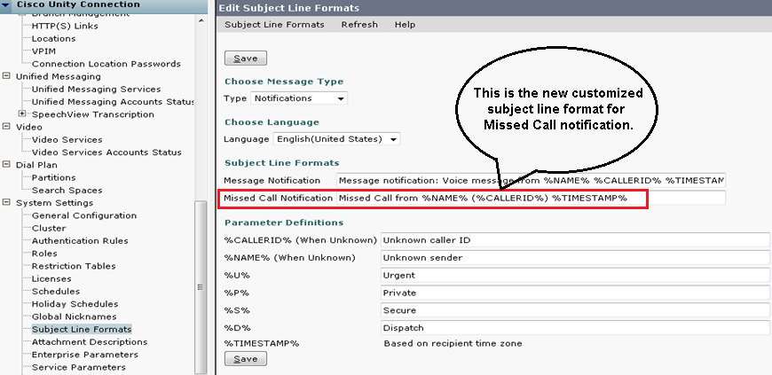
Subject Line Format Page - Customized
Admin can configure or customize Subject Line for Missed Call Notification on CUCA.

Slide 20
Use Case 2
Missed Call Notification via Customized Subject Line Format
You can customize Subject Line Format for Notification type including the timestamp and message priorities:
  “Missed Call from %NAME% %CALLERID% %TIMESTAMP% ”
Drop the call when caller reach the called party user's/system greeting
  Check that subject line of the HTML notification contains the customized format with replaceable parameters including the timestamp

Slide 21
Use Case 3
Missed Call Notification when mailbox quota of user is full
Pre-requisite: Configure user1 with following notification devices:
  HTML Notification associated with Missed Call Template
Outside Caller sends message to user1 when mailbox quota of user1 is full
  User1 gets missed call notification.

Slide 22
VMREST API

Slide 23
VMREST API’s
GET API
vmrest/notificationtemplates - This API is used to fetch the list of notification templates.
  e.g. https://<connection-server>/vmrest/notificationtemplates
vmrest/notificationtemplates/<notificationtemplateid> - This API is used to fetch the details of specific notification template.
  e.g. https://<connection-server>/vmrest/notificationtemplates/<notificationtemplateid>
vmrest/users/<userobjectid>/notificationdevices/htmldevices- This API is used to fetch the list of HTML notification devices for a user.
  e.g. https://<connection-server>/vmrest/users/<userobjectid>/notificationdevices/htmldevices
vmrest/users/<userobjectid>/notificationdevices/htmldevices/<deviceid>- This API is used to fetch the detail of a specific HTML device .
  e.g. https://<connection-server>/vmrest/users/<userobjectid>/notificationdevices/htmldevices/<deviceobjectid>

Slide 24
Get API(Cont.)
/vmrest/users/<userobjectid>/mailboxattributes- This API is used to fetch the mailbox quota details of user
e.g https://<connection server>/vmrest/users/<userobjectid>/mailboxattributes

Slide 25
POST API
vmrest/notificationtemplates : This API is used to create notification template in the system
  Sample Input XML
  <?xml version="1.0" encoding="UTF-8" standalone="yes"?>
  <NotificationTemplate>
  <NotificationTemplateName>Missed_Call</NotificationTemplateName>
  <Content><![CDATA[<![CDATA[<html xmlns="http://www.w3.org/1999/xhtml">
  %MISSED_CALL%<HTML><TITLE>Notification</TITLE><BODY><H3>There is a voice message for you.</H3><BR>Please click on following link to access voice message.%MESSAGE_MINI_PLAY%<H4> <br> Message Status : <img src="%MESSAGE_STATUS%" /> <br> <I>%Disclaimer% By using custom variable : This email may contain confidential and privileged material for the sole use of the intended recipient.</I></H4></BODY></HTML>]]]]>><![CDATA[]]>
  </Content>
  </NotificationTemplate>
  Response :
  /vmrest/notificationtemplates/<ObjectdId>
  For Missed Call Template , do provide “%MISSED_CALL%” tag in Content of the XML request

Slide 26
POST API(Cont.)
/vmrest/users/<userobjectid>/notificationdevices/htmldevices : This API is used to create HTML device for a user
  Sample Input XML
  <NotificationDevice>
  <DisplayName>HTML_DEVICE</DisplayName>
  <Active>false</Active>
  <Type>8</Type>
  <Undeletable>false</Undeletable>
  </NotificationDevice>
  Response :
  /vmrest/users/<userobjectid>/notificationdevices/htmldevices/<ObjectId>

Slide 27
PUT API
/vmrest/users/<userobjectid>/mailboxattributes- This API is used to edit the mailbox quota details of user
  <MailboxAttributes>
  <MessageAgingPolicyObjectId>95c73eff-e26a-44ae-bc77-bfb6ea9a92ca</MessageAgingPolicyObjectId>
  <SendReadReceipts>false</SendReadReceipts>
  <Send>11534336</Send>
  <Receive>11534336</Receive>
  <Warn>11534336</Warn>
  </MailboxAttributes>

Slide 28
Troubleshooting

Slide 29
Annotated diagnostics information
User can find the annotated logs from following path
http://wikicentral.cisco.com/display/UNITYTRANS/Annotated+diagnostics+for+Missed+Call+Notifications

