Slide 1
Subject Line Customization for Notifications in Unity Connection 11.0
EDCS - 1490300
Apr 9, 2015

Slide 2
Abbreviations
CUCA – Cisco unity Connection Administration
REST – Representational State Transfer

Slide 3
Agenda
Overview
Subject Line Format Customization
REST APIs
Troubleshooting

Slide 4
Overview

Slide 5
Overview
‘Subject Line Customization’ feature of Cisco Unity Connection provides the administrator with a web interface through which the subject line for voice messages and notifications can be configured with localization support.
In earlier releases, Subject Line was configurable for voice messages that were sent via TUI and received in user’s mailbox. Release 11.0 onwards, Subject Line can also be configured for SMTP and HTML Notifications.
Subject Line can be customized for following types of notifications:
Voice Message Notifications
Missed Call Notifications
Scheduled Summary Notifications
NOTE : Missed Call and Scheduled Summary Notifications are applicable for HTML Notification Devices only.

Slide 6
Subject Line Format Customization

Slide 7
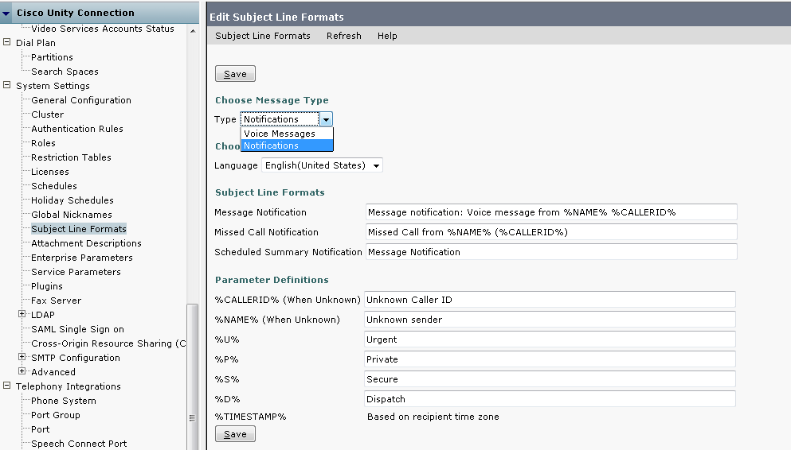
Subject Line Format Page – default configurations

Slide 8
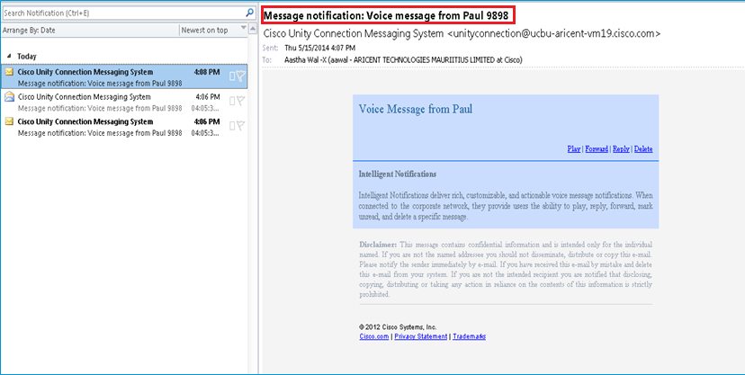
HTML Notification mail with default Subject line (for Voice Message Notifications)
Notes:
By default %NAME% and %CALLERID% are replaced by sender’s name and caller id (can be extension or SIP URI).

Slide 9
Customizing Subject Line Format
In addition to the regular text, the Subject Line Format fields can accept the following parameter definitions:
Parameter | Replaced with
%CALLERID% | Caller Id of the sender when known. OR Text configured on CUCA when unknown.
%NAME% | Display Name of the sender when known. OR Text configured on CUCA when unknown.
%U% | Text configured on CUCA for urgent message.
%P% | Text configured on CUCA for private message.
%S% | Text configured on CUCA for secure message.
%D% | Text configured on CUCA for dispatch message.
%TIMESTAMP% | Delivery time of the message as per the recipient’s time zone.
Notes:
%CALLERID% - Can also be the SIP URI of the sender.

Slide 10
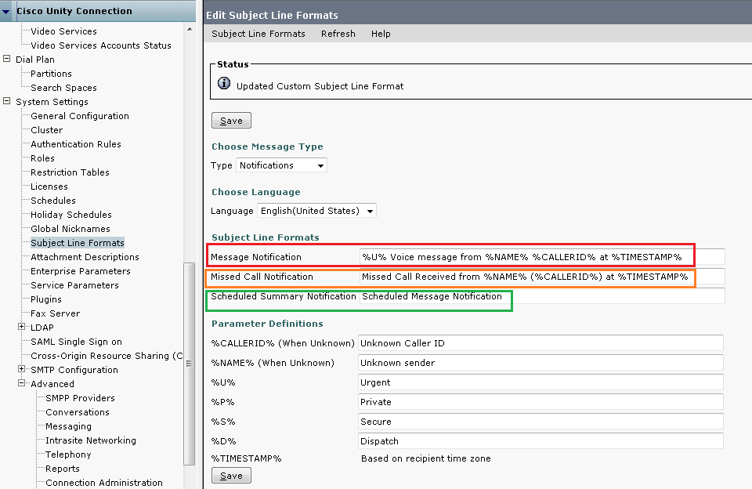
Subject Line Format Page - Customized

Slide 11
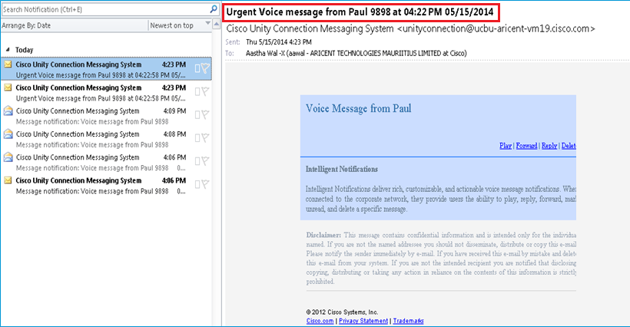
HTML Notification mail with customized Subject line (for Voice Message Notifications)

Slide 12
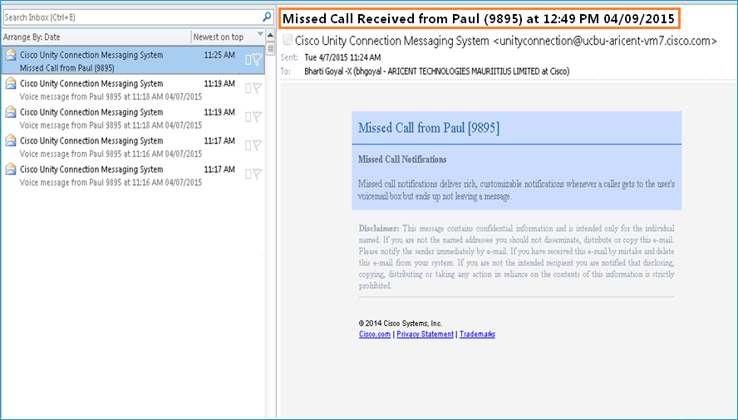
HTML Notification mail with customized Subject line (for Missed Call Notifications)

Slide 13
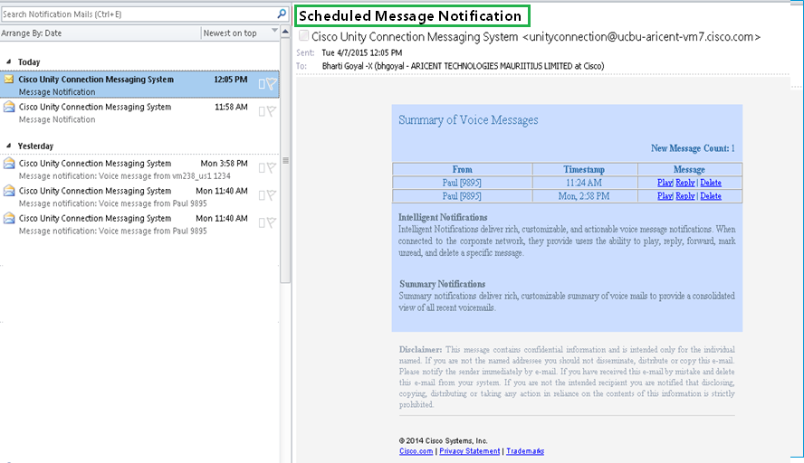
HTML notification mail with customized Subject line (for Scheduled Summary Notifications)

Slide 14
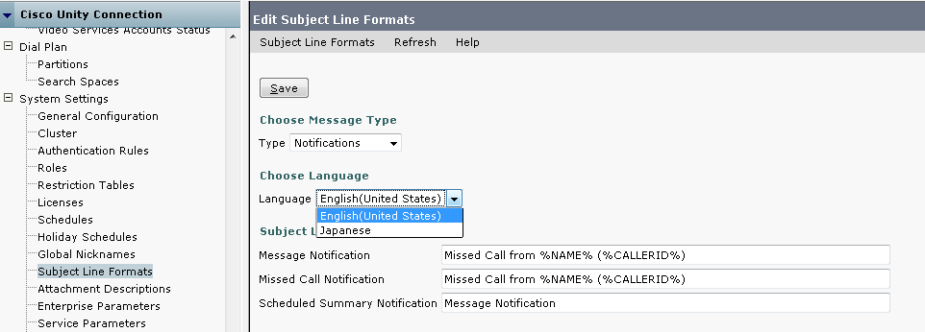
Locale Specific Subject Line
Language drop down displays list of all the installed languages on Unity Connection.
Specific language can be selected from drop down to customize subject lines and parameter definitions for that locale.

Slide 15
REST APIs

Slide 16
GET API – Subject Line Formats
vmrest/subjectlineformats
This API is used to fetch the list of all subject line formats for voice messages and
notifications.
Request URI :: https://<hostname>/vmrest/subjectlineformats
Response
<SubjectLineFormats total=“7"> <SubjectLineFormat> <URI>/vmrest/subjectlineformats/26f0d0bc-7369-4867-a020-efd4e947c348</URI> <ObjectId>26f0d0bc-7369-4867-a020-efd4e947c348</ObjectId> <LanguageCode>1033</LanguageCode> <FactoryDefaultSubject>Message notification: Voice message from %NAME% %CALLERID%</FactoryDefaultSubject> <Subject>Message notification: Voice message from %NAME% %CALLERID%</Subject> <SubjectType>5</SubjectType> <MessageType>2</MessageType> <CustomSubjectParameterURI>/vmrest/subjectlineparameters?query=(MessageType%20is%202) </CustomSubjectParameterURI> </SubjectLineFormat> … </SubjectLineFormats>

Slide 17
GET API – Subject Line Formats (Contd…)
vmrest/subjectlineformats/<subject-line-format-objectid>
This API is used to fetch details of a specific subject line format.
URI: https://<hostname>/vmrest/subjectlineformats/<objectid>
vmrest/subjectlineformats?query=(MessageType is <message-type>)
This API is used to fetch details of subject line formats for a specific message type. The message
type above represents Voice Messages(1) or Notifications(2).
URI: https://<hostname>/vmrest/subjectlineformats?query=(MessageType is 2)
Notes:
Response:
<Call>
<number>1007</number>
<id>1105</id>
<connected>true</connected>
<callType>video</callType>
<nativeConnectionId>16</nativeConnectionId>
</Call>
It will have Call Type as
Audio if previous call placed is audio otherwise it will have value video.

Slide 18
PUT API – Subject Line Formats
vmrest/subjectlineformats/<subject-line-format-objectid>
This API is used to modify a specific subject line format.
Request URI :: https://<hostname>/vmrest/subjectlineformats/<subject-line-format-objectid>
Request | Response
<SubjectLineFormat> <Subject>%D% %U% %P% Message from %NAME% (%CALLERID%) %TIMESTAMP%</Subject> </SubjectLineFormat> | Response Code:204 Ok

Slide 19
GET API – Subject Line Parameters
vmrest/subjectlineparameters
This API is used to fetch the list of all subject line parameters for voice messages and
notifications.
Request URI :: https://<hostname>/vmrest/subjectlineparameters
Response
<SubjectLineParameters total="15"> <SubjectLineParameter> <URI>/vmrest/subjectlineparameters/713982bb-4dd9-4b46-bfd0-66d094b4585e</URI> <ObjectId>713982bb-4dd9-4b46-bfd0-66d094b4585e</ObjectId> <LanguageCode>1033</LanguageCode> <Parameter>Unknown Caller ID</Parameter> <FactoryDefaultParameter>Unknown Caller ID</FactoryDefaultParameter> <ParameterType>1</ParameterType> <MessageType>2</MessageType> </SubjectLineParameter> ... </SubjectLineParameters

Slide 20
GET API – Subject Line Parameters (Contd…)
vmrest/subjectlineparameters/<subject-line-parameter-objectid>
This API is used to fetch details of specific subject line parameter.
URI: https://<hostname>/vmrest/subjectlineparameters/<objectid>
vmrest/subjectlineparameters?query=(MessageType is <message-type>)
This API is used to fetch details of subject line parameter for a specific message type. The message
type above represents Voice Messages(1) or Notifications(2).
URI: https://<hostname>/vmrest/subjectlineparameters?query=(MessageType is 2)
Notes:
Response:
<Call>
<number>1007</number>
<id>1105</id>
<connected>true</connected>
<callType>video</callType>
<nativeConnectionId>16</nativeConnectionId>
</Call>
It will have Call Type as
Audio if previous call placed is audio otherwise it will have value video.

Slide 21
PUT API – Subject Line Parameters
vmrest/subjectlineparameters/<subject-line-parameter-objectid>
The API is used to modify a specific subject line parameter definition.
Request URI :: https://<hostname>/vmrest/subjectlineparameters/<subject-line-parameter-objectid>
Request | Response
<SubjectLineParameter> <Parameter>Unknown</Parameter> </SubjectLineParameter> | Response Code:204 Ok

Slide 22
Troubleshooting

Slide 23
Troubleshooting
Notifications not received
Verify that the SMTP and/or HTML notification devices under ‘Users->Edit Notification Devices’ page are enabled with valid email ID.
Verify that SMTP smart host is configured on Connection Administration page.
Verify that following services are up and running:
Connection SMTP Server
Connection Notifier
Notifications received only for Urgent messages
Verify if Urgent only checkbox is selected in HTML or SMTP notification devices. To receive notifications for other messages as well, uncheck the checkbox.
Annotated logs wiki:
http://wikicentral.cisco.com/display/UNITYTRANS/Annotated+diagnostics+for+Subject+Line+Customization+for+Notifications

Slide 24
Logs collected via CLI
CLI to list the log files:
file list activelog cuc/diag_Tomcat*
file list activelog cuc/diag_CuNotifier*
CLI to collect specific log file:
file get activelog cuc/diag_Tomcat*.uc
file get activelog cuc/diag_CuNotifier*.uc
NOTE: The logs for VMREST and CUCA are captured in diag_Tomcat*.uc files and logs of Notifier are captured in
diag_CuNotifier*.uc files.

Slide 25
References
Cisco Unity Connection Administration Guide:
http://www.cisco.com/c/en/us/td/docs/voice_ip_comm/connection/11x/administration/guide/11xcucsagx.html
Design Guide:
http://www.cisco.com/c/en/us/td/docs/voice_ip_comm/connection/11x/design/guide/11xcucdgx.html
REST API Doc wiki:
http://docwiki-dev.cisco.com/wiki/Cisco_Unity_Connection_Provisioning_Interface_(CUPI)_API _--
_Custom_Subject_Line

Slide 26
Thanks

