Slide 1
Next Generation Security Support in Unity Connection 11.0
EDCS-1464707

Slide 2
Abbreviations
CUCA - Cisco unity Connection Administration
REST - Representational State Transfer
CSR - Certificate Signing Request
CA - Certificate Authority
CUC – Cisco Unity Connection
CUCM - Cisco Unified Communication Manager
NGE – Next Generation Encryption

Slide 3
Agenda
Overview
Next Generation Security Ciphers
Supporting Interfaces
Tomcat/Jetty
SIP Interface
SRTP Interface
REST APIs
Troubleshooting
References

Slide 4
Overview

Slide 5
Next Generation Security Ciphers
Interface | Pre 11.0 Release | Release 11.0 and Onwards
TLS version | TLS 1.0 | TLS 1.0 - TLS 1.2
SIP (Certificates) | Only RSA key based self-signed certificates | RSA key and EC key based certificates (self-signed and Third party)
SIP (Ciphers) | AES-128 SHA1 cipher only | AES-256 SHA384 ciphers only RSA preferred AES-128 SHA256 ciphers only RSA preferred AES-256, AES-128 ciphers ECDSA preferred AES-256, AES-128 ciphers ECDSA only AES-256, AES-128 ciphers RSA preferred AES-128 SHA1 cipher only
SRTP(Ciphers) | AES-128 SHA1 cipher only | All supported AES-256,AES-128 ciphers AEAD AES256 GCM-based ciphers only AEAD AES128 GCM-based ciphers only AES-128 SHA1 cipher only

Slide 6
Next Generation Security Ciphers (Contd.)
Interface | Pre 11.0 Release | Release 11.0 and Onwards
Tomcat / Jetty | RSA and SHA based ciphers are supported. TLS_RSA_WITH_AES_256_CBC_SHA TLS_DHE_DSS_WITH_AES_256_CBC_SHA TLS_RSA_WITH_AES_128_CBC_SHA TLS_DHE_RSA_WITH_AES_128_CBC_SHA SSL_RSA_WITH_3DES_EDE_CBC_SHA SSL_DHE_RSA_WITH_3DES_EDE_CBC_SHA | SHA2 algorithms for next generation security ciphers are supported. TLS_ECDHE_RSA_WITH_AES_256_GCM_SHA384 TLS_ECDHE_RSA_WITH_AES_128_GCM_SHA256 TLS_RSA_WITH_AES_256_CBC_SHA TLS_DHE_DSS_WITH_AES_256_CBC_SHA TLS_RSA_WITH_AES_128_CBC_SHA TLS_DHE_RSA_WITH_AES_128_CBC_SHA SSL_RSA_WITH_3DES_EDE_CBC_SHA SSL_DHE_RSA_WITH_3DES_EDE_CBC_SHA

Slide 7
Supporting interfaces

Slide 8
Brief Description
Configuration
Use Case
Tomcat and Jetty

Slide 9
Description OS Admin Certificate Purpose
Certificate Purpose | Description
tomcat | Web application and Jetty interface uses tomcat RSA key based certificates. This could be self-signed or Third Party.
tomcat-trust | Trust store to validate RSA key based certificates for Web applications and Jetty Interface
Note : Above Configuration is also applicable for SIP Interface.

Slide 10
Configuring RSA Key based Third Party Certificate
Generate CSR for CUC and get certificate signed from CA
Upload root certificate in “tomcat-trust” of CUC
Upload leaf certificate in “tomcat” store of CUC
Restart “Connection Conversation Manager” on CUC
Restart “Cisco Tomcat” on CUC.

Slide 11
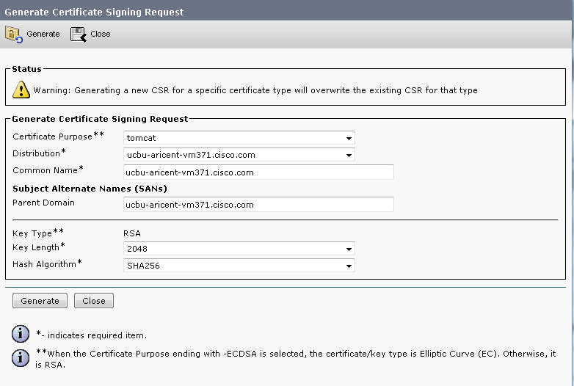
Generate CSR for RSA Certificate
Notes:
CSR can be generated from Cisco Unified OS Administration -> Security -> Certificate Management -> Generate CSR.
This CSR is used to generate Third Party Certificate from CA(Certificate Authority)

Slide 12
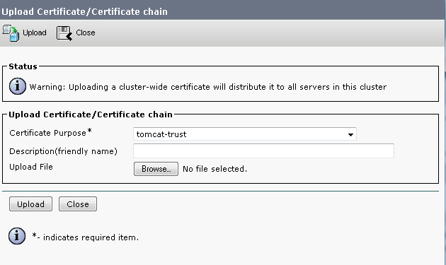
Upload Root Certificate in CUC Trust Store
Notes:
Upload Third Party RSA key based certificates from Cisco Unified OS Administration -> Security -> Certificate Management -> Upload Certificate.
Upload CA Root certificate in Tomcat trust store of CUC for RSA key based certificate negotiation.

Slide 13
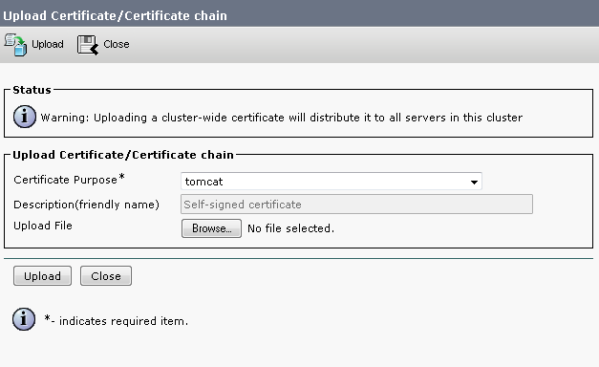
Upload CA Signed Leaf Certificate on CUC
Notes:
Upload third party RSA key based certificate from Cisco Unified OS Administration -> Security -> Certificate Management -> Upload certificate
Upload CA signed , RSA key based leaf certificate in Tomcat store on CUC.

Slide 14
Use Case 1 : Web Application Login(Web Inbox)
Login to web application (CUCA/Inbox/CPCA).
Take the sniffers , CUC should negotiate on the ciphers send by the browser.
Ensure ciphers selected by server (CUC) should be first matching cipher in list(depends on ciphers list sent by browser).
Notes:
Note : Web applications (i.e. CUCA, CPCA, Web Inbox, REST) will negotiate with CUC on Next generation security ciphers.

Slide 15
Brief Description
Configuration
Use Case
SIP Interface

Slide 16
Description of TLS Ciphers
TLS Ciphers | Description
AES-256 SHA384 ciphers only RSA preferred | The option AES-256 SHA384 ciphers only RSA preferred, includes the ciphers in following order: – AES-256 SHA384 RSA – AES-256 SHA384 ECDSA
AES-128 SHA256 ciphers only RSA preferred | The option AES-128 SHA256 ciphers only RSA preferred, includes the ciphers in following order: – AES-128 SHA256 RSA – AES-128 SHA256 ECDSA
AES-256, AES-128 ciphers ECDSA preferred | The option AES-256,AES-128 ciphers ECDSA preferred, includes the ciphers in following order: – AES-256 SHA384 ECDSA – AES-128 SHA256 ECDSA – AES-256 SHA384 RSA – AES-128 SHA256 RSA – AES-128 SHA1 RSA
Notes:
Note : Default Setting: AES-256, AES-128 ciphers RSA preferred

Slide 17
Description of TLS Ciphers- Contd.
TLS Ciphers | Description
AES-256, AES-128 ciphers ECDSA only | The option AES-256,AES-128 ciphers ECDSA only, includes the ciphers in following order: – AES-256 SHA384 ECDSA – AES-128 SHA256 ECDSA
AES-256, AES-128 ciphers RSA preferred (Default) | The option AES-256,AES-128 ciphers RSA preferred, includes the ciphers in following order: – AES-256 SHA384 RSA – AES-128 SHA256 RSA – AES-256 SHA384 ECDSA – AES-128 SHA256 ECDSA – AES-128 SHA1 RSA This cipher provides highest level of security and backward compatibility with connection peers that doesn't support the newer ciphers.
AES-128 SHA1 cipher only | The option AES-128 SHA1 ciphers only, includes the ciphers in following order: – AES-128 SHA1 RSA
Notes:
Note : Default Setting: AES-256, AES-128 ciphers RSA preferred

Slide 18
Description Contd.
CUC uses RSA key based tomcat certificates and EC key based CallManager-ECDSA certificates for SIP Interface.
When CUC acts as a server it sends certificates based on the negotiated cipher i.e. Cipher received from CUCM and selected on CUC.
When CUC acts as a client it sends EC key based certificates if “AES-256, AES-128 ciphers ECDSA only“ is selected on CUC and with all other options it sends RSA key based certificates.

Slide 19
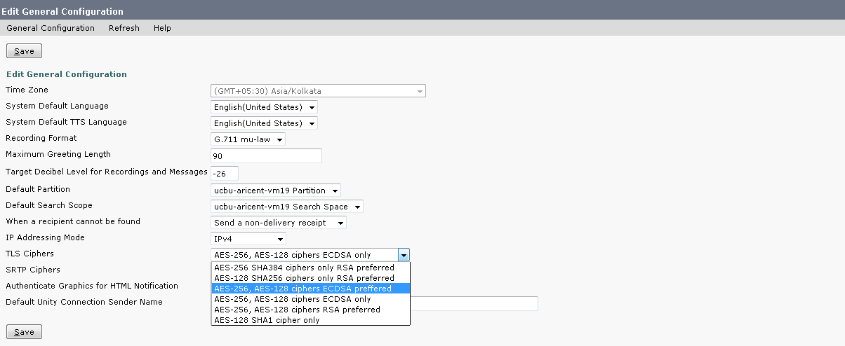
Configuring TLS Cipher
Note : For Changes to take effect Connection Conversation Manager Service restart is required.
Notes:
Cipher can be configured from Cisco Unity Connection Administration -> System settings -> General Configuration
NOTE : In earlier Releases, default cipher AES-128 SHA1 was not configurable

Slide 20
OS Admin Certificate Description
Certificate Purpose | Description
CallManager-ECDSA | SIP interface uses EC key based CalllManager-ECDSA certificates. This could be self-signed or Third Party.
CallManager-trust | Trust store for SIP to validate EC key based CallManager-ECDSA certificates

Slide 21
Configuring EC Key based Third party certificate
Generate CSR for CUC and get certificate signed from CA
Generate CSR for CUCM and get certificate signed from CA
Upload root certificate in “CallManager-trust” of CUC and in “CallManager-trust” of CUCM
Upload leaf certificate in “CallManager –ECDSA” of CUC and in “CallManager-ECDSA” of CUCM
Restart CCM service on CUCM and restart Conversation Manager on CUC

Slide 22
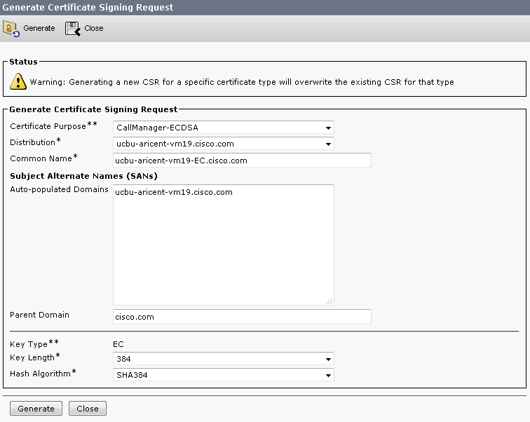
Generate CSR for ECDSA Certificate
Notes:
CSR can be generated from Cisco Unified OS Administration -> Security -> Certificate Management -> Generate CSR.
This CSR is used to generate Third Party Certificate from CA.

Slide 23
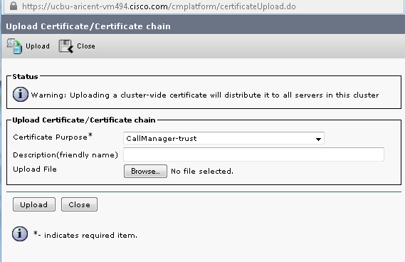
Upload Root Certificate in CUCM Trust Store
Notes:
Upload EC key based root certificate of CA in Call manager Trust on Cisco Unified OS Administration -> Security -> Certificate Management -> Upload Certificate/Certificate Chain on CUCM.

Slide 24
Upload Root Certificate in CUC Trust Store
Notes:
Upload EC key based root certificate of CA in Call manager Trust on Cisco Unified OS Administration -> Security -> Certificate Management -> Upload Certificate/Certificate Chain on CUC.

Slide 25
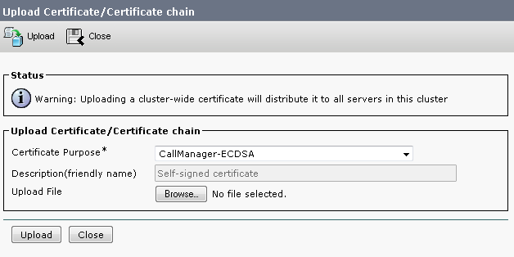
Upload CA Signed Leaf Certificate on CUCM
Notes:
Upload EC key based leaf certificate( CA Signed ) in “CallManager-ECDSA” store on Cisco Unified OS Administration -> Security -> Certificate Management -> Upload Certificate/Certificate Chain on CUCM.

Slide 26
Upload CA Signed Leaf Certificate on CUC
Notes:
Upload EC key based leaf certificate( CA Signed ) in “CallManager-ECDSA” store on Cisco Unified OS Administration -> Security -> Certificate Management -> Upload Certificate/Certificate Chain on CUC.

Slide 27
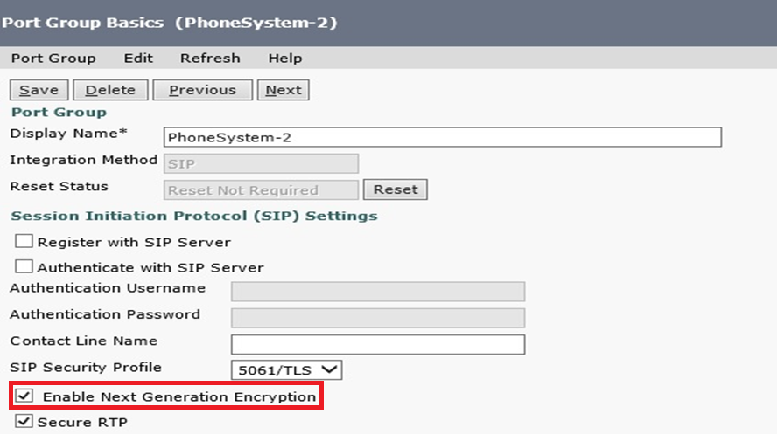
Configuring Port Group to enable NGE
Notes:
A configurable check box option per port group is provided on the page Telephony Integrations -> Port Group -> Enable Next Generation Encryption.
Unchecking this option, Next Generation Encryption will not be used.

Slide 28
Use Case 2 : Drop a voicemail with Negotiation on ECDSA key based Certificate
Create a secure SIP integration setup.
Configure TLS cipher to “AES-256, AES-128 ciphers ECDSA only” on CUC.
Configure TLS cipher to “AES-256, AES-128 ciphers ECDSA only” on CUCM.
Place a call and take Sniffers.
CUC should negotiate on: TLS_ECDHE_ECDSA_WITH_AES_256_GCM_SHA384

Slide 29
Brief Description
Configuration
Use Case
SRTP Interface

Slide 30
Description of SRTP Ciphers
SRTP Ciphers | Description
All supported AES-256,AES-128 ciphers | When this option is selected, the AES-256-based ciphers are preferred over the AES-128-based variants in the order of strength of the cipher suite. This cipher provides highest level of security and backward compatibility with connection peers that doesn't support the newer ciphers.
AEAD AES256 GCM-based ciphers only | When this option is selected, only the AEAD AES256 GCM based ciphers are recognized and negotiated during media establishment.
AEAD AES128 GCM-based ciphers only | When this option is selected, only the AEAD AES128 GCM based ciphers are recognized and negotiated during media establishment.
AES-128 SHA1 cipher only | When this option is selected, only the AES-128-based SHA1ciphers are recognized and negotiated during media establishment
NOTE: If there is cipher mismatch during media negotiation and peer supports SRTP fallback, then the call becomes non-SRTP call
Notes:
SRTP fallback header is visible in the SIP INVITE message that comes from CUCM.
Header to be checked : “Supported: X-cisco-srtp-fallback”

Slide 31
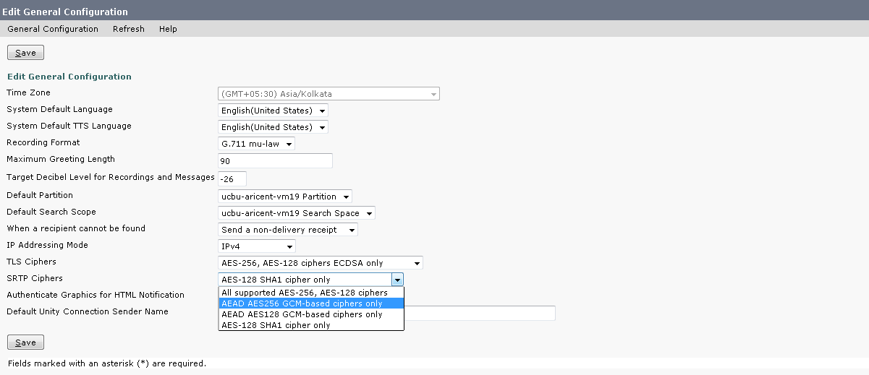
Configuring SRTP Cipher
Note : For Changes to take effect Connection Conversation Manager Service restart is required.
Notes:
NOTE : In earlier Releases, default cipher AES-128 SHA1 was not configurable.

Slide 32
Use case 3 : Drop a voicemail with SRTP negotiation on AES-256 GCM cipher
Create a setup with SRTP enabled on it.
Configure SRTP cipher to “All supported AES-256, AES-128 ciphers” on CUC.
Configure SRTP cipher to “All supported AES-256, AES-128 ciphers” on CUCM.
Place a call and Verify the logs and Sniffers.
CUC should negotiate on AEAD_AES_256_GCM.

Slide 33
REST APIs

Slide 34
GET API – TLS and SRTP Ciphers
vmrest/generalconfigurations
This API is used to fetch the existing configuration of SIP TLS cipher on Unity Connection
Request URI :: https://<hostname>/vmrest/generalconfiguration
Response
<GeneralConfigurations total="1"> <GeneralConfiguration> <URI>/vmrest/generalconfigurations/070b0cda-accb-4534-af43-2cf8fd9e6113</URI> <ObjectId>070b0cda-accb-4534-af43-2cf8fd9e6113</ObjectId> <TlsCiphers>4</TlsCiphers> <SrtpCiphers>3</SrtpCiphers> </GeneralConfiguration> </GeneralConfigurations>
Note : For TlsCiphers and SrtpCiphers values , Please refer the doc wiki in References Section

Slide 35
PUT API –TLS Cipher
vmrest/generalconfigurations/<ObjectId>
This API is used to modify TLSCipher.
Request URI :: https://<hostname>/vmrest/generalconfigurations/<Objectid>
Request | Response
<GeneralConfiguration> <TlsCiphers>1</TlsCiphers> </GeneralConfiguration> | Response Code:204 Ok

Slide 36
PUT API – SRTP Cipher
vmrest/generalconfigurations/<ObjectId>
This API is used to modify SRTPCipher.
Request URI :: https://<hostname>/vmrest/generalconfigurations/<Objectid>
Request | Response
<GeneralConfiguration> <SrtpCiphers>2</SrtpCiphers> </GeneralConfiguration> | Response Code:204 Ok

Slide 37
Troubleshooting

Slide 38
Troubleshooting
Annotated logs wiki link
Tomcat /Jetty and SIP Interface
http://wikicentral.cisco.com/display/UNITYTRANS/Annotated+Traces+for+Next+Generation+Security+support+in+Unity+Connection
SRTP Interface
http://wikicentral.cisco.com/display/UNITYTRANS/Annotated+Traces+for+Next+Gen+security+ciphers+in+SRTP

Slide 39
References
Cisco Unity Connection Administration Guide:
SIP Integration guide:
http://www.cisco.com/c/en/us/td/docs/voice_ip_comm/connection/11x/integration/guide/cucm_sip/cucintcucmsip.html
OS Administration:
http://www.cisco.com/c/en/us/td/docs/voice_ip_comm/connection/11x/os_administration/guide/11xcucosagx.html
REST API Doc wiki:
http://docwiki.cisco.com/wiki/Cisco_Unity_Connection_Provisioning_Interface_%28CUPI%29_API_--_General_Configuration#TLS_AND_SRTP_Ciphers

