Slide 1
System Backup And Restore Utility

Slide 2
Notice
The information in this presentation is provided under Non-Disclosure agreement and should be treated as Cisco Confidential. Under no circumstances is this information to be shared further without the express consent of Cisco.
Any roadmap item is subject to change at the sole discretion of Cisco, and Cisco will have no liability for delay in the delivery or failure to deliver any of the products or features set forth in this document.
Notes:
2
2

Slide 3
Agenda
What is this system backup and restore tool?
How is it different from DRS?
How does it work?
Troubleshooting
Q&A

Slide 4
System backup and restore tool
Introduction: System restore tool is intended for creating restore points on the Unity Connection which in case of database or configuration failure can be used to restore the system with minimum downtime.
Three system restore points would be available viz.
temp , recent and daybefore.
daybefore : Restore point for backup taken one day before.
recent : Restore point created on the current day.
temp: Temporary Restore created anytime other than scheduled backups.

Slide 5
System …
Three modes will be available while restoring a restore point viz. database , config and both
database : For Db backup
config: For platform configuration backup
both:For both Db and platform configuration back

Slide 6
System Restore vs DRS
System Restore tool
DRS
Backup consists
Database backup
Platformconfig.xml file
DSCP settings
Security tokens
Hostname details
Licenses
Backup stored locally for data security
Backup and restore is faster (2 minutes to 10 minutes)
Full server backup
Backup stored on SFTP server
Backup and restore takes longer duration (can take hours in case of over the wire backup)

Slide 7
System Restore vs DRS
System Restore tool
DRS
Db consistency and foreign key constraints are checked before creating a restore point
Email notification for failed restore point creation is sent to system-backup-and-restore-admin
Note: Require SMTP server for email notification.
No consistency check is performed
No such provision is present.

Slide 8
System Restore vs DRS
System Restore tool
DRS
Affected users details with message count is shown before restore operation
Does not recover when hardware failure occurs.
Server cannot be rebuilt from the backup
No such provision is present
It is used for recovery from hardware failure.
Server can be rebuilt from the backup

Slide 9
How does it work
Three system restore points would be available viz. temp , recent and daybefore.
Three Restore modes will be available after creating a restore point viz. database , config and both
Db consistency and foreign key constraints are checked before creating a restore point to ensure clean data backup every time.
For 'config' and 'both' restore modes, the system is restarted after confirmation from the user before the restart operation and a warning message stating “ WARNING: This operation will lead the server to restart.”.
.

Slide 10
How …
The restore point creation process is guided by a sysagent task (Create Backup Restore Point) from
connection administration page ( Task Management )
CLI command through sysagent task (Data.SystemRestoreBackupTask)
By Default the sysagent task is turned off and needs to be turned on to avail the feature.
The sysagent task is configured to run every day at 2300 hours by default, which can further be configured as per customer
System restore point are soft restore points taken on connection server. This allows restore back ups to be secure and fast

Slide 11
How …
Backup through Gui
GUI Interface to Configure task schedules and check the task’s execution history:
CUCA-> Task Management-> Create Backup Restore Point

Slide 12
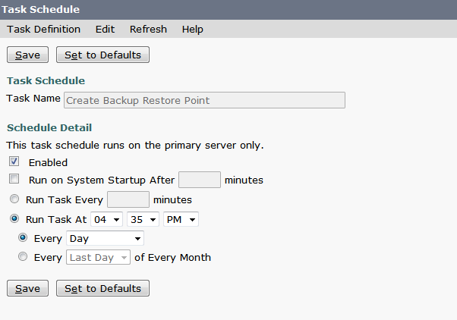
How …
Scheduling Backup Through GUI
Example: Schedule Create Backup Restore Point task from Task Management

Slide 13
How …
CLI to take backup
CLI to restore backed up data

Slide 14
Troubleshooting
The log file for System Restore utility error scenarios is created at path /common/RestorePoints/recent named as ERRORS.log. Check the error logs to troubleshoot any problem while backup or restore operation.
Some issues:
ISSUE No. 1
Resolution:
Reboot the system to get the db up.

Slide 15
Troubleshooting
Issue No. 2: Error in ERRORS.log file.
Validating indexes for unitymbxdb1:informix.syserrors...
ERROR: Bad key information in TBLspace description.
ERROR: Index ix_tbl_message_messageobjectidtypepriority for unitymbxdb1:informix.tbl_message is bad.
TBLspace data check for unitymbxdb1:informix.syserrors
Resolution:
Drop and re-create the corrupted indexes.

Slide 16
THANKS

