Slide 1
Cisco Unity Connection -
Configurable “FROM" Field for Notifications and Outside Callers Messages
EDCS-1486365
March 20, 2015

Slide 2
Notice
The information in this presentation is provided under Non-Disclosure agreement and should be treated as Cisco Confidential. Under no circumstances is this information to be shared further without the express consent of Cisco.
Any roadmap item is subject to change at the sole discretion of Cisco, and Cisco will have no liability for delay in the delivery or failure to deliver any of the products or features set forth in this document.

Slide 3
Agenda
Introduction
What's new
Configuration
Demo
Troubleshooting Tips

Slide 4
Introduction

Slide 5
Introduction
Cisco Unity Connection can notify a user for new messages by sending notifications. Administrator can set up Unity Connection to send SMTP notifications and text messages as well.
With this new feature, administrator can now update ‘FROM’ field for notifications and outside caller’s messages.

Slide 6
What’s new
Administrator can update default ‘FROM’ field as per enterprise need and it will reflect in all notifications and outside caller’s messages.
A new option added at CUCA under System Settings -> General Configuration -> “Default Unity Connection Sender Name”

Slide 7
Default Displayname Usage for Outside Caller’s Messages and Notifications
If Outside Caller leaves a message to Connection user, then message ‘FROM’ field shows displayname of user ‘UnityConnection’.
Same is applicable for Notifications.

Slide 8
Configuration

Slide 9
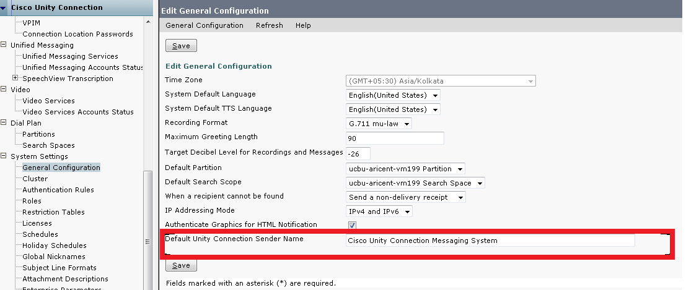
New field added on CUCA: "Default Unity Connection Sender Name" field on General Configurations page
A new field "Default Unity Connection Sender Name" added on 'General Configurations’ under ‘System Settings’ page.
Default value of "Default Unity Connection Sender Name" field is "Cisco Unity Connection Messaging System“.

Slide 10
Rest API to Update "Default Unity Connection Sender Name"
Added new Rest API.
<server>/vmrest/setDefaultSenderName
Methods supported are: GET, PUT
GET: https://<connection-server>/vmrest/setDefaultSenderName
Displays the details of default user ‘UnityConnection’:
<User>
<ObjectId><objectId of user ‘UnityConnection’></ObjectId>
<DisplayName><Displayname of user ‘UnityConnection’></DisplayName>
</User>

Slide 11
Rest API to Update "Default Unity Connection Sender Name” continued. .
PUT: https://<connection-server>/vmrest/setDefaultSenderName
To update the DisplayName of default user ‘UnityConnection’,
Request Body:
<User>
<DisplayName>< Displayname of user ‘UnityConnection ></DisplayName>
</User>
Response Code : 204

Slide 12
Demo

Slide 13
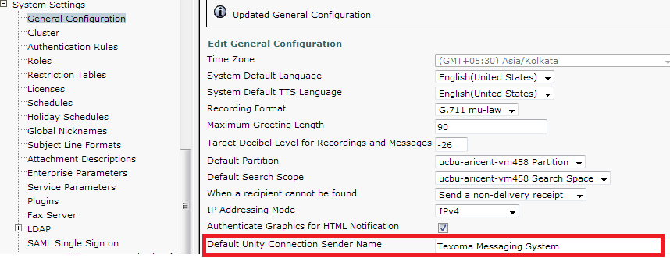
Update Displayname of User ‘UnityConnection’ for Notifications and Outside Caller’s Messages
Administrator can update Displayname of user ‘UnityConnection’ as “Texoma Messaging System” on General Configurations under System Settings page.

Slide 14
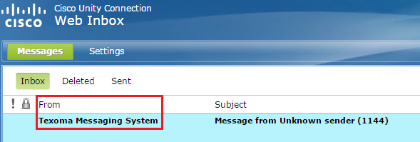
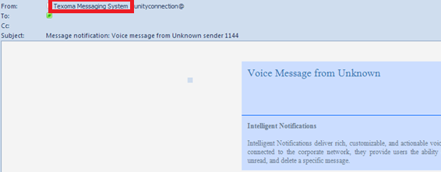
Post-Update in DisplayName
Outside caller’s messages(FROM field updated to ‘Texoma Messaging System’).
Notifications(FROM field updated to ‘Texoma Messaging System’).

Slide 15
Troubleshooting Tips

Slide 16
Traces
Enable following to troubleshoot "Default Unity Connection Sender Name” update related issues.
Micro Traces | Description | Level
cuca | Administrator page traces | All
VMREST | VMREST API traces | All
Log files to be collected : diag_Tomcat_xxxxxxx.uc

Slide 17
Configuration Issues
Problem Statement:
Updated DisplayName is not getting reflected in messages received from outside callers or in notifications.
Action Required:
Verify that displayname got modified using vmrest API GET: ‘https://<server>/vmrest/setDefaultSenderName’.
For additional details, refer diag_Tomcat_xxxxxxx.uc

