Slide 1
Unity Connection
Media Player
December 2017
<EDCS #11991846>

Slide 2
Notice
The information in this presentation is provided under Non-Disclosure agreement and should be treated as Cisco Confidential. Under no circumstances is this information to be shared further without the express consent of Cisco.
Any roadmap item is subject to change at the sole discretion of Cisco, and Cisco will have no liability for delay in the delivery or failure to deliver any of the products or features set forth in this document.

Slide 3
Agenda
Introduction
Media Player GUI
Media Player Functionality
Demo Scenarios
Troubleshooting Tips
References

Slide 4
Introduction
With Cisco Unity Connection 11.5(1), new Media player was introduced with following features
  Compatible with all latest browsers
  No dependency on Java
  Playback and Record functionality using TRAP
With Cisco Unity Connection 11.5(1) SU5 and 12.5(1) onwards, Record and Playback functionality using Computer is also available in Media Player.

Slide 5


Media Player GUI
Computer Mode Enabled
Upload
Progress Bar
Recording Length
Volume
TRAP Mode Enabled
Download
Number/URI (Text
Box is enabled
only in case of the
TRAP Mode)
Play
Stop
Record
Speed

Slide 6
Media Player Functionality
Functionality | Media Player Unity Connection Upto 11.5SU(4) and 12.0 | New Media Player Unity Connection 11.5SU(5), 12.5 and later
Trap Play & Record | ✓ | ✓
Computer Play & Record | ✗ | ✓
Upload & Download | ✓ | ✓
Speed & Volume Control | ✓ | ✓
Toggle Functionality | ✗ | ✓
Play/Pause/Resume/Stop | ✓ | ✓
Record/Pause/Resume/Stop | ✓ | ✓

Slide 7
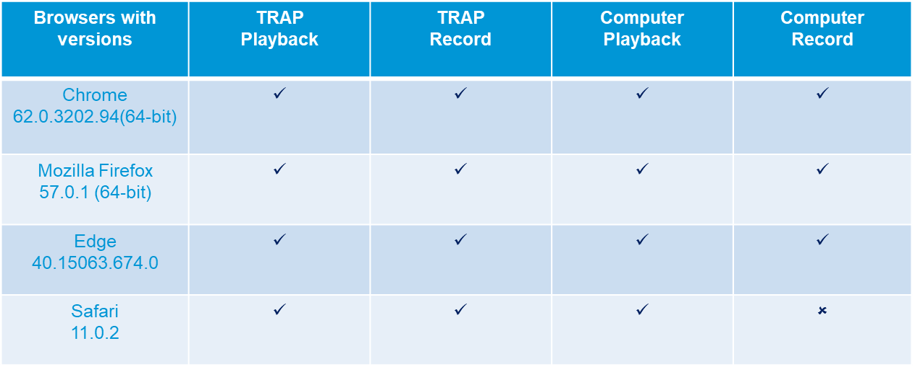
Browser Compatibility
Note: IE does not support Computer Record/Playback
For the supported browser version, refer the following link-
https://www.cisco.com/c/en/us/td/docs/voice_ip_comm/connection/compatibility/matrix/b_cucclientmtx.html

Slide 8
Demo Scenarios
Scenario 1: Media Player TRAP Record/Pause/Stop
Login to Cisco Unity Connection Administration with the login credentials
Select a user on Search Users page
On Edit User Basics page click on Record button of Media Player under Recorded Name field
Recording will start from the TRAP
Pause recording and resume recording
Stop recording
Play temporary recording
Save User to view recording for voicename

Slide 9
Scenario 2: Media Player TRAP Play/Pause/Stop
Login to Cisco Unity Connection Administration with the login credentials
Select a user on Search Users page
On Edit User Basics page click on Play button of Media Player under Recorded Name field
Recording will be played by phone on given Number or URI
During Play, Pause the playback
After Pause user can Resume or Stop playback

Slide 10
Scenario 3: Media Player Computer Record/Pause/Stop
Login to Cisco Unity Connection Administration with the login credentials
Select a user on Search Users page
On Edit User Basics page click on Record button of Media Player under Recorded Name field
Recording will start from the computer
Pause recording and resume recording
Stop recording
Play temporary recording
Save User to view recording for voice name

Slide 11
Scenario 4: Media Player Computer Play/Pause/Stop
Login to Cisco Unity Connection Administration with the login credentials
Select a user on Search Users page
On Edit User Basics page click on Play button of Media Player under Recorded Name field
Recording will be played from the computer
During Play, Pause the playback
After Pause user can Resume or Stop playback

Slide 12
Scenario 5: Media Player Speed and Volume Functionality
Click on Play button of Media Player
Increase/Decrease Volume
Change Speed to -1x, 1x, 2x, 3x
Stop playback
Increase/Decrease Volume
Start playback again
Stop playback

Slide 13
Scenario 6: Media Player Upload Functionality
Login to Cisco Unity Connection Administration with the login credentials
Select a user on Search Users page
Select Edit and open Greetings(e.g Standard)
On Edit Greeting page, Click Upload button of Media Player
Browse and Select .wav file(supported format only)
Save User
Note: After uploading the prerecorded file, you must Save the page.

Slide 14
Scenario 7: Media Player Download Functionality
Login to Cisco Unity Connection Administration with the login credentials
Select a user on Search Users page
Select Edit and open Greetings(e.g Standard)
On Edit Greeting page, Click Download button of Media Player
Save .wav file in any desired location

Slide 15
Troubleshooting Tips
Troubleshooting Scenario 1
Problem Statement
Not able to play on Safari using computer
Action Required
Do the following to check the browser settings:
Go to Safari > Preferences > Websites > AutoPlay
Make sure that "Allow All Auto Play" option is selected

Slide 16
Troubleshooting Scenario 2
Problem Statement
Not able to download recordings
Action Required
Check the following browser's Download Settings:
  Download Location
  Ask where to save file before downloading

Slide 17
Troubleshooting Scenario 3
Problem Statement
Unable to Upload a .wav file.
Action Required
The file being uploaded may not be in supported .wav format
Convert the .wav file to another supported audio format
Use a .wav file that is recorded in a supported audio format
Or alternatively, Make a new recording by using a phone/computer

Slide 18
Reference Links
User Guide for the Cisco Unity Connection Messaging Assistant Web Tool (Release 12.x)
https://www.cisco.com/c/en/us/td/docs/voice_ip_comm/connection/12x/user/guide/assistant/b_12xcucugasst.html
Troubleshooting Guide for Cisco Unity Connection Release 12.x
  https://www.cisco.com/c/en/us/td/docs/voice_ip_comm/connection/12x/troubleshooting/guide/b_12xcuctsg.html
Annotated diagnostics wiki for Media Player
  https://ccbu-wiki.cisco.com/display/UNITYTRANS/Annotated+diagnostics+for+Media+Player

Slide 19
Thank You

