Slide 1
Unity Connection
Custom Roles
February 2018
EDCS -

Slide 2
Notice
The information in this presentation is provided under Non-Disclosure agreement and should be treated as Cisco Confidential. Under no circumstances is this information to be shared further without the express consent of Cisco.
Any roadmap item is subject to change at the sole discretion of Cisco, and Cisco will have no liability for delay in the delivery or failure to deliver any of the products or features set forth in this document.

Slide 3
Agenda
Introduction
Read Only Administrator Role
Create Custom Roles by Inheriting System Roles
Custom Roles REST API’s
Demo
Troubleshooting
References

Slide 4
Introduction
Roles are used to control access to the system. It is a set of privileges which govern the operations allowed to a user.
Current Behavior from 11.5 release:
System Administrator can create new custom roles, assign/un-assign roles to the users, manage access control based on the business requirement.
From 12.5 onwards:
A new System Role, Read Only Administrator, has been introduced.
Privilege “Read Access To System Configuration Data - Read Access” is implicit to any new Custom Role created.
Custom Roles can be created by Inheriting System Roles, if required.
Custom Role API’s have been introduced.
Notes:
Only System Administrator can create/modify/delete custom roles

Slide 5
Read Only Administrator Role
A new System Role has been added – Read Only Administrator, which has read access for the following:
All Cisco Unity Connection pages
CUCM driven pages
RTMT Client
Serviceability pages

Slide 6
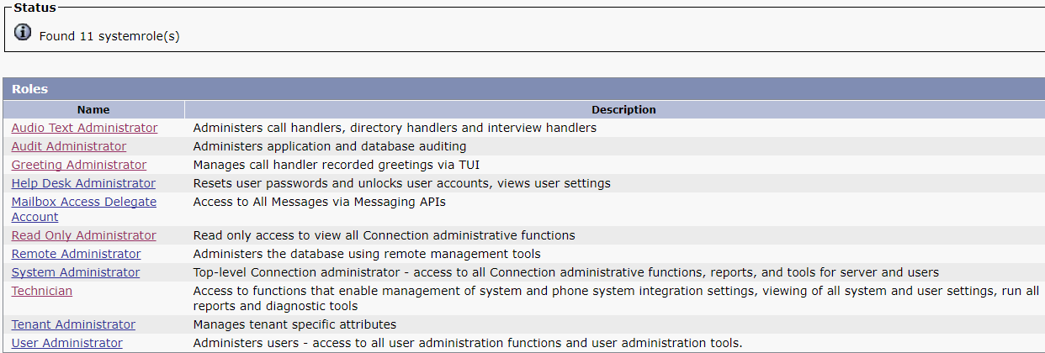
Read Only Administrator Role
Go to: System Settings -> Roles -> System Roles -> Read Only Administrator

Slide 7
Create Custom Roles by Inheriting System Roles
Allows System Administrator to
  Create a new Custom Role by Inheriting the System Role, if required.
On selecting any System Role To Inherit, privileges corresponding to that System Role are assigned.
Additional privileges can be assigned to a Custom Role.
Notes:
Privileges corresponding to Inherit System Role cannot be unassigned .
Only System Roles - Audio Text Administrator, Greeting Administrator, Help Desk Administrator, Technician, User Administrator, Tenant Administrator can be Inherited while creating a new Custom Role.

Slide 8
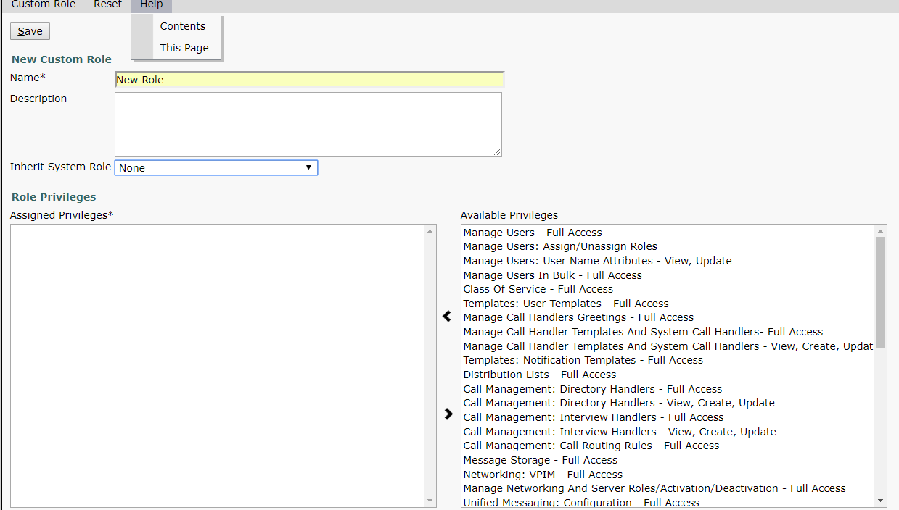
Create Custom Roles by Inheriting System Roles
Go to: System Settings -> Roles -> Custom Roles

Slide 9
Custom Roles REST API’s
System Administrator can use following API’s :
  To create a Custom Role – POST
  https://<server>/vmrest/customroles?systemRoleToInherit=<systemRoleToInherit_objId>
  To modify a Custom Role –
  PUT https://<connection_server>/vmrest/customroles/<objectId>
  To delete a Custom Role –
  DELETE https://<connection-server>/vmrest/customroles/<objectId>
  To enlist System Roles - GET https://<connection-server>/systemroles
  To enlist Custom Role - GET https://<connection-server>/customroles
  To enlist All Privileges - GET https://<connection-server>/vmrest/privileges
  To enlist Privileges of a Role -
  GET https://<connection-server>/vmrest/roles/<object_id>/privileges
Notes:
Only System Roles - Audio Text Administrator, Greeting Administrator, Help Desk Administrator, Technician, User Administrator, Tenant Administrator can be Inherited while creating a new Custom Role.
In systemRoleToInherit tag, we need to provide the objectId of the System Role that you want to Inherit while creating a new Custom Role.
Refer to doc link : https://www.cisco.com/c/en/us/td/docs/voice_ip_comm/connection/DocWiki/APIs/guide/b_Cisco_Unity_Connection_APIs.html for detailed information about the tags

Slide 10
Demo Scenario :
Read Only Admin
Custom Admin for System Settings
Modify Custom Role to manage Greetings and Users

Slide 11
Demo Scenario 1 : Create “Read Only Administrator” System Role
Go to: Users-> Add New-> add user(ReadOnlyAdminUser)
Assign role “Read Only Administrator” to user “ReadOnlyAdminUser”.
ReadOnlyAdminUser will be able to view Connection Configuration Settings
ReadOnlyAdminUser will not be able to modify Configuration Settings
Notes:
Privilege “Read Access To System Configuration Data - Read Access” is associated by default while creating a new custom role for view access.

Slide 12
Demo Scenario 2 : Create Custom Role to manage System settings
System Administrator creates a Custom Role and gives following privileges:
  “System Settings - Full Access”
  “System Settings: Advanced - Full Access”
System Administrator assigns “Custom Role” to “SystemSettingsAdminUser”.
SystemSettingsAdminUser :
will be able to manage System settings
will not be able to manage other settings
will be able to view all Connection pages

Slide 13
Demo Scenario 3 : Sample Custom Role to manage Greetings and Users
Move “Manage Users - Full Access” privilege to Assigned Privileges “Sample_Role” Custom role and select “Greeting Administrator” from Inherit System Role
Assign this role to a user.
  User will be able to modify users and greetings
Un-assign “Manage Users - Full Access” privilege from the role.
  User will not be able to modify users
  User will be able to modify greetings

Slide 14
Troubleshooting
Problem Scenarios with Solution:
  Custom Role create/update/delete failure:
      If Custom Role create/update/delete action fails, then check that the login user has System Administrator role.
  Custom Role update:
      If we modify Inherit System Role of a Custom Role, then, its Assigned privileges are reset to the default privileges of the inherit System Role.
  Role Assignment/Un-assignment failure:
      If Custom Role assign/un-assign action fails, then first check that user has privilege “Manage Users: Assign/Unassign Roles” after that login user role:-
      Custom Administrator - If Login user is Custom Admin, then it cannot assign/un-assign System role or role having privilege “Super Custom Administrator” to a user.
      Super Custom Administrator - If Login user is Custom Admin, then it cannot assign/un-assign System role to a user.

Slide 15
Troubleshooting
Problem Scenarios with Solution:
  User create/update/delete failure:
      If a User create/update/delete action fails, then first check that user has privileges “Manage Users - Full Access” and “Manage Users: Call Handlers - Full Access” after that login user role:-
      Custom Administrator - If Login user is Custom Admin, then it cannot perform operations on a user having System role or role having privilege Super Custom Administrator.
      Super Custom Administrator - If Login user is Custom Admin, then it cannot perform operations on a user having System role.

Slide 16
References
Doc Wiki: https://www.cisco.com/c/en/us/td/docs/voice_ip_comm/connection/12x/administration/guide/b_12xcucsag.pdf.
Annotated Wiki: https://ccbu-wiki.cisco.com/display/MESSAGING/Annotated+diagnostics+for+Custom+Roles.
Notes:
https://www.cisco.com/c/en/us/td/docs/voice_ip_comm/connection/12x/administration/guide/b_12xcucsag.pdf.

Slide 17
Thank You

