Slide 1
Unity Connection
Specific License Reservation TOI
Aug 2018
EDCS-12879147

Slide 2
Notice
The information in this presentation is provided under Non-Disclosure agreement and should be treated as Cisco Confidential. Under no circumstances is this information to be shared further without the express consent of Cisco.
Any roadmap item is subject to change at the sole discretion of Cisco, and Cisco will have no liability for delay in the delivery or failure to deliver any of the products or features set forth in this document.

Slide 3
Agenda
Overview on Smart Licensing in Unity Connection
License Reservation
  Specific License Reservation (SLR)
SLR in Unity Connection
  Prerequisites
  Product and License Authorization States in SLR
  Specific License Reservation Flow Diagram
  Licenses page in SLR mode
  CLI supported in Specific License Reservation
    Enable Specific License Reservation
    Request Reservation Code
    Return Authorization Code
    Install Authorization Code
    Return Reserved License

Slide 4
    Cancel Reservation Request
    Disable License Reservation
  High Availability in Unity Connection
  Troubleshooting
  Annotated Traces
  Logs & Events

Slide 5
Overview on Smart Licensing in Unity Connection
In Unity Connection, from 12.0 onward PLM was deprecated and Smart License Manager (SLM) is being used for licensing which is enabled by default.
Cisco Smart Software Licensing made it easier to buy, deploy, track, and renew Cisco software by removing today's entitlement barriers and providing information about your software install base. This was a major change to Cisco's software strategy, moving away from a PAK-based model to a new approach that enables flexibility and advanced consumer-based models.
As an enhancement to Smart Licensing, License Reservation mode will be introduced in 12.5 to support Licensing in highly secure networks.
Note:
For further details on Smart Licensing, follow the below mentioned link:
https://www.cisco.com/c/en/us/td/docs/voice_ip_comm/connection/12x/install_upgrade/guide/b_12xcuciumg.html

Slide 6
License Reservation
License Reservation is a set of capabilities that have been designed for highly secure environments where communications with outside environments is difficult.
A primary goal of License Reservation is to provide a mechanism for a product to operate normally without ongoing communication with either the Cisco Smart Software Manager (CSSM) or a Smart Software Satellite (on-site collector).
There are two types of License Reservation:
      Permanent License Reservation(Dark networks)
      Only a bare minimum of data can be interchanged, and none electronically – everything must be typed.
      Specific License Reservation(Highly secure environments)
      Products can be staged and configured in an open environment and some electronic exchange is allowed prior to deployment in a locked setting where no ongoing communication is allowed or possible. Notably it is much easier to bring electronic data into the classified environment than to take it out of the classified network.
      Note: Unity Connection supports only Specific License Reservation.

Slide 7
Specific License Reservation (SLR)
Specific License Reservation (SLR) is a feature used in highly secure networks. It provides a method for Customers to deploy a Software License on a Device (Product Instance) without communicating usage information to Cisco.
This is a solution for customers that can exchange initial information, want to consume entitlements normally (not everything possible), or track entitlement usage in the portal.
When a customer activates a product, they manually exchange information (copy and paste) with the CSSM once as a part of product authorization and configuration. No further interaction with the CSSM (or Smart Software Satellite) is needed or expected. The exchange will cause the CSSM to permanently allocate the consumed entitlements to the License Reservation product instance

Slide 8
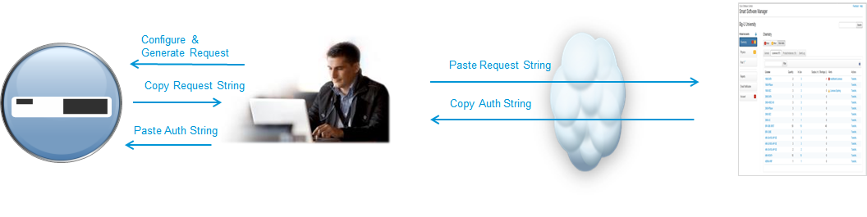
Specific License Reservation - Contd.
High Level Process
    Customer installs Unity Connection and Smart Licensing is enabled.
    Manually exchange License information (copy and paste) with the CSSM
    Two way data exchange via ASCII strings
    Product license consumption entered into CSSM
    CSSM performs a validity check
    CSSM returns an authorization locked to UDI
    Entitlement usage recorded and tracked in the CSSM

Slide 9
SLR in Unity Connection
On fresh installed Unity Connection Smart Licensing is enabled but License Reservation is disabled.
On Unity Connection, from Release 12.5 onwards either Smart Licensing or Specific License Reservation will be enabled.
EVALUATION period will last maximum for 90 days(for entire product life).
Unity Connection will move to Enforcement mode when product is in NOT AUTHORIZED – RESERVED state for more than 90 days.
In Enforcement mode:
  User Provisioning will be stopped in Unity Connection.
  User will not be able to modify Class of Service.
  User will not be able to create speech connect port.

Slide 10
Prerequisites
To configure a product for SLR operations, following are the prerequisites:
Smart Account on Cisco Smart Software Manager(CSSM)
Virtual Account under Smart Account
Licenses associated with Virtual Account. In case of SLR, following License PID are allowed:
CUC_BasicMessaging
CUC_EnhancedMessaging
CUC_SpeechConnectPort
Note:
In Unity Connection, from 12.5 onward either Smart Licensing or Specific License Reservation can be enabled at a time.

Slide 11
Product and License Authorization States in SLR
Product Sates
  Unregistered: Specific License Reservation has been enabled but the reservation has not taken place.
  Reservation In Progress: Specific License Reservation has been enabled and request code has been generated.
  Registered- Specific License Reservation: License Reservation Authorization code has been installed
  successfully and device registration has been completed.
License Authorization States
    No License In Use : When the product is not consuming any licenses.
    Authorized - Reserved : When the product is consuming licenses and is having sufficient licenses in Virtual Account
    Evaluation Mode : Product EVAL period will continue counting down until an Authorization Code is installed.
    Not Authorized - Reserved : Product goes in Not Authorized state due to following reasons:
  1. Usage exceeds from number of License installed.
2. No valid license is present.
3. Insufficient number of license reserved at the time of authorization code installation

Slide 12
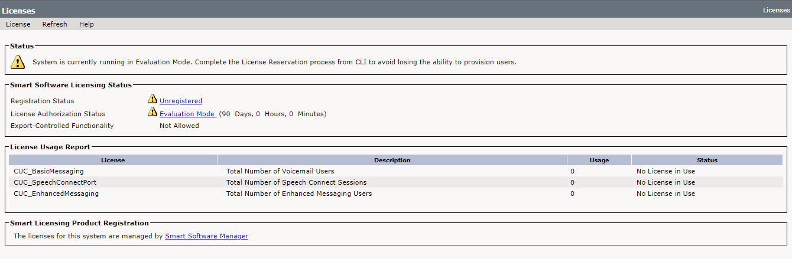
Licenses page in SLR mode
Login to Cisco Unity Connection Administration page
Go to “System Settings” then click on “Licenses”.
By default product will be running in evaluation mode which last for 90 calendar days.
When SLR is enabled, following page will appear in which License details will be displayed.

Slide 13
CLI supported in Specific License Reservation
CLI’s for License Reservation :
  license smart reservation enable
  license smart reservation request
  license smart reservation install “authorization code”
  license smart reservation install-file <SFTP URL PATH>
  license smart reservation return
  license smart reservation cancel
  license smart reservation disable
  license smart reservation return-authorization “authorization code”
Note:
For more License status details, “show license status” or “show license summary” commands can be used.

Slide 14
Specific License Reservation Flow Diagram
Return Authorization
Code
admin: license smart reservation return-authorization
Generate Auth Code on CSSM
Cancel
Reservation Request
admin: license smart reservation cancel
Product State: Unregistered
Authorization Status: EVAL Mode
Product State: Unregistered
Authorization Status: EVAL Mode
User will generate Authorization code on CSSM
Initial state of product
Enable license reservation
Request Reservation code
Install authorization code
Return reservation license
Disable
Product state: Unregistered
Authorization status: EVAL mode
admin: license smart reservation enable
admin: license smart reservation request
admin: license smart reservation return
admin: license smart reservation disable
Product State: Unregistered
Authorization Status: EVAL Mode
Product State: Reservation in Progress
Authorization Status: EVAL Mode
Product State: Registered
Authorization Status: Authorized-Reserved
Product State: Unregistered
Authorization Status: EVAL Mode
Product State: Unregistered
Authorization Status: EVAL Mode
admin: license smart reservation install
Generate Auth Code on CSSM

Slide 15

Enable Specific License Reservation
This command enables License Reservation mode.
license smart reservation enable
License Page status after enabling SLR

Slide 16
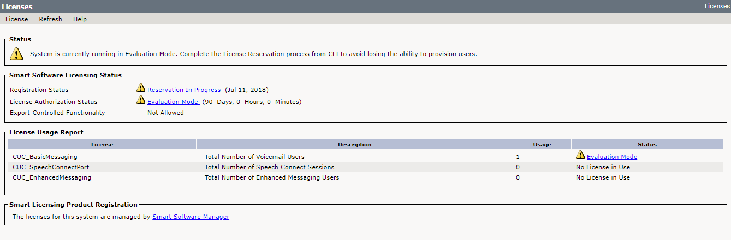
Request Reservation Code
This command generates Reservation Request code which is entered in CSSM to generate authorization code.
license smart reservation request
License page status after Reservation Request

Slide 17
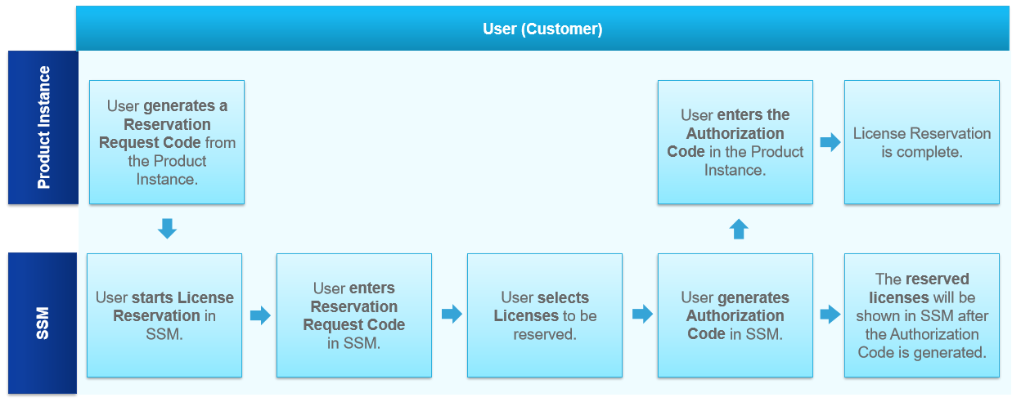
Steps to generate authorization code
Note : For detailed steps , follow the below mentioned link:
https://www.cisco.com/c/dam/global/ja_jp/products/smart-software-licensing/literature/cisco-software-smart-software-licensing-specific-license-reservation.pdf

Slide 18
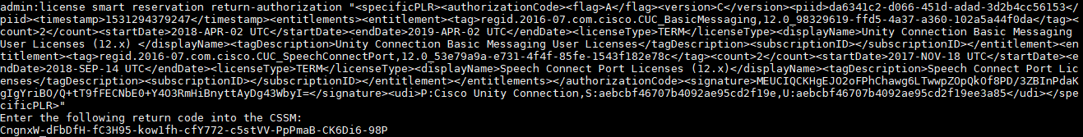
Return Authorization Code
This command returns Authorization code which is generated in CSSM and the device will transit back to the unregistered state. Also product will move to EVAL mode.
license smart reservation return-authorization “authorization-code”
License page status after return-authorization

Slide 19
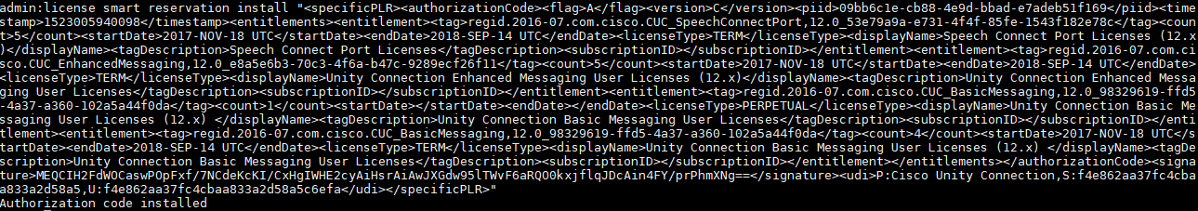
Install Authorization Code
This command installs Authorization code generated by CSSM to register device successfully.
There are two types of command supported in Unity Connection for authorization code installation:
license smart reservation install “authorization-code”

Slide 20
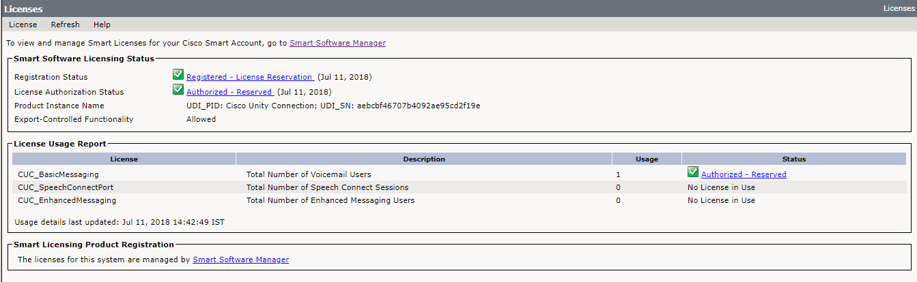
This command installs Authorization code from file using SFTP server.
license smart reservation install-file <SFTP URL>
License page status after authorization code installation

Slide 21
Return Reserved License
This command will remove the license reservation authorization code and the device will transit back to the unregistered state. It will generate return code.
license smart reservation return
License page status after Reservation Return

Slide 22
Cancel Reservation Request
This command cancels Specific License Reservation process.
license smart reservation cancel
License Page status after reservation cancel

Slide 23
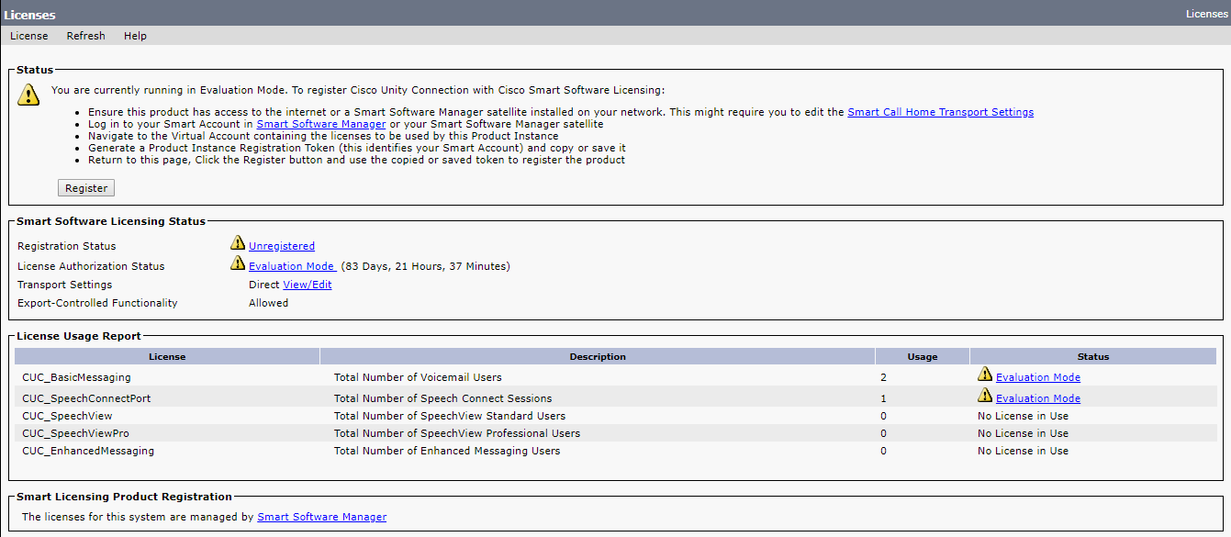
Disable License Reservation
This command disables License Reservation.
license smart reservation disable
License Page status after disabling SLR

Slide 24
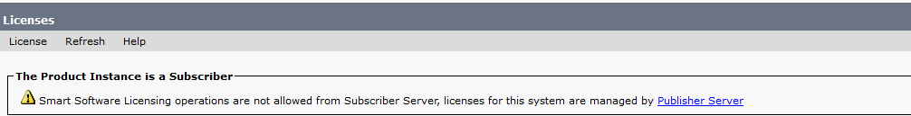
High Availability in Unity Connection
CLI Behaviour :
Specific License Reservation configuration commands are disabled on subscriber, although all show commands are by default enabled on the system and would get successfully executed.
Following error response is shown on subscriber CLI for SLR configuration commands :
GUI Behaviour :
Licenses page is visible but no operation is allowed from Subscriber via GUI, only the details of licenses and registration are visible.
Following warning message is shown on Licenses page of Subscriber CUCA :
Smart Software Licensing operations are not allowed from Subscriber, licenses for this system are managed by Publisher

Slide 25
Troubleshooting

Slide 26
Troubleshooting Case 1 – Install
If Authorization code installation fails with message:
  CLI : “License Reservation authorization code is invalid.”
For Resolution perform the following steps:
Retry License Reservation with valid Authorization Code.
If the above steps do not work, turn on all diagnostic logs from CUC Serviceability -> Micro Traces -> CuSlmSvr. Check logs either through CLI – show license trace or RTMT “Connection Smart License Manager Server” Service logs - diag_CuSlmSvr_000*.uc.

Slide 27
Troubleshooting Case 2 – Return Authorization Code
If return Authorization code fails with message:
  CLI : “License Reservation authorization code is invalid.”
For Resolution perform the following steps:
Retry License Reservation Return with valid Authorization Code.
If the above steps do not work, turn on all diagnostic logs from CUC Serviceability -> Micro Traces -> CuSlmSvr. Check logs either through CLI – show license trace or RTMT “Connection Smart License Manager Server” Service logs - diag_CuSlmSvr_000*.uc.
Note : To generate Authorization Code, follow the below mentioned link:
https://www.cisco.com/c/dam/global/ja_jp/products/smart-software-licensing/literature/cisco-software-smart-software-licensing-specific-license-reservation.pdf

Slide 28
Troubleshooting Case 3 – Install From File
If install from file fails with message:
  CLI: “Invalid Host Name”
  Resolution : Check if SFTP server hostname is valid.
  CLI: “File not found”
  Resolution: Check if valid file name is provided in SFTP address.
  CLI: “Failed to Connect SFTP Server, Try Again Later”
  Resolution: Check if valid username and password are provided for SFTP server.
  If the above steps do not work, turn on all diagnostic logs from CUC Serviceability -> Micro Traces -> CuSlmSvr. Capture logs from CLI command show license trace or RTMT “Connection Smart License Manager Server” Service logs diag_CuSlmSvr_000*.uc.

Slide 29
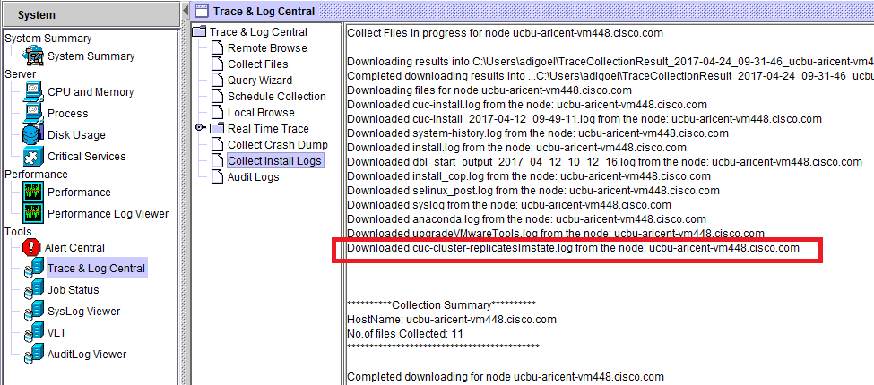
Troubleshooting Case 4 – High Availability
If there is any discrepancy between the status of Publisher and subscriber then check -
Logs corresponding to the script; can be downloaded from RTMT “Install Logs”:- cuc-cluster-replicateslmstate.log

Slide 30
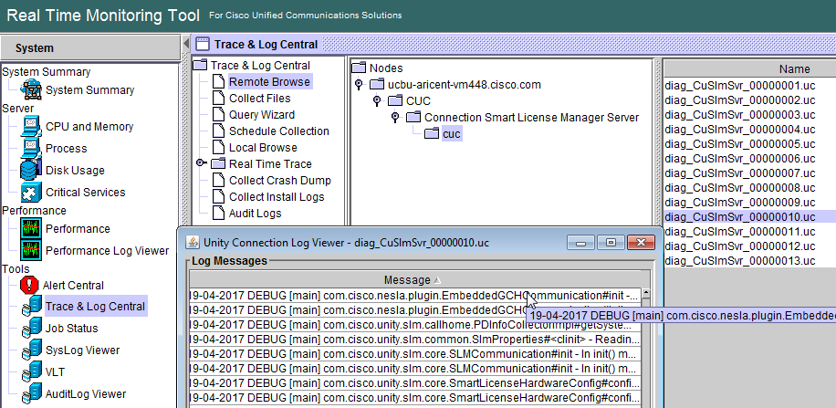
Annotated Traces
If you are facing any issue with SLM service, turn on all the diagnostic traces through CUC Serviceability -> Micro Traces-> CuSlmSvr and analyze the logs through the following ways:
CLI command –
show license trace
Logs at RTMT under
service
“Connection Smart
License Manager
Server” namely
diag_CuSlmSvr_000*.uc.

Slide 31
Annotated Traces – Sample Traces
Reservation Request
12:06:26.094 |16498,,,CuSlmSvr,3,10-04-2018 INFO [SLM-2] com.cisco.unity.slm.notification.impl.GlobalNotificationListenerImpl#onNotify - {
"failReasonCode": "Success",
"failMessage": "Successful.",
"enforceMode": "NotApplicable",
"allowRestricted": false,
"notificationType": "NotifyReservationInProgress"
}
Install authorization code
13:31:13.954 |8420,,,CuSlmSvr,3,10-04-2018 INFO [SLM-3] com.cisco.unity.slm.notification.impl.GlobalNotificationListenerImpl#onNotify - {
"failReasonCode": "Success",
"failMessage": "Successful.",
"enforceMode": "NotApplicable",
"allowRestricted": false,
"notificationType": "NotifyReservationInstalled"
}

Slide 32
Annotated Traces – Sample Traces – Contd.
Not Authorized
13:31:14.092 |8420,,,CuSlmSvr,3,10-04-2018 INFO [SLM-3] com.cisco.unity.slm.notification.impl.GlobalNotificationListenerImpl#onNotify - {
"failReasonCode": "Success",
"failMessage": "Successful.",
"enforceMode": "NotAuthorized",
"allowRestricted": false,
"notificationType": "NotifyEnforcementMode"
}

Slide 33
Logs & Events
For any SLR event like enable, disable, install, request, etc alerts and CiscoSyslogs are generated.
CiscoSyslogs
  RTMT: System -> Tools -> SysLog Viewer -> Open SysLog Viewer. Select Node. Logs -> Application Logs -> CiscoSyslog
  System File: /var/log/active/syslog/CiscoSyslog
  Sample Log : Feb 7 14:23:45 ucbu-aricent-vm293 local7 6 : 0: ucbu-aricent-vm293.cisco.com: Feb 07 2018 08:53:45.320 UTC : %UC_UCLIC-6-EvtCucSlrEnable: %[AppID=CuSlmSvr][ClusterID=][NodeID=ucbu-aricent-vm293]: License Reservation is successfully enabled.
Events
  For SLR , following events are introduced.
  EvtCucSlrInProgress
  EvtCucSlrInstallSuccess
  EvtCucSlrReturnSuccess
  EvtCucSlrCancel
  EvtCucSlrAuthFailed
  EvtCucSlrEnable
  EvtCucSlrDisable
  EvtCucSlrNotAuthorized
  For further detail on alarm and events wiki link:
  https://ccbu-wiki.cisco.com/pages/viewpage.action?spaceKey=MESSAGING&title=Alarms+and+Alerts+Generated+for+Specific+License+Reservation

Slide 34
Links for Reference
Overall Specific License Reservation feature
https://ccbu-wiki.cisco.com/display/MESSAGING/Smart+Licensing+%3A%3A+Specific+License+Reservation+%28SLR%29+Requirement
For Alarms/Alerts generated on Smart License Manager
https://ccbu-wiki.cisco.com/display/MESSAGING/Alarms+and+Alerts+Generated+for+Specific+License+Reservation
https://www.cisco.com/c/en/us/td/docs/voice_ip_comm/connection/12x/alarm_messages/12cucalrmmsgdef.html
Annotated Logs wiki
https://ccbu-wiki.cisco.com/display/MESSAGING/Annotated+Wiki+for+Specific+License+Reservation
Install, Upgrade, and Maintenance Guide for Cisco Unity Connection Release 12.x
https://www.cisco.com/c/en/us/td/docs/voice_ip_comm/connection/12x/install_upgrade/guide/b_12xcuciumg.html

Slide 35
Thank You

