Slide 1
Unity Connection
Video playback support over Inbox
May 2018
EDCS - 13385772

Slide 2
Notice
The information in this presentation is provided under Non-Disclosure agreement and should be treated as Cisco Confidential. Under no circumstances is this information to be shared further without the express consent of Cisco.
Any roadmap item is subject to change at the sole discretion of Cisco, and Cisco will have no liability for delay in the delivery or failure to deliver any of the products or features set forth in this document.

Slide 3
Agenda
Introduction
Call Flow of Video Message
Enhanced the CUMI API to get Session-Id of a Video Message
Enhancement of Video Message over Web Inbox
Demo Scenario
Troubleshooting
References

Slide 4
Introduction
Video Message is supported over Web Inbox through TRAP.
Current Behavior from 11.5 release:
A user can play Video Message using video enabled end point through Telephony User Interface (TUI).
From 12.5 onwards:
User can play a Video Message through TRAP over Web Inbox
Enhanced the CUMI API (/vmrest/messages/<message_id>) to get Video Session-Id of a Video Message

Slide 5
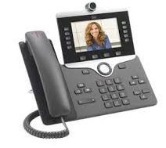
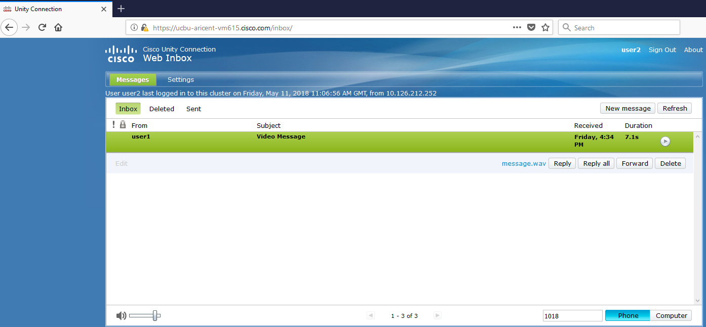
Call Flow of Video Message
Video Message plays through TRAP over phone
1. Place a Call
2. Ring No Answer
User 2
User 1
3. Drops a Video Message for User 2
Logged in from user2
5. Play this Video Message
Video Message on Web Inbox of User 2
4. Enter extension to play through TRAP
Web Inbox of User 2

Slide 6
Enhanced the CUMI API to get Session-Id of a Video Message
In case of Video Message, we get the session-id of the message in response of the following CUMI API:
GET /vmrest/messages/<message-id>
Response:
<Message>
<Subject>Message from user1 (1001)</Subject>
<Read>true</Read>
<Dispatch>false</Dispatch>
<Secure>false</Secure>
<Priority>Normal</Priority>
<Sensitivity>Normal</Sensitivity>
<URI>/vmrest/messages/0:b4ffbaa5-19ad-4f4f-b95a-933a32e00d64/attachments/0</URI>
<SessionId>122162627c12b61</SessionId>
…………
</Message>
NOTE : Here, field <SessionId> describes the unique ID for the Video Message.

Slide 7
Enhancement of Video Message over Web Inbox
In case of RNA, you can record a Video Message for a user with Cisco IP phone having video capabilities.
User can play the Video Message with TUI.
Now Unity Connection allows the user to play the Video Message over Web Inbox through TRAP.
Note: This functionality is applicable for Cisco Unity Connection 12.5(1) and later. If you are upgrading Unity Connection from any earlier release to 12.5(1), you cannot play the Video Messages received in earlier version with Web Inbox.

Slide 8
Demo Scenario :
Play a Video Message recorded through RNA
Get the Video Session-Id of a Video Message

Slide 9
Demo Scenario 1 : Play a Video Message
User A and User B are video enabled users.
User A calls User B, Call gets forwarded to the Voice Mail of User B as User B does not answer
User A leaves a Video Message for User B.
Login to Web Inbox of User B
Play the message received from User A through TRAP from Web Inbox
Demo Scenario 2 : Session-Id of a Video Message
Execute the REST API : GET /vmrest/mailbox/folders/inbox/messages to get the message-id of the Video Message
Execute the REST API : GET /vmrest/messages/<message_id> (message_id of the above video message) to get the message details

Slide 10
Troubleshooting
Problem Statement with Action:
  Statement: Unable to play Video Message over Web Inbox through TRAP
  Action:
        Make sure the Video Server is associated to the user
        Make sure the services – “Cisco Media Sense API Service” and “Cisco MediaSense Media Service” of the Video Server are up and running
        Make sure the “Cisco Conversation Manager” is restarted after updating the Video Service page
Annotated Logs Wiki:
https://ccbu-wiki.cisco.com/display/UNITYTRANS/Annotated+diagnostics+for+Video+playback+support+over+Inbox

Slide 11
References
Doc Wiki: http://docwiki.cisco.com/wiki/Cisco_Unity_Connection_Messaging_Interface_(CUMI)_API_--_Using_the_CUMI_API
Notes:
http://docwiki.cisco.com/wiki/Cisco_Unity_Connection_Messaging_Interface_(CUMI)_API_--_Using_the_CUMI_API

Slide 12
Thank You

