Slide 1
Unity Connection
Cipher Control - To Manage Ciphers
July’18
EDCS: 13515703

Slide 2
Notice
The information in this presentation is provided under Non-Disclosure agreement and should be treated as Cisco Confidential. Under no circumstances is this information to be shared further without the express consent of Cisco.
Any roadmap item is subject to change at the sole discretion of Cisco, and Cisco will have no liability for delay in the delivery or failure to deliver any of the products or features set forth in this document.

Slide 3
Agenda
Feature Requirement & Solution
TLS Interfaces with Recommended Ciphers
SSH Interfaces with Recommended Ciphers
Cipher Management User Interface
    Cipher Management User Interface (TLS)
    Cipher Management User Interface (SSH)
Behaviour of SIP Interface in Unrestricted mode
Ciphers Restrictions
Troubleshooting
References

Slide 4
Feature Requirements & Solution
Requirements:
To comply with Security Guidelines of the organization and to have an ability to control ciphers allowed on different secure interfaces on Unity Connection.
To provide a comprehensive configurable option for defining the Ciphers that will be offered for TLS and SSH connections and to allow customer administrators to have complete control over the Ciphers that are used in their networks.
Solution:
To implement the feature requirements, Unity Connection release 12.5(1) and later provides a new Cipher Management UI page with TLS (ALL, HTTPS, SIP) and SSH (SSH Ciphers, SSH Key Exchange and SSH MAC) interfaces to configure the recommended ciphers for these interfaces which are deemed secure and also provide the NOT break compatibility with other elements in the deployment, ex: legacy devices/endpoints, HTTP client etc.

Slide 5
TLS Interfaces with Recommended Ciphers
In Cipher Management UI Page, following TLS interfaces are added to set ciphers/algorithms in Unity Connection
S.No. | Interfaces | Description | Recommended Ciphers
1. | HTTPS TLS | To enable the administrator to configure TLS ciphers in Unity Connection for HTTPS interface | ECDHE-RSA-AES256-GCM-SHA384:ECDHE-RSA-AES256-SHA384:ECDHE-RSA-AES256-SHA:AES256-GCM-SHA384:AES256-SHA256:AES256-SHA:ECDHE-RSA-AES128-GCM-SHA256:ECDHE-RSA-AES128-SHA256:ECDHE-RSA-AES128-SHA:AES128-GCM-SHA256:AES128-SHA256:AES128-SHA
2. | SIP TLS | To enable the administrator to configure TLS ciphers in Unity Connection for Secure SIP call | ECDHE-RSA-AES256-GCM-SHA384:ECDHE-RSA-AES256-SHA384:ECDHE-RSA-AES256-SHA:AES256-GCM-SHA384:AES256-SHA256:AES256-SHA:ECDHE-RSA-AES128-GCM-SHA256:ECDHE-RSA-AES128-SHA256:ECDHE-RSA-AES128-SHA:AES128-GCM-SHA256:AES128-SHA256:AES128-SHA
3. | ALL TLS | To enable the administrator to configure TLS ciphers in Unity Connection for all other interfaces like IMAP/LDAP/SCCP including HTTPS and SIP as well. Note: If ALL interface is configured with either of the above two mentioned interfaces (HTTPS/SIP), then the above two interfaces will override the ALL interface Ciphers. | ECDHE-RSA-AES256-GCM-SHA384:ECDHE-RSA-AES256-SHA384:ECDHE-RSA-AES256-SHA:AES256-GCM-SHA384:AES256-SHA256:AES256-SHA:ECDHE-RSA-AES128-GCM-SHA256:ECDHE-RSA-AES128-SHA256:ECDHE-RSA-AES128-SHA:AES128-GCM-SHA256:AES128-SHA256:AES128-SHA

Slide 6
SSH Interfaces with Recommended Ciphers
In Cipher Management UI Page, following SSH interfaces are added to set ciphers/algorithms in Unity Connection .
S.No. | Interfaces | Description | Recommended Ciphers
1. | SSH Cipher | To enable the administrator to configure SSH Cipher in Unity Connection | aes128-ctr,aes192-ctr,aes256-ctr,aes128-gcm@openssh.com,aes256-gcm@openssh.co
2. | SSH Key Exchange | To enable the administrator to configure SSH Key algorithms in Unity Connection | ecdh-sha2-nistp521,ecdh-sha2-nistp384,ecdh-sha2-nistp256,diffie-hellman-group14-sha1,diffie-hellman-group1-sha1,diffie-hellman-group-exchange-sha256,diffie-hellman-group-exchange-sha1
3. | SSH MAC | To enable the administrator to configure SSH MAC algorithms in Unity Connection | hmac-sha2-512,hmac-sha2-256,hmac-sha1

Slide 7
Cipher Management User Interface
A new Cipher Management User Interface page is implemented with TLS (ALL/HTTPS/SIP) and SSH (SSH Ciphers, SSH Key Exchange and SSH MAC) interfaces to configure the recommended ciphers for these interfaces.
In the Cipher Management UI page, following are the two fields corresponding to each interface:
Cipher String: User can enter valid ciphers in lower case or upper case or separated by space at the beginning or in between of multiple ciphers separated by comma (,).
Cipher Expansion String: System will convert the cipher values from Cipher String input from upper case to lower case, remove the spaces in between of multiple ciphers and if they are valid it will display here else error message “You have entered an invalid Cipher String” will be displayed.
NOTE: We need to configure Ciphers on publisher node having primary role in a cluster. Also ensure that we follow the prompt messages on saving cipher strings on Cipher Management UI page on all nodes of the cluster.

Slide 8
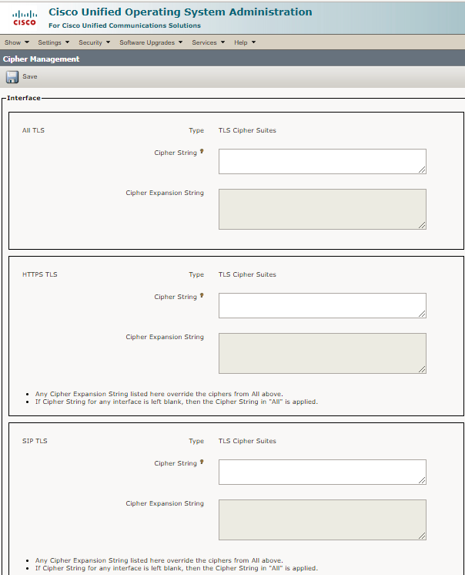
Cipher Management User Interface (TLS)
UI Behaviour of TLS interfaces on Cipher Management page

Slide 9
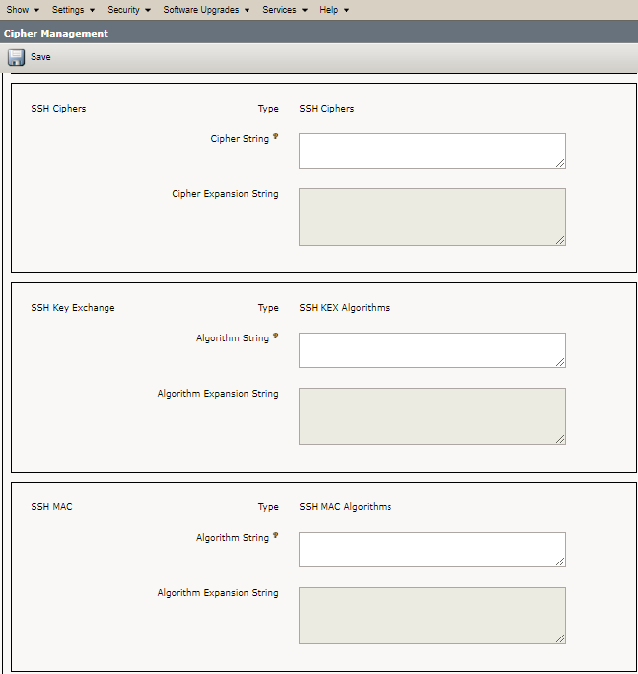
Cipher Management User Interface (SSH)
UI Behaviour of SSH interfaces on Cipher Management page

Slide 10
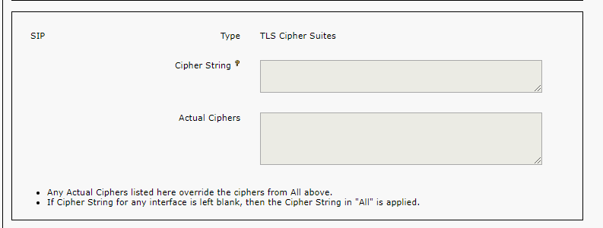
Behaviour of SIP Interface in Unrestricted mode
UI behavior of SIP Interface when Unity Connection is in Unrestricted mode
In Unrestricted version of Unity Connection, only SIP interface will be greyed out i.e., it will not configurable.
By default all Unity Connection Secure nodes over SIP will not be supported in unrestricted version of Unity Connection.
It is not configurable in unrestricted versions of Unity Connection

Slide 11
Cipher Restrictions
S.No. | Limitation | Description
1. | Internally Disabled Ciphers | The cipher configuration page allows configuration of any Ciphers supported by OpenSSL or OpenSSH. However, there are few Ciphers which are internally disabled based on Cisco’s security standards to avoid accidental exposure of critical data.
2. | Validation in GUI | Configured ciphers are validated as per OpenSSL validation. For e.g if a configured cipher is ALL:BAD:!MD5, then user will not get any warning message as OpenSSL considers this as a valid string. But if user configure AES128_SHA instead of AES128-SHA (underscore instead of a hyphen), OpenSSL would identify this as an invalid cipher suite.
3. | Authenticated mode (NULL ciphers) | If you have NULL ciphers in use on your interfaces (for example on SIP interface on Unity Connection configured in Authenticated mode), the NULL ciphers support would be revoked if ciphers are configured either in the ALL TLS interfaces or SIP Interface. Please do not configure ciphers in these two interfaces if NULL ciphers is in use.
4. | Over-ride functionality | Without configuring anything on Cipher Management UI page, the original functionality on all the interfaces will be retained. But with configuration done on these interfaces, any previously configured cipher settings (For example through enterprise parameters) will be over-ridden by these settings at a global level.

Slide 12
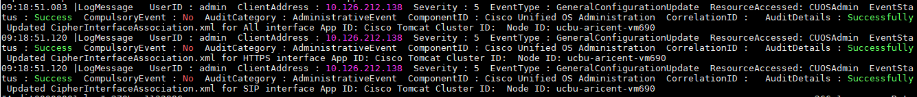
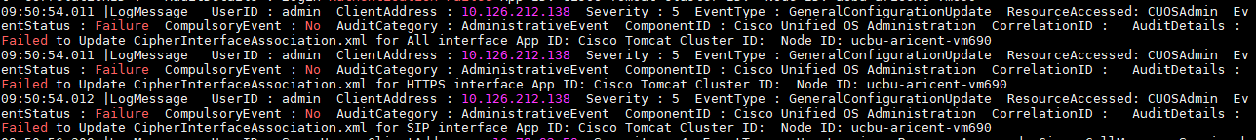
Troubleshooting
Scenario 1:
Whenever the Cipher Management UI page is saved, then corresponding audit log messages will be updated in Audit Logs (Log Location: /var/log/active/audit/AuditApp/)
If Cipher Management UI updated successfully, then below message will be printed in audit logs
If Cipher Management UI update fails, then below message will be printed in audit logs

Slide 13
Troubleshooting Contd.
Scenario 2:
Whenever the Cipher Management UI page is saved and tomcat service is restarted then corresponding messages will be updated in Syslog Logs (Log Location: /var/log/active/syslog/CiscoSyslog).
If Cipher Management UI updated successfully, then below message will be printed in Cisco Syslog.

Slide 14
Troubleshooting Contd.
Scenario 3:
If tomcat service is restarted without making any changes to Cipher Management UI page, then corresponding message will be updated in Syslog messages (Log Location: /var/log/active/syslog/messages)
If there is no change in the SSH Interfaces and if anyone restarts the server, then below message will be printed in message file (Log Location: /var/log/active/syslog/messages)

Slide 15
References
Security Guide for Cisco Unity Connection Release 12.x
https://www.cisco.com/c/en/us/td/docs/voice_ip_comm/connection/12x/security/b_12xcucsecx.html
Cisco Unified Communications Operating System Administration Guide for Cisco Unity Connection Release 12.x
https://www.cisco.com/c/en/us/td/docs/voice_ip_comm/connection/12x/os_administration/b_12xcucosagx.html
Annotated diagnostics for Cipher Control
https://ccbu-wiki.cisco.com/display/UNITYTRANS/Annotated+diagnostics+for+Cipher+Control

Slide 16
Thank You

