Slide 1
Cisco Unity Connection
Opus Codec Support
April 2017
EDCS-11616238

Slide 2
Notice
The information in this presentation is provided under Non-Disclosure agreement and should be treated as Cisco Confidential. Under no circumstances is this information to be shared further without the express consent of Cisco.
Any roadmap item is subject to change at the sole discretion of Cisco, and Cisco will have no liability for delay in the delivery or failure to deliver any of the products or features set forth in this document.

Slide 3
Agenda
Introduction
What’s New
Opus Characteristics
Configuration
Use Cases
Impact on Disk with Various Codecs
Supported Interfaces
Troubleshooting & References

Slide 4
Introduction
Opus is a speech and audio codec.
Opus is designed to handle a wide range of interactive audio applications, including Voice over IP, video conferencing, in-game chat, and even live distributed music performances.
With Opus, users can benefit from voice quality at both high and low bit rates, resiliency, and freedom from royalties

Slide 5
What’s New
Introducing Opus codec as line codec in Cisco Unity Connection 12.0 to implement consistent wideband audio codec support across the CTG portfolio
Support of line codecs in Cisco Unity Connection are:
Codec | Sampling Rate | Codec type
G.711 mu-law G.711 a-law | 8000 Hz | Narrowband
G.729 | 8000 Hz | Narrowband
G.722 | 8000 Hz | Narrowband
iLBC | 8000 Hz | Narrowband
Opus | 16000 Hz | Narrowband - Wideband

Slide 6
What’s New (Cont.)
Unity Connection supports Opus as line codec for following functionalities:
  Playback : User will call into Cisco Unity Connection and that call negotiated over Opus, where the user listen audio stream encoded with Opus in the form of
  Greetings , Prompts
  Voice messages which are played back to the endpoint
  Note: Any pre-recorded .wav file will be played with 8KHz sampling rate, To have these files with 16k sampling rate , wav file needs to be re-recorded with Opus.
  Recording : User will call into Cisco Unity Connection and that call will negotiated over Opus. Endpoint can transmit audio stream which will be record as wav file, it will be based on the recording format:
  If recording format = PCM, then wav file will be created with 16 KHz sampling rate
  If recording format = G729 , G711 (non-PCM) then wav file will be created with 8 KHz sampling rate which mean User will not enjoy the wide band functionality of Opus.
Note :In Cisco Unity Connection PCM is the only recording format which supports
16000 sampling rate with Opus
Notes:
Note :

Slide 7
Opus Characteristics
Opus Characteristics | Allowed Range as per RFC | CUC Supports
Payload type | 96-127 | 114
Sampling rate (The rate at which samples of an analog signal are taken in order to be converted into digital form) | 8KHz -48 KHz (narrowband - wideband) | 16 KHz
Bitrates (The ratio of the number of bits that are transferred between devices in a specified amount of time, typically one second) | 6 kb/s - 510 kb/s | 128 Kb/s
Frame sizes | 2.5 ms - 60 ms | 20 ms
Supported sounds (In monaural sound one single channel is used In stereophonic sound more channels are used (typically two)) | Mono , Stereo | Mono
Application supported | Music, speech , VOIP | VOIP, speech
Notes:
Notes
Mono and Stereo :In monaural sound one single channel is used. It can be reproduced through several speakers, but all speakers are still reproducing the same copy of the signal.
In stereophonic sound more channels are used (typically two). You can use two different channels and make one feed one speaker and the second channel feed a second speaker (which is the most common stereo setup). This is used to create directionality, perspective, space.

Slide 8
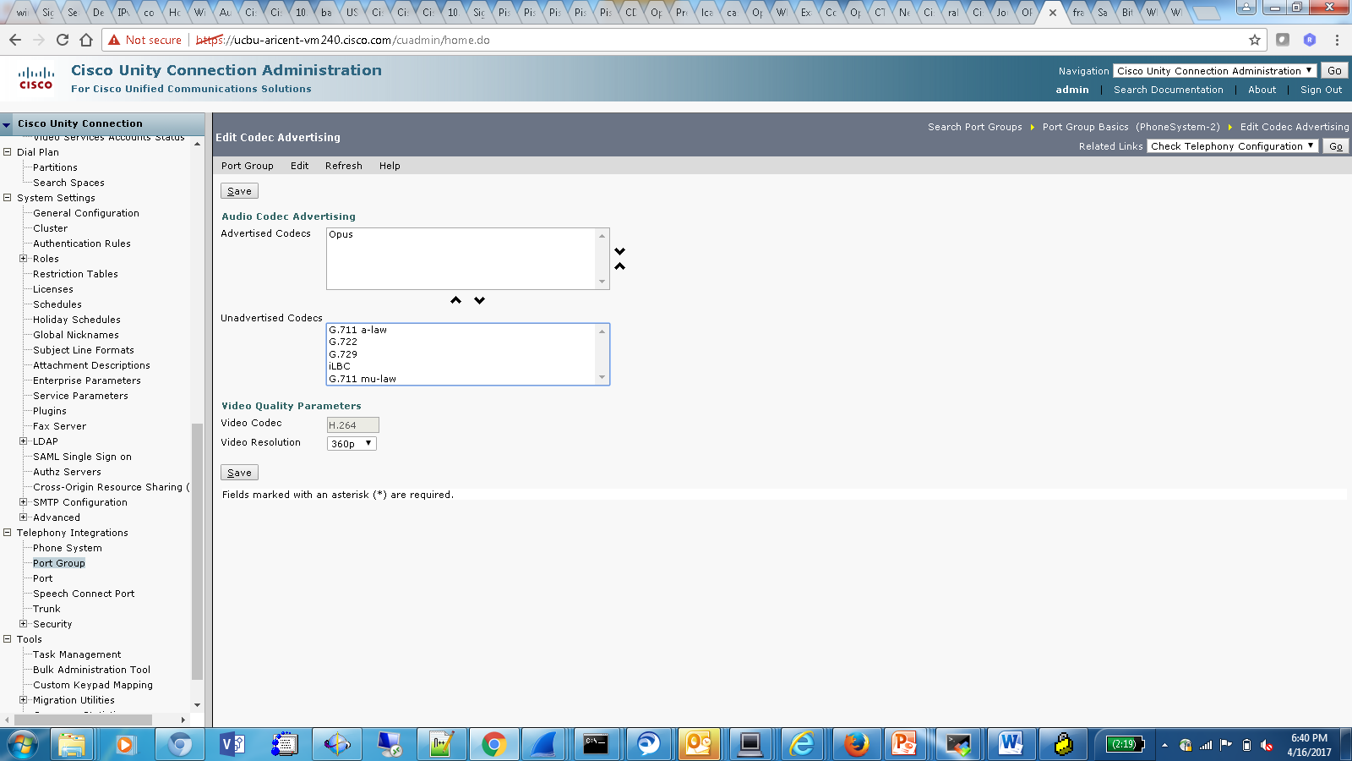
Configuration
Login into Cisco Unity Connection Administration Page
Go To->Telephony Integration , select port group for SIP protocol
Click on Codec Advertise from the Edit menu
Select Opus codec from unadvertised codec list to advertised codec
Note : Opus codec support with unity connection is not available with SCCP protocol

Slide 9
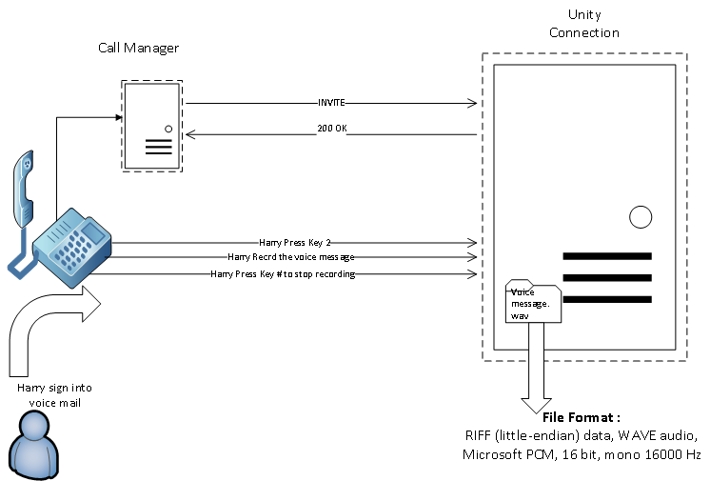
Use Case 1
Leaving message when Recording format is PCM: Send a voice message from Harry to Tom by pressing key 2 on Phone key menu

Slide 10
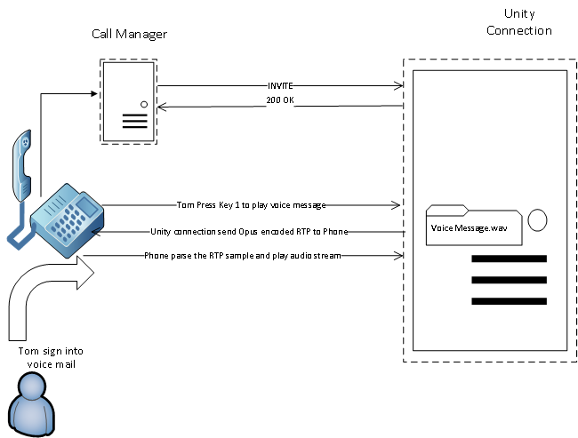
Use Case 2
Retrieving voice message: Tom login into his voice mail and listen all the voice messages send by Harry by pressing key 1

Slide 11
Impact on Disk with Various Codecs
Line Codec | Recording Format | File Format on system | File size on system for 7sec recording
Opus | PCM | RIFF (little-endian) data, WAVE audio, Microsoft PCM, 16 bit, mono 16000 Hz | 228 KB
Opus | G711u | RIFF (little-endian) data, WAVE audio, ITU G.711 mu-law, mono 8000 Hz | 57 KB
G729 , | PCM | RIFF (little-endian) data, WAVE audio, Microsoft PCM, 16 bit, mono 8000 Hz | 110 KB
G729 | G711u | RIFF (little-endian) data, WAVE audio, ITU G.711 mu-law, mono 8000 Hz | 56 KB
Note :With Opus codec file size will be double, ensure impact on Mailbox quota accordingly.

Slide 12
Supported Interface
Unity connection qualifies following interfaces with Opus
Phone model 77xx,88xx
Jabber version 11.8.0 and above
WebInbox 12.0 and above
ViewMail For Outlook 12.0(1) and above

Slide 13
Troubleshooting & References
Troubleshooting :
http://ccbu-wiki2.cisco.com:8080/display/MESSAGING/Annotated+diagnostics+for+Opus+Codec
References :
Draft IETF doc reference:
http://tools.ietf.org/html/draft-ietf-payload-rtp-opus-01
Unity Connection wiki link for Opus :
http://ccbu-wiki2.cisco.com:8080/display/MESSAGING/OPUS+Codec+Support+F2465

Slide 14
Thank You

