Slide 1
IPv6 in Connection 8.5
Dexter Team (ucbu-cuc-dexter@cisco.com)

Slide 2
IPv6 Support in Connection 8.5
IPv6 is supported with the following connections in CUC 8.5:
SCCP phone system integrations with CUCM 7.1(2) and later
SIP phone system integrations with CUCM 8.5 and later (ANAT must be enabled)
Disabled by default.
IPv6 is NOT supported in Cisco Unified Communications Manager Business Edition (CUCMBE).

Slide 3
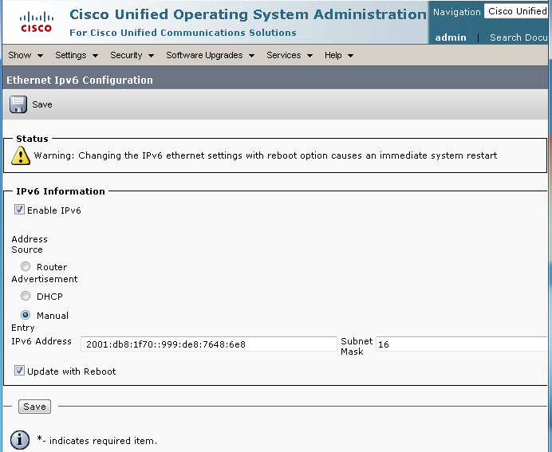
Configuration: Enable IPv6 and Configure Address
Cisco Unified OS Administration: Settings > IP > Ethernet IPv6 Configuration
We recommend using a static non-link-local IPv6 address.
Reboot required for changes to take effect.
Notes:
Alternatively, you can use CLI commands to enable IPv6 and configure the IPv6 address:
Enable IPv6 by using the set network ipv6 service enable command.
Set a static IPv6 address for your server by using the set network ipv6 static_address <addr> <mask> command. The DHCPv6 client is also supported, but its use is not recommended.
To view the platform's IPv6 address settings, use the show network ipv6 settings command.

Slide 4
Alternate Configuration: Enable IPv6 and Configure Address
As an alternative to using Cisco Unified OS Administration, you can use CLI commands to enable IPv6 and configure the IPv6 address:
Enable IPv6 by using the set network ipv6 service enable command.
Set a static IPv6 address for your server by using the set network ipv6 static_address <addr> <mask> command. The DHCPv6 client is also supported, but its use is not recommended.
To view the platform's IPv6 address settings, use the show network ipv6 settings command.
Notes:
CLI commands are an alternative to using Cisco Unified Operating System Administration (see previous slide).

Slide 5
Configuration (Continued): Configure CUCM
Creating an integration:
CUCM SCCP Integration Guide for CUC Release 8.x
CUCM SIP Trunk Integration Guide for CUC Release 8.x
Adding IPv6 to an existing integration:
Follow the steps in the “Configuration Checklist for IPv6” section in the “Internet Protocol Version 6” chapter of the CUCM Features and Services Guide for your release of CUCM.
For SIP integrations, don’t forget to configure the SIP trunk with the CUC IPv6 destination address and reset the trunk.
(In Cisco Unified CM Administration, on the Device menu, select Trunk. Find the trunk corresponding to the CUC server. On the Trunk Configuration page, change the value of the Destination Address IPv6 field, save the change, and reset the trunk.)

Slide 6
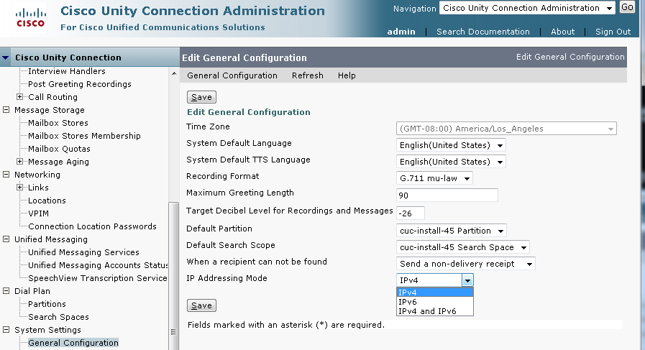
Configuration (Continued): IP Addressing Mode
CUC Administration: System Settings > General Configuration
See speaker notes for field definitions
Notes:
When Cisco Unity Connection is configured for IPv6, select the option from the IP Addressing Mode list to control where Connection listens for incoming traffic:
IPv4
IPv6
IPv4 and IPv6
This setting is applicable to integrations with Cisco Unified Communications Manager phone systems via SCCP or SIP.
Default Setting: IPv4

Slide 7
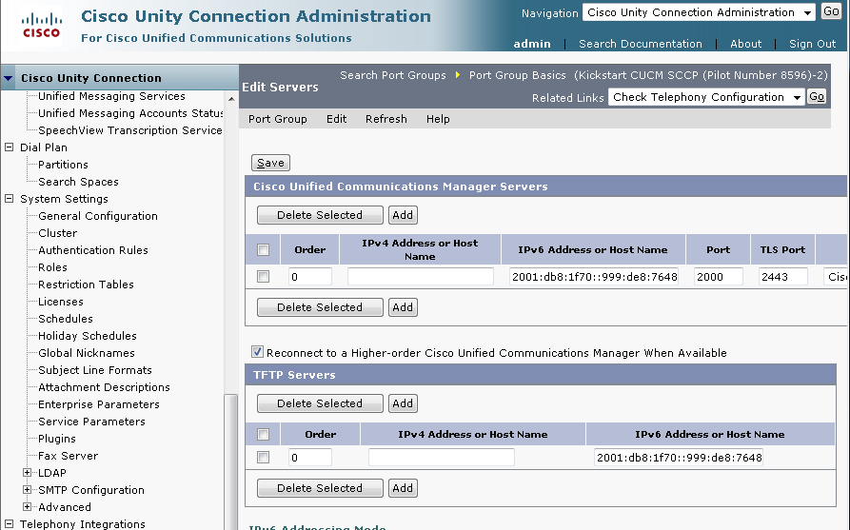
Configuration (Continued): Configuring CUCM IPv6 Addresses in Connection 8.5 (SCCP or SIP)
CUC Administration: Telephony Integrations > Port Group > Edit > Servers
See speaker notes for field definitions
Notes:
The IPv6 Addrss or Host Name field appears on the Edit Servers page for SCCP and SIP port groups
Enter the IPv6 address (or host name) of the Cisco Unified Communications Manager server (or TFTP server) that the port group connects to.
You must enter an IP address or host name in this field, or an IP address or host name in the IPv4 Address or Host Name field (or, if applicable, enter information in both fields). You cannot leave both fields blank.

Slide 8
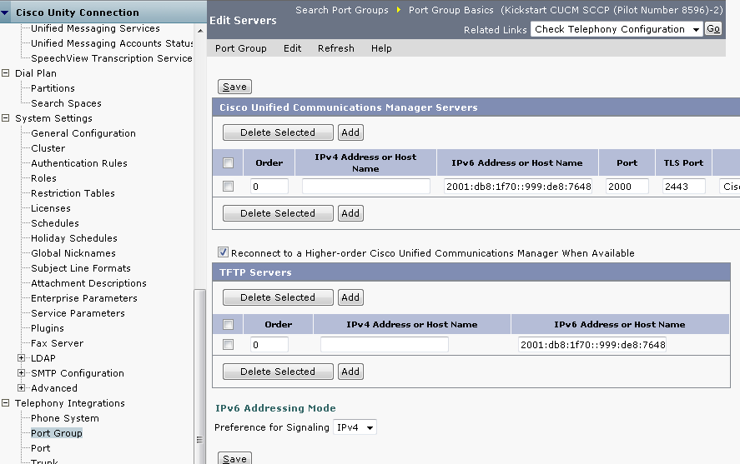
Configuration (Continued): Configuring IP Addressing Mode Preference for SCCP Integrations
CUC Administration: Telephony Integrations > Port Group > Edit > Servers
See speaker notes for field definitions
Notes:
The Preference for Signaling setting on a SCCP port group Edit Servers page determines the call control signaling preference when registering with Cisco Unified Communications Manager. This setting is applicable only when the IP Addressing Mode option on the System Settings > General Configuration page is set to IPv4 and IPv6.
Select the option from the list to control how Connection controls out-going traffic:
IPv4
IPv6
Default Setting: IPv4

Slide 9
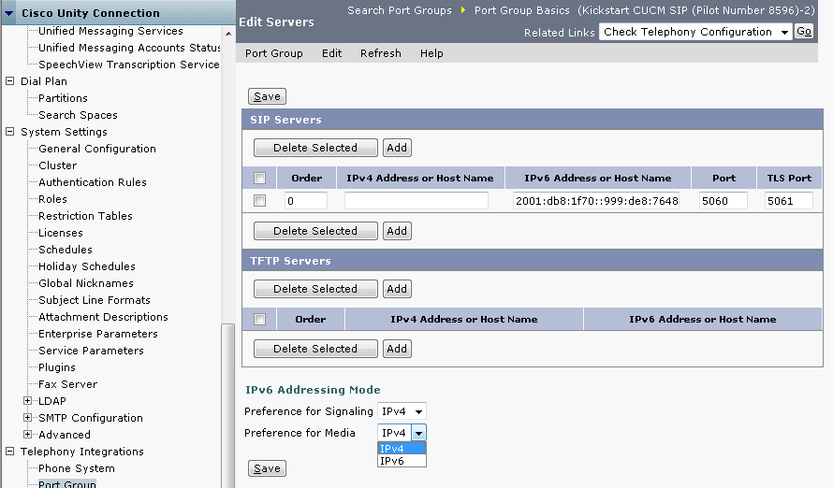
Configuration (Continued): Configuring IP Addressing Mode Preference for SIP Integrations
CUC Administration: Telephony Integrations > Port Group > Edit > Servers
See speaker notes for field definitions
Notes:
The Preference for Signaling setting on a SIP port group Edit Servers page determines the call control signaling preference when initiating SIP requests. This setting is applicable only when the IP Addressing Mode option on the System Settings > General Configuration page is set to IPv4 and IPv6.
Select the option from the list to control how Connection controls out-going traffic:
IPv4
IPv6
Default Setting: IPv4
The Preference for Media setting (only available for SIP port groups) determines the preferred addressing mode for media events when communicating with dual-stack (IPv4 and IPv6) devices. This setting is applicable only when the IP Addressing Mode option on the System Settings > General Configuration page is set to IPv4 and IPv6.
Select the option from the list to control how Connection handles media traffic:
IPv4
IPv6
Default Setting: IPv4

Slide 10
Additional Considerations
The CTL file required for security features (authentication and encryption) for SCCP integrations uses IPv4 addressing. Therefore, in order to use authentication and encryption with SCCP secure ports, you must retain the IPv4 address or host name for the Cisco Unified CM server(s) on the port group in Connection.
For information on setting up SCCP secure ports, see the CUCM SCCP Integration Guide for CUC Release 8.x. (Appendix: Cisco Unified Communications Manager Authentication and Encryption of Cisco Unity Connection Voice Messaging Ports)

Slide 11
Additional Considerations (Continued)
Some versions of Cisco Adaptive Security Appliance (ASA) do not support application inspection for IPv6 traffic for Unified Communications application servers and endpoints. Cisco recommends not using IPv6 for Unified Communications if you are using a Cisco ASA version that does not provide this support. See the documentation for your version of Cisco ASA to determine whether application inspection is supported in your deployment.

Slide 12
Additional Considerations (Continued)
The Port Test and Port Group Test utilities (in the Related Links box on SCCP integration port and port group pages in Cisco Unity Connection Administration) do not test IPv6 connectivity. Even when Connection is configured to use IPv6 for a SCCP integration, the utilities confirm that Connection can communicate with the phone system by using IPv4 addressing.

Slide 13
Troubleshooting IPv6
To show port registration details, you can turn on the MiuIO level 12 micro trace, and/or the Call Control (Miu) Traces macro trace (for SIP or SCCP as applicable).
The traces can be collected in the diag_CuCsMgr_<NNNNNNNN>.uc log files.

