Slide 1
Unity Connection 8.0(2) Virtualization TOI
Clemens Rossell (clrossel)
UCBU

Slide 2
Disclaimer
Some things you should know first:
This TOI does not cover virtualization basics
For a very high level overview of virtualization refer to the following Skyhook TOI from Jim Bryant:
http://wwwin-eng.cisco.com/Eng/VTG/IPCBU/Presentations/skyhook-virtualization-tac-toi.pptx

Slide 3
TOI Objectives
What should you know by the end of the TOI?
What is Cisco’s ideal target customer for virtualization?
Unity Connection installation requirements
How should the virtual machine be configured?
Connection OVA templates: (1) what are they & (2) why should customers use them?
Connection scalability in a virtual environment
VOS licensing model for virtualization & impact
Physical to Virtual (P2V) Migration Process

Slide 4
Customer Expectations
Our ideal customer is:
Very knowledgeable of virtualization, not a newbie
Maintains an existing virtual infrastructure:
Existing Fibre-Channel SAN storage
Existing VMware vCenter Server
Existing VMware hosts
Does not need hand holding (from Cisco) on VMware infrastructure maintenance & operations
Typically 2,500 subscriber base

Slide 5
Installation Requirements
What does a customer need to know?
Cisco Unified Computing System hardware only
Fibre-Channel SAN storage
VMware ESX-i 4 Update 1 or higher
ESX4 is not supported, it lowers performance
All VMware features, except for VMware High Availability (HA), not supported for initial release
Do not oversubscribe host CPU & memory
At least one NTP server accessible to Connection
Connection 8.0(2) or higher (see P2V migration)

Slide 6
Virtual Machine Configuration
How should a customer configure the CUC VM?
One of the following minimums must be met
2 vCPU + 4GB RAM + One 200GB vDisk
4 vCPU + 4GB RAM + Two 146GB vDisks
RAM & storage may be increased beyond minimums, for example:
4 vCPU + 8GB RAM + Two 300GB vDisks
Do not oversubscribe host CPU & memory
Virtual Machine Hardware 7 or higher

Slide 7
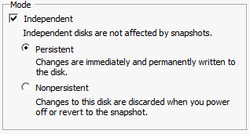
Virtual Machine Configuration (cont.)
How should a customer configure the CUC VM?
vDisks configured as Independent Persistent
Independent persistent mode provides the best storage performance, important for a real-time app
Disks not affected by snapshots (not supported anyway)

Slide 8
Connection VMware OVA Templates
What are they?
Two templates providing the following overlays:
2 vCPU + 4GB RAM + One 200GB vDisk
4 vCPU + 4GB RAM + Two 146GB vDisks
An OVA template is VMware’s way of rubber stamping VMs, all settings deployed to new VM
Provides starting point if customer wishes to make additional customization, e.g increased RAM or storage resources assigned to VM
SAN alignment: the virtual disks have been already aligned @ 64K boundaries, improved IOPS vs. creating a VM from scratch

Slide 9
Connection VMware OVA Templates (cont.)
Why would a customer use the Cisco overlays?
Not required to install Connection in a VM
Highly recommended due to IOPS gain w/ respect to file aligned virtual disks
Customer will need to set BIOS boot order appropriately prior to installation:
virtual DVD drive boots first
then hard drive
VMware does not currently store BIOS settings in OVA
IOPS gains may be lost if storage capacity of virtual disks increased, may be necessary in some cases

Slide 10
Scalability Limits Based on Overlays
How does Connection in a VM scale?
2 vCPU + 4GB RAM + One 200GB vDisk
100 Ports
5,000 Subscribers
4 vCPU + 4GB RAM + Two 146GB vDisks
150 Ports
10,000 Subscribers
Note that port scalability is less than the current highest physical overlay (250 ports on a 7845 I3).
Increasing storage will increase the number of subscribers that the Connection VM can have, e.g. two 300 GB vDisks can scale to 20,000 subscribers

Slide 11
Virtualization Licensing Model
VOS platform changed how licensing works in a VM
Physical MAC address no longer used to host license for any VOS-based app (Connection/UCM)
Slightly similar to Microsoft Windows Activation: license is tied to multiple machine data points
Customer must run “show status” CLI command to obtain “License MAC” value after Connection install
Existing customer licenses for physical machines will not work in a virtual environment
Customer must engage Cisco account team to obtain new licenses for virtualization

Slide 12
Virtualization Licensing Model (cont.)
VOS platform changed how licensing works in a VM
License MAC value tied to: Timezone, NTP Server, NIC speed/duplex setting, hostname, DHCP/static setting, primary DNS setting, SMTP hostname & X.509 certificate information
Changing any of the machine settings listed above after installation will require re-hosting of licenses (existing licenses will become invalid)
Customers should plan out network settings of Connection VM before install to prevent re-hosting

Slide 13
Virtualization Licensing Model (cont.)
Licensing grace period
Once you change one of the parameters that creates the License MAC, you will enter a 30 day grace period.
Customer can revert to previous settings & the license will be valid again.
Customer can request a re-host of the license during the grace period.
If a customer needs more than a 30-day grace period: change settings back to the licensed values & then change back to what you need & customer will get 30 more days.

Slide 14
Virtualization Licensing Model (cont.)
Key takeaways
License process does not change, only the “license key” changes
The License MAC value is:
Not the MAC of the NIC in the virtual machine
A hash of various data from the Cisco Unity Connection server
Hashed to produce a 12 digit hex string that looks like a MAC address
Not a real MAC address

Slide 15
Physical to Virtual Migrations
Cisco expects most customers to follow this path
Customer’s physical server supports CUC 8.X:
Run Disaster Recover System (DRS) backup on physical machine
Shutdown physical machine
Fresh install in VM of same version as physical machine (must use exact hostname & network settings for DRS to work)
Run DRS restore of data
Upgrade to Cisco Unity Connection 8.0(2)

Slide 16
Physical to Virtual Migrations (cont.)
Cisco expects most customers to follow this path
Customer’s physical server does not support 8.X:
Upgrade to Unity Connection 7.1(3) on physical machine
Run Disaster Recover System (DRS) backup on physical machine
Shutdown physical machine
Fresh install of 7.1(3) on VM (must use exact hostname & network settings for DRS to work)
Run DRS restore
Upgrade to Cisco Unity Connection 8.0(2)
Customer must upgrade VM to Unity Connection 8.0(2) or higher or will not be TAC supported

Slide 17
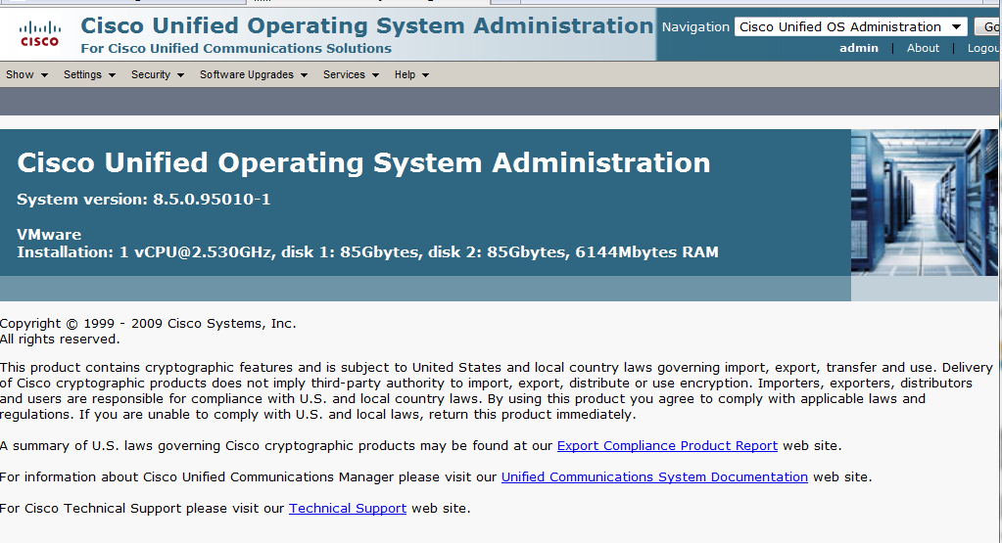
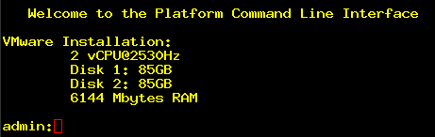
How to identify Connection in a VM?
The VOS platform will show virtual machine configuration from CLI & GUI to easily identify a system running in a virtual machine

Slide 18
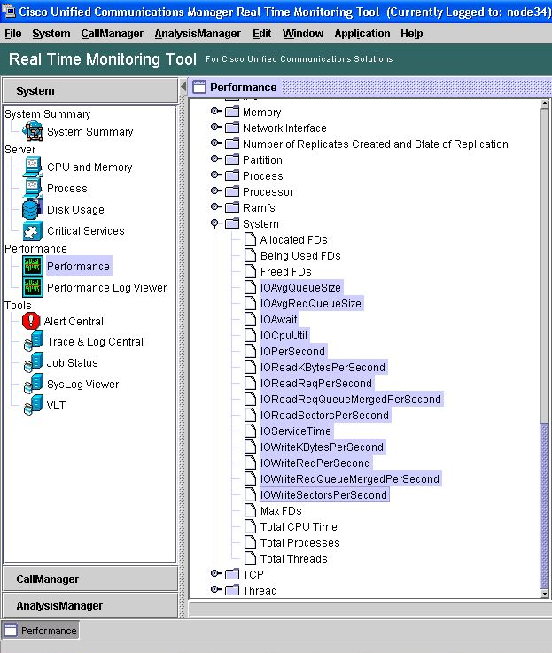
New RTMT Counters
New disk I/O counters added to help identify SAN issues

